Slide 1
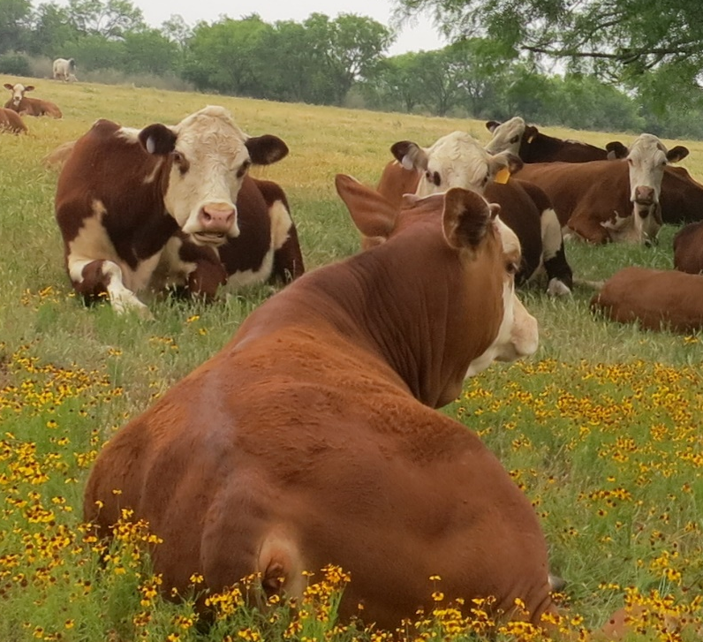


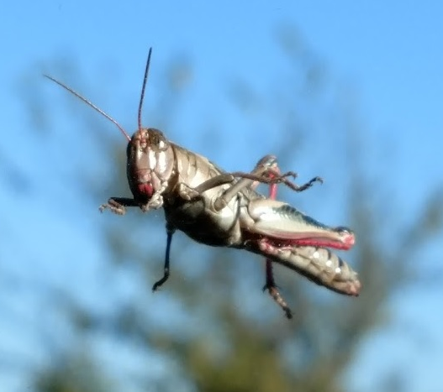
Month
Soil C & N
Grass N
Grass P
Grass K
Grass Mg
Grass Na
Grass Si
Notes:
Grass hypothesized relationships

Slide 2
Month
Soil C & N
Forb N
Forb P
Forb K
Forb Mg
Forb Na
Notes:
Forb hypothesized relationships

Slide 3
A) Grass
B) Forb
Month
Soil C & N
Month
Soil C & N
Grass N
Forb N
Grass P
Forb P
Grass K
Forb K
Grass Mg
Forb Mg
Grass Na
Forb Na
Key
Positive
Grass Si
Negative
Notes:
Grass hypothesized relationships

Slide 4
Grass N
R² = 0.77
Soil C & N
R² = 0.27
Grass P
R² = 0.63
Month
Grass K
R² = 0.75
Grass Mg
R² = 0.44
Grass Na
R² = 0.26
Positive
Negative
Grass Si
R² = 0.76
Fischer’s C = 69.3, P = 0.57
Notes:
Grass model

Slide 5
Forb N
R² = 0.54
Soil C & N
R² = 0.27
Forb P
R² = 0.47
Month
Forb K
R² = 0.72
Forb Mg
R² = 0.51
Forb Na
R² = 0.41
Positive
Negative
Fischer’s C = 53.6, P = 0.64
Notes:
Forb model

Slide 6
A) Grass
Grass N
R² = 0.77
Soil C & N
R² = 0.27
Grass P
R² = 0.63
Month
Grass K
R² = 0.75
Grass Mg
R² = 0.44
Grass Na
R² = 0.26
Grass Si
R² = 0.76
B) Forb
Forb N
R² = 0.54
Soil C & N
R² = 0.27
Forb P
R² = 0.47
Month
Forb K
R² = 0.72
Forb Mg
R² = 0.51
Forb Na
R² = 0.41
Key
Positive
Negative
Notes:
Grass model

