Slide 1
Lean and Six Sigma
Example: Project Report
Project Name:
Project Leader:
Project Champion:

Slide 2
Define
Measure
Analyze
Improve
Control

Slide 3
Project Problem and Goal Statement
Problem Statement:
Lower than expected billability, also described as Excessive Bench Capacity, results in chargeability variances and negatively impacts services margins by approximately $100,000,000 per year.
Goal Statement:
Improve billability from current 60% to 70% while maintaining planned fee adjustment. Corrective action plan will be prepared by June 200X, implemented by July 200X. Benefits will be evaluated 6 and 12 months following implementation.

Slide 4
Operational Definitions of Key Terms
AR: Accounts Receivable
Accounts Receivable: Monies owed to us by a customer for goods and services provided.
AP: Accounts Payable
AR Representative: Employee responsible for tracking monies owed to us by a customer.
Accounts Payable: Monies owed by us to a vendor or supplier for goods and services received.
Backorder: Product or service that was ordered by a customer but not delivered due to out of stock situations.
Check: Any form of payment from a customer to us.
DSO: Days sales outstanding. (Ending AR for Period * Days in Period) / Sales for Period
Progress Bill: A temporary billing file that “holds” the invoice until all tasks have been completed.
Retainage: Monies that are owed to us and retained by the customer to ensure specific performance of the contract and warranty claims are completed.
SOP: Standard Operating Procedure.
Waiver: A legal document releasing our ownership of the products and services sold.

Slide 5
Expected Results – Business Case
Relevant Metrics: (Usually these are associated with quality- effectiveness, efficiency, time or cost.) Some common metrics are:
Response Time (minutes, hours, days …) Cycle Time (minutes, hours, days …)
Downtime (minutes, hours, days …)
Correctness (of information or data) or Error Rate (%)
Billability (%)
Efficiency (%)
Document Error Rate (%) Defect rate (%)
Availability (of systems) (%, Mean Time Between Failure, Mean Time to Repair)
Cost of Poor Quality ($)
Rework ($) Repair ($)
Warranty ($) Expedite ($)
Improvement Targets:
50% reduction in cycle time
Increase System Availability from 88% to 98%
Operational/Strategic Impact:
$60,000,000 improvement to bottom line (this would seem to be a large undertaking)

Slide 6
Expected Results – Business Case
Operational and Strategic Impact:
Hard Benefits: $145k or 1.82 FTE can be delivered in AMP from improved customer contact data. Wasted labor time spent in AMP on finding correct contact data for problem resolution estimated to be 5 min/defect on approx 1656 defects per month or $100k per annum. Wastage of labor in the customer satisfaction survey of 3 mins per defect or $24k per annum.
Reduced wastage in billing disputes (125/month @ 15 mins each) or $20k per annum
Soft Benefits:
Improve customer satisfaction from less wrong contacts.
Improved service performance through less time loss in tickets including wait time.

Slide 7
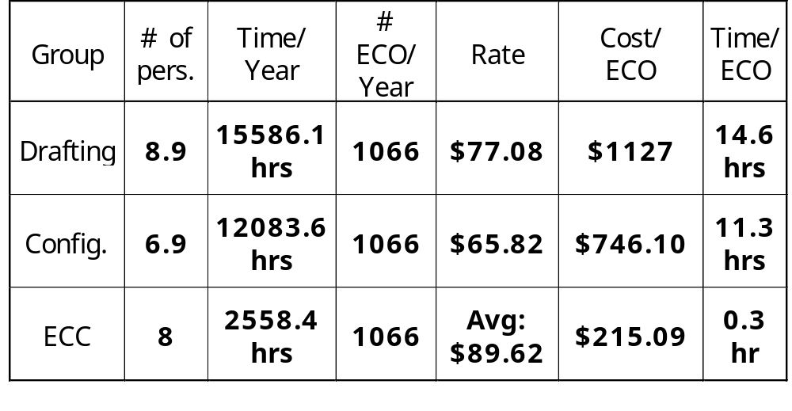
Business Case - COPQ calculation
Cost: $2,088 / ECO
Total ECO Cost
$2,226,006

Slide 8
Roles and Team Membership
Project Champion or Sponsor:
Project Team Leader or Black Belt:
Project Team Members:
Ad Hoc Members or SMEs:

Slide 9
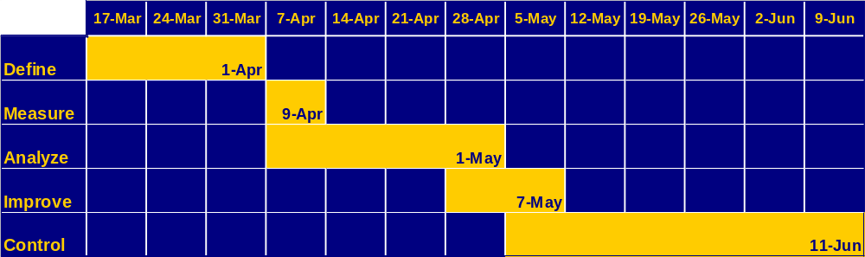
Project Plan

Slide 10
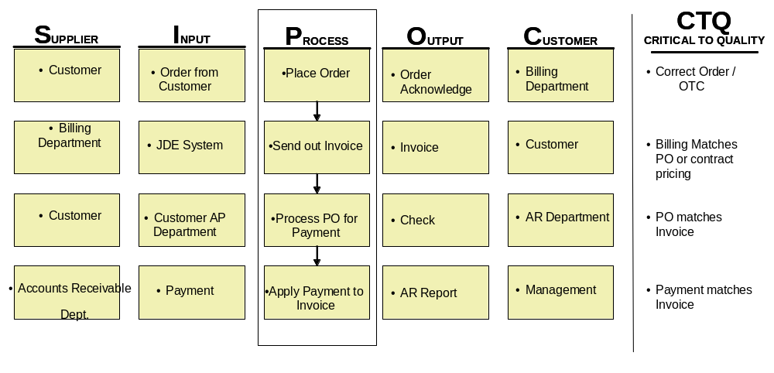
High Level Process Map (SIPOC)

Slide 11
Define
Measure
Analyze
Improve
Control

Slide 12
Project Y (or Ys) in Y = f (x)
Y1 = Percent of 24-hour orders processed by end of business next day.
Y2 = Percent of 48-hour orders processed by end of business second day

Slide 13
Detailed Process Map
Process Decomposition Using
Swim Lane Business Modelling

Slide 14
Detailed Process Map
WARP Implementation
Solution Accepted
Close Problem
Customer
Ticket
Customer Support
Validate
Services
Customer
Satisfaction
Service Delivery
Approved
Create
Work Order or
Monet
Coordinators
Approved
Ticket
Request
Create
No
Queue
Buy
Billable
Coordination
Ticket
yes
Request?
yes
Update
Ticket
Assign
Resolve
Technician
Receive
Request/
Ticket
Equipment
Verify
Solution
Route Buy
MMO
Ticket for
Create P.O.
Internal Approval

Slide 15
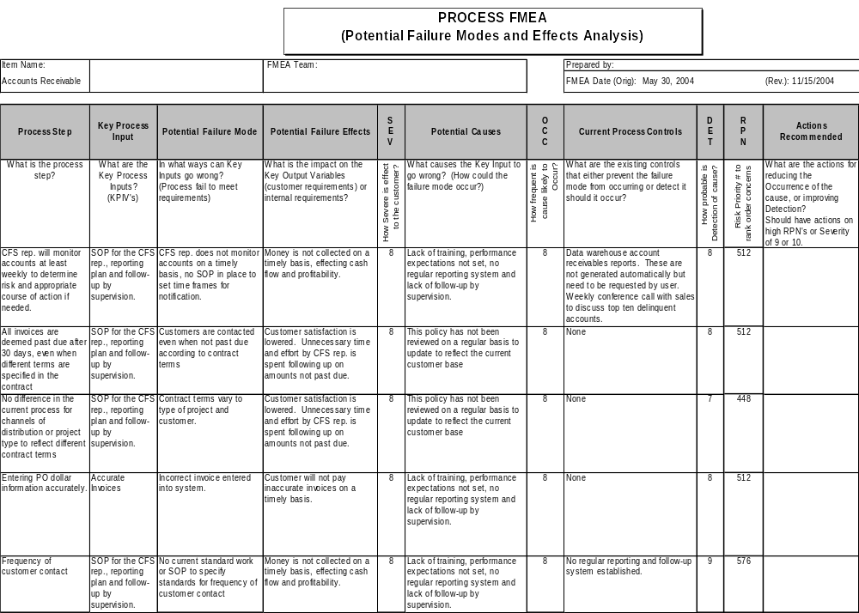
Process FMEA
OBSERVATION:
Controls not in place for many processes

Slide 16
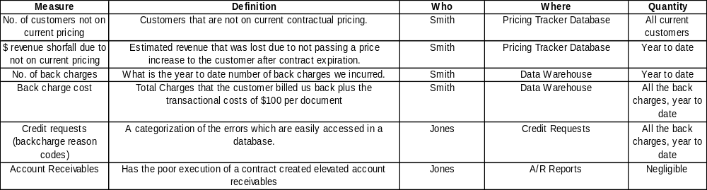
Plan for Data Collection (Measure Phase)
  How many customers not on current pricing?
  How much revenue have we missed due to not being on current price?
  How many customer back charges (credits) have we incurred?
  What is the cost of those back charges?
  Do we have back charge reasons in a database?
  What impact does poor execution of the contract have on Account Receivables?

Slide 17
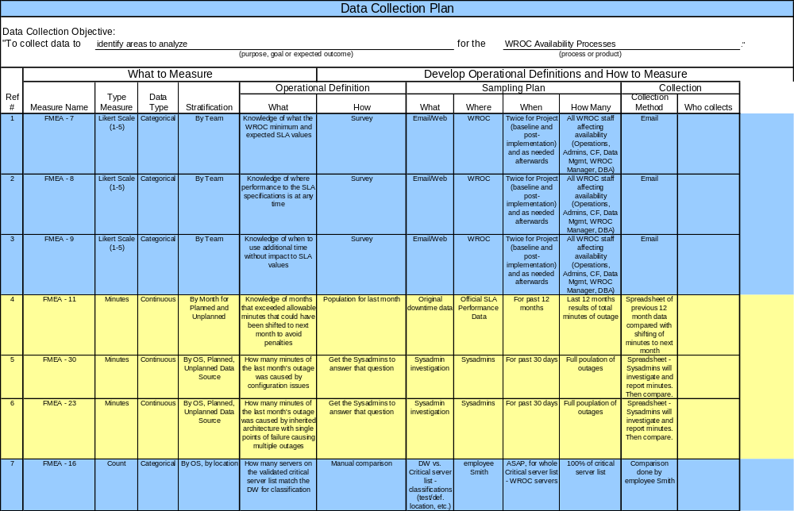
Data Collection Plan – Measure
(Delete this example)

Slide 18
Validate Measurement System
Validate Measurement System
Tested 5 contractor payroll sheets with a mix of errors or none
3 Field Service Reps reviewed sheets
FSRs graded for error and type
Compared FSRs to themselves for repeatability
Compared FSR to Expert (Manager) for accuracy

Slide 19
Validate Measurement System
Statistical Report - Discrete Data Analysis Method
DATE:
27/02/2004
NAME:
Help desk
PRODUCT:
defective contacts
BUSINESS:
help desk
Source
Person A
Repeatability
Accuracy
Total Docs Inspected
12
Person B
Person C
Person A
Person B
Person C
# Matched
11
12
12
12
12
12
False Positives
12
11
11
0
12
0
11
0
False Negatives
0
0
0
Mixed
99.8%
100.0%
99.8%
99.8%
1
100.0%
0
99.8%
1
95% UCL
91.7%
100.0%
91.7%
91.7%
100.0%
91.7%
Calculated Score
61.5%
73.5%
61.5%
61.5%
73.5%
61.5%
95% LCL
Total Inspected
Overall Repeat. and Reprod.
Overall Repeat., Reprod., & Accuracy
# in Agreement
12
12
10
10
95% UCL
97.9%
97.9%
Calculated Score
83.3%
83.3%
95% LCL
51.6%
51.6%
Repeatability by Individual
95% UCL
Accuracy by Individual
95% UCL
Calculated Score
Calculated Score
110.0%
95% LCL
110.0%
95% LCL
100.0%
100.0%
90.0%
90.0%
80.0%
80.0%
70.0%
70.0%
60.0%
Accuracy
60.0%
Repeatability
50.0%
50.0%
40.0%
40.0%
30.0%
30.0%
20.0%
20.0%
10.0%
10.0%
0.0%
Person A
Person B
Person C
0.0%
Person A
Person B
Person C
Notes
Observed that the results on Tues were less accurate than Mon
and that person B made no mistakes
(Delete this example)

Slide 20
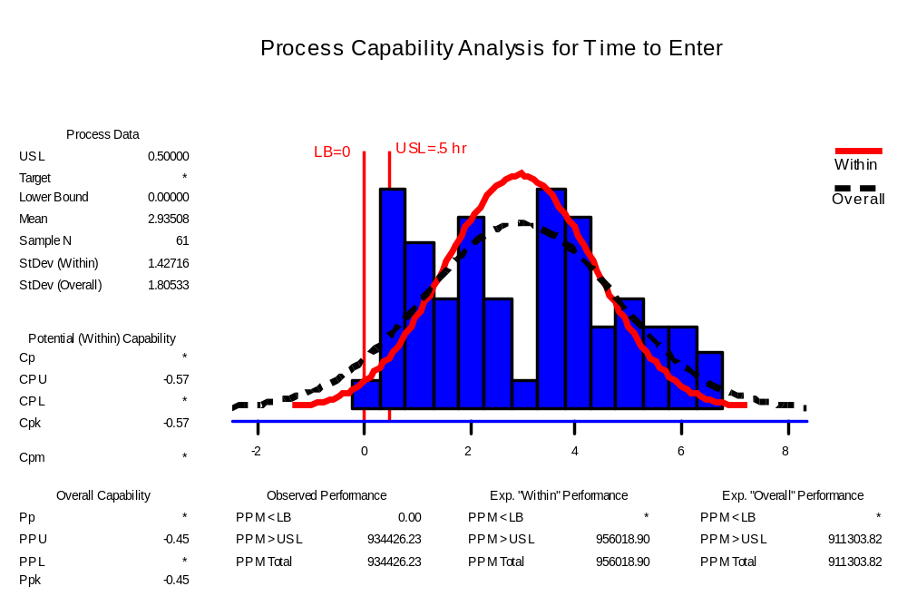
Measure Process Capability
Capability for Time (hrs) : Cpu= -.57, Cpk=-.57 (short term)
Process is NOT CAPABLE

Slide 21
Measure Baseline Performance
CURRENT
COPQ: $1,177,000
PPM or DPMO: 572,840
Sigma Level: 1.29
GOAL
COPQ: $588,500
PPM or DPMO: 286,420
Sigma Level: 2.05

Slide 22
Measure Baseline Performance
Baseline Process Measures
 | Incomplete | Non Compliant | Compliant
Americas | 9.52% | 38.10% | 52.38%
Asia/Pac | 0.00% | 0.00% | 100.00%
MEUA | 0.00% | 100.00% | 0.00%
Baseline Process Sigma
DPMO = 510,638
Defects = 51.06%
Yield = 48.94%
Process Sigma = 1.47

Slide 23
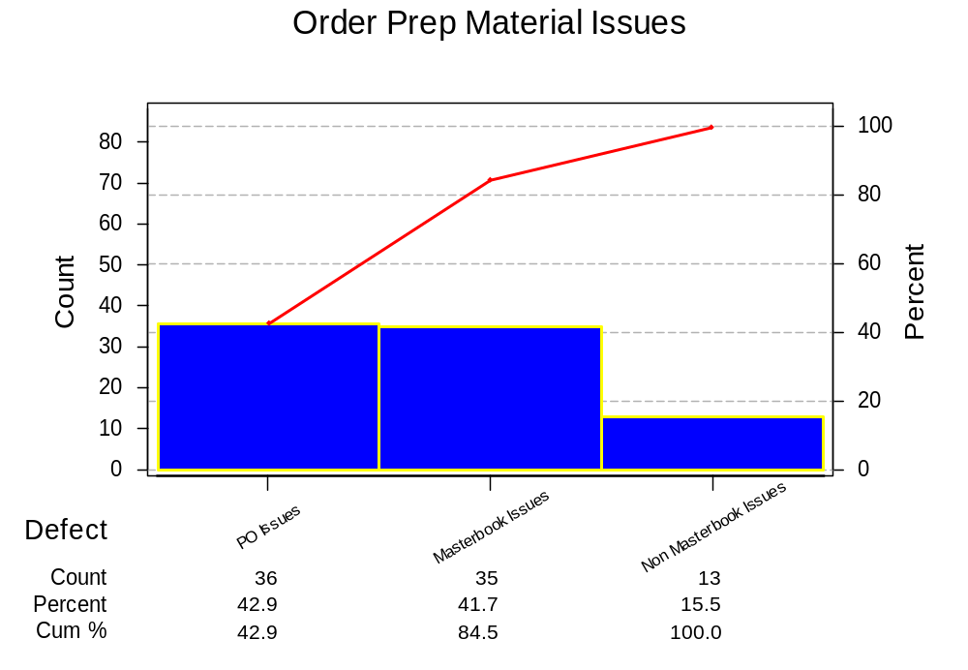
Pareto Diagram

Slide 24
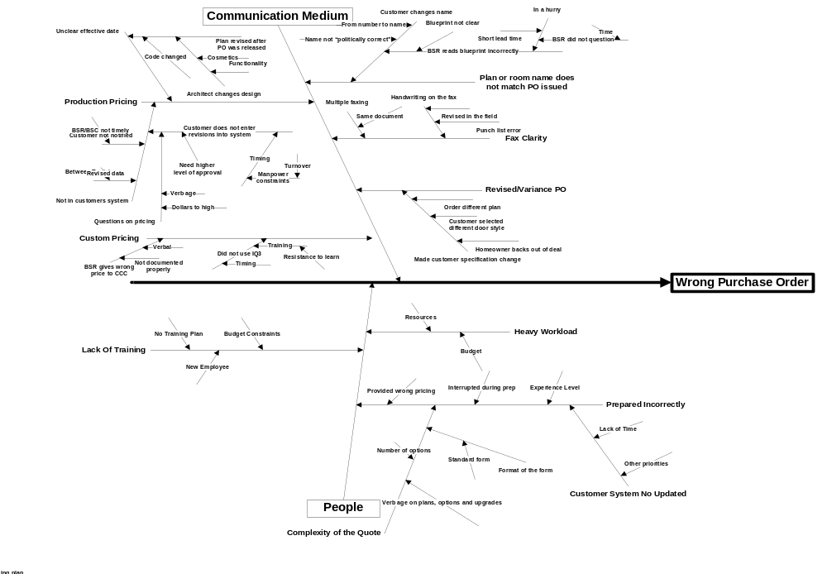
Cause-Effect Diagram on Vital Few categories
Customer Purchase Orders are out of scope due to Customer process.

Slide 25
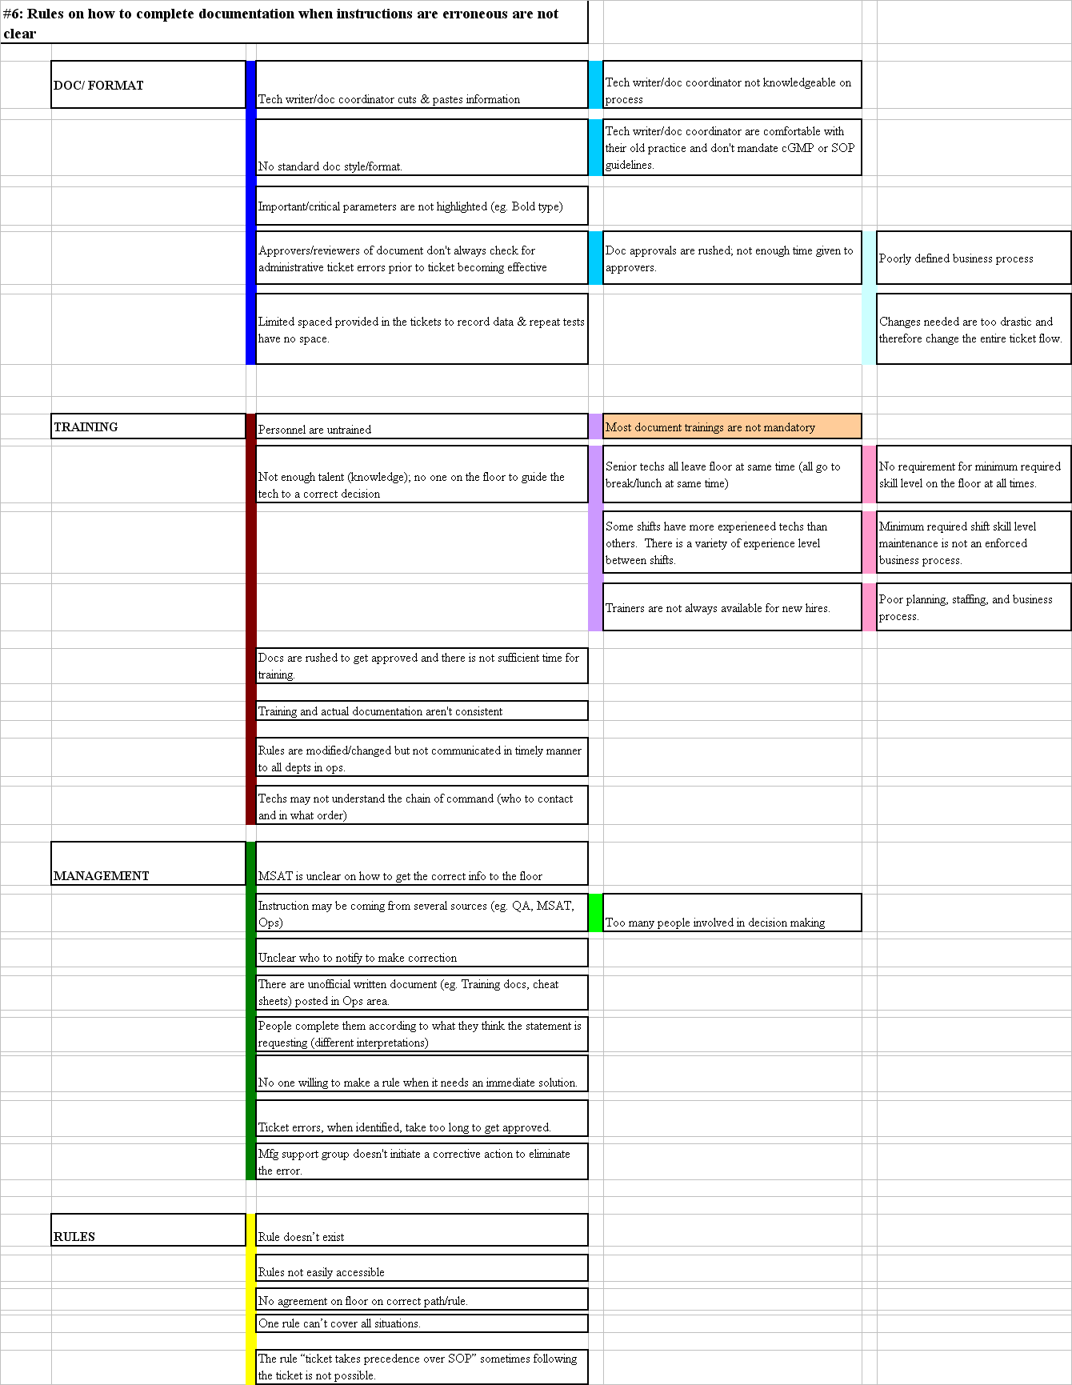
Excel-based Example: Cause-Effect Diagram 4

Slide 26
Potential X’s --Theories to be Tested
X₁: Is there a difference in error rate by type of document?
X₂: Is there a difference in response cycle time by product type?
X₃: Is there a difference in win rate by region?
X₄: Is product knowledge related to years of experience ?
X₅: Is win-loss independent of industry knowledge.

Slide 27
Define
Measure
Analyze
Improve
Control

Slide 28
Theories to be Tested – Manual Invoices
X₁: Low transaction limits on VISA cards cause defects
X₂: The site not being on JD Edwards causes defects
X₃: The current high rework levels cause defects
X₄: The product or service purchased causes defects
X₅: The supplier not accepting VISA causes defects
X₆: The site/ operation affects the level of defects
X₇: The supplier affects the level of defects
X₈: Ease of process at time of purchase causes defects
X₉: Training/ Awareness causes defects

Slide 29
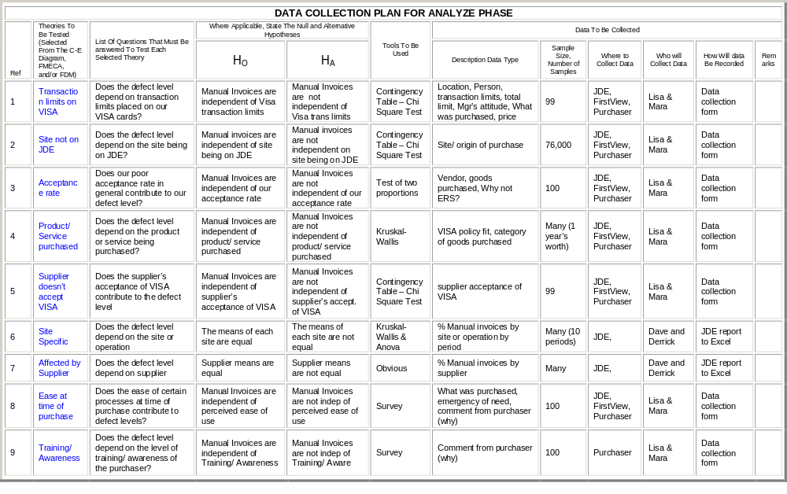
Data Collection Plan for Manual Invoices
(Delete this example)

Slide 30
Test of Theories X₁
Theory: Our VISA trans limits restrict usage
Ho: Transaction limits on VISA cards are independent of defect Levels
Analysis:
Conclusion: Manual Invoices are independent of VISA transaction limits
Chi-Square Test: Within Visa Trans Limits, Outside Visa Trans Limits
Expected counts are printed below observed counts
Within V Outside Total
EC 37 11 48
35.39 12.61
Manual 36 15 51
37.61 13.39
Total 73 26 99
Chi-Sq = 0.073 + 0.205 +
0.069 + 0.193 = 0.539
DF = 1, P-Value = 0.463
(Delete this example)

Slide 31
Test of Theories X₂
Theory: If a site is not on JD Edwards, manual invoices will be higher.
Ho: Manual invoices are independent of site being on JD Edwards
Analysis:
Conclusion: Manual Invoices are not independent of site being on JD Edwards
Chi-Square Test: Site on JDE, Site not on JDE
Expected counts are printed below observed counts
Site on Site not Total
EC 37977 399 38376
36734.55 1641.45
Manual 35226 2872 38098
36468.45 1629.55
Total 73203 3271 76474
Chi-Sq = 42.022 +940.434 +
42.329 +947.296 = 1972.081
DF = 1, P-Value = 0.000

Slide 32
Summary Results of Theories Tested
X₁: Low transaction limits on VISA cards cause defects - FALSE
X₂: The site not being on JD Edwards causes defects - TRUE
X₃: High levels of rework have stopped us from reducing the defect level - FALSE
X₄: Defects are caused by category of purchase - TRUE
X₅: The supplier not accepting VISA causes defects - TRUE
X₆: The site/ operation affects the level of defects - TRUE
X₇: The supplier affects the level of defects – TRUE
X₈: Ease of process causes defects - SURVEY
X₉: Training/ Awareness causes defects - SURVEY
(Delete this example)

Slide 33
Vital Few X’s
Manual Invoices
Y = f (x₂,x₄,x₅ ,x₆,x₇)
Vital Few X’s are:
-- X₂ – Site not on JDE
-- X₄ – Category of Purchase
-- X₅ – Non-acceptance of VISA
-- X₆ – Site/Operation
-- X₇ – Supplier

Slide 34
Define
Measure
Analyze
Improve
Control

Slide 35
Solutions for Proven Xs
Proven Xs (Causes) Strategies
X2: Compliance is dependant on month of expiration.
X4: Compliance is affected by the number of resources available.
X5: Current process is not being followed.
X10: You focus on that which you are measured.
To improve % compliance rate, have contracts expire one year from proposal date
To improve our % compliant rate, we need to realign resources and measure complexity by account
To improve their process flow we need to standardize and simplify the process
To improve their focus we need to add a % compliant metric for all field sales

Slide 36
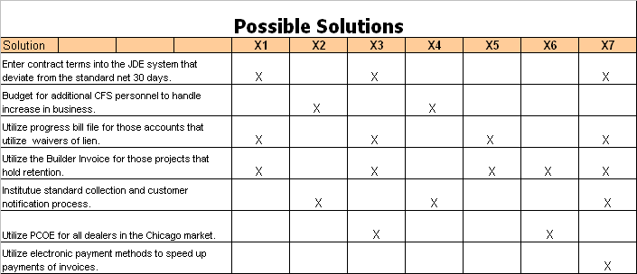
Solutions Matrix

Slide 37
Descriptions of Possible Solutions, Pros & Cons
Possible Solution
Strengths
Weaknesses
Software Form Solution
Link Excel Forms
Insures complete information
Supports standard processes
Automatic notification
Provides current data for analysis
Increases through put time
Decreases resource requirements
Insures complete information
Increases through put time
Supports standard processes
Decreases resource requirements
Huge to develop
No scope of work
Forms being developed to input direct to JDE

Slide 38
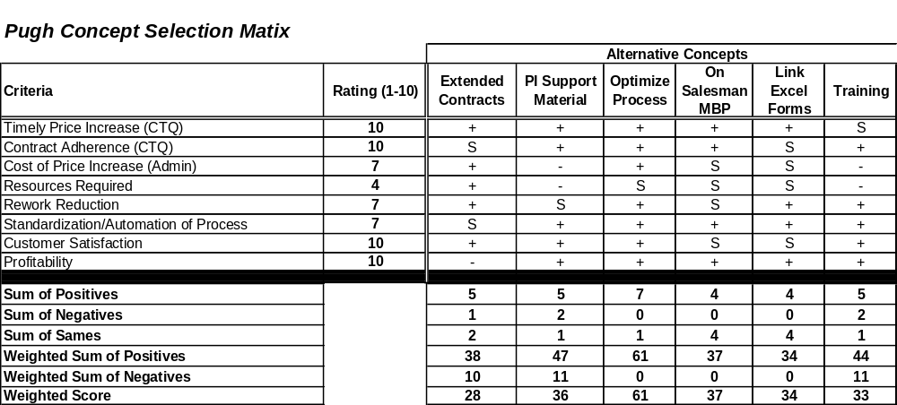
Evaluation using Pugh Concept Matrix
Selected Concepts

Slide 39
Evaluation using Criteria-based Selection Matrix
Criteria Based Selection Matrix
Solution reviewed
weight (9
Process to
critical, 1
bulk upload
Increase
Improve
Get help
not
Remove
data into
Return
Develop
resources at
quality of
desk to
significant
redundant
USD and
tickets to
alternate
Help desk to
customer
capture data
Solution Decision tree
)
steps
electronic
help desk
contact data
reduce error
contact data
as customer
difficulty (1 = impossible,
systems
and fix on fly
source
rates
provided
contacts
9 = easy)
9
7
4
3
1
7
4
Redundant customer
6
54
42
24
18
6
42
24
contacts in USD causing
incorrect selection
No effective update
process exists to update
7
63
49
28
21
7
49
28
client contact
information
No effective update
process exists to update
8
72
56
32
24
8
56
32
USD contact information
No effective update
process exists to update
5
45
35
20
15
5
35
20
root cause
Regional cost center
information
No effective update
process exists to update
4
36
28
16
12
4
28
16
USD cost center
30
270
210
120
90
30
210
120
information
RESULT

Slide 40
Pay Off Matrix
Quote sheet Training | One person to quote Products made in house
Single source | Improve non-X service margins
High
Improve master books
Benefit
Low
Low
High
Cost / Effort

Slide 41
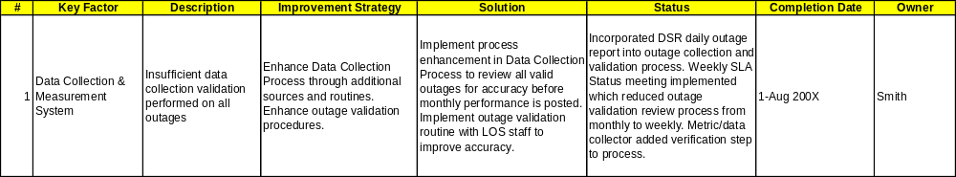
Selected Solutions Implementation

Slide 42
Updated Process Map
Solution Accepted
Close Problem
Customer
Ticket
Customer Support
Validate
Services
Customer
Satisfaction
Service Delivery
Approved
Create
Work Order or
Monet
Coordinators
Approved
Ticket
Request
Create
No
Queue
Buy
Billable
Coordination
Ticket
yes
Request?
yes
Update
Ticket
Assign
Resolve
Technician
Receive
Request/
Ticket
Equipment
Verify
Solution
Route Buy
MMO
Ticket for
Create P.O.
Internal Approval

Slide 43
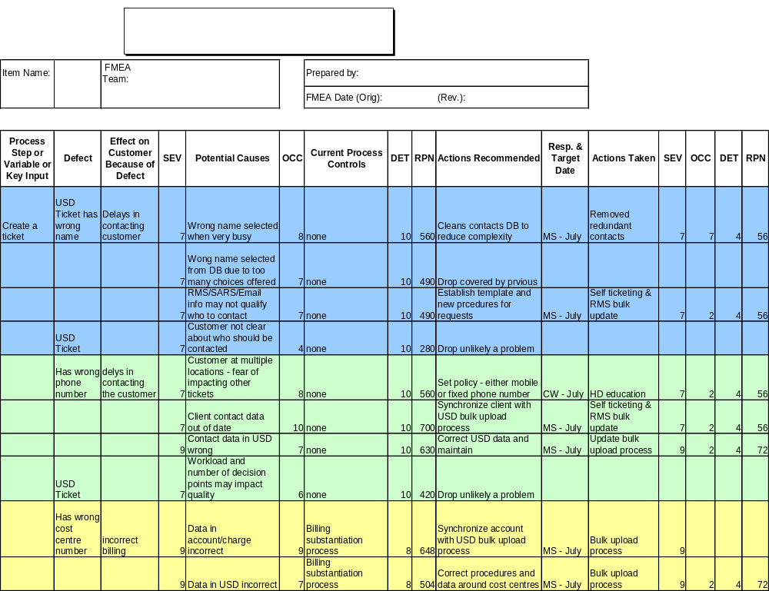
Updated Process FMEA

Slide 44
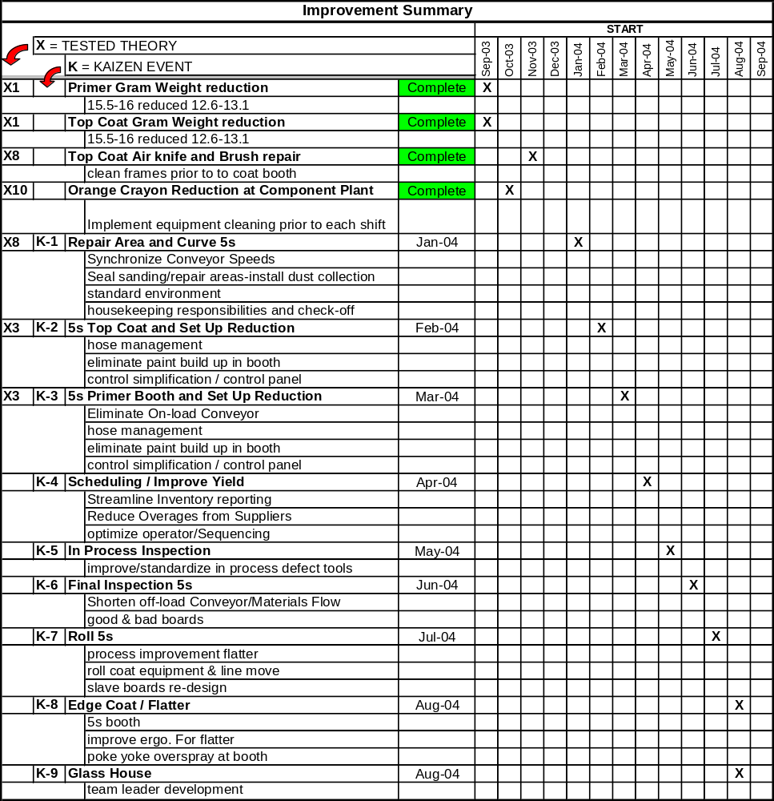
Implementation Plan

Slide 45
Implementation Plan
Recommendation Scope and Definition:
Task
Description
Resource
Task Status (G/Y/R)
Start Date
Finish Date
Adjusted Date
Get agreement on proposal
Meeting with management of business units B and F, as well as, representatives from the Project Management group to get agreement on proposal and set a start date for implementing recommendation.
Smith
G
4/13/04
4/21/04
Discuss Tools and Guidelines
Meeting with Project Management group to discuss what types of feedback questions are asked currently. Write up a guidance document that may contain possible feedback questions and data analysis examples.
Smith,
Project Mgmt Group representatives
G
4/21/04
4/26/04
Communicate System
Communicate to business units B and F and upper management on new feedback rule.
Jones
G
4/26/04
4/30/04
Monitor effectiveness
Obtain feedback data from next business process change to test whether the feedback loop helped in implementation process.
Error Proofing Team
G
4/30/04
TBD

Slide 46
Error Rate Before/After Improvement
Is the Error Rate after improvement significantly different than the error rate before improvement?
Ho: Error Rate is independent of before vs. after improvements made.
Chi-Square Test: Before Improvements, After Improvements
Expected counts are printed below observed counts
Before Imp. After Imp. Total
Late Orders 23 4 27
15.65 11.35
On-time Orders 119 99 218
126.35 91.65
Total 142 103 245
Chi-Sq = 3.453 + 4.761 +
0.428 + 0.590 = 9.231
DF = 1, P-Value = 0.002
Analysis:
P is <.05, Reject Ho.
Conclusion: Occurrence of late orders were lower after improvement than before.

Slide 47
Define
Measure
Analyze
Improve
Control

Slide 48
Control Plan
Process Name:
Processing of Expedite Orders
Date:
4/14/2003
Control
Subject
Unit of
Sensor
Frequency of
Sample Size
Recording of
Measured
Subject
Goals
Meas.
Measurement
Measurement/
by Whom
Tool Used
Processing
90% on-time
% Expedite
and Entry of
Entry of
orders not
Sorter
Calculate Daily
All Expedite
P-Chart
Sorter/
Expedite
Expedite
entered before
Orders
Supervisor
Orders
Orders
12:30PM
Adequate Fax
No late orders
Population
Machine paper
due to fax
N/A
Sorter
4 Times per day
(Two Fax
N/A
Sorter
level to print
machine out of
Machines)
faxes
paper
Adequate Fax
No late orders
Population
Machine Toner
due to fax
N/A
Sorter
4 Times per day
(Two Fax
N/A
Sorter
level to print
machine out of
Machines)
faxes
toner.
Sort and
distribute all
Distribution of
submitted
1 Delivery per
Sorter stamps
faxed expedite
Expedites
30 min, 1
All Faxed
date/time of
orders to
every 30 min
Elapsed Time
Clock/Watch
Delivery per 15
Orders on two
distribution on
XCC's
XCC's
before
min.
fax machines
orders
10:30AM.
Every 15 min.
10:30 to 12:00
Usage of
Return time of
Message
XCC indicated
Message
Check every fax
All fax
Board when
on message
board used per
Sorter
distribution
distribution
N/A
Sorter
XCC is not
board for every
absence
cycle
cycles
available
absence >15
min.
XCC/Keyer
Whenever
Elapsed Time
enters with-in
Stamped time
performance
to Enter Order
30 minutes of
Elapsed Time
and Computer Entry
level drops
30 Expedite
Data Collection
Supervisor
receipt
Time
below 90% on a
Orders
Form
(delivery by
given day
Sorter)

Slide 49
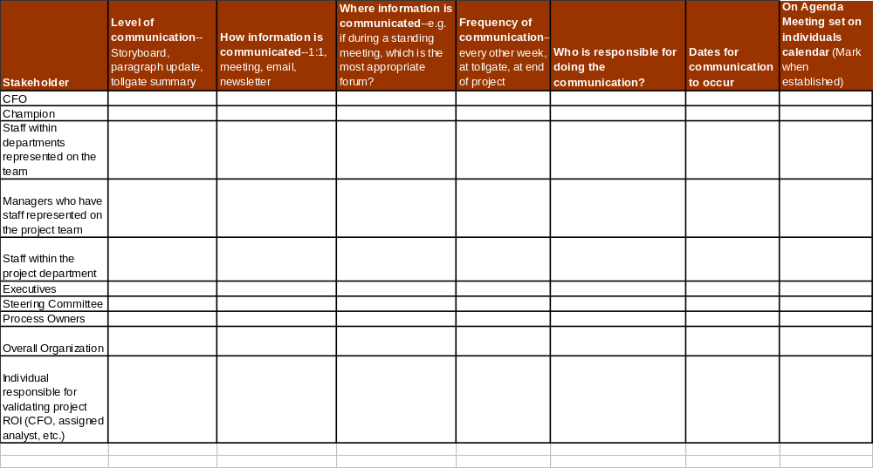
Communication Plan

Slide 50
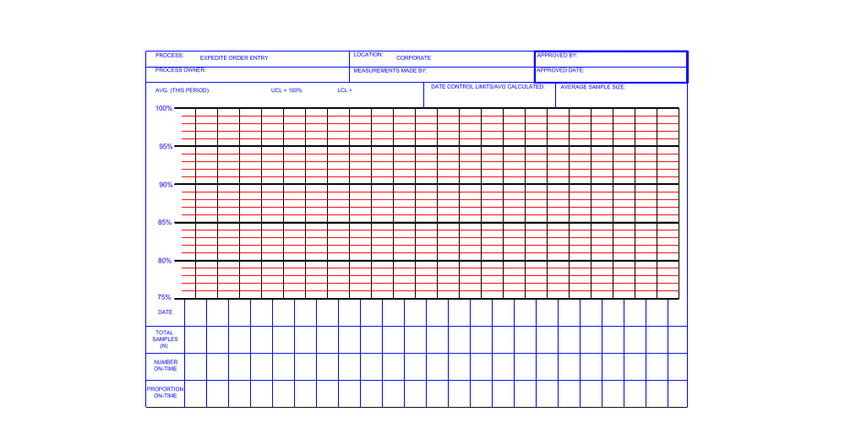
P Control Chart for Order Entry Performance

Slide 51
Error Rate Before/After Improvement
Is the Error Rate after improvement significantly different than the error rate before improvement?
Ho: Error Rate is independent of before vs. after improvements made.
Chi-Square Test: Before Improvements, After Improvements
Expected counts are printed below observed counts
Before Imp. After Imp. Total
Late Orders 23 4 27
15.65 11.35
On-time Orders 119 99 218
126.35 91.65
Total 142 103 245
Chi-Sq = 3.453 + 4.761 +
0.428 + 0.590 = 9.231
DF = 1, P-Value = 0.002
Analysis:
P is <.05, Reject Ho.
Conclusion: Occurrence of late orders were lower after improvement than before.

Slide 52
Project Results
Baseline
COPQ = $1,177,000
DPMO = 572,840
Sigma Level = 1.29
Goal
COPQ = $588,500
DPMO = 286,420
Sigma Level = 2.05
Actual Achieved
COPQ = $516,000 (i.e., saved more than goal)
DPMO = 250,000
Sigma Level = 2.15

Slide 53
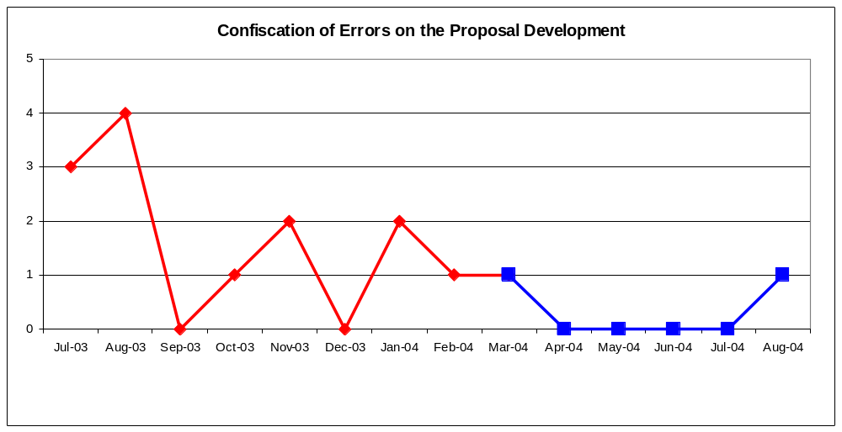
Project Results
Process Change Implemented

Slide 54
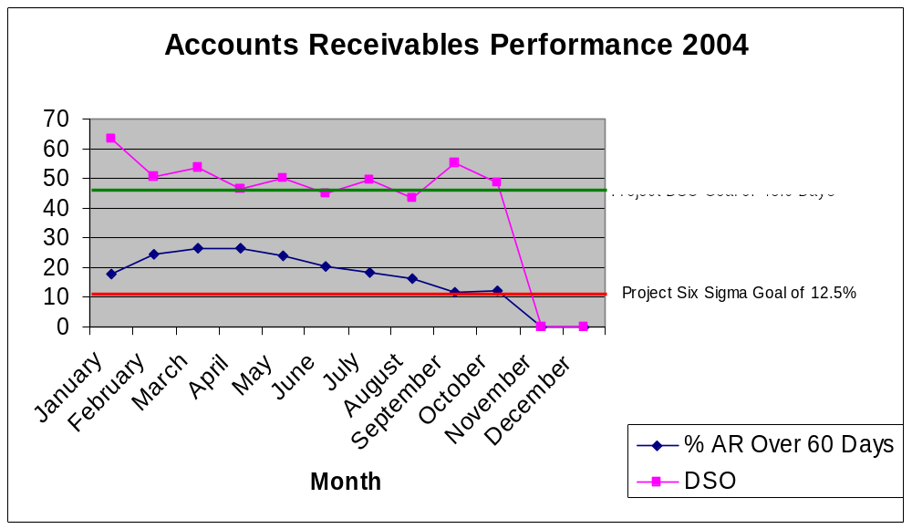
Results Tracking Performance

Slide 55
Lessons Learned
Too many on a team makes it difficult to schedule meetings, keep it under five.
Verify data early in the process. Bad data found later extends project and breaks project focus. Challenge and verify!
25% time requirement from green belts is difficult if not offsetting other work.
A Green Belt should have ownership of the Process or have the project on their MBOs.
Excellent process to get support to change.

Slide 56
The End
Do not forget to recommend a new project to management
Document Reports and New Processes
Schedule Your Recognition Celebration

