Slide 1
Linux (for Robotics)
Carmine Tommaso Recchiuto

Slide 2

Linux
Why Linux for Robotics?
The focus will be always on robotics developers!
Yes, but why Linux?
Have you ever heard of ROS? (Yes, at least last week). ROS only fully supports Linux systems.
As a matter of fact, Linux is much more widespread than you may think: Google, Facebook, or any major internet site uses Linux servers. If you are using an Android phone, you are using Linux. 498 out of 5000 world’s speediest supercomputers use Linux. And of course, almost all robots uses Linux.

Slide 3
Linux
Versatility
Linux is available under the GNU GPL license, which means it can be freely used on almost any product or service you’re developing, as long as the license terms are respected. Also, Linux development is community-based. This means that you can work with other Linux developers to share knowledge and learning.
Security
Linux is one of the most secure operating systems around, from devices/files to
programs, access mechanisms, and secure messaging.
Real-time
RTLinux is a hard realtime operating system microkernel. Many RTOS (RTAI,…) are based on the Linux kernel

Slide 4
Linux
While there are hundreds of Linux commands, there are really only a handful that you will use repeatedly. Do you know the Pareto Principle (also known as the 80/20 rule)? For many event, roughly 80% of the effects come from 20% of the causes.
We will focus on learning the fundamentals, the handful of commands and tools that you will use most frequently.
To follow the examples that will be proposed during the course, you should have
a linux distribution:
Native linux OS
Linux subsystem for windows (WSL) (not recommended)
Virtual Machine
Docker!

Slide 5

Linux
A Linux distribution (often abbreviated as distro) is an operating system made from a software collection that is based upon the Linux kernel
Distributions?
A typical Linux distribution comprises a Linux kernel, GNU tools and libraries, additional software, documentation, a window system (the most common being the X Window System),
a window manager, and a desktop environment.
Which one? One of the most popular desktop Linux distribution, and also well compatible with ROS, is Ubuntu
In the following, we will always refer to the Ubuntu distribution for the commands description.

Slide 6
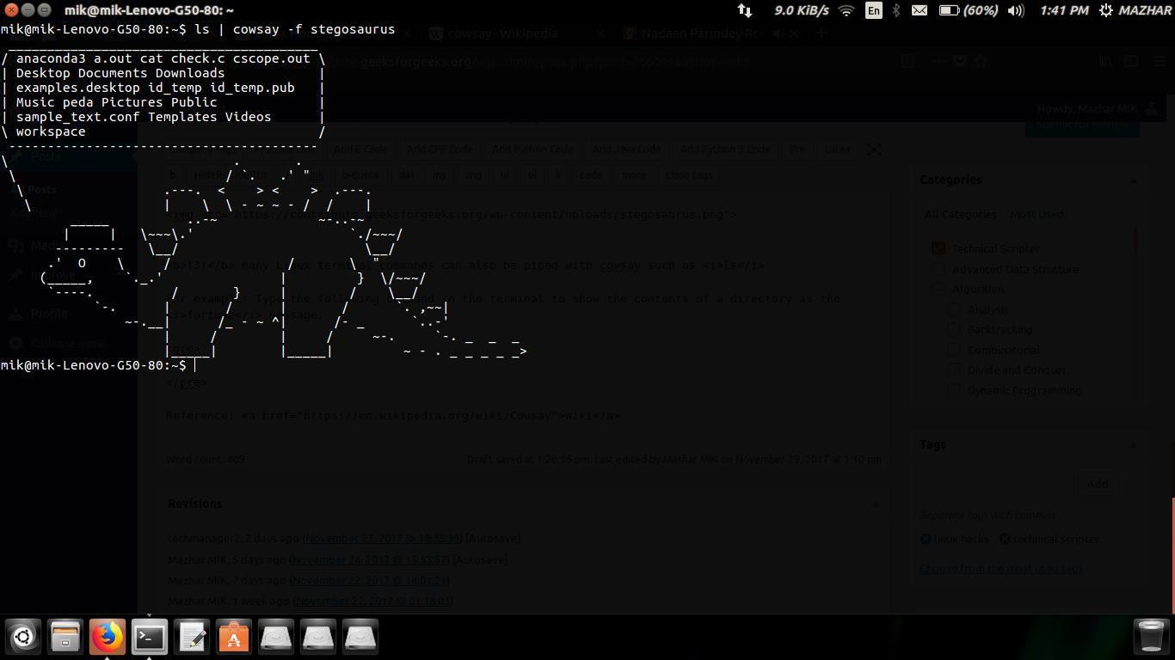
Linux Shell
A Shell provides you with an interface to the Unix system. It gathers input from you and executes programs based on that input. When a program finishes executing, it displays that program's output.
The shell is an environment in which we can run our commands, programs, and shell scripts.
The prompt, $, which is called the command prompt, is issued by the shell. While the prompt is displayed, you can type a command. It contains some basic information like the current user or the current path you are on.
Es. $date

Slide 7
Linux Shell – apt-get
apt-get
APT (Advanced Package Tool) is the command line tool to interact with the Ubuntu packaging system. What is a packaging system??
A packaging system is a way to provide programs and applications for installation. This way, you don’t have to build a program from the source code.
apt-get basically works on a database of available packages. If you don’t update this database, the system won’t know if there are newer packages available or not. In fact, this is the first command you need to run on any Debian-based Linux system after a fresh install.
$ sudo apt-get update

Slide 8
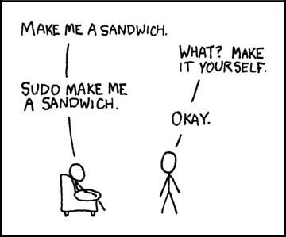
Superuser privileges
Wait, what is sudo?
It stands for superuser do: it allows users to run programs with the security privileges of another user, by default the superuser.
Who is the superuser?
A superuser is a special user account used for system administration which is capable of making unrestricted, potentially adverse, system-wide changes. In order to possibly become a “superuser”, the user should be listed in the
/etc/sudoers file.
By default, sudo requires that users authenticate themselves
with a password. By default, this is the user's password,

Slide 9
Explore the folder Hierarchy
Let’s go back to the Linux shell. As many OS, Linux systems are composed of 2 main elements: folders and files. The basic difference between the two is that files store data, while folders store files and other folders. The folders, often referred to as directories, are used to organize files on your computer. The folders themselves take up virtually no space on the hard drive.
Let’s check out the directory (i.e. folder) structure of the my_ros/src folder, the workspace folder for ROS. We want to do that using the command $ tree
If the program is not installed you can run the command
$sudo apt-get install tree
Now, how to reach the correct directory?
$cd /home/my_ros/src
The cd command is one of the most important ones in Linux. It allows you to go into a specific directory. When using commands like "cd" you can use the Tab key to autocomplete file and directory names

Slide 10
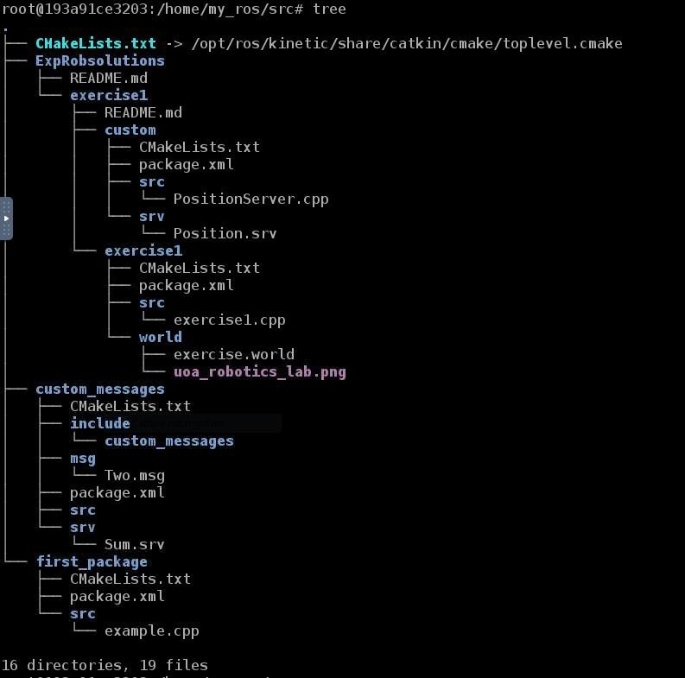
Explore the folder Hierarchy
Once you reach the correct folder, you may execute the command
$tree
to get a snapshot of the folder hierarchy
How we move up of one folder?
$cd ..
How to list all files in a directory?
$ls
Directories and files will be listed on screen, with different colours depending on the read, write and execution permission.

Slide 11
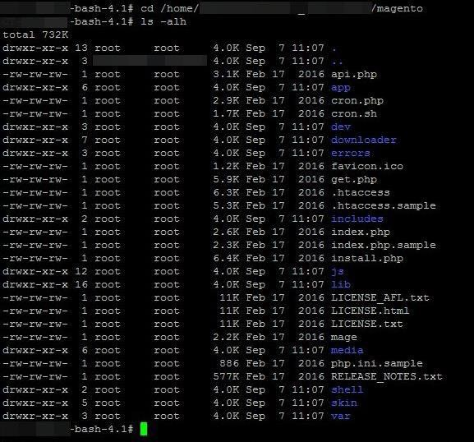
Explore the folder Hierarchy
$ls does not list list hidden files. To list hidden files, you should run:
$ls –a
explicitely lists all the files. You will see a . in front of the name of the hidden files.
~
But how to know all the options for a command??
$man ls or $ls –help
Other must-know things:
$pwd (it returns the current path)
$~ (it’s equivalent to the home folder of your system)

Slide 12
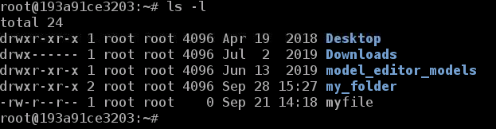
Create Files and Directories
So, up until this point, you've been learning about some very important tools in order to be able to navigate around any Linux-based machine. In the following section, though, you are going to start learning about some tools that will allow you to actually interact with the system, which basically means that you will be able to modify it.
The mkdir command is another essential tool in Linux. It allows you to create a new directory. For instance, try executing the following commands:
$cd ~ (it will bring you to the home directory)
$mkdir my_folder
Now, if you execute the ls command again, you will be able to visualize your new folder.

Slide 13
Create Files and Directories
On the other hand, you can also create new files. There are several ways in which you can create a new file in Linux. I would say that the most commonly used is with the touch command. Go inside the folder you created in the previous section, and create a new file named my_file.txt.
$cd ~/my_folder
$touch my_file.txt
Now, you will be able to visualize our new file using the ls command. Great! So we have created a new file but…it’s empty!

Slide 14
vi visual editor
vi is the default tool in Linux systems for text editing. Of course there are many tools, offering a nice graphical user interface, but there can be some situations (e.g., you are working on a remote robot) in which you may need to modify text using vi.
Basically, vi has 2 different modes: Command and Insert modes:
Command Mode: This mode allows you to use commands in order to interact with the file. For instance, go to a certain line of the file, delete certain lines, etc...
Insert Mode: This mode allows you to insert text into the file.
By default, vi opens with the command mode activated. In order to switch to the insert mode, you will have to type the character i. After pressing i, any character that you type now will be written into the file. Now, type any phrase or word you want into the file, and save it.
…
How to save it?

Slide 15
vi visual editor
You should go back to the command mode, by pressing the esc key of your keyboard.
Now for example you may delete one character by pressing the x key.
In order to save the file, you have to enter the following sequence of characters -> :wq.
Now, just type enter on your keyboard, and the file will be saved. The character w stands for write and the character q stands for quit. So basically, you are telling your file to save and exit.
Now, you can enter your file again and you should see whatever you've written into the file. What if you want to exit the text editor without saving?
You may only type :q, but if you have added some new test to your file, you should explicitly tell the editor to ignore the changes you have done, by entering :q!

Slide 16
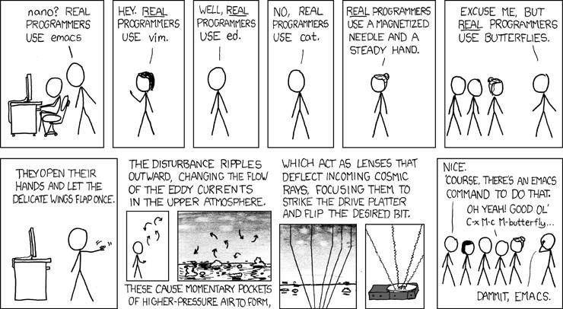
gedit text editor
Don’t worry, things may be simpler in most cases.
For example, if you are working in a machine with a graphical user interface and a windows manager, you may use gedit.
$gedit my_file.txt
Gedit is the default text editor of the GNOME Desktop environment. It includes syntax highlighting for various program code and text markup formats

Slide 17
Commands move and copy
The command mv in Linux stands for move, so it's quite self-explanatory. It allows you to move files or folders from one location to another. For instance, let's try the following commands. First off, let's make sure we are on the directory of the file/folder we want to move.
$mv my_file.txt /home/my_ros/my_file.txt
In other words, the structure is:
mv <file/folder we want to move> <destination>

Slide 18
Commands move and copy
In Linux systems, the command cp stands for copy. So basically, it allows you to copy a file or a folder (or multiples) from one location to another one.
$cp my_file.txt /root/my_folder/my_file.txt
In other words, the structure is:
cp <file/folder we want to move> <destination>
However, it is NOT possible to copy a folder using the regular cp command. In order to copy a folder, you will need to use the -r argument.
cp –r <folder we want to move> <destination>
Remember that you can always run $man cp or $cp --help to list all the available options.

Slide 19
Commands remove
In Linux, the rm command stands for remove. So, you can use it to remove some of the files and folders that you
have created:
$rm my_file.txt
Of course make sure we are in the correct folder.
For removing folders, it works exactly the same as with the copy command: you need to add a -r flag to the command.
$rm –r <folder to remove>

Slide 20
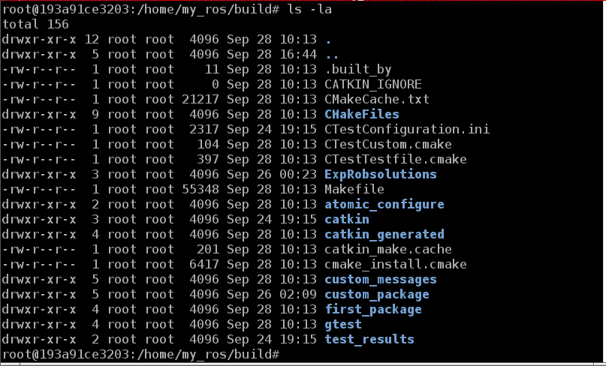
Explore permissions
We are going now to explore some advanced utilities that will allow you to interact deeply with a Linux system.
One of these features is related to assigning the correct permissions to file.
Let’s go in one folder, and execute the command:
$ls –la
The -l flag allows us to see some basic data related to the files or folders, like the permissions of the files/folders, their creation date/time, etc.
For now, let's just focus on the first part (on the left), These are the PERMISSIONS of the file.

Slide 21
Explore permissions
Each file or directory has 3 permissions types:
read: The Read permission refers to a user's ability to read the contents of the file. It is stated with the character r.
write: The Write permission refers to a user's ability to write or modify a file or directory. It is stated with the character w.
execute: The Execute permission affects a user's ability to execute a file or view the contents of a directory. It is stated with the character x.
On the other hand, each file or directory has three user-based permission groups:
owner: The Owner permissions apply only to the owner of the file or directory, and will not impact the actions of other users. They are represented in the first 3 characters.
group: The Group permissions apply only to the group that has been assigned to the file or directory, and will not affect the actions of other users. They are represented in the middle 3 characters.
all users: The All Users permissions apply to all other users on the system, and this is the permission group that you want to watch the most. They are represented in the last 3 characters.

Slide 22
Explore permissions
So, what does -rw-r--r-- mean?
The owner of the file (in this case, it's us) has read (r*) and *write (w*) permissions, and the *group and the rest of users have only read (r) permissions.
So, if permissions appear with a - symbol, it means that the permissions are not applied.
In this case, this file has no execution permissions. And this, if we want to actually execute the file, could be quite a problem. Then... how can we change this?

Slide 23
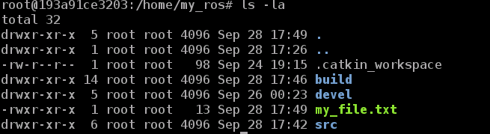
Command chmod
In Linux, the chmod command is used to modify the permissions of a given file or directory (or many of them). There are a couple of ways to use this command, though, so let's go by parts.
Let’s first modify my_file.txt by writing “echo hello”.
Now, let's try the next command:
$chmod +x my_file.txt
Let's now execute the ls command again and see how the permissions have changed.

Slide 24
Command chmod
As you can see, the execution permissions, which are represented by the character x, have been added to all the permission groups.
What if I only want to modify the permissions for 1 of the groups? Or what if I want to remove a permission instead of assigning it?
chmod <groups to assign the permissions><permissions to assign/remove> <file/folder names>
As for the groups, you can specify them using the following flags:
u: Owner g: Group o: Others
a: All users. For all users, you can also leave it blank, as we did in the example command you executed before.
Permissions to assign/remove may be: (+/-) (r/w/x).

Slide 25
Command chmod
So, for example:
$chmod go-x my_file.txt
will remove the permission x (execution), only for the users Groups and Others, of the file my_file.txt. The same thing can be done using Binary References.
Basically, the whole string stating the permissions (rwxrwxrwx) is substituted by 3 numbers. The first number represents the Owner permission; the second represents the Group permissions; and the last number represents the permissions for all other users.
Each permission has a number assigned: r = 4, w = 2, x = 1.
Then, you add the numbers to get the integer/number representing the permissions you wish to set.
$chmod 740 my_file.txt -> rwxr-----

Slide 26
Bash scripts
In one of the previous example, we have executed the file my_file.txt
What we have done, it is basically a script: a series of commands within a file capable of being executed
In Linux we have a specific way of writing scripts: bash scripts.
A bash script is a regular text file that contains a series of commands. These commands are a mixture of commands you would normally type yourself on the command line (such as the ones we have been reviewing, cd, ls, or cp) and also commands we could type on the command line. Anything you can run normally on the command line can be put into a script and it will do exactly the same thing. Similarly, anything you can put into a script can also be run normally on the command line and it will do exactly the same thing.
Let’s create a bash scripts.

Slide 27

Bash scripts
$touch bash_scripts.sh
Inside the file, let’s place the following contents: #!/bin/bash
echo Hello there, Roboticists!
As you can see, the file extension is .sh. Usually, this is the extension you will always use when you create a new bash script. Note also that the script starts with the line #!/bin/bash. All bash scripts will start with this special line. Basically, it let's the Linux system know that this file is a bash script.
What if I run
$./bash_scripts.sh?

Slide 28
Bash scripts
Yes, remember to fix the permissions!
$ chmod +x bash_scripts.sh
Now you can execute the script!
In a bash script, the command echo is used in order to print something on the Shell.
You can also pass parameters to a bash script. This is used when you want your script to perform in a different way, depending on the values of the input parameters (also called arguments).
How?

Slide 29
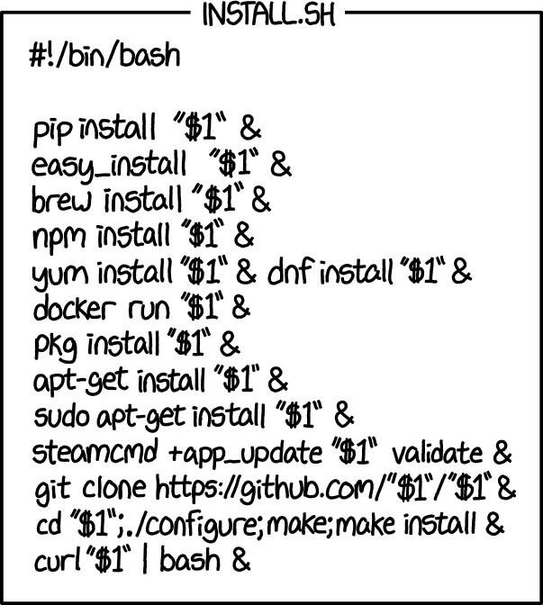
Bash scripts
In fact, it's pretty simple. You can access an argument inside a script using the variables $1, $2, $3, and so on. The variable $1 refers to the first argument, $2 to the second argument, and $3 to the third argument.
So, let’s change our script in this way:
#!/bin/bash
Echo Hello there, $1!
And run the script:
$./bash_scripts.sh students

Slide 30
The .bashrc script
The .bashrc file is a special bash script, which Linux executes whenever a new Shell session is initialized. It contains an
assortment of commands, aliases, variables, configuration, settings, and useful functions.
As you may have noticed, the .bashrc file is a hidden file. It is automatically generated by the Linux system and it is always placed in the HOME folder (in our case, this is /home/user/). However, you can still modify it in order to customize your Shell session.
The .bashrc script runs automatically any time you open up a new terminal, window or pane in Linux. However, if you have a terminal window open and want to rerun the .bashrc script, you have to use the following command:
$ source .bashrc
Why is it important for Robotics?
It may be used to set-up the ROS environment, to set ROS workspaces, or to set environmental variables.

Slide 31
Environmental variables
An environment variable is a named value that can affect the way running processes will behave on a computer.
For example, a running process can query the value of the HOME variable to find the directory structure owned by the user running the process.
Environmental variables may be set by using the command export
We can also run the export command by itself in order to see all the environment variables running.
$ export
But, there are a lot of variables...
In Linux systems, the grep command is used in order to filter elements. For, instance, execute the following command.
$ export | grep ros
You can always use grep to filter results.

Slide 32
Understanding processes
A process refers to a program in execution. Basically, it’s a running instance of a program. It is made up of the program instructions, data read from files, other programs or input from a system user.
Basically, there are 2 types of processes in Linux:
Foreground processes : These are initialized and controlled through a terminal session. In other words, there has to be a user connected to the system to start such processes; they haven’t started automatically as part of the system functions/services.
Background processes: These are processes not connected to a terminal. This means that they don’t expect
any user input. Process may be started in background, by adding & after the command.
There exist several different commands that will allow you to visualize the running processes on the system. In this course, though, we are going to focus on 2 of them: top and ps.

Slide 33
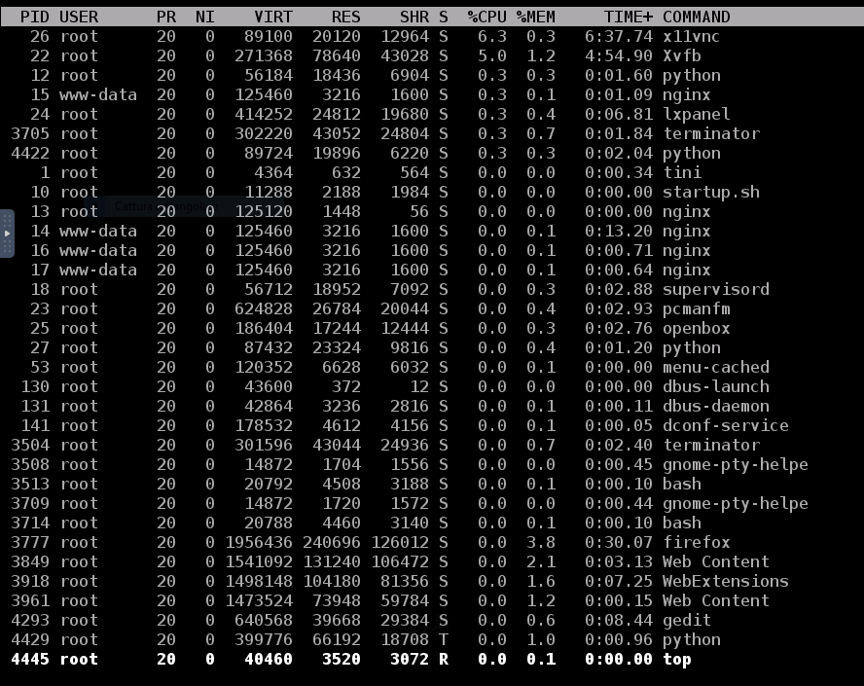
Understanding processes
top provides a dynamic real-time view of the running system. Usually, this command shows the summary information of the system and the list of processes or threads which are currently managed by the Linux Kernel
It also shows some additional information, such as cpu usage and memory occupation

Slide 34
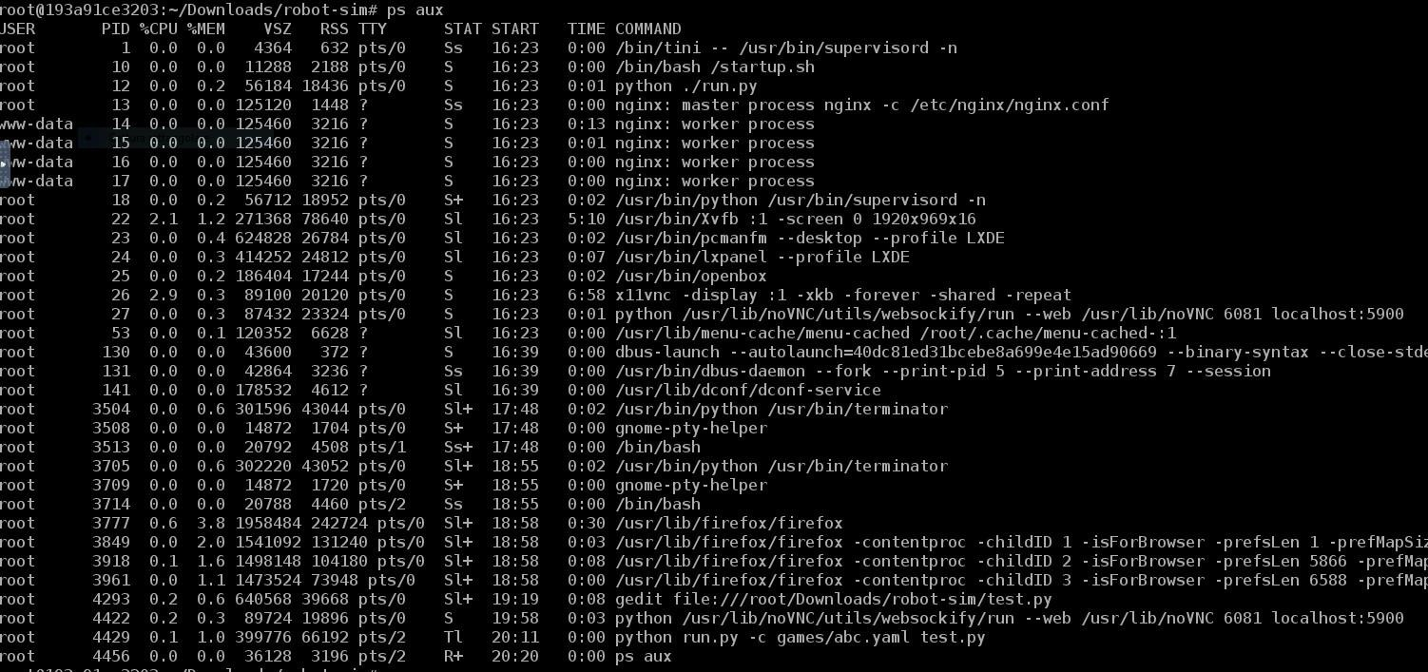
Understanding processes
ps stands for process status. However, if you execute it, you will only see the processes of the user, which are attached to a terminal.
If you want to see all active processes, use the command:
$ps aux
Consider that you can use the grep command to filter results:
Es:
$ps aux | grep python

Slide 35
Killing processes
Ctrl + C is used to kill a process with the signal SIGINT, and can be intercepted by a program executed in a shell, so that it can clean itself up before exiting (in our case, stop the robot), or not exit at all. It depends on how the application is built.
Ctrl + Z is used for suspending a process by sending it the signal SIGSTOP, which cannot be intercepted by the program. Basically, it sends SIGTSTOP to a foreground application, effectively putting it in the background. Thus, the process is still there, running in the background.
How can I stop a process that is running in the background? Well, for this case, Linux provides
the kill command. It's very easy to use, but you need to know the Process ID (PID) of the process you want to terminate. If you check the previous slide, when running ps, you get also the list of all PIDs associated to process.
Just execute:
$ kill <PID_number> to kill the process associated to that PID number.

Slide 36

SSH protocol
Secure Shell, most commonly known as ssh, is a protocol that allows users to connect to a remote machine in a secure way. It is based on a Client-Server architecture. So, from your local machine (Client), you can log into the remote machine (Server) in order to transfer files between the two machines, execute commands on the remote machine, etc...
In robotics, it is mostly used to access the remote machine that runs in a real (physical) robot from any computer in order to control it and send commands to it.
$ssh <user>@<host>
<host> makes reference to the remote machine you want to access (where the SSH Server is running), and <user> makes reference to the account in which you want to login from the remote machine.

Slide 37
SSH protocol
Please consider that the host and the client should be in the same LAN, or the host should be in some way accessible from the outside.
Finally, in order to close an ssh session and go back to your local machine, all you have to do is to execute the exit command on Shell.

Slide 38
That’s all
Of course there are many other commands and things to know about Linux, but these info should be sufficient to start!
Next steps: Python and CPP!

Slide 39
Python (for Robotics)
Carmine Tommaso Recchiuto, Phd

Slide 40
Python
C++ and Python are the most popular languages in robotics. In this course, and probably in most of the course that you will have, you will these two programming languages. Indeed, ROS can be programmed using Python or C++
If you want to quickly prototype something and don’t want the headaches of having errors fire all over your program because you forgot a semicolon, you should use Python.
That’s one of the reasons why Python is winning every year more space in the robotics sector. Especially in
robotics research, Python is the number one preferred language
Many of the artificial intelligence libraries used for robotics are written in Python: the reinforcement learning algorithms of OpenAI, the learning libraries of Scikit-learn, the OpenCV libraries for image processing, the deep learning of Tensorflow, and many others.

Slide 41
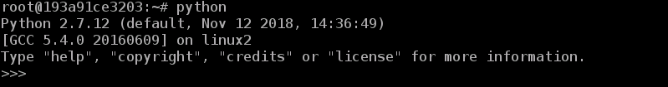
Python
To install python in Ubuntu Linux, just type:
$sudo apt-get install python (python3)
You may find out the default version of Python in your system by tiping:
$python (then you should write exit() to close the python shell)
You may have been noticed that there are two python versions: python2 and python3. Although Python 2.7 is still widely used, Python 3 adoption is growing quickly. They have different (sometimes incompatible) libraries, and other differences. Older ROS versions are based on Python2, while ROS Noetic and ROS2 work with Python3. In the following, we will mainly refer to Python3.

Slide 42
Install Pip
Pip is a tool that will help us manage software packages for Python.
Software packages are bundles of code written by someone else that are designed to solve a specific problem. Why write code to solve a specific problem from scratch, when someone else has already written code to solve that exact same problem?
$sudo apt-get install python3-pip (installing pip for python2 in Ubuntu 20 is a bit more complex).
If at any point in the future you want to install a Python-related package using pip, you can use the following command:
$pip3 install <package_name>
For example, to install the scientific computing package called Numpy, you would type:
$pip3 install numpy

Slide 43
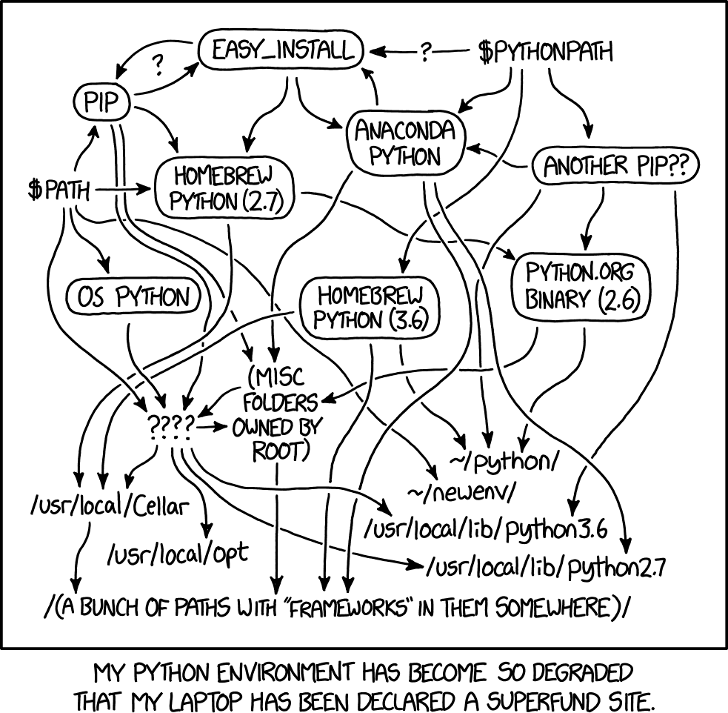
Pip
Very important, in some context it can be needed to install a specific version of a package, for compatibility problems. You can still do that with PIP, by running:
$pip3 install <package_name>==<version_number>
There are actually other package management systems which work well with python, such as conda, easy_install,…

Slide 44
Create your first program
Let’s create our first program. Programs is Python are often called scripts. It may happen that sometimes I will say scripts and sometimes I will say programs. Both words mean the same thing.
Create a new directory named python_for_robotics.
$mkdir python_for_robotics
Move to that directory
$c python_for_robotics
Let’s create the file hello_world.py, and we modify it with gedit.
$gedit hello_world.py

Slide 45
Create your first program
Here we write the following code:
#!/usr/bin/env python
print("Hello, World!")
The first line is the “shebang” line. the program loader takes the presence of the first two characters (#!) as an indication that the file is a script, and tries to execute that script using the interpreter specified by the rest of the first line in the file.
The second line is a print statement (please notice that in python2 it will work also without the parentheses).
You can execute the python script by typing $python hello_world.py. Another way to run a program is to make a Python script executable.
Open a new terminal window, move to where your hello_world.py program is located, and type:
$chmod +x hello_world.py
$./hello_world.py

Slide 46
Create your first program
The same thing can be done with a python shell:
$python
>>> print (“Hello, World”)
So, a program may be written directly inside the Python interpreter: you write a line of code, and the interpreter executes that code, one line at a time.
However, the more common (and comfortable) way to write Python programs is to create Python files (called
scripts) containing (lots of) lines of code.
Let’s see an example

Slide 47
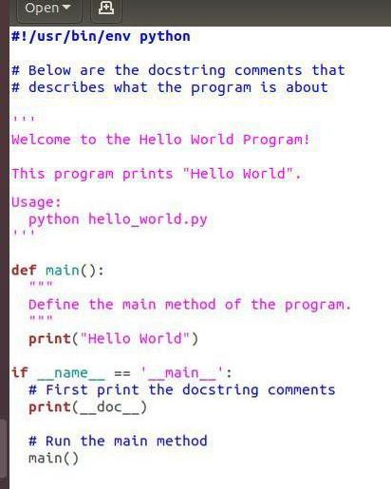
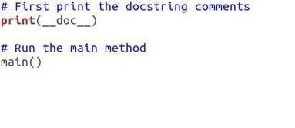
More complex programs
In the first line I inform the program about where to find the Python interpreter (#! /usr/bin/env python) (shebang)
Then I wrote some comments to tell what the program does and what command to type in the terminal window to run the code (python hello_world.py). Please refer to the slides related to the Software Documentation for more details
Then I defined a method named main. This is where we implement our code.
The final block of code prints the comments and runs the main method.

Slide 48
Variables
Python is completely object oriented, and not "statically typed". You do not need to declare variables
before using them, or declare their type. Every variable in Python is an object.
What does object-oriented means? OO is a programming paradigm based on the concept of objects, which can contain data and code: data in the form of fields (often known as attributes or properties), and code, in the form of procedures (often known as methods).
So, if you want to declare a integer variable and assigning the value 5, you just need to type:
x = 5
Python also allows you to change the type of the variable during the program. For instance, you could do something like this:
x=5
x=“five”

Slide 49
Data Types
In the example before, we have seen numbers and strings. Numbers may be integer or float, and strings are sequence of characters with quotes or double quotes.
We may have also Lists, an ordered sequence of items, where all the items of the list do not need to be of the same type. To declare a Python List, you just have to put all the items inside brackets [ ], and separate each item by commas.
l = [1, 2, “hello”, 6]
At any time, you can access a specific item of the list.
print (l[2])
print (l[0:1])
Tuples are similar to lists, but they cannot be updated. Values separated by commas, are enclosed within parentheses ().
t = (1, 2, “hello”, 6)

Slide 50
Data Types
Dictionaries are also similar to lists, in the sense that they contain a list of values and that they can be updated. But the main difference is that items in dictionaries are accessed via keys and not via their position. So basically, dictionaries are a list of items, with each item being a pair made up of a key and a value.
dict = {"Jon": 25, "Daenerys": 22, "Cersei": 31, "Night King": 35}
print (dict["Jon"])
print (dict["Night King"])
>>> 25
>>> 35

Slide 51
If-Else statements
When programming robots, we often want a robot to take some action or return some data based on some condition. For example, imagine a security guard robot whose job is to check the age for each person wanting to enter a nightclub. Suppose this robot is naive. Instead of checking the person’s ID, the robot asks for the person’s age.
We want this robot to allow anybody inside the club who is 18 years old or older but turn away anyone who is under the age of 18. In other words, if the person is greater than or equal to 18 years old, let them in, otherwise, keep them out.
Let’s try the following code:

Slide 52
If-Else statements
#!/usr/bin/env python
# Robot security guard for a nightclub # Ask for the person's age
age = input("How old are you?: ")
# Make a decision based on the person's age
if int(age) < 18:
print("You may NOT enter") print("Goodbye")
else:
print("You may enter")
Remember that the hash # symbol is how we write comments in Python. Everything after the # symbol is a comment. When we run the program on our computer, the computer will ignore this line.
The input command is Python’s way of accepting input from the user (in this case, the person trying to enter the nightclub). We store the user’s input inside the variable named age.
An if-else statement consists of the if keyword, followed by a condition (i.e. age greater than or equal to 18 years old) and a colon

Slide 53
TWO IMPORTANT REMARKS
#!/usr/bin/env python
# Robot security guard for a nightclub # Ask for the person's age
age = input("How old are you?: ")
# Make a decision based on the person's age
if int(age) < 18:
print("You may NOT enter") print("Goodbye")
else:
print("You may enter")
Indentation!
Indentation is very important: In Python, indenting (i.e. leaving whitespace using either the Tab key on your computer or the Space bar) has meaning. Code that is at the same location in the program and is indented the same number of spaces from the left margin will run together.

Slide 54
TWO IMPORTANT REMARKS
#!/usr/bin/env python
# Robot security guard for a nightclub # Ask for the person's age
age = input("How old are you?: ")
# Make a decision based on the person's age
if age < 18:
print("You may NOT enter") print("Goodbye")
else:
print("You may enter")
Be careful with data types!
Try removing the int() in if int(age) < 18
You will get errors if you are comparing integers with
strings

Slide 55
If-elif-else statements
#!/usr/bin/env python
# Robot security guard for a nightclub
# Ask for the person's age
age = input("How old are you?: ")
# Make a decision based on the person's age
if int(age) < 18:
print("You may NOT enter") print("Goodbye")
elif int(age) >= 18 and int(age) < 21: print("You may enter, but you CANNOT drink") else:
print("You may enter")
If we have more than one condition, you can use the
statement elif
These statements are useful for enabling a robot to make decisions based on a set of conditions.

Slide 56
FOR Loops
For loops allow the code inside them to be executed repeatedly for a known number of times. Let’s look at an example.
Imagine we want our security guard robot to walk up and down the hall 5 times. Each time the robot moves, it prints its motion to the screen. One way to do this is by writing the following Python code:
print("robot moving right") print("robot moving left") print("robot moving right") print("robot moving left") print("robot moving right") print("robot moving left") print("robot moving right") print("robot moving left") print("robot moving right") print("robot moving left")

Slide 57
FOR Loops
… but we can do the same by writing
# From 0 to 5 (i.e. run the code 5 times)
for i in range (0, 5):
print("robot moving right")
print("robot moving left")
The variable i will start at 0 and it will be incremented each time the code inside the loop executes.
When i will be equal to 5, the loop stops.
You can also use a for loop to move through items in a list:
# Create the list
colors = ["red","orange","green","blue"]
# Here we are using x instead of i. We can # use any character for this variable.
for x in colors:
print(x)

Slide 58
WHILE Loops
#!/usr/bin/env python
# The robot begins at the origin (x=0, y=0, and z=0) robot_x = 0
robot_y = 0
robot_z = 0
# Print the robot's starting position
print("Current Position: x=" + str(robot_x) + " y=" +
str(robot_y) + " z=" + str(robot_z))
# Stop executing code once either x, y, or z exceeds 5
while (robot_x < 5 or robot_y < 5 or robot_z < 5): # Increment the robot's x position by 1
robot_x += 1
# Increment the robot's y position by 1 robot_y += 1
# Increment the robot's z position by 1
robot_z += 1
# Print the robot's current position
print("Current Position: x=" + str(robot_x) + " y=" +
str(robot_y) + " z=" + str(robot_z))
While loops execute a set of statements until a condition is FALSE
For example, let’s say we have a robot that operates in a three-dimensional space. The robot moves around the space and prints its x, y, and z coordinates. Once the robot gets more than 5 units from the origin (where x=0, y=0, and z=0), in either the x, y, or z direction, the robot stops printing its position. Let’s use a while loop to make this happen.
Research Track I
print("Mission complete.")
Carmine Tommaso Recchiuto

Slide 59
Using functions
A function in Python is a piece of code designed to perform a specific task. When you are writing big programs with hundreds of lines of code, programs without functions can be really hard to read and debug (i.e. debug means “to find errors”). In this case, you can use functions to group lines of code into separate bundles based on the specific task they are designed to perform.
Functions are really helpful because they allow you to reuse pieces of code rather than typing identical lines of
code again and again.
For example, imagine if you had to add multiple pairs of numbers together and print out the sum each time. Let’s
do this now.
#!/usr/bin/env python
# Add 3 and 4 and print the result a = 3 + 4
print("3 + 4 = " + str(a))
# Add 5 and 7 and print the result b = 5 + 7
print("5 + 7 = " + str(b))
# Add 2 and 9 and print the result c = 2 + 9
print("2 + 9 = " + str(c))

Slide 60
Using functions
Annoying. What about:
def add(number1, number2):
sum = number1 + number2 print(str(number1) + " + " + str( number2) + " = " + str(sum))
# Define the main function.
# This method calls the add function above.
def main():
add(3,4)
add(5,7)
add(2,9) add(25,30)
# When we run the program, this is where # the program will start executing code. main()
This is how usually code is structured in Python. You have the main function (remember the first example?), which is executed in the script.
When a function (e.g. add) is called by the main function, the code inside that
function executes (e.g. numbers are added, and the sum is printed). Once the block of code inside the function executes, program control then goes back to the main program and continues where it left off.

Slide 61
Handling exceptions
You know that sometimes things do not go as planned when you write a piece of software. Your program might stop all of a sudden due to some unforeseen error.
You should anticipate errors that might appear when running a program and then find a way to handle them. Errors in Python are referred to as exceptions. Let’s see an example related to handling exceptions in Python
#!/usr/bin/env python
# Here we will print the variable named researchtrack print(researchtrack)
If you run this script, you will get an error, because the variable has never been defined

Slide 62
Handling exceptions
How to handle this situation? Try-except statement
#!/usr/bin/env python
try:
print(researchtrack)
except:
print("An exception occurred.\nVariable research track is not defined.")
When you run the script, the try block is the first piece of code that gets executed. If there is an error inside the try block, the except (short for “exception”) block of code gets executed. If there is NOT an error inside the try block, program control skips the except block of code and moves on to whatever code follows that.
So the two keywords here are try and except.
try contains the code you want to execute
except contains the code for handling any exception thrown during the execution of the try block.

Slide 63
Classes and Objects
Python uses classes and objects as a way to model things that exist in the real world.
We already mentioned that objects in Python are made up of data and functions. Let’s be more precise.
An object is actually an instance of a class. Imagine that you want to control a mobile robot. The specific mobile
robot that you want to control will be an object of the class robot.
So, what is a class?
A class is a template for an object, which enable reuse of code in your Python programs.
Let’s make an example. Imagine that you have a number of mobile robots and you want to control the speed of these robots. It would be really tedious and inefficient to create a brand new template for each robot you want to control.
The smarter thing to do is to create a single class (i.e. template or blueprint) called the robot class. Then, when you want to control a specific robot (i.e. object), all you need to do is reuse the class.

Slide 64
Classes and Objects
#!/usr/bin/env python
# Here is where we define the class named Robot
class Robot:
#### Data ####
# Here is where we define the main function of the program.
def main():
# All classes have a function called init (), which executes each time you create a new object
def init (self, name, max_speed): self.max_speed=max_speed self.speed=0
self.name=name
# The syntax below shows how to create an object of a class. robot_1 = Robot("robot_1", 10)
robot_2 = Robot("robot_2", 20) robot_3 = Robot("robot_3", 5)
#### Functions ####
# Function to speed up the robot by a certain amount
def speed_up(self, speed_increase):
self.speed += speed_increase
if self.speed > self.max_speed: self.speed = self.max_speed
print(self.name + " speed is now " + str(self.speed) + " m/s")
# The syntax below shows how to call a function from an object.
robot_1.speed_up(20) robot_2.speed_up(20) robot_3.speed_up(2)
# Slow down robot 3 by 10 m/s robot_3.slow_down(10)
# Function to slow down the car by a certain amount.
def slow_down(self, speed_decrease):
self.speed -= speed_decrease
if self.speed <-self.max_speed:
self.speed = -self.max_speed
print(self.name + " speed is now " + str(self.speed) + " m/s")
# Run the main function.
# Code execution starts (and ends) here. main()

Slide 65
Classes and Objects
#!/usr/bin/env python
# Here is where we define the class named Robot
class Robot:
#### Data ####
# All classes have a function called init (), which executes each time you create a new object
def init (self, name, max_speed): self.max_speed=max_speed self.speed=0
self.name=name
#### Functions ####
# Function to speed up the robot by a certain amount
def speed_up(self, speed_increase):
self.speed += speed_increase
if self.speed > self.max_speed:
self.speed = self.max_speed
print(self.name + " speed is now " + str(self.speed) + " m/s")
# Function to slow down the car by a certain amount.
def slow_down(self, speed_decrease):
self.speed -= speed_decrease
if self.speed <-self.max_speed:
self.speed = -self.max_speed
print(self.name + " speed is now " + str(self.speed) + " m/s")
The self parameter is a reference to the current instance of the class, and is used to access variables that belongs to the class.
The class Robot has three attributes (data), among which max_speed and name are set in the init function and may be used for having different instance of the class.
The class has also two methods (functions): speed_up and slow_down, which acts on the attribute speed.

Slide 66
Classes and Objects
# Here is where we define the main function of the program.
def main():
# The syntax below shows how to create an object of a class.
robot_1 = Robot("robot_1", 10) robot_2 = Robot("robot_2", 20) robot_3 = Robot("robot_3", 5)
# The syntax below shows how to call a function from an object.
We have than the main function of the program, which create three objects of the class Robot, and then modifies the speed of the three robots.
The code execution starts and ends with the main()
function
robot_1.speed_up(20) robot_2.speed_up(20) robot_3.speed_up(2)
# Slow down robot 3 by 10 m/s robot_3.slow_down(10)
# Run the main function.
# Code execution starts (and ends) here.
main()

Slide 67
Working with FIles
When you build a robotics project, you will often have to work with files. For example, imagine an underwater robot that needs to take periodic measurements of the water temperature. You might want to record all the information from the temperature sensor inside a text file.
f = open("myfile.txt", "w")
Open(), write(), read(), close()
# We write this text to the text file f.write("Hello!")
When we open a file, the newly created file
is stored inside a variable, which is a file object. We can then use the methods write(), read(), close().
# Close the text file f.close()
# Append (i.e. 'a') text to the existing text file f = open("myfile.txt", "a")
# Here is the text we are appending.
# The '\n' symbol means to put the text on a new line. f.write("\nNow we have some more text in this file!") f.close()
# Open and read (i.e. 'r') the file f = open("myfile.txt", "r") print(f.read())

Slide 68
Import
Imports are very useful and common in Python. Imports allow you to include in your program the code created in other Python modules. This means that the Python code in your program can execute the Python code defined in another program file, without having to rewrite it.
But what is a module? A module is a simply a file that contains functions that you would like to include in your application.
#!/usr/bin/env python
import robot
Example: I may write another script, which imports the module robot where I have defined the class Robot.
def main():
robot_1 = robot.Robot("robot_1", 10) robot_2 = robot.Robot("robot_2", 20) robot_3 = robot.Robot("robot_3", 5)
robot_1.speed_up(20) robot_2.speed_up(20) robot_3.speed_up(2)
robot_3.slow_down(10)
main()

Slide 69
Import
If needed, I can also import only a class of a module, or a function (method)
#!/usr/bin/env python
from robot import Robot
def main():
robot_1 = Robot("robot_1", 10) robot_2 = Robot("robot_2", 20) robot_3 = Robot("robot_3", 5)
robot_1.speed_up(20) robot_2.speed_up(20) robot_3.speed_up(2)
robot_3.slow_down(10)
main()

Slide 70
Import
You may have noticed that the main() is executed twice. This happens because when we import the module, the whole script is executed. Is there a way to have a different behavior if the script is imported, or if it is directly executed as a stand-alone piece of code?
Yes, there is…
We can execute the code only if the script is directly launched, but we do not execute it if the script is imported, by doing this:
if name == ‘ main ’:
main()

Slide 71
That’s all!
In the remaining part of the class we are going to practice some of our recently acquired Linux – Python skills!
ONLY IF YOU ARE NOT USING THE DOCKER IMAGE PROVIDED (or if you want to use the python3 version):
Open a shell and execute the following command:
$ sudo apt-get udpate
$ sudo apt-get install git
$ git clone https://github.com/CarmineD8/python_simulator
$ cd python_simulator
$ git checkout python3
$ sudo apt-get install python3-dev python3-pip python3-pygame python3-yaml
$ sudo pip3 install pypybox2d
$ cd /usr/local/lib/python3.8/dist-packages/pypybox2d (check the actual pypybox2d install directory, in your case it may be different)
- add the line “from functools import reduce” in shapes.py
IF YOU ARE USING THE DOCKER IMAGE PROVIDED :
Just go to /Desktop/ResearchTrack1/python_simulator/robot-sim

Slide 72
Exercise
Indeed, the simulator requires three libraries: pygame, PyPyBox2D, and PyYAML
Now open a terminal shell, move to the robot-sim directory and run:
$python run.py test.py
If everything works, you should see a mobile robot and some boxes.
Please follow the instructions at https://github.com/CarmineD8/python_simulator , and try to do the exercises 1
and 2.

