Slide 1
工具简介
郭海林
@海风林影
github.com/hazirguo

Slide 2


Slide 3
What is Git?
History of Version Control
local：diff
centralized：CVS、SVN
distributed：Git
Git

Slide 4
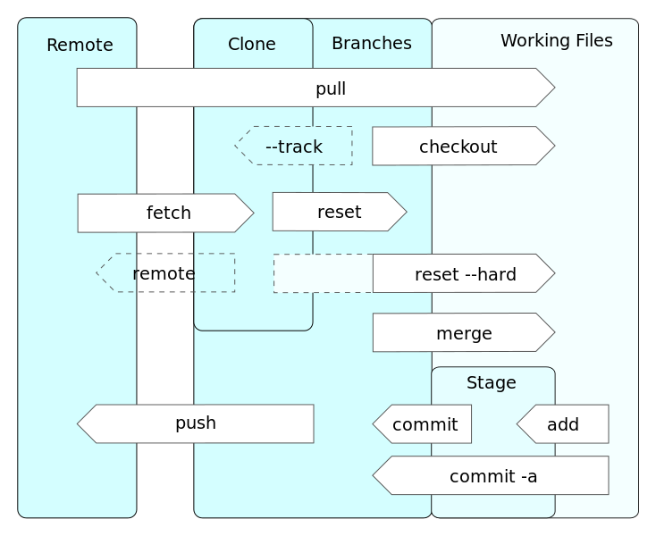
Git operations
from Wikipedia

Slide 5
Git Reference
Pro Git

Slide 6


Slide 7
What is GitHub?
a web-based hosting service for software development projects
use the Git revision control system

Slide 8
Services
Social Coding
feeds
followers
social network graph
Gist
Wikis
Web Pages

Slide 9
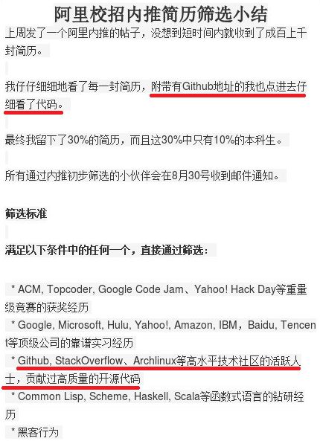
Come on, Guys!
2008.4 launched
2011.8 surpassed sf & gc in popularity
2011.9 reached over 1 million users
2012.9 over 2 million users, 3.7 million repo
2013.1 passed 3 million users, 5 million repo
…
Twitter、Facebook、淘宝、百度、豆瓣…
Bootstrap、RTEMS、jQuery、Linux…

Slide 10


Slide 11
What is markdown?
Markdown is a text-to-HTML conversion tool for web writers. Markdown allows you to write using an easy-to-read, easy-to-write plain text format, then convert it to structurally valid XHTML (or HTML).
—— John Gruber
Markup VS Markdown
WYSIWYG: What You See Is What You get!
Markdown lets you think about what you’re writing instead of how it looks.

Slide 12
Who use it?
StackOverflow.com uses Markdown for posts and comments.
github.com uses a custom blend GFM for their discussions.
…
YOU!

Slide 13
How to use it?
Headers
Phrase Emphasis
List
Link
Code
Blockquotes
Horizontal Rules
…
reference:
Wikipedia
SquareSpace
Daring Fireball
GitHub Flavored Markdown

Slide 14
Markdown tools
Editors
Mou for Mac
MarkdownPad2 for Windows
ReText for Linux
Online Tools
Markable.in
dillinger.io

Slide 15
Enjoy it!

