Slide 1
Binder Introduction
Xincong Jiang
2014-8-7

Slide 2
Nominee
Agenda
How it works in native?
Why use binder?
How a client works
How it works in java
advantages
Basic flow of binder
How a service register it to sm
How service manager build itself
Other ipc
Just a glance of it
A simple example

Slide 3
Other ipc
Other ipc we can sue
Memory share: fast but unsafe
Semaphore and Message: do not support c-s
Socket: support c-s but not efficient

Slide 4
advantages
Why binder
Safety, recognize PID/UID
Efficiency, only copy data once
IPC | Data copy times
Memory share | 0
Binder | 1
Socket/pipe/message | 2

Slide 5
Nominee
Agenda
How it works in native?
Why use binder?
How a client works
How it works in java
advantages
Basic flow of binder
How a service register it to sm
How service manager build itself
Other ipc
Just a glance of it
A simple example

Slide 6
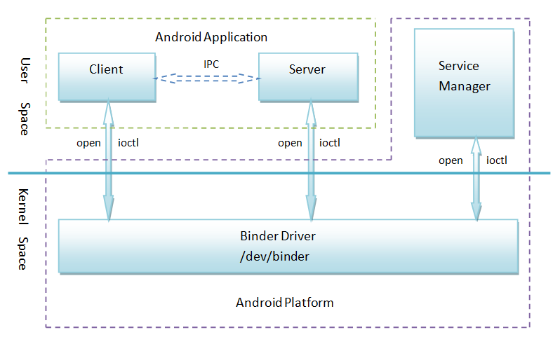
Basic flow of binder

Slide 7
Basic flow of binder
Binder list
Service manager
1 add service
2 get service
3 provider service
service
client
4 use service

Slide 8
A simple example
class IXXX: public IInterface
{
public:
DECLARE_META_INTERFACE(XXX);
virtual getXXX() = 0;
}
class BnXXX: public BnInterface<IXXX>
{
public:
virtual status_t onTransact( uint32_t code, const Parcel& data, Parcel* reply, uint32_t flags = 0);
};
IMPLEMENT_META_INTERFACE(XXX, "android.xxx.IXXX");
status_t BnXXX::onTransact(
uint32_t code, const Parcel& data, Parcel* reply, uint32_t flags)
{
switch(code) {
case GET_XXX: {
CHECK_INTERFACE(IXXX, data, reply);
do something
return NO_ERROR;
} break;
}
class BpXXX: public BpInterface<IXXX>
{
public:
BpXXX (const sp<IBinder>& impl)
: BpInterface< IXXX >(impl) {}
vitural getXXX()
{
Parcel data, reply;
data.writeInterfaceToken(IXXX::getInterfaceDescriptor());
data.writeInt32(pid);
remote()->transact(GET_XXX, data, &reply);
return;
}
}
interface
Service:
int main()
{
sp<ProcessState> proc(ProcessState::self());
sp<IServiceManager> sm = defaultServiceManager();
sm->addService(“service.name”,new XXXService());
IProcessState::self()->startThreadPool();
IPCThreadState::self()->joinThreadPool();
}
Client:
Void func()
{
sp<IServiceManager> sm = defaultServiceManager();
sp<IBinder> binder;
do{
binder = sm->getService(String16(“XXX Service”));
…//if do not get then sleep and retry, else break
}while(true);
sXXXService = interface_cast<IXXXService>(binder);
sXXXService->getXXX();
……
}

Slide 9
How service manager build itself
frameworks/base/cmds/servicemanager/service_manager.c
int main(int argc, char **argv)
{
struct binder_state *bs;
void *svcmgr = BINDER_SERVICE_MANAGER;
bs = binder_open(128*1024);
if (binder_become_context_manager(bs)) {
LOGE("cannot become context manager (%s)\n", strerror(errno));
return -1;
}
svcmgr_handle = svcmgr;
binder_loop(bs, svcmgr_handler);
return 0;
}
1 open binder device
bs = binder_open(128*1024);
2 tell binder driver I’m the manager
binder_become_context_manager(bs);
3 wait for request
binder_loop(bs, svcmgr_handler);

Slide 10
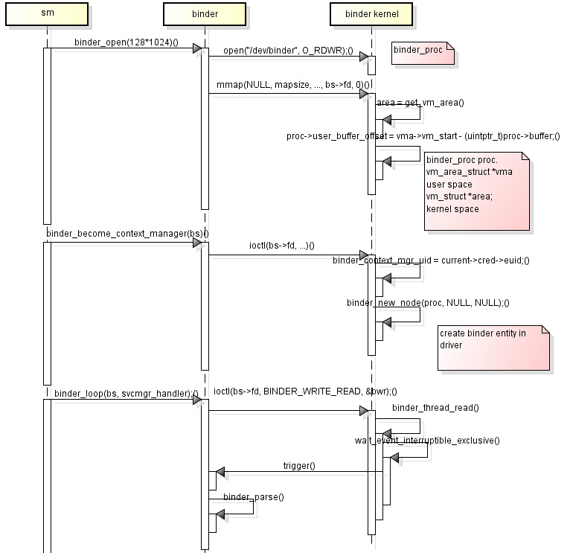
How service manager build itself

Slide 11
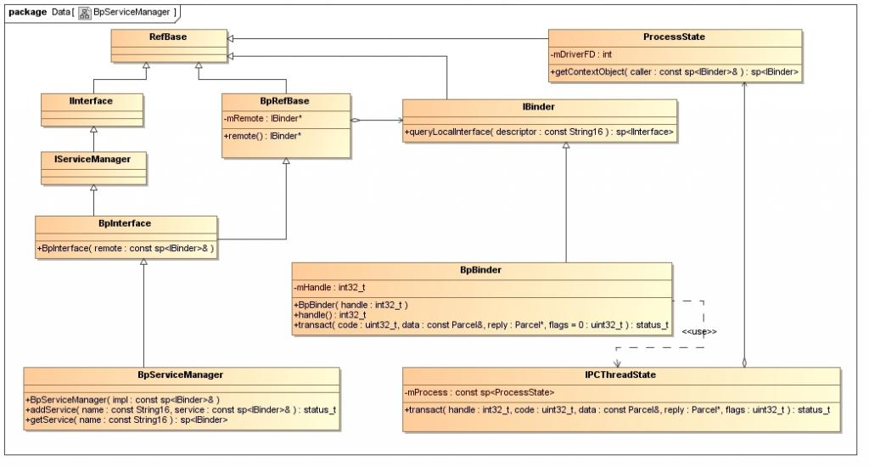
A typical class map of service manager interface

Slide 12
How a service register it to sm
A typical service--MediaPlayerService
int main(int argc, char** argv)
{
sp<ProcessState> proc(ProcessState::self());
sp<IServiceManager> sm = defaultServiceManager();
LOGI("ServiceManager: %p", sm.get());
AudioFlinger::instantiate();
MediaPlayerService::instantiate();
CameraService::instantiate();
AudioPolicyService::instantiate();
ProcessState::self()->startThreadPool();
IPCThreadState::self()->joinThreadPool();
}

Slide 13
How a service register it to sm
First, do something with driver
ProcessState::ProcessState()
: mDriverFD(open_driver())
…….
{
if (mDriverFD >= 0) {
#if !defined(HAVE_WIN32_IPC)
// mmap the binder, providing a chunk of virtual address space to receive transactions.
mVMStart = mmap(0, BINDER_VM_SIZE, PROT_READ, MAP_PR IVATE | MAP_NORESERVE, mDriverFD, 0);
if (mVMStart == MAP_FAILED) {
// *sigh*
LOGE("Using /dev/binder failed: unable to mmap transaction me mory.\n");
close(mDriverFD);
mDriverFD = -1;
}
#else
mDriverFD = -1;
#endif
}
if (mDriverFD < 0) {
// Need to run without the driver, starting our own thread pool.
}
}
static int open_driver()
{
……
int fd = open("/dev/binder", O_RDWR);
……
}
mDriverFD
SIZE:1024X1024-8*4096

Slide 14
How a service register it to sm
Second, get a service manager binder
sp<IServiceManager> sm = defaultServiceManager();
if (gDefaultServiceManager != NULL) return gDefaultServiceManager;
else gDefaultServiceManager =
interface_cast<IServiceManager>(ProcessState::self()->getContextObject(NULL));
gDefaultServiceManager = interface_cast<IServiceManager>(new BpBinder(0));
gDefaultServiceManager = new BpServiceManager(new BpBinder(0));
Handle 0 points to SM
Nobody knows handle number of sm, so give it a fixed one

Slide 15
How a service register it to sm
Third, instantiate and register itself in SM
void MediaPlayerService::instantiate() {
defaultServiceManager()->addService(
String16("media.player"), new MediaPlayerService());
}
Fourth, wait for request from client
IPCThreadState::self()->joinThreadPool(mIsMain);

Slide 16
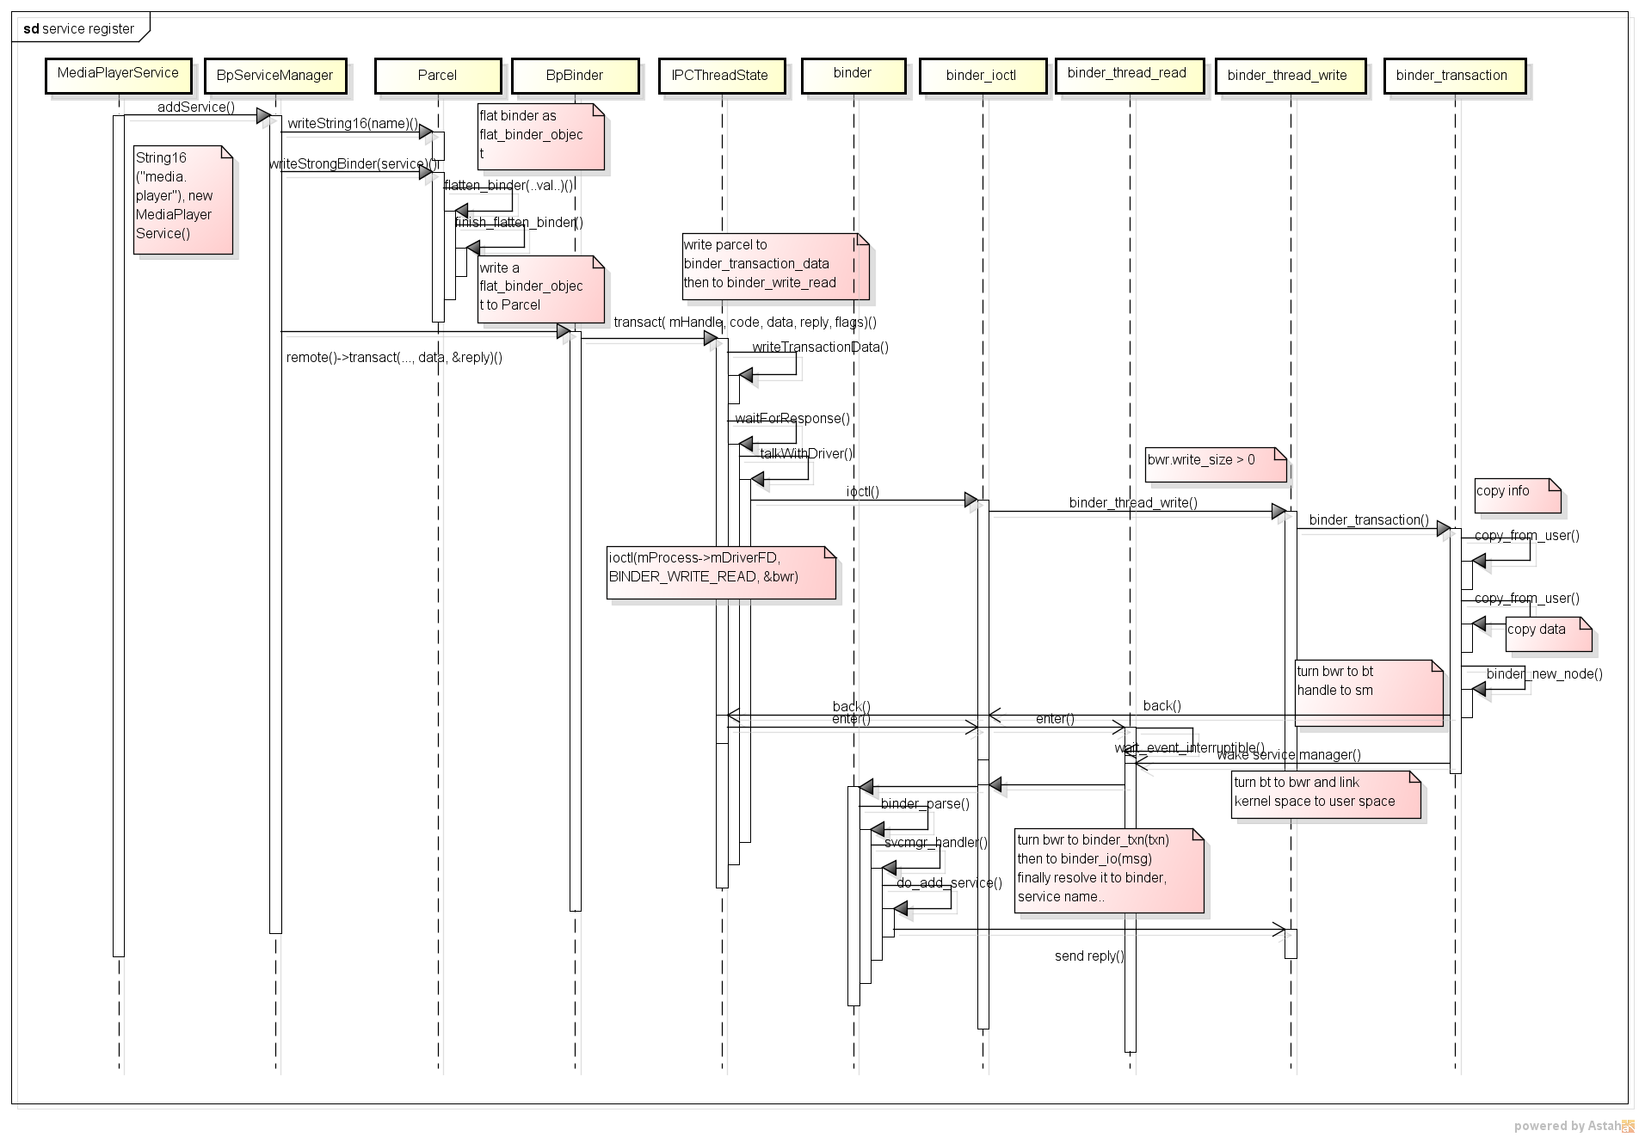
How a service register it to sm
user space
kernel space
IBinder *local = binder->localBinder();
obj.type = BINDER_TYPE_BINDER;
obj.binder = local->getWeakRefs();
obj.cookie = local;
binder_transaction_data tr;
tr.target.handle = handle;
tr.code = code;
tr.flags = binderFlags;
tr.data_size = data.ipcDataSize();
tr.data.ptr.buffer = data.ipcData();
tr.offsets_size = data.ipcObjectsCount()*sizeof(size_t);
tr.data.ptr.offsets = data.ipcObjects();
Parcel data, reply;
data.writeInterfaceToken(IServiceManager::getInterfaceDescriptor());
data.writeString16(name);
data.writeStrongBinder(service);
status_t err = remote()->transact(ADD_SERVICE_TRANSACTION, data, &reply);
out->writeObject(flat, false);
*reinterpret_cast<flat_binder_object*> ( mData+mDataPos) = val;
mObjects[mObjectsSize] = mDataPos;
service
copy_from_user(t->buffer->data, tr->data.ptr.buffer, tr->data_size)
copy_from_user(offp, tr->data.ptr.offsets, tr->offsets_size)
t->code = tr->code;
t->flags = tr->flags;
t->buffer = binder_alloc_buf(target_proc, tr->data_size,
tr->offsets_size, !reply && (t->flags & TF_ONE_WAY));
tr.code = t->code;
tr.flags = t->flags;
tr.data_size = t->buffer->data_size;
tr.offsets_size = t->buffer->offsets_size;
tr.data.ptr.buffer = (void *)t->buffer->data + proc->user_buffer_offset;
tr.data.ptr.offsets = tr.data.ptr.buffer + ALIGN(t->buffer->data_size, sizeof(void *));
sm
strict_policy = bio_get_uint32(msg);
s = bio_get_string16(msg, &len);
s = bio_get_string16(msg, &len);
ptr = bio_get_ref(msg);
si->ptr = ptr;
si->len = len;
memcpy(si->name, s, (len + 1) * sizeof(uint16_t));
svclist = si;

Slide 17
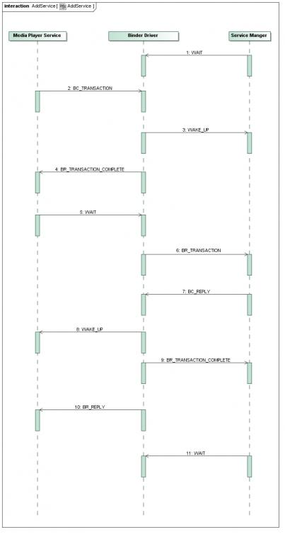
How a service register it to sm
Message flow
Only covers first 6 steps in sd before
The state machine is hard to analyze
Why binder is quick?
copy
client
data
data
service
data
link
Just one copy

Slide 18
How a service register it to sm
Wait and response
IPCThreadState::self()->joinThreadPool();
talkWithDriver();
cmd = mIn.readInt32();
executeCommand(cmd);
new MediaPlayerService()
case BR_TRANSACTION:
sp<BBinder> b((BBinder*)tr.cookie);
const status_t error = b->transact(tr.code, buffer, &reply, tr.flags);
onTransact(code, data, reply, flags);
BnMediaPlayerService::onTransact(uint32 code…)

Slide 19
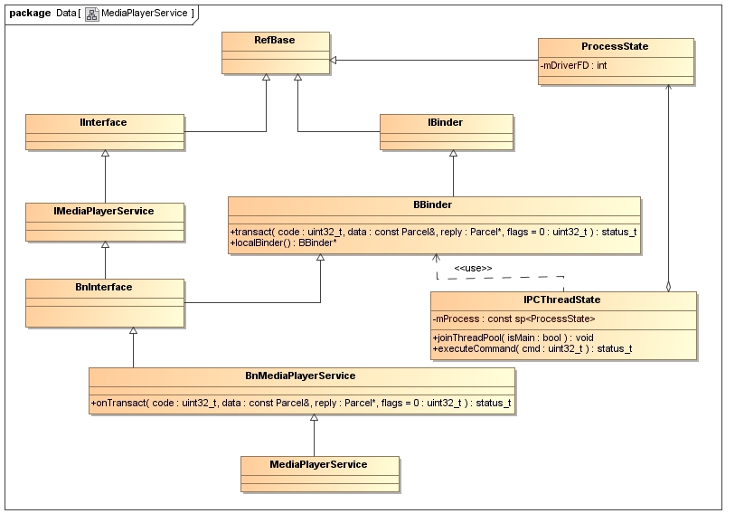
A typical class map in service side

Slide 20
A typical data wrapper flow
binder
service
Data structure
flat_binder_object
Parcel
Class & func
Parcel
Parcel
binder_transaction_data
IPCThreadState
binder_write_read
IPCThreadState
user space
binder_write_read
binder_ioctl
kernel space
binder_transaction_data
binder_thread_write/read
binder_transaction
binder_transaction

Slide 21
A typical data wrapper flow
ADD_SERVICE_TRANSACTION
struct binder_transaction_data {
union {
size_t handle;
void *ptr;
} target;
void *cookie;
unsigned int code;
unsigned int flags;
pid_t sender_pid;
uid_t sender_euid;
size_t data_size;
size_t offsets_size;
union {
struct {
/* transaction data */
const void *buffer;
/* offsets from buffer to
flat_binder_object structs */
const void *offsets;
} ptr;
uint8_t buf[8];
} data;
};
struct binder_transaction {
int debug_id;
struct binder_work work;
struct binder_thread *from;
struct binder_transaction *from_parent;
struct binder_proc *to_proc;
struct binder_thread *to_thread;
struct binder_transaction *to_parent;
unsigned need_reply:1;
struct binder_buffer *buffer;
unsigned int code;
unsigned int flags;
long priority;
long saved_priority;
uid_t sender_euid;
};
media.player
struct binder_write_read {
signed long write_size;
signed long write_consumed;
unsigned long write_buffer;
signed long read_size;
signed long read_consumed;
unsigned long read_buffer;
};
struct flat_binder_object {
/* 8 bytes for large_flat_header. */
unsigned long type;
unsigned long flags;
/* 8 bytes of data. */
union {
/* local object */
void *binder;
/* remote object */ signed long handle;
};
/* extra data associated with local object */
void *cookie;
};
new MediaPlayerService());

Slide 22
How a client works
Client get service from sm
get a service manager binder
get service from sm binder
use service
sp<IServiceManager> sm = defaultServiceManager();
binder = sm->getService(String16("media.player"));

Slide 23
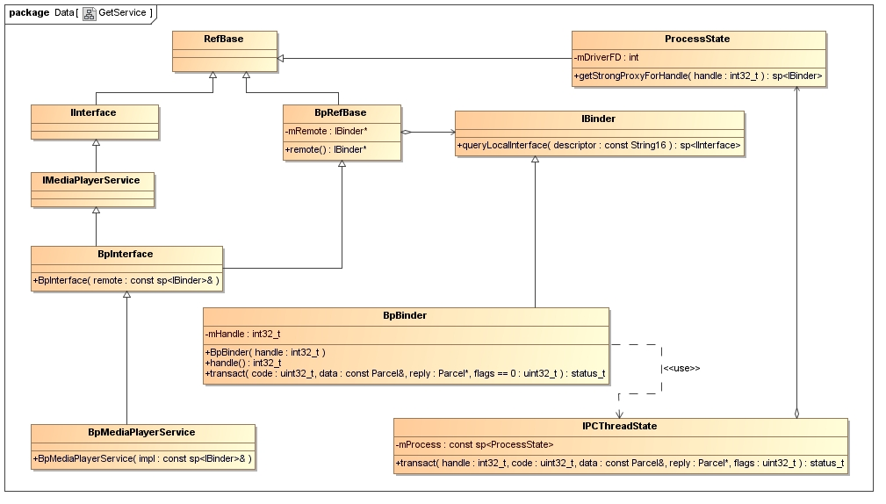
A typical class map in client side

Slide 24
Nominee
Agenda
How it works in native?
Why use binder?
How a client works
How it works in java
advantages
Basic flow of binder
How a service register it to sm
How service manager build itself
Other ipc
Just a glance of it
A simple example

Slide 25
Just a glance of java
ServiceManager
ServiceManagerProxy
public final class ServiceManager {
......
private static IServiceManager sServiceManager;
......
private static IServiceManager getIServiceManager() {
if (sServiceManager != null) {
return sServiceManager;
}
// Find the service manager
sServiceManager = ServiceManagerNative.asInterface(BinderInt ernal.getContextObject());
return sServiceManager;
}
......
}
class ServiceManagerProxy implements IServiceManager {
public ServiceManagerProxy(IBinder remote) {
mRemote = remote;
}
public IBinder asBinder() {
return mRemote;
}
public IBinder getService(String name) throws RemoteException {
Parcel data = Parcel.obtain();
Parcel reply = Parcel.obtain();
data.writeInterfaceToken(IServiceManager.descriptor);
data.writeString(name);
mRemote.transact(GET_SERVICE_TRANSACTION, data, reply, 0);
IBinder binder = reply.readStrongBinder();
reply.recycle();
data.recycle();
return binder;
}
public IBinder checkService(String name) throws RemoteException {…}
public void addService(String name, IBinder service, boolean allowIsolated)
throws RemoteException {…}
public String[] listServices() throws RemoteException {…}
private IBinder mRemote;
}
Call native function

Slide 26
Just a glance of java
frameworks/base/core/java/
android/os/IHelloService.aidl
public interface IHelloService extends android.os.IInterface
{
/** Local-side IPC implementation stub class. */
public static abstract class Stub extends android.os.Binder implements android.os.IHelloService
{
private static final java.lang.String DESCRIPTOR = "android.os.IHelloService";
/** Construct the stub at attach it to the interface. */
public Stub()
{ this.attachInterface(this, DESCRIPTOR); }
public static android.os.IHelloService asInterface(android.os.IBinder obj)
{
if ((obj==null)) { return null; }
android.os.IInterface iin = (android.os.IInterface)obj.queryLocalInterface(DESCRIPTOR);
if (((iin!=null)&&(iin instanceof android.os.IHelloService))) {
return ((android.os.IHelloService)iin);
}
return new android.os.IHelloService.Stub.Proxy(obj);
}
public android.os.IBinder asBinder()
{ return this; }
public boolean onTransact(int code, android.os.Parcel data, android.os.Parcel reply, int flags) throws android.os.RemoteException
{ switch (code) case TRANSACTION_setVal: … }
private static class Proxy implements android.os.IHelloService
{
private android.os.IBinder mRemote;
Proxy(android.os.IBinder remote)
{ mRemote = remote; }
public android.os.IBinder asBinder()
{ return mRemote; }
……
public void setVal(int val) throws android.os.RemoteException
{ … }
public int getVal() throws android.os.RemoteException
{ …}
}
static final int TRANSACTION_setVal = (android.os.IBinder.FIRST_CALL_TRANSACTION + 0);
static final int TRANSACTION_getVal = (android.os.IBinder.FIRST_CALL_TRANSACTION + 1);
}
public void setVal(int val) throws android.os.RemoteException;
public int getVal() throws android.os.RemoteException;
}
package android.os;
interface IHelloService
{
void setVal(int val);
int getVal();
}
out/target/common/obj/JAVA_LIBRARIES/framework_intermediates/src/core/java/android/os/IHelloService.java

Slide 27
Just a glance of java
Service
System server
package com.android.server;
import android.content.Context;
import android.os.IHelloService;
import android.util.Slog;
public class HelloService extends IHelloService.Stub {
private static final String TAG = "HelloService";
HelloService() {
init_native();
}
public void setVal(int val) {
setVal_native(val);
}
public int getVal() {
return getVal_native();
}
private static native boolean init_native();
private static native void setVal_native(int val);
private static native int getVal_native();
}
try {
Slog.i(TAG, "Hello Service");
ServiceManager.addService("hello", new HelloService());
} catch (Throwable e) {
Slog.e(TAG, "Failure starting Hello Service", e);
}
Client
public class Hello extends Activity implements OnClickListener {
......
private IHelloService helloService = null;
......
@Override
public void onCreate(Bundle savedInstanceState) {
helloService = IHelloService.Stub.asInterface(
ServiceManager.getService("hello"));
}
......
}

Slide 28
Just a glance of java
*.aidl
java
Client
Service
jni
jni
Bp*Service & Bn*Service
Client
Service
native
ioctl
ioctl
kernel
Binder driver

Slide 29
Just a glance of java
if use java
Java
Native&
kernel

Slide 30
Thanks!

