Slide 1
Survival analysis
Ewing lab meeting
4th June 2022

Slide 2
What’s the underlying question?
How does the time to a given event differ between groups of individuals?
e.g.
time from diagnosis to death
time to heart attack
time until the machine breaks

Slide 3
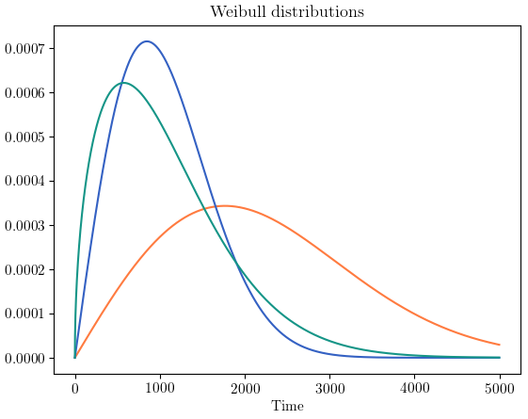
Why not just compare the means/medians?
Density

Slide 4
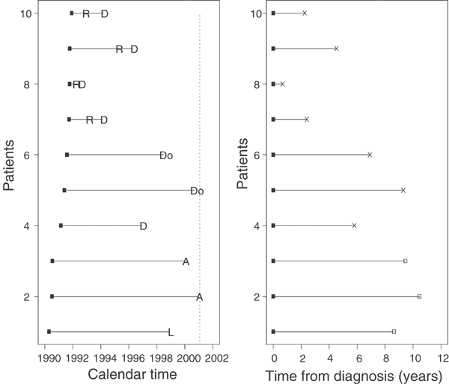
Survival analysis allows us to use info from patients that don’t have events
Clark et al, 2003, BJC

Slide 5
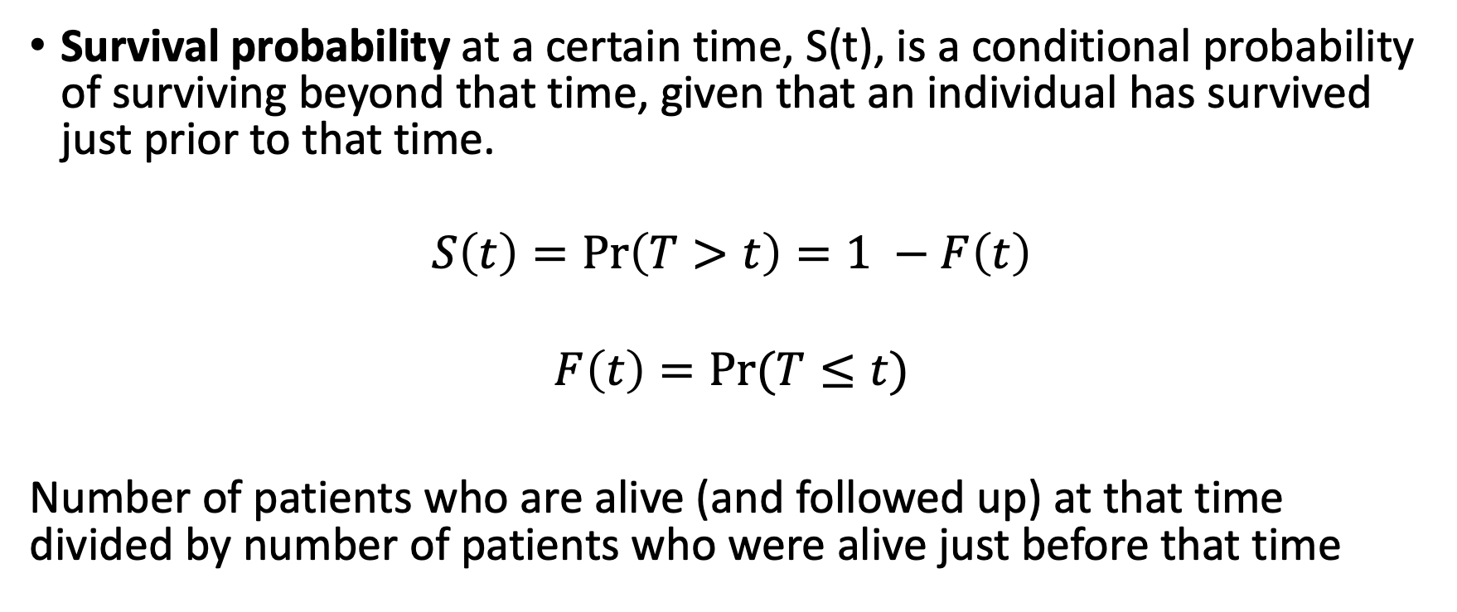
Survival probability
Survival probability at a certain time, S(t), is a conditional probability of surviving beyond that time, given that an individual has survived just prior to that time.
$$S\left(t\right)=\operatorname{Pr}\left(T>t\right)=1 −F\left(t\right)$$
$$F\left(t\right)=Pr⁡(T≤t)$$
Number of patients who are alive (and followed up) at that time divided by number of patients who were alive just before that time

Slide 6
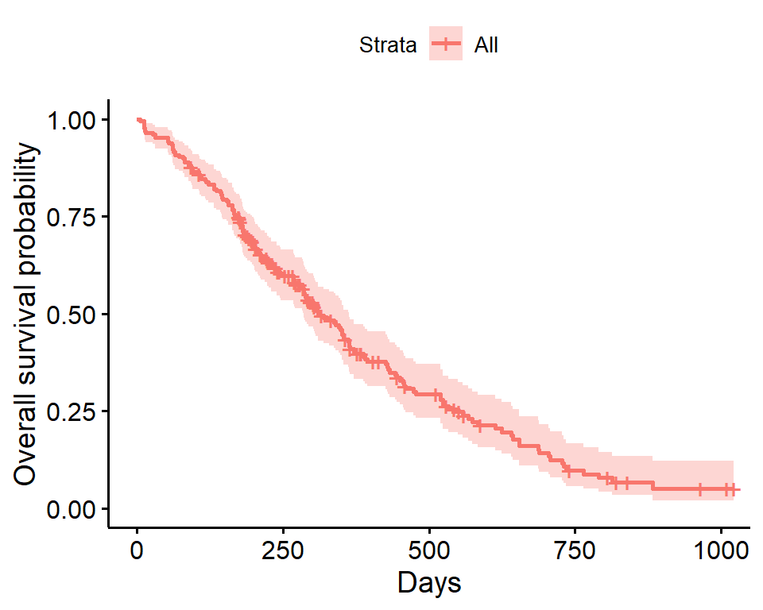
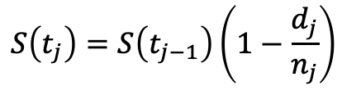
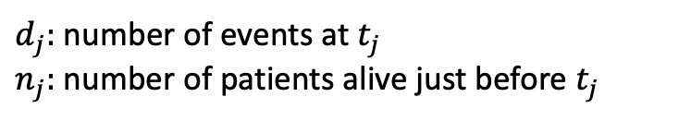
Kaplan–Meier survival estimate
Survival probability is a step function:
$$S\left(t_{j}\right)=S\left(t_{j−1}\right)\left(1−\frac{d_{j}}{n_{j}}\right)$$
$d_{j}:$ number of events at $t_{j}$
$n_{j}:$number of patients alive just before $t_{j}$

Slide 7
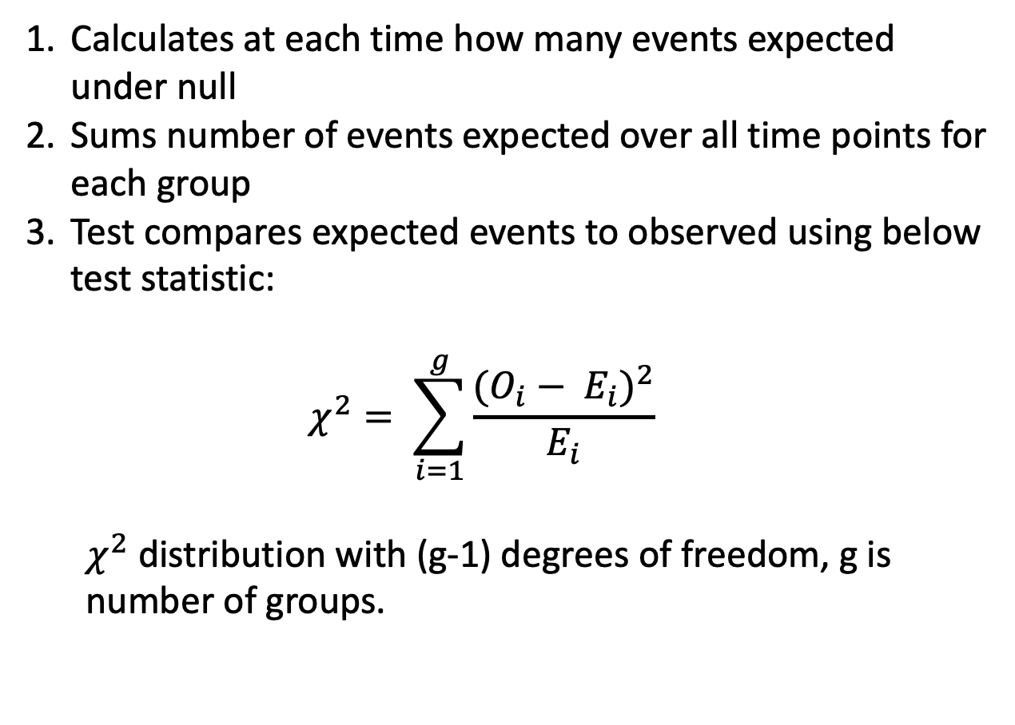
Comparing survival times between groups
Method 1:
log-rank test
nonparametric
R survdiff function
Caveats:
no effect size!
Calculates at each time how many events expected under null
Sums number of events expected over all time points for each group
Test compares expected events to observed using below test statistic:
$$χ^{2}= \sum_{i=1}^{g}{\frac{{(O_{i}− E_{i})}^{2}}{E_{i}}}$$
$χ^{2}$ distribution with (g-1) degrees of freedom, g is number of groups.

Slide 8
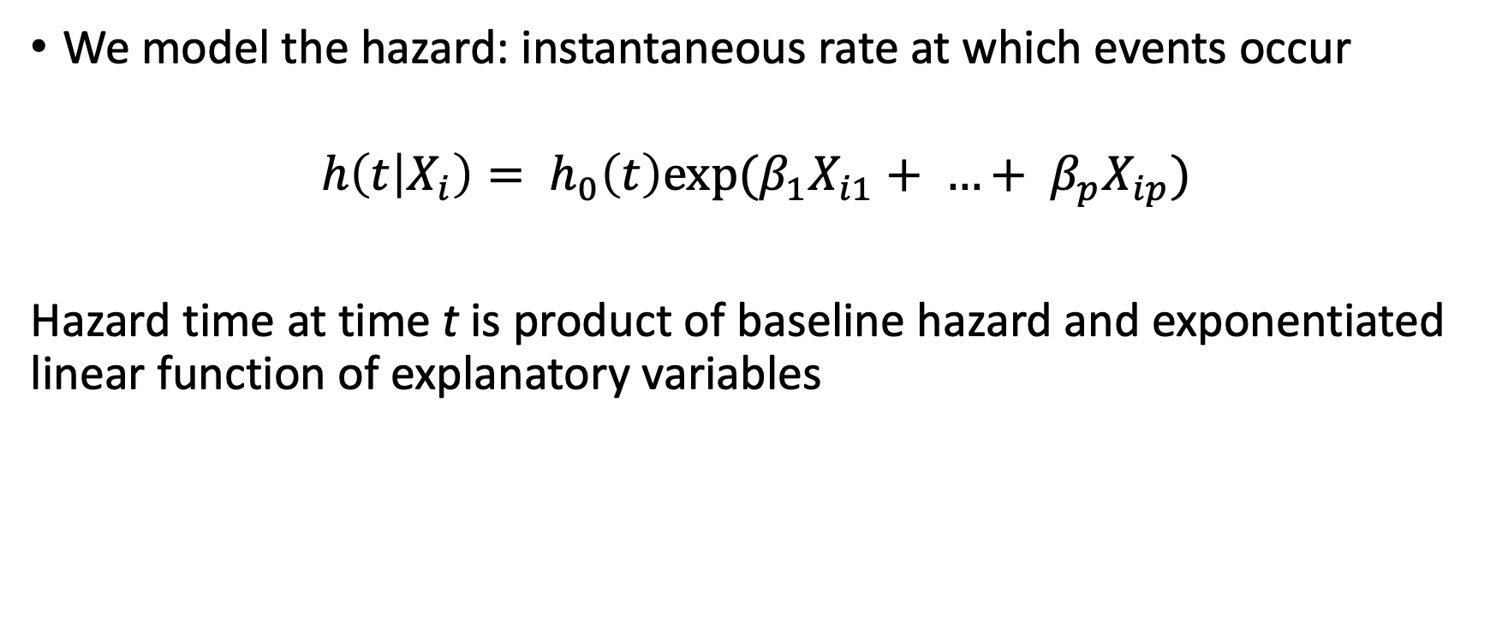
Method 2: The Cox Proportional Hazards regression model
We model the hazard: instantaneous rate at which events occur
$$h\left(t | X_{i}\right)= h_{0}\left(t\right)exp⁡(β_{1}X_{i1}+ …+ β_{p}X_{ip})$$
Hazard time at time t is product of baseline hazard and exponentiated linear function of explanatory variables

Slide 9
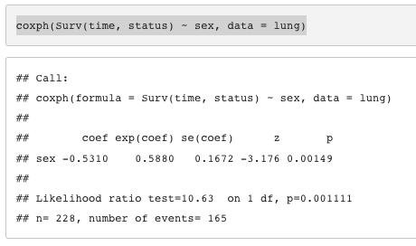

How to fit a CoxPH model?
Hazard ratio :
Ratio of hazards between two groups at any point in time
HR = exp($β$)
HR > 1: increased hazard of death
HR < 1: reduced hazard of death
e.g. HR = 0.59: for sex where male is reference category
0.6 times as many females are dying as males at any given time.

Slide 10
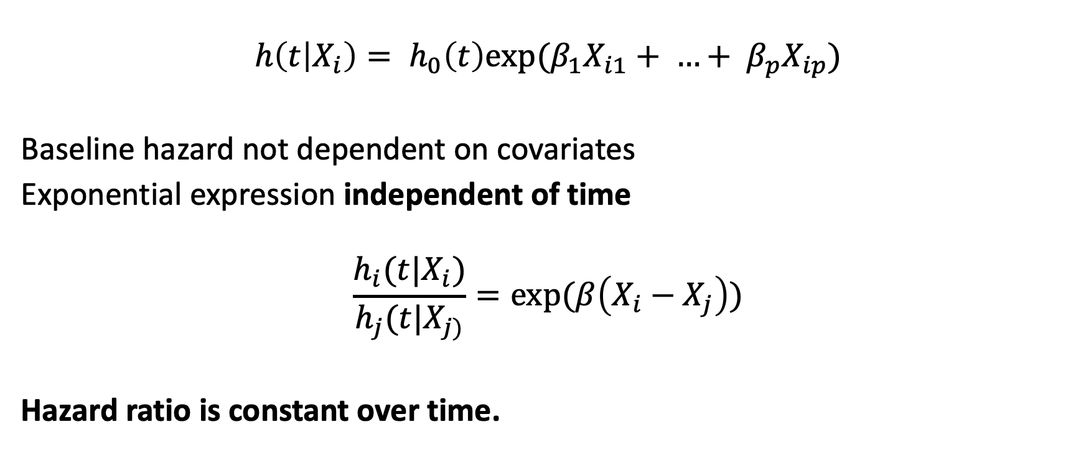
Proportional Hazards assumption
$$h\left(t | X_{i}\right)= h_{0}\left(t\right)exp⁡(β_{1}X_{i1}+ …+ β_{p}X_{ip})$$
Baseline hazard not dependent on covariates
Exponential expression independent of time
$$\frac{h_{i}(t|X_{i})}{h_{j}(t|X_{j)}}=exp⁡(β\left(X_{i}−X_{j}\right))$$
Hazard ratio is constant over time.

Slide 11
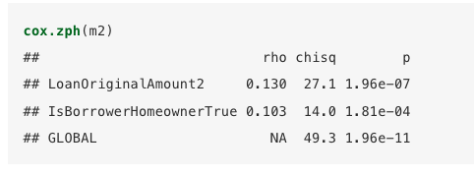
How to test Proportional hazards assumption?
Do survival curves cross?
How well does the model fit the data? Are the residuals fairly constant over time?

Slide 12
Pros for using CoxPH model
Can adjust for multiple covariates
More powerful than non-parametric method
Get an accurate estimate of effect size associated with a variable
Many extensions available when data doesn’t fit the assumptions

Slide 13
Further reading
Clark, T., Bradburn, M., Love, S., & Altman, D. (2003). Survival analysis part I: Basic concepts and first analyses. 232-238. ISSN 0007-0920.
M J Bradburn, T G Clark, S B Love, & D G Altman. (2003). Survival Analysis Part II: Multivariate data analysis – an introduction to concepts and methods. British Journal of Cancer, 89(3), 431-436.
Bradburn, M., Clark, T., Love, S., & Altman, D. (2003). Survival analysis Part III: Multivariate data analysis – choosing a model and assessing its adequacy and fit. 89(4), 605-11.
Clark, T., Bradburn, M., Love, S., & Altman, D. (2003). Survival analysis part IV: Further concepts and methods in survival analysis. 781-786. ISSN 0007-0920.

