Slide 1
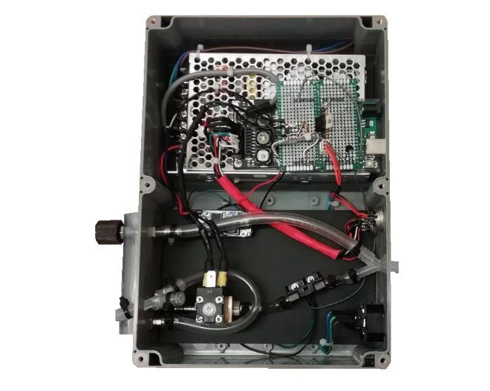
Power
supply
Processor
Rotameter
Nitrogen
Mixed gas
Carbogen
Valve
Gas flow sensor

