Slide 1
Controlled oxygen levels during machine perfusion
Ewout Bergsma
Chirurgical research laboratory UMC Groningen
Prof. dr. H.G.D. Leuvenink
Warning: this presentation includes images of real porcine kidneys and blood

Slide 2
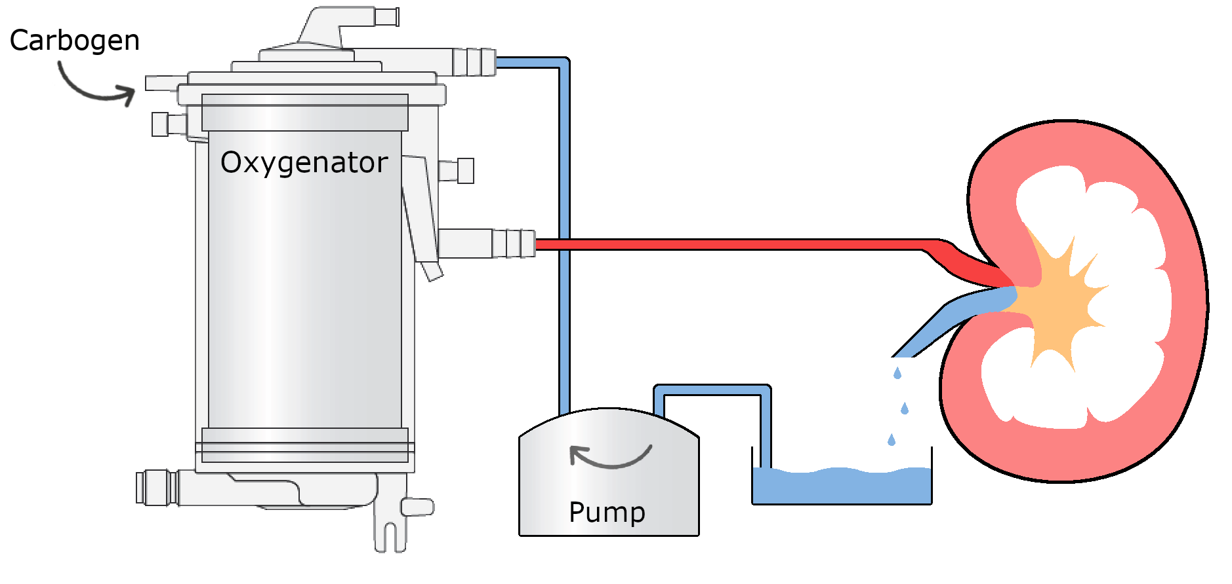
Note: this project only includes porcine kidneys

Slide 3
Content
Rationale
Situational & theoretical analysis
Conceptual model
Research design & results
Discussion
Conclusion
Questions

Slide 4
Next up
Rationale
Situational & theoretical analysis
Conceptual model
Research design & results
Discussion
Conclusion
Questions

Slide 5
Rationale
Transplantation organs shortage
Extended criteria
More oxygenation research
Organ preservation
Cold storage
Cold machine perfusion
Warm machine perfusion
(1/3)
Notes:
In 2018 almost 1200 patients were waiting for an organ, 741 of which are waiting for a kidney.
Increasing since 2015, every year.
Due to shortage; older and DCD.
IRI.
CS -> HMP, adds three years to the survival.

Slide 6
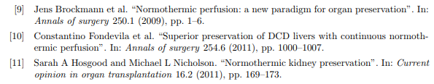
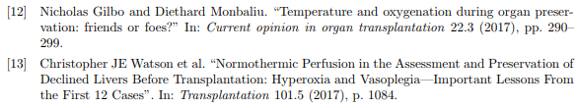
Rationale
Research applications
Innovation
Exclusion
(2/3)
Notes:
Normal temp better than cold
Over oxygenating is bad, [12] different kidneys have different needs

Slide 7
“How can one build a solution for an automated system that can dynamically control the oxygen level in a kidney perfusion machine for research applications?”
What type of oxygen sensor is the best fit for the system?
How should the oxygen level be influenced by the system?
How can the system adjust for the different oxygen requirements of the kidney?
(3/3)

Slide 8
Next up
Rationale
Situational & theoretical analysis
Conceptual model
Research design & results
Discussion
Conclusion
Questions

Slide 9
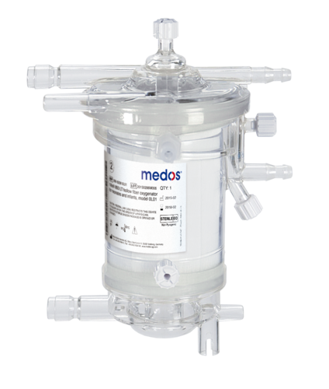
Oxygenator
Medos Hilite 1000
Reused
Various ports
Warming
Gas
Blood
(1/3)

Slide 10
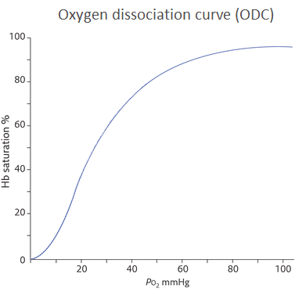
Oxygen dissociation curve
Oxygen forms
Gaseous oxygen
Dissolved in the perfusion solution
Bound to an oxygen carrier
Influenced by:
pH
Temperature
CO₂
Extra
Notes:
Shift left:
Decrease in pH
Increase of temp
Increase of CO2

Slide 11
Oxygen sensor types
Gaseous
Interesting
R. Ubbink
Dissolved
All perfusion solutions
Control for need?
Oximetry
Red blood cells
(2/3)

Slide 12
Control decision
Restrict carbogen flow
Restricts CO₂
Mix carbogen nitrogen
Air
(3/3)

Slide 13
Next up
Rationale
Situational & theoretical analysis
Conceptual model
Research design & results
Discussion
Conclusion
Questions

Slide 14
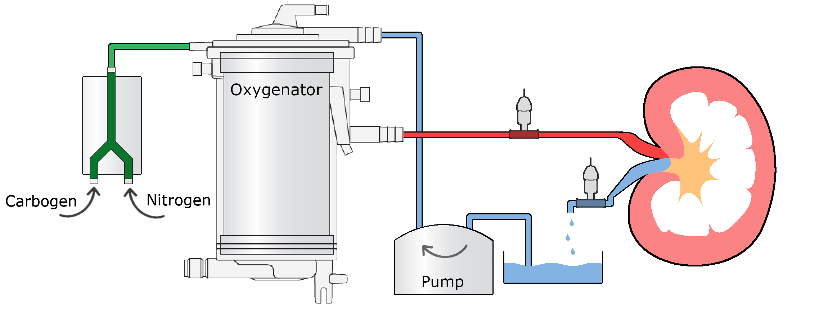
(1/3)

Slide 15
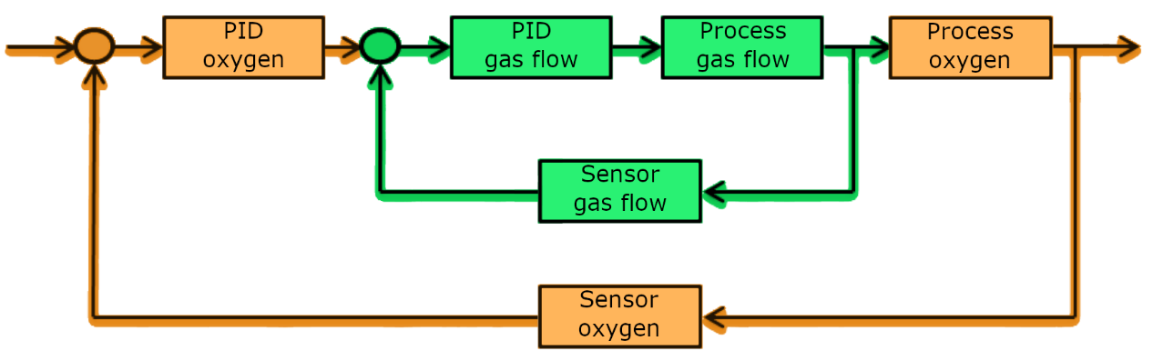
Feedback design
(2/3)

Slide 16
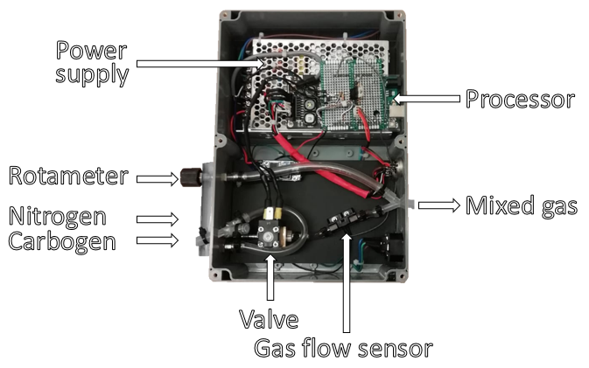
(3/3)

Slide 17
Next up
Rationale
Situational & theoretical analysis
Conceptual model
Research design & results
Discussion
Conclusion
Questions

Slide 18
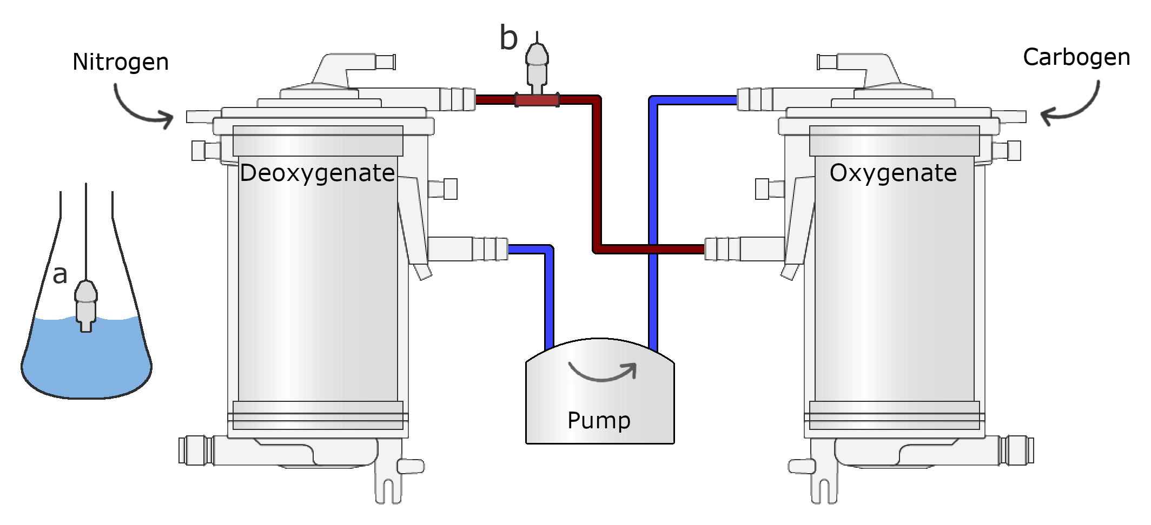
Effect of flow rate on response time sensor Design

Slide 19
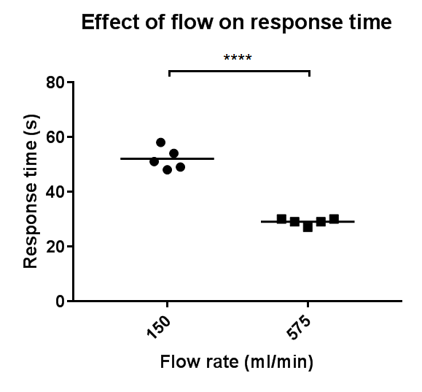
Effect of flow rate on response time sensor Results

Slide 20
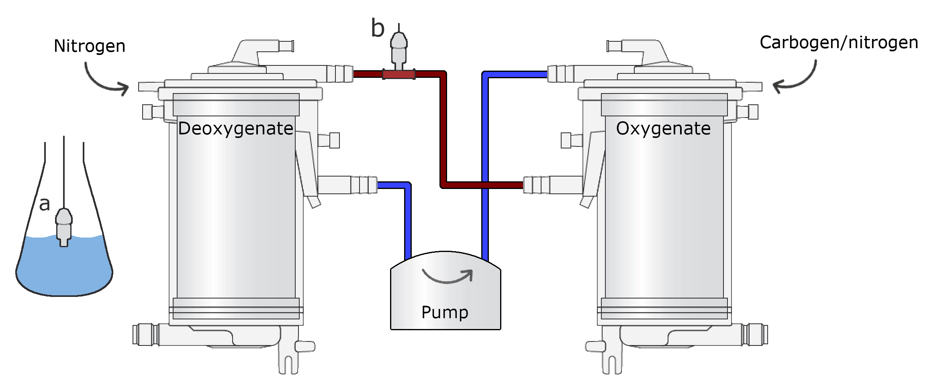
Response time sensor to different deltas Design
Blood flow: 150 ml/min
325.8 hPa/min (H. Maassen)

Slide 21
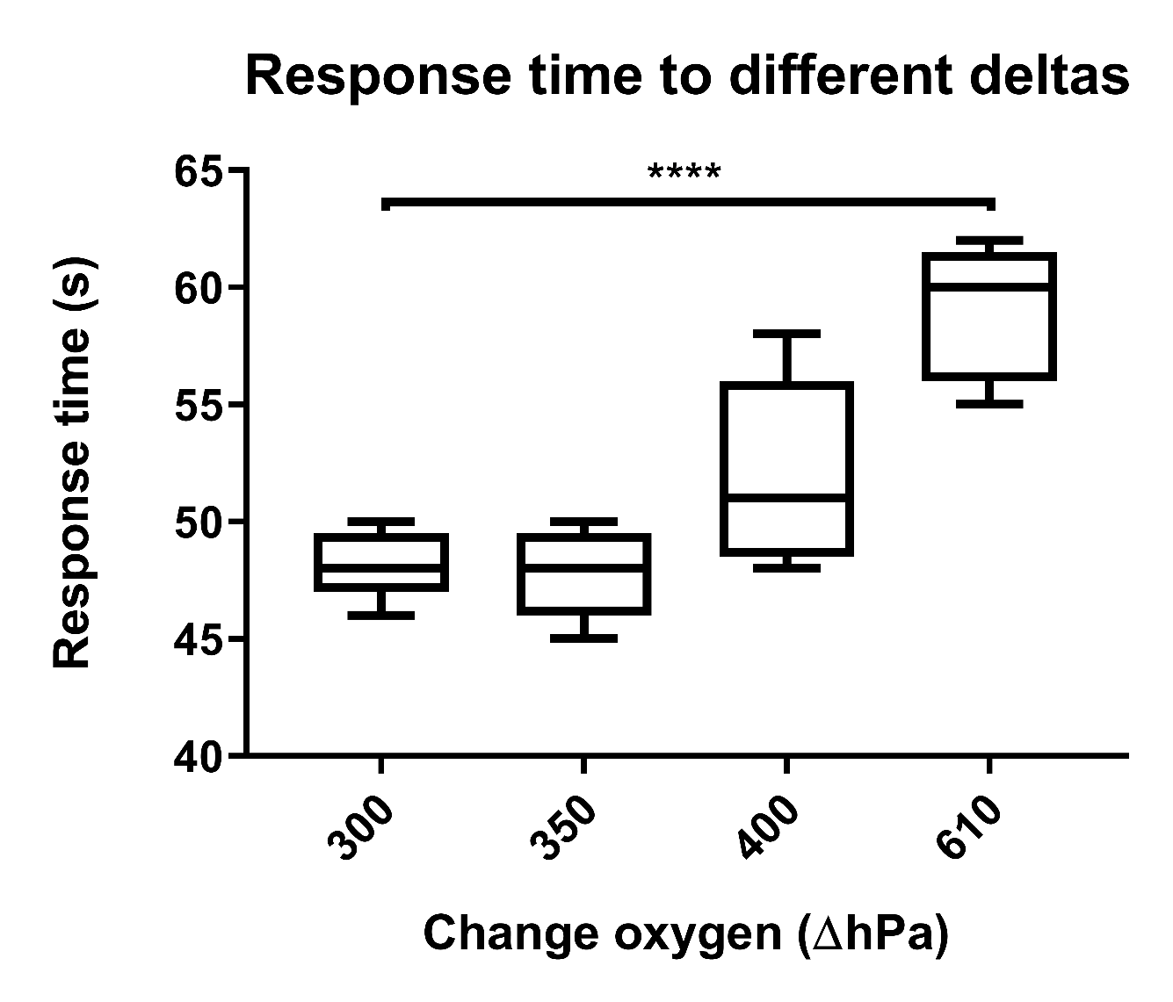
Response time sensor to different deltas Results

Slide 22
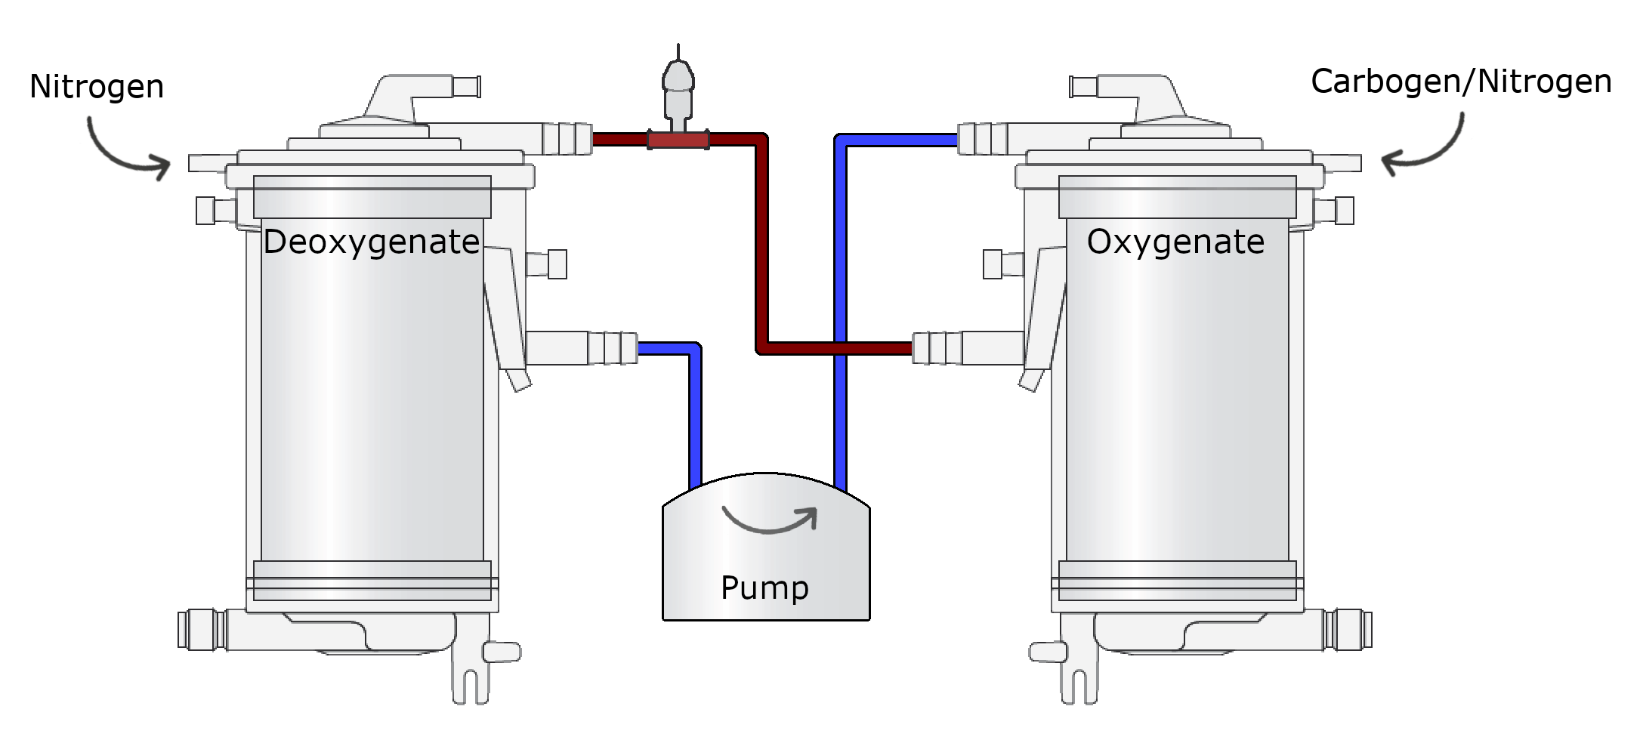
Nitrogen carbogen ratio Design
133.3 hPa
Different carbogen and nitrogen flows

Slide 23
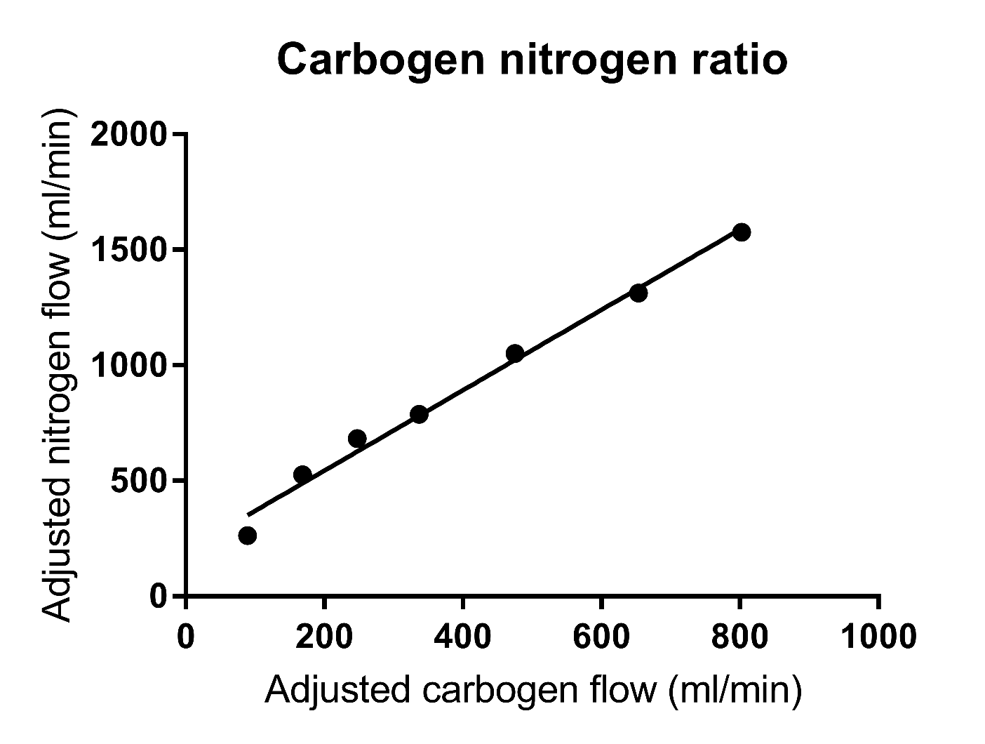
Nitrogen carbogen ratio Results

Slide 24
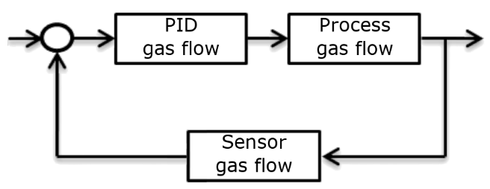
Gas flow subsystem tuning Design

Slide 25
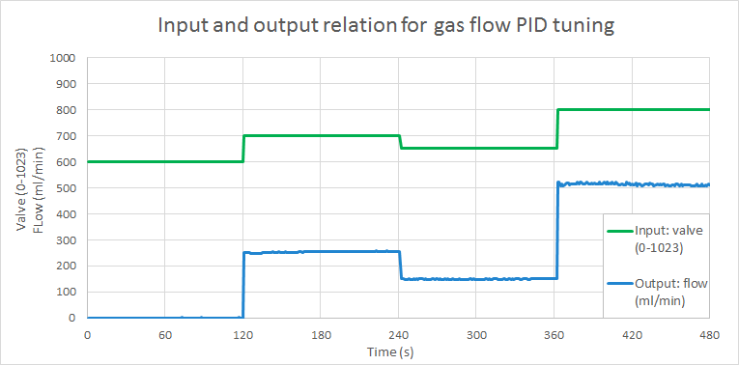
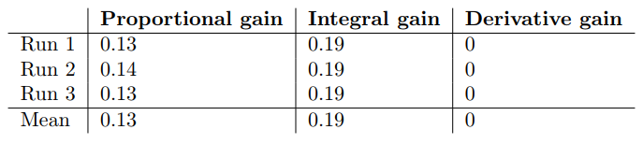
Gas flow subsystem tuning Results

Slide 26
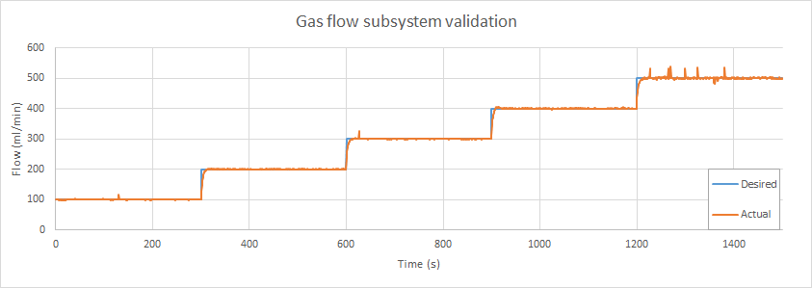

Gas flow subsystem Validation

Slide 27
Full system tuning Design

Slide 28
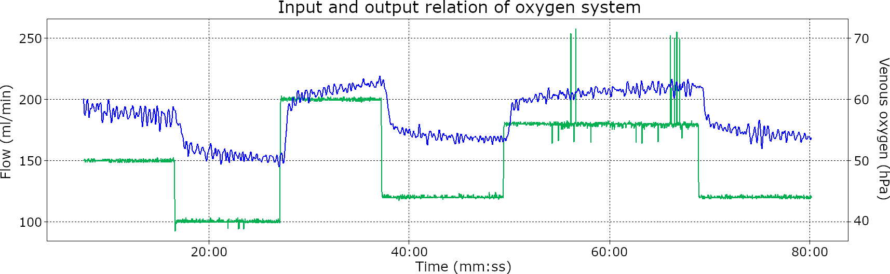
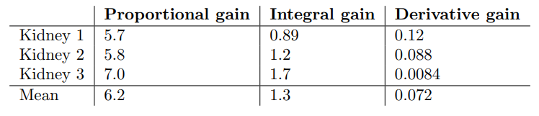
Full system tuning Results

Slide 29
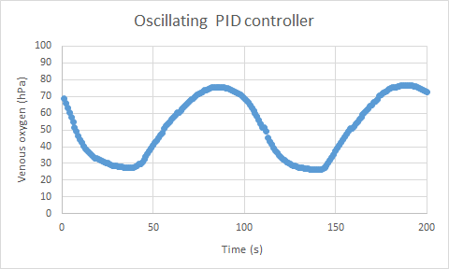
Full system tuning Validation 1

Slide 30
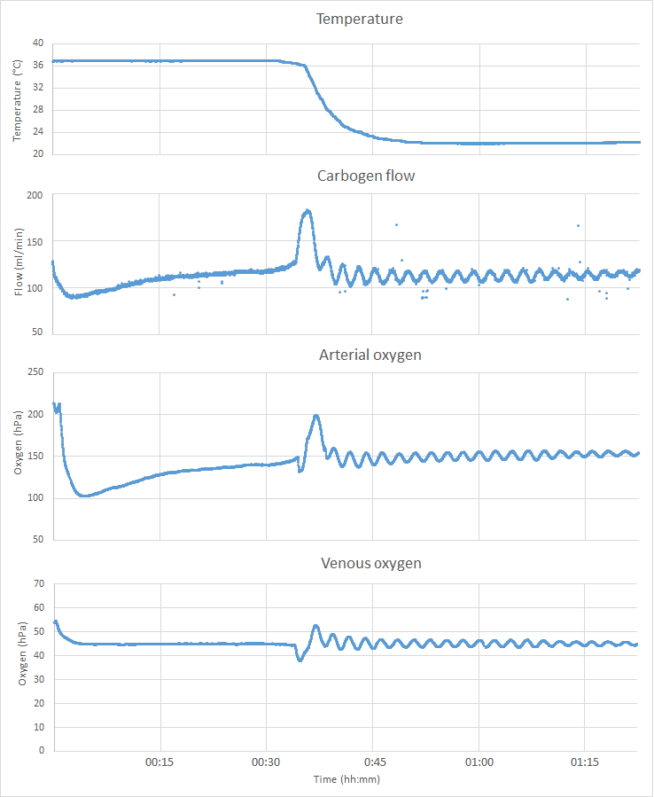
Full system tuning
Validation 2

Slide 31
Next up
Rationale
Situational & theoretical analysis
Conceptual model
Research design & results
Discussion
Conclusion
Questions

Slide 32
Discussion
Full loop tuning needs work
Temperature validation

Slide 33
Next up
Rationale
Situational & theoretical analysis
Conceptual model
Research design & results
Discussion
Conclusion
Questions

Slide 34
Conclusion
Dissolved oxygen sensor
Mixing carbogen and nitrogen
Stable venous

Slide 35
Future recommendations
Research effectiveness
Overoxygenating
Needs of kidney
Better full loop tuning
More complex full loop control?

Slide 36
Next up
Rationale
Situational & theoretical analysis
Conceptual model
Research design & results
Discussion
Conclusion
Questions

Slide 37
Question?
Thanks to, UMCG:
Prof. dr. H.G.D. Leuvenink
Dr. C. Moers
Dr. M.W.N. Nijsten
All colleagues
Thanks to, Hanze:
Corina
Felipe

Slide 38
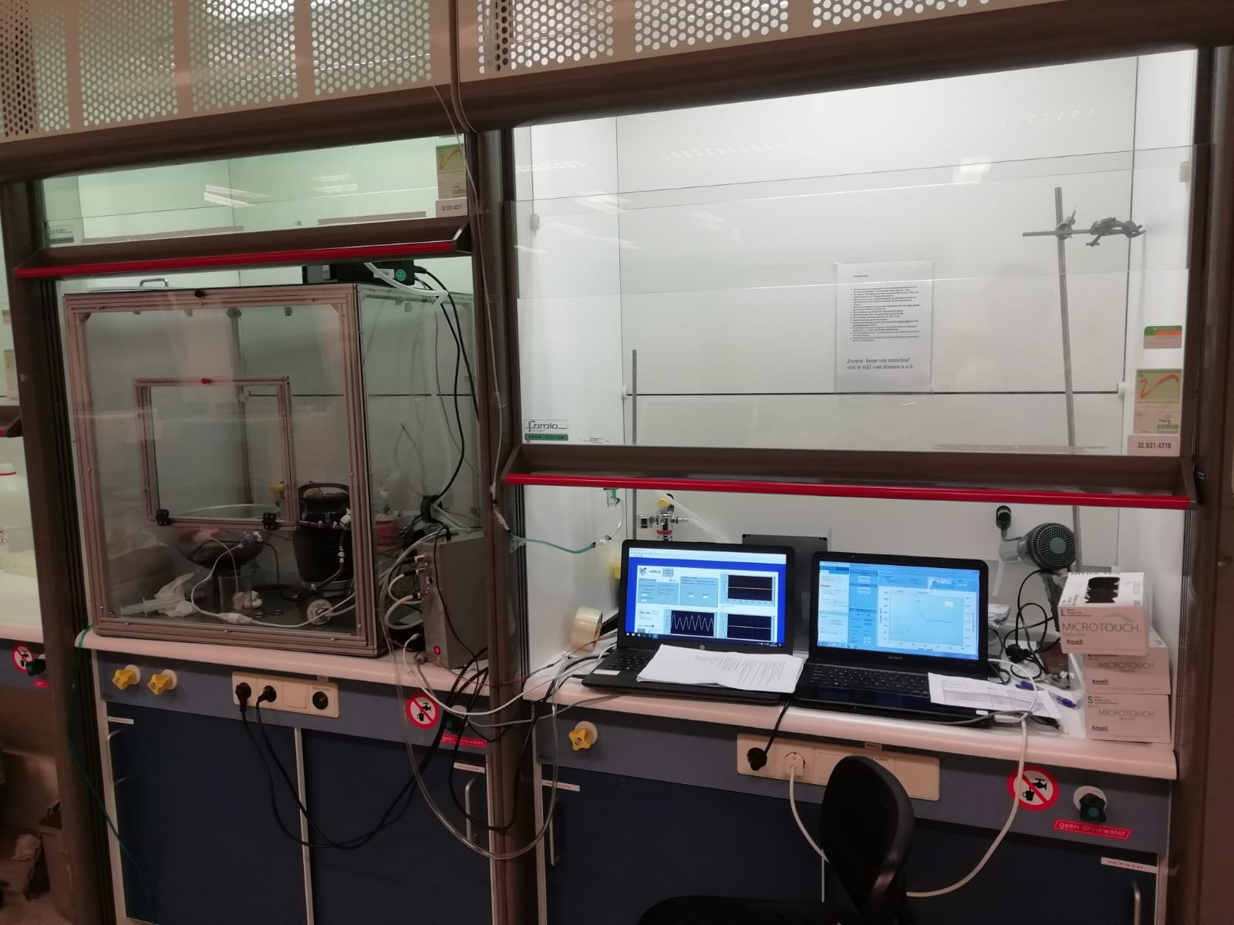

Slide 39
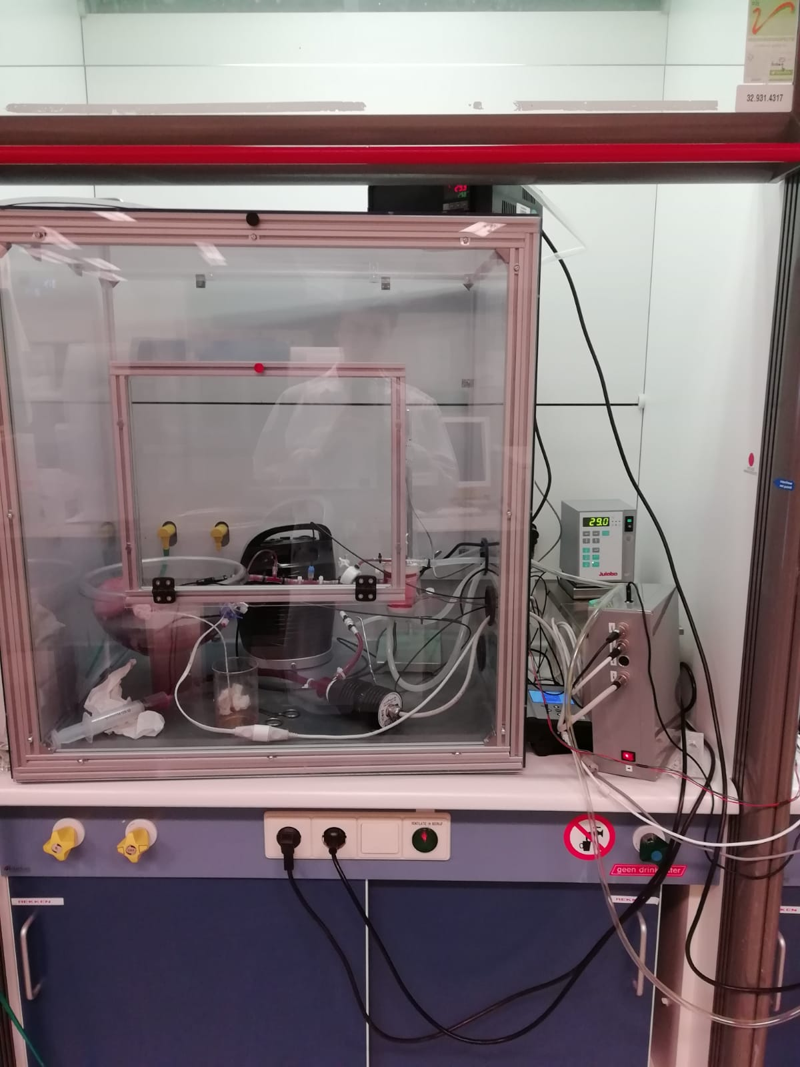

Slide 40
