Slide 1
What do we want?
Take better care of (ex vivo) kidneys
Saturated
Static
How
Monitor metabolism
Stear and adjust

Slide 2
Metabolism
Breaking down and building
Anabolism
Catabolism
Hormones
Cellular respiration
Notes:
Anabolism: Muscle, tissue, bones
Catabolism: ATP
Hormones: Steroids, Glucagon

Slide 3
Cellular respiration
C₆H₁₂O₆ + 6 O₂ → 6 CO₂ + 6 H₂O + 38 ATP

Slide 4
Cellular respiration
C₆H₁₂O₆ + 6 O₂ → 6 CO₂ + 6 H₂O + 38 ATP
Glucose Oxygen carbon dioxide water energy

Slide 5
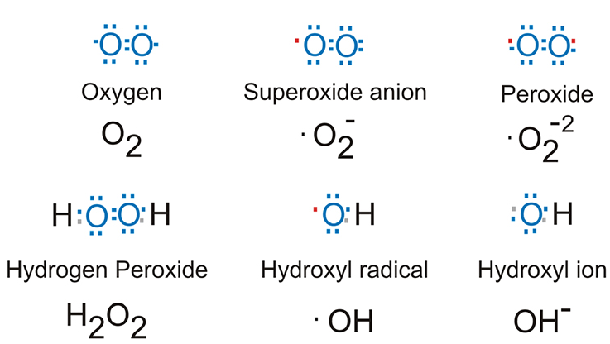
Reactive oxygen species
Oxygen radicals
Damage DNA/RNA
Damage membranes
More..
(ROS not always bad)
Source: biotek.com

Slide 6
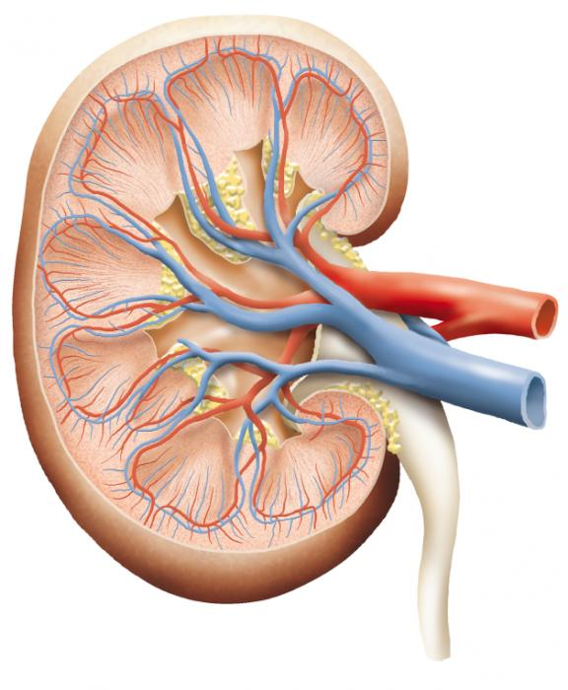
Consequence
O₂ in
O₂ out
Delta O₂
CO₂ produced
Rinse
Source: medicalnewstoday.com

Slide 7
Dissolved vs saturation
Pulse oximetry
Requires hemoglobin
Blood gas analysis
Sampling
Time
Partial pressure
oxygen dissociation curve
pH
Temperature
PCO₂
Hemoglobin

Slide 8
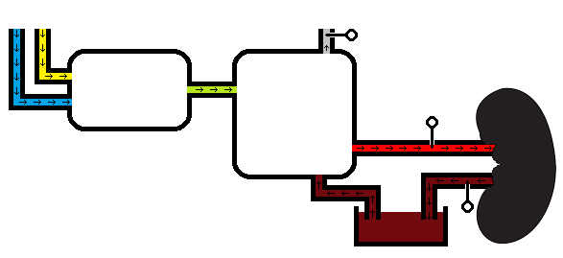
Type of sensor
Dissolved oxygen
Versus gaseous
Optical
Non-invasive
Non-consuming
Optical dissolved oxygen sensor
Gas control
Oxygenator
Image will reappear

Slide 9
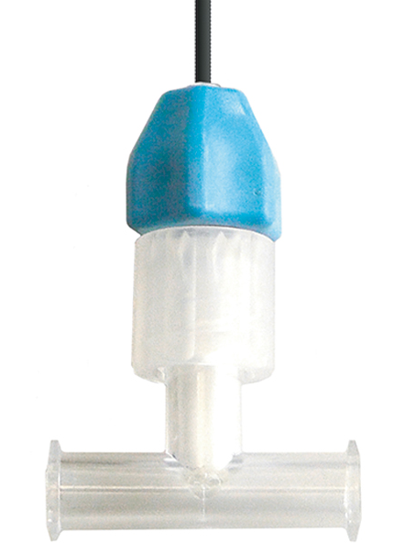
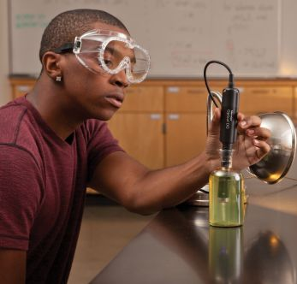
Flow-through
Non-invasive
No contact with air
Close to SophistiKate
(Can be in-line or on-line)
Optical flow-through dissolved oxygen sensor
Source: presens.de
Source: vernier.com

Slide 10
Sensor range
Arterial:
Physiological 79-100 mm Hg
Critical 25-40 mm Hg
Suitable range: 25-100 mm Hg
Venous:
Physiological 30-40 mm Hg

Slide 11
But..
Machine perfusion ≠ physiological
Oxygen consumption kidney
In rest 7% of the body’s oxygen is consumed by kidney
50*0.07 = 3.5 mm Hg
Suitable range venous: 0-100 mm Hg
CardiacOutput * (CaO₂ – CvO₂)?

Slide 12
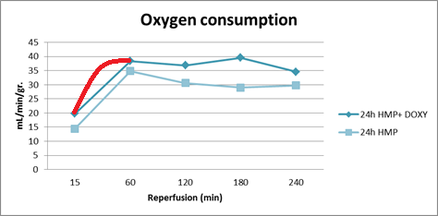
Response time
Quickest change in partial pressure?
Consumption
Reperfusion
Papers
≠ unsaturated
Data from available experiments
Sample rate challenge
Source: L. van Leeuwen

Slide 13
Accuracy
Highest tolerable error
Arbitrary element challenge

Slide 14
Machine perfusion diagram
O₂
N₂
CO₂ + O₂ + N₂
A
%
Gas control
Oxygenator
B
↑O₂
↑CO₂
C

