Slide 1
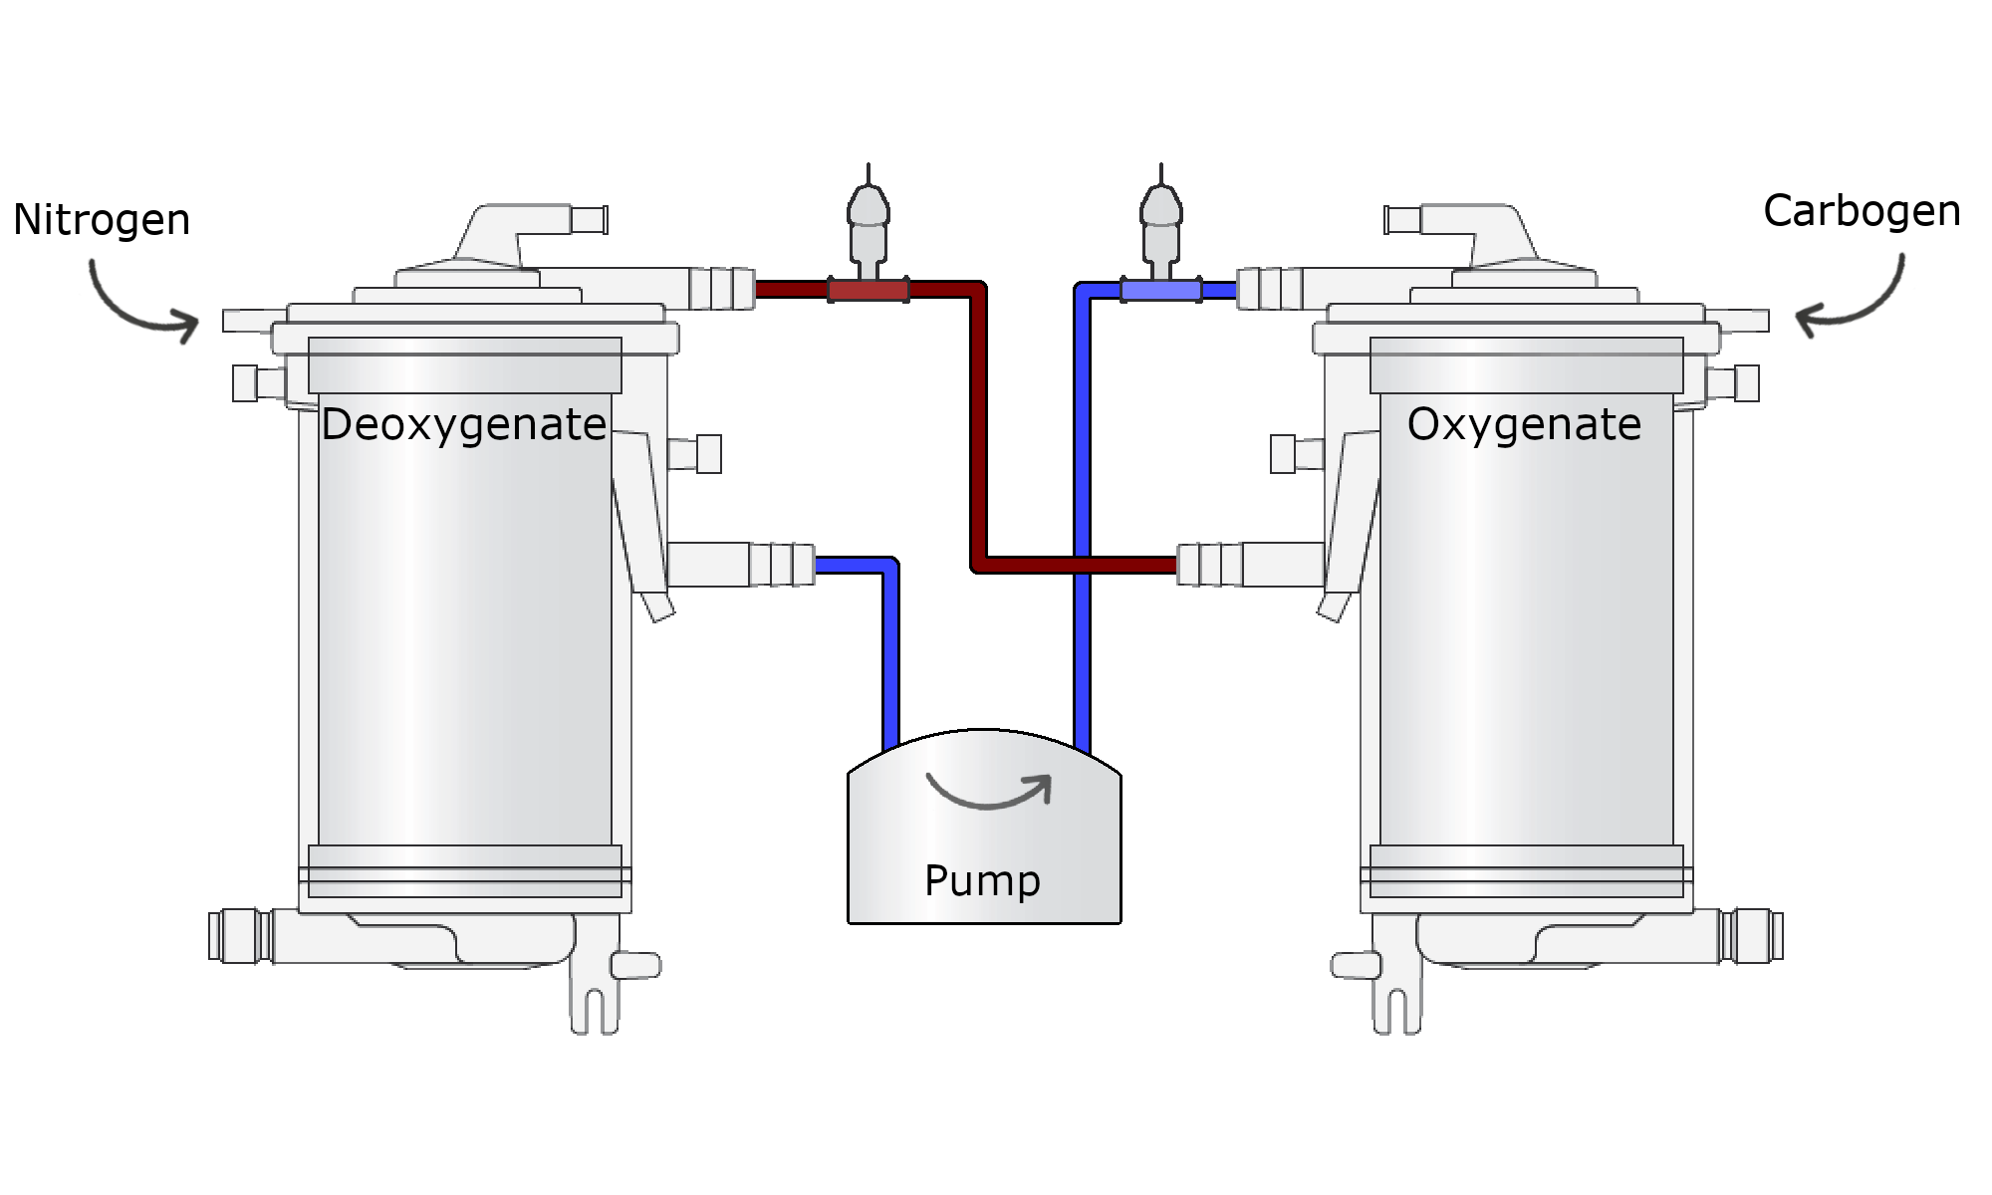
Ewout Bergsma
Electronics student
Oxygen control for SophistiKate

Slide 2
