Slide 1
CLOUD ARCHITECTURE PROPOSAL
Secure, Scalable Web Application on AWS
Fast to reach, resilient under load, safe to access, repeatable to deploy, and inside budget.
CloudFront
ALB
EC2 + Auto Scaling
Private S3
GitHub Actions
Presented by: Cloud Architect | Purpose: agree the design before implementation
Notes:
Open: I'm here to get agreement on the architecture and cost guardrails before we build. I'll show the problem, the design, how it's secured, how we deploy and monitor it, and the decisions I need from you.

Slide 2
The customer's problems and our design response
Every component exists because of a specific symptom
Customer problem | Design response | How we will prove it
Slow page loads | CloudFront edge caching + static files in S3 | Before/after page-load tests; cache-hit headers
Unavailable at peak traffic | ALB + Auto Scaling Group (min 1 / desired 2 / max 3) across 2 Availability Zones | Stop one instance: traffic continues on the other
Security concerns | HTTPS (ACM), CloudFront-only access, scoped security groups, private S3, IAM least privilege | curl tests; direct ALB and S3 access blocked
No deployment process | GitHub branching + PRs + GitHub Actions | Push to main updates the live site
Limited budget, future growth | Free Tier-sized instances, ASG caps, AWS Budgets alerts, modular design | Budget alert active; cleanup owner named
Notes:
Walk down the rows. Stress that nothing in the design is decorative: each service answers one symptom, and each has a test that shows the improvement. We will not promise a speed figure until we measure it.

Slide 3
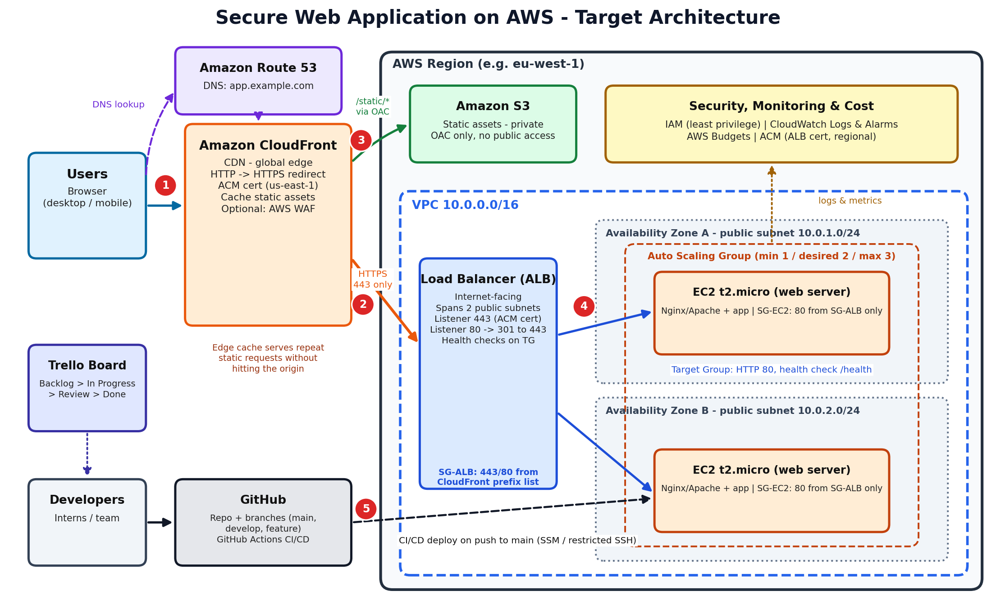
Target architecture
Edge
CloudFront is the only public entry: HTTPS, caching, HTTP→HTTPS.
Compute
ALB + ASG in two AZs; health checks replace failed servers.
Storage
Private S3 via OAC for /static/*.
Delivery
GitHub Actions → EC2 / S3.
Notes:
Read the diagram left to right using the red numbers: 1 user to CloudFront, 2 CloudFront to ALB over HTTPS, 3 static files from S3, 4 ALB to a healthy instance, 5 deployment path from GitHub. Note two AZs, no single point of failure on the request path.

Slide 4
How a request travels, and why each component is needed
1
Browser → CloudFront
HTTPS; HTTP is redirected. Cached content returns here.
Component | Role | If omitted
CloudFront | Edge cache, secure single entry, TLS | Slower, origin exposed
ALB | Balances, health checks, TLS, scaling hook | Single point of failure
EC2 + ASG | Runs nginx app; scales and self-heals | Nowhere to run the app
2
CloudFront → ALB
Uncached/dynamic requests, HTTPS only to the origin.
3
CloudFront → S3
/static/* from a private bucket via OAC (parallel branch).
4
ALB → EC2
Healthy instance in either AZ; port 80 inside the VPC.
Considered and rejected: single EC2 (no resilience), ALB only (no CDN, exposed), CloudFront→EC2 direct (no load balancing).
Result: faster delivery, balanced load, resilience if an instance or zone fails.
Notes:
Explain S3 is a branch from CloudFront, not step five after EC2. Emphasise that I considered simpler options and rejected them for specific reasons.

Slide 5
Security: HTTPS on every leg and layered access control
Leg | Protection
Browser → CloudFront | HTTPS, TLS 1.2+, ACM cert (us-east-1), HTTP redirected
CloudFront → ALB | HTTPS only; origin name matches regional ACM cert
CloudFront → S3 | OAC-signed; bucket policy trusts one distribution
ALB → EC2 | HTTP inside VPC; EC2 accepts only the ALB (accepted risk)
Security group | Port | Allowed source
sg-alb | 443 / 80 | CloudFront managed prefix list only
sg-ec2 | 80 | sg-alb only
sg-ec2 | 22 | Admin IP only, or none (use SSM)
Defense in depth
Identity and data
Prefix list admits any CloudFront distribution, so add a secret origin header checked by the ALB. WAF is a documented future step.
MFA on root, IAM least privilege, EC2 instance role (no keys on servers), S3 Block Public Access, encryption at rest.
Verify: curl redirect test, direct ALB and S3 access blocked, SG rules reviewed, padlock and certificate checked.
Notes:
Two certificates: us-east-1 for CloudFront and a regional one for the ALB. Be upfront about the HTTP hop between ALB and EC2 and that it is a conscious trade-off.

Slide 6
Deploy, monitor and control cost
Deploy (GitHub Actions)
Monitor (CloudWatch + SNS)
Cost (AWS Budgets)
• PRs into protected main
• Push to main triggers workflow
• Deploy via SSM Run Command + OIDC: no open SSH, no stored keys
• Sync /static to S3; verify health endpoint
• Rollback: git revert, push
• Alarm: EC2 CPU > 80%
• Alarm: ALB 5xx rate > 5%
• nginx logs to CloudWatch, 7-day retention
• Alarms email the team through SNS (subscription confirmed)
• Monthly budget: alerts at 80% actual, 100% forecast
• Watch ALB, public IPv4, Route 53, domain
• ASG capped at 3 instances
• Teardown owner and order agreed
Evidence plan Page-load before/after | stop one instance, traffic continues | HTTPS and blocked-bypass tests | live deployment from a push | alarm email received | budget screenshot
Notes:
Be clear that SSM with OIDC is my recommendation; if the mentor requires SSH we restrict and document the risk. Name the costs that are not free so nobody is surprised.

Slide 7
Decisions I need from you today
Decision | My recommendation
Region and domain | One region for everything; ACM for CloudFront in us-east-1. A custom domain is needed for ACM certificates.
Network model | Public subnets in 2 AZs, locked down by security groups (no NAT cost). Private subnets as a later upgrade.
Deployment method | SSM Run Command via GitHub OIDC; restricted SSH only if the mentor requires it.
Auto Scaling | Adopt: min 1 / desired 2 / max 3, CPU target 50%.
Cost guardrail | Agree a monthly budget; confirm ALB is covered by our Free Tier model.
Main risks
• Surprise charges: budget alerts, cleanup owner
• Certificate region/validation: request early
• CloudFront 502/504: matching origin cert, test before lock-down
Next steps
1. Approve design and owners
2. Phase 1 setup and certificates
3. Build and validate phase by phase
4. Demo with evidence
Ask: approve the architecture and cost guardrails so implementation can start.
Notes:
Close by asking for explicit approval of each row. Record the decisions and owners on Trello and in the repo docs.

