Slide 1
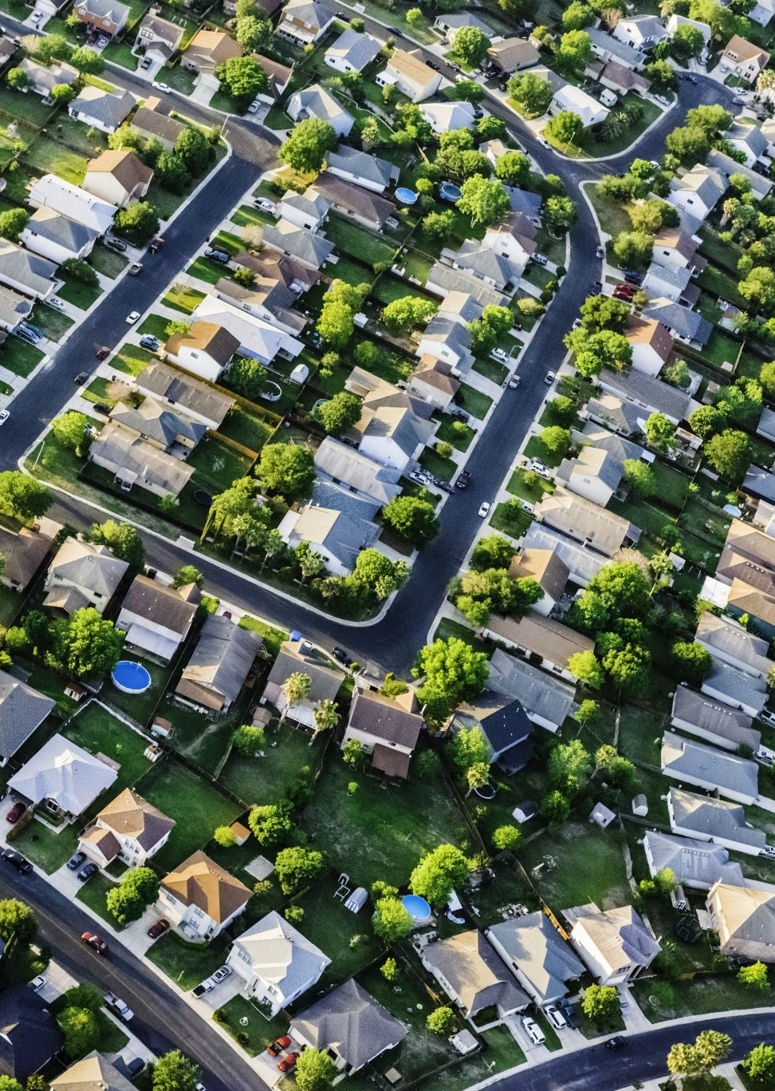
Housing Prices In The Northeast
Edward Wynman

Slide 2
Today’s Agenda
Overview of the project
01
Overview of the Dataset
02
Overview of the Analysis
03
Data Visualizations
04

Slide 3
Project Overview
View the dataset and perform data cleaning, data analysis, and data visualization
How do house prices vary by the number of bedrooms?
How do house prices vary by the number of bathrooms?
How do house prices vary by the presence of a basement?
How do house prices vary by the presence of air conditioning?
How do house prices vary by the presence of being on a mainroad?

Slide 4

The Dataset
The dataset contains various features related to housing such as price, area, number of bedrooms, number of bathrooms, stories, and more. It provides a comprehensive overview of different aspects of housing data, allowing for analysis and exploration of housing prices and the factors influencing them.

Slide 5
Dataset Headers
Price
area
Bedrooms
Bathrooms
Stories
Mainroad
Guestroom
Basement
Hotwaterheating
Airconditioning
Parking
prefarea
furnishingstatus

Slide 6
Data Analysis
Mean Price with Basement: 5242615.18
Mean Price without Basement: 4509965.93
Mean Price with Air Conditioning: 6013220.58
Mean Price without Air Conditioning: 4191939.68
Mean Price with Guest Room: 5792896.91
Mean Price without Guest Room: 4544545.62

Slide 7
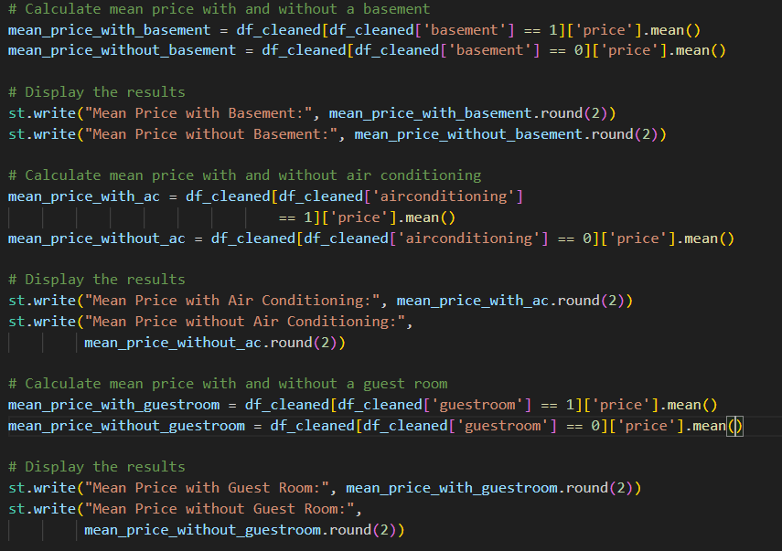
Data Analytics Method

Slide 8
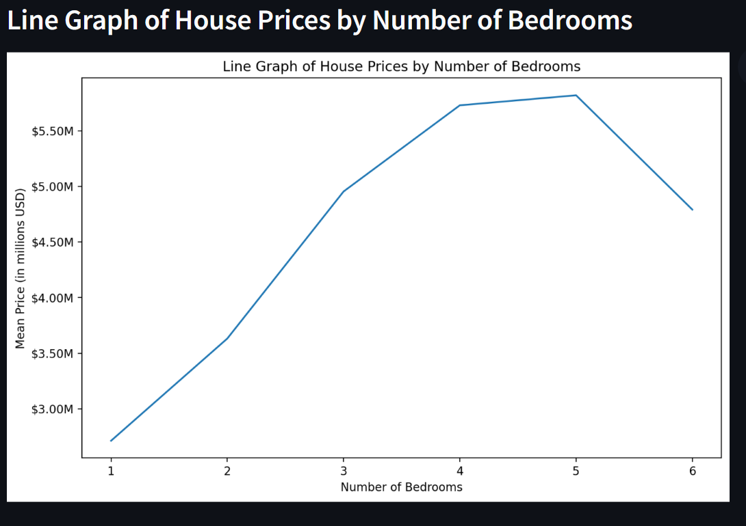
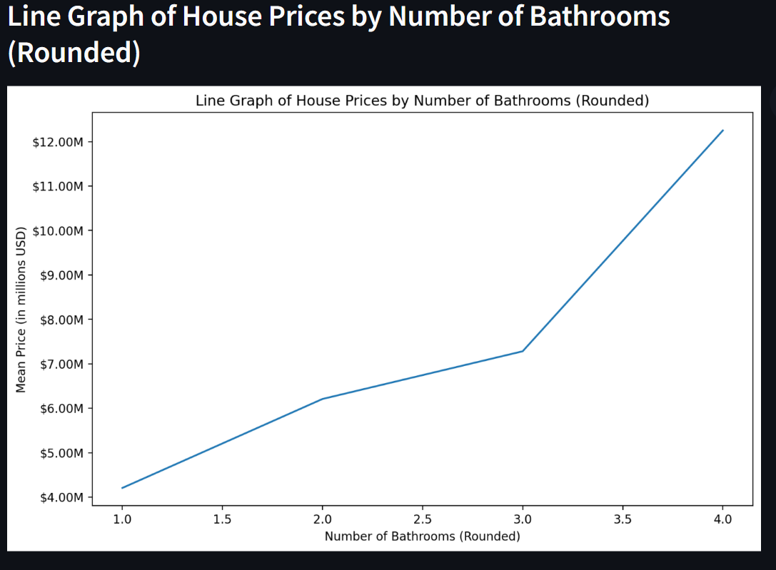
Data Visulizations

Slide 9
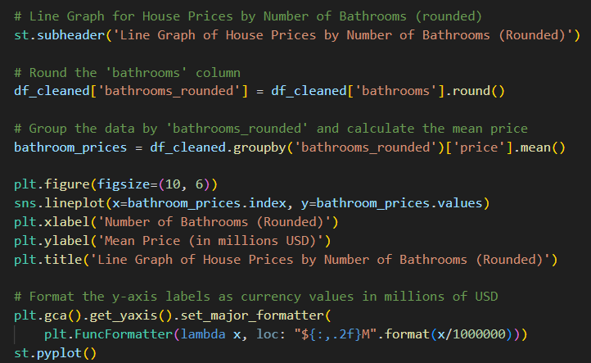
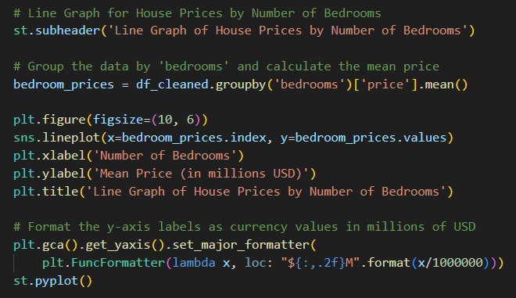
Data Visualizations Methods

Slide 10
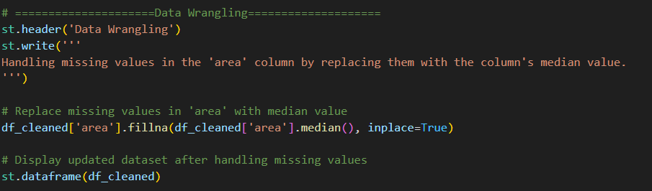
Data Wrangling Methods Handle missing values and replace them with the columns median value

Slide 11
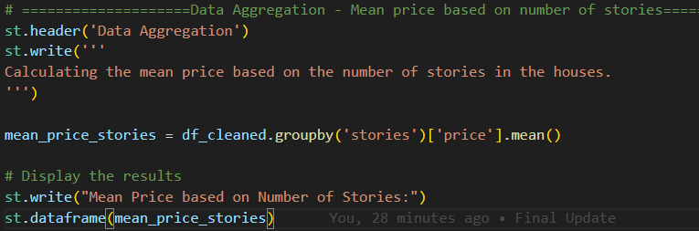
Data Aggregation Methods Mean price based on number of stories

Slide 12


