Slide 1
SXM Export Overview
Folder: C:\Users\chem-ptch0510\OneDrive - Nexus365\Documents\Scripts\Mine\OmicronInfinitySXM\sxm_files_2_xyz\data
5 exported channels

Slide 2
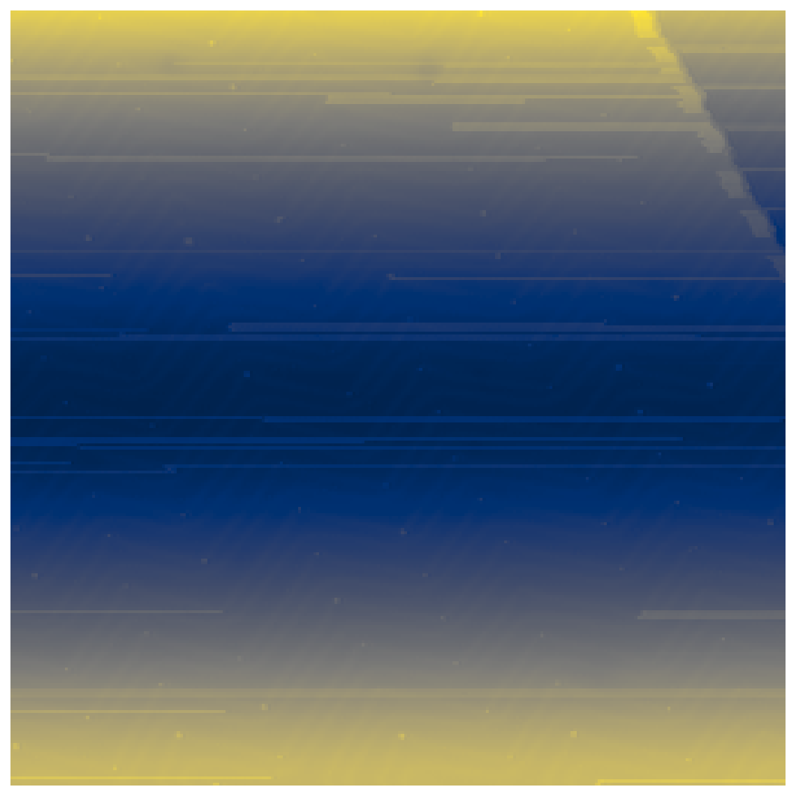
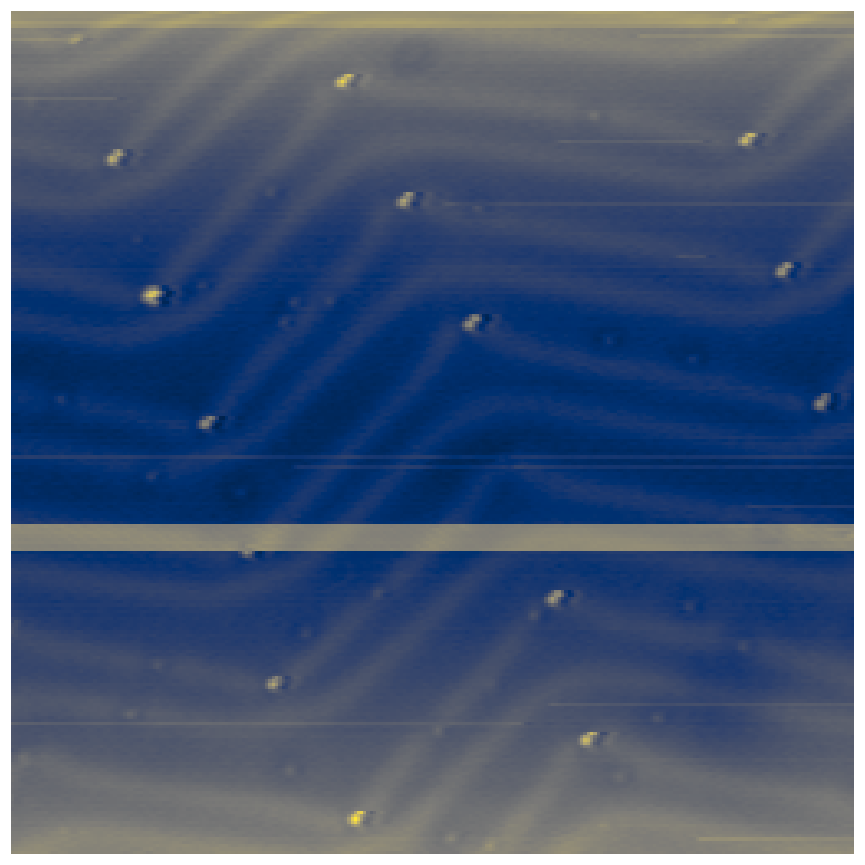
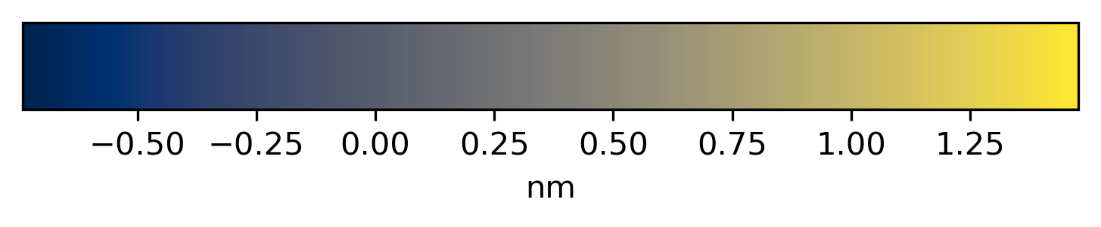
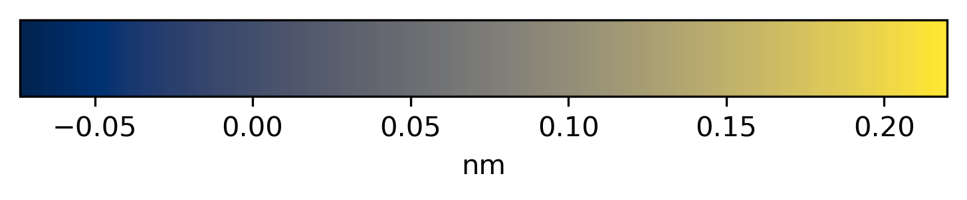
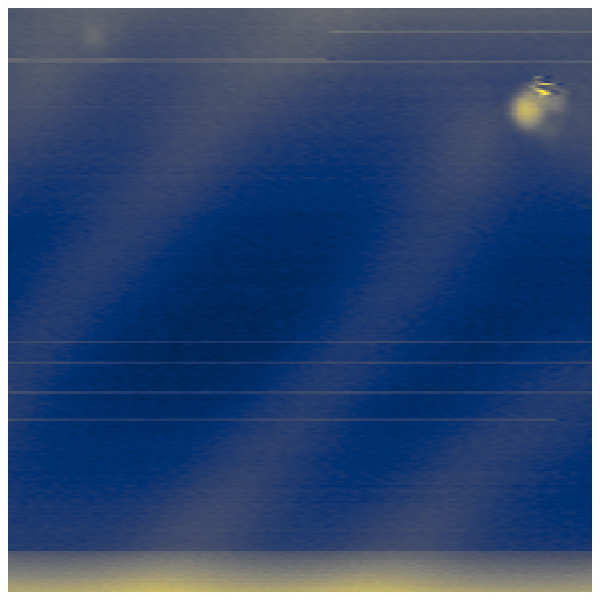
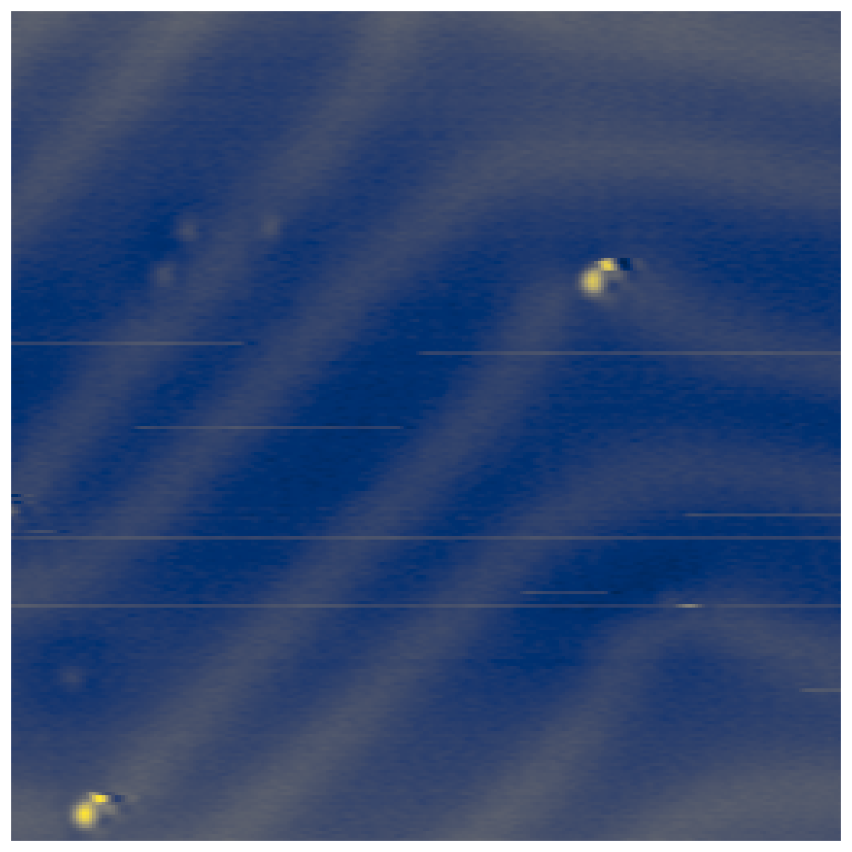
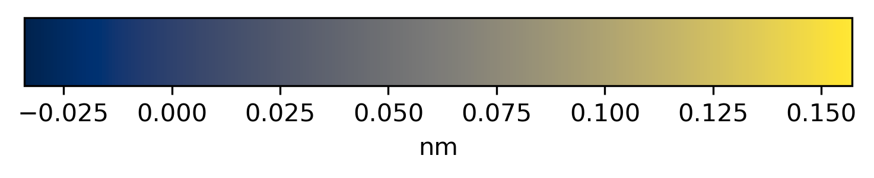
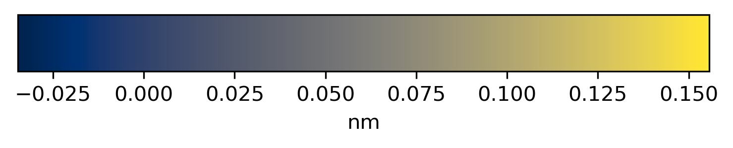
25 nm
10 nm
□ 20240919_Exp01_Au111_PtIr-1_CO_S... (9/20/2024 12:13:09)
TopoFwd | 256×256 px | 100.0×100.0 nm | -300.000 mV | 2.0E-0011 A
□ 20240919_Exp01_Au111_PtIr-1_CO_S... (9/20/2024 12:14:34)
TopoFwd | 256×256 px | 35.0×35.0 nm | -300.000 mV | 2.0E-0011 A
2 nm
5 nm
□ 20240919_Exp01_Au111_PtIr-1_CO_S... (9/20/2024 12:15:34)
TopoFwd | 256×256 px | 8.0×8.0 nm | -300.000 mV | 2.0E-0011 A
□ 20240919_Exp01_Au111_PtIr-1_CO_S... (9/20/2024 12:16:23)
TopoFwd | 256×256 px | 15.0×15.0 nm | -300.000 mV | 2.0E-0011 A

Slide 3

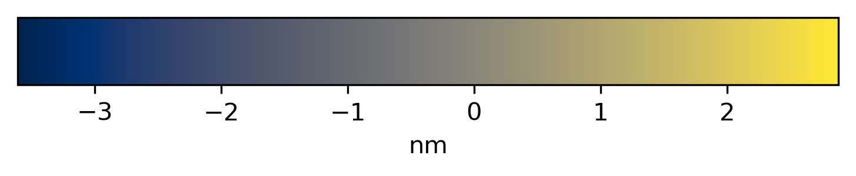
2 nm
□ 20240919_Exp01_Au111_PtIr-1_CO_S... (9/20/2024 12:17:34)
TopoFwd | 256×256 px | 7.611×7.611 nm | -300.000 mV | 2.0E-0011 A

