Slide 1

Study of Uncertainty Quantification Techniques for the NEPTUNE Project
Peter V. Coveney & Maxime Vassaux
Centre for Computational Science,
University College London,
UK
&
Institute for Informatics
University of Amsterdam,
Netherlands

Slide 2
Proposed activities
Activity 1: Knowledge report on high-throughput VVUQ capabilities for the NEPTUNE software
Objective 1: write a concise set of recommendations as to which UQ methodologies to develop (March)
Objective 2: explicitly describe the architecture of UQ workflows for co-design purposes toward exascale (June)
Activity 2: Workshops on UQ for ExCALIBUR partners
Objective 3: hold a first meeting to introduce EasyVVUQ capabilities, provide hands-on tutorials and partners to present the structure of their codes and UQ requirements (mid-January)
Objective 4: hold a second meeting to present our shortlist of recommended UQ methods (early July)

Slide 3
January UQ workshop and hackathon
UQ NEPTUNE workshop on January 18
Presentation of UQ and MOR capabilities
Presentation of application partners use cases
VECMA Hackathon from January 19 to 21
assist adoption of EasyVVUQ and VECMAtk for multi-model coupling and HPC execution
provide hands-on tutorials and partners to present the structure of their codes and UQ requirements
detailed description and registration: https://www.vecma.eu/vecma-toolkit-hackathon-19-22-january-2021/

Slide 4
High-throughput UQ reporting
Concise set of recommendations as to which UQ methodologies to develop
Establish standard use cases of Bout++ and Nektar++ simulations jointly with NEPTUNE partners
Perform UQ on the defined use cases using EasyVVUQ (VECMA) and MOGP (ATI) capabilities
Draw on VECMA expertise
open source and open development software
D2.2: Report on advanced multiscale UQ algorithms, including intrusive approaches, and mapping thereof in UQPs and first results on V&V.
D2.1: Report on multiscale UQ algorithms based on non-intrusive MC and semi-intrusive MC and mapping thereof in UQPs
Involvement of David Coster and Jalal Lakhlili (Fusion, MPG-IPP), Wouter Edeling (UQ, CWI) and Eric Daub (MOR, ATI)
in particular during NEPTUNE UQ workshop (18/01) and VECMA hackathon (19-21/01)

Slide 5
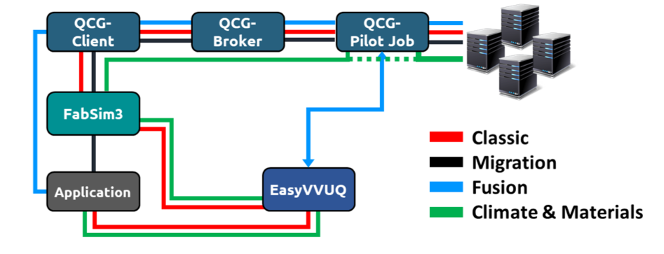
VECMAtk: a generic toolkit for (VV)UQ
An actionable VVUQ toolkit for potential exascale multiscale, multi-model applications (VECMA)
identified UQ patterns
fully automated generation, management, and execution of UQ campaigns
EasyVVUQ: library for creating application-specific UQ procedures, called Campaigns.
FabSIM, MUSCLE3 and QCG-Client/PJM: to ease data transfer and job submission onto multiple Tier-0/1 EU supercomputers

Slide 6
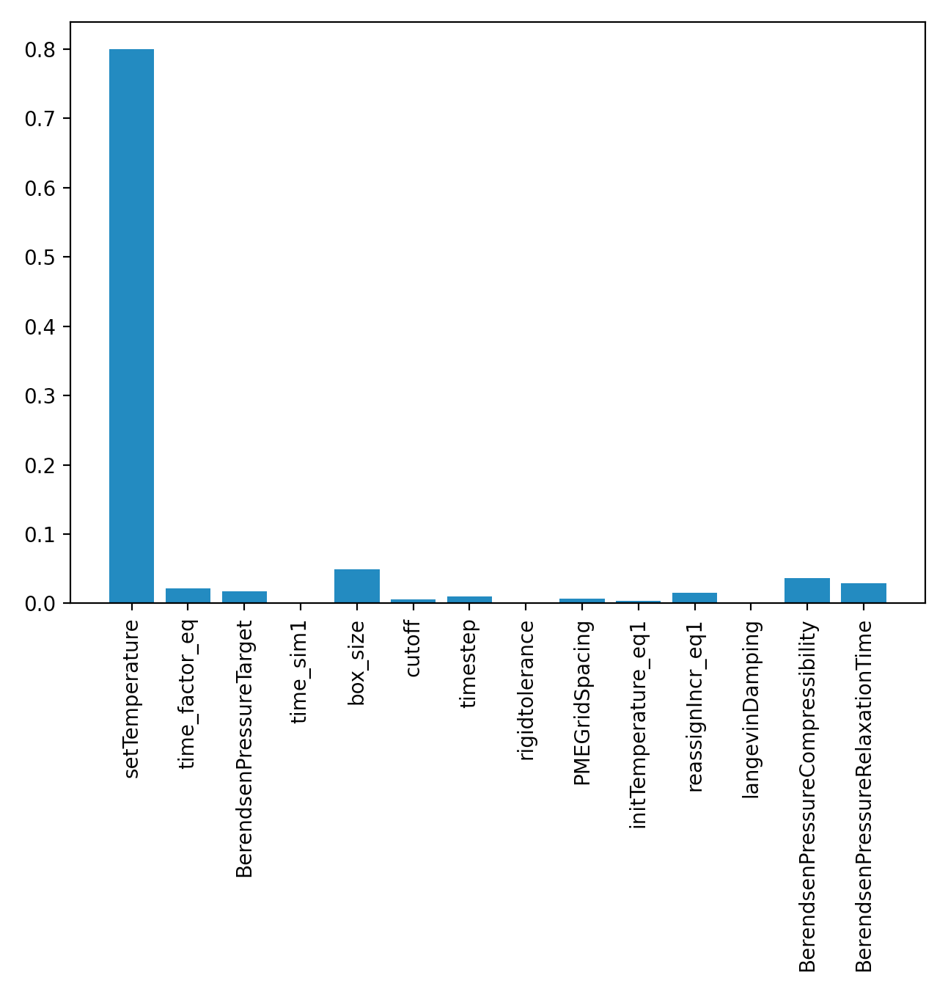
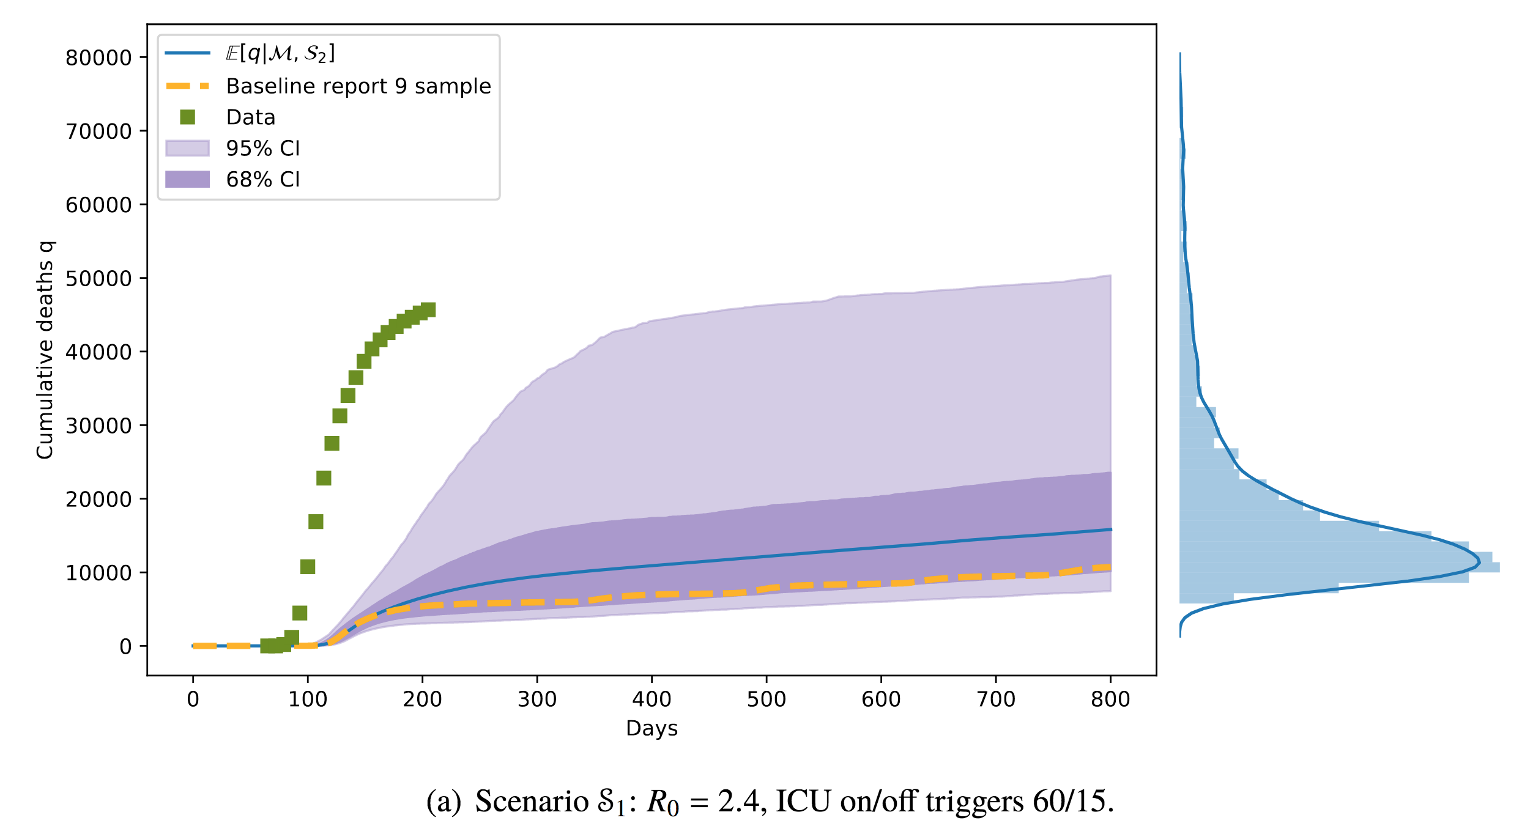
VECMAtk: a generic toolkit for (VV)UQ
examples of application
large-scale SA and UQ campaign driven EasyVVUQ adaptive sampling capabilities
BAC using NAMD
CovidSim [1]
[1] Edeling, W., Coveney, P.V., et al. "Model uncertainty and decision making: Predicting the Impact of COVID-19 Using the CovidSim Epidemiological Code." (2020): https://www.researchsquare.com/article/rs-82122/v3

Slide 7

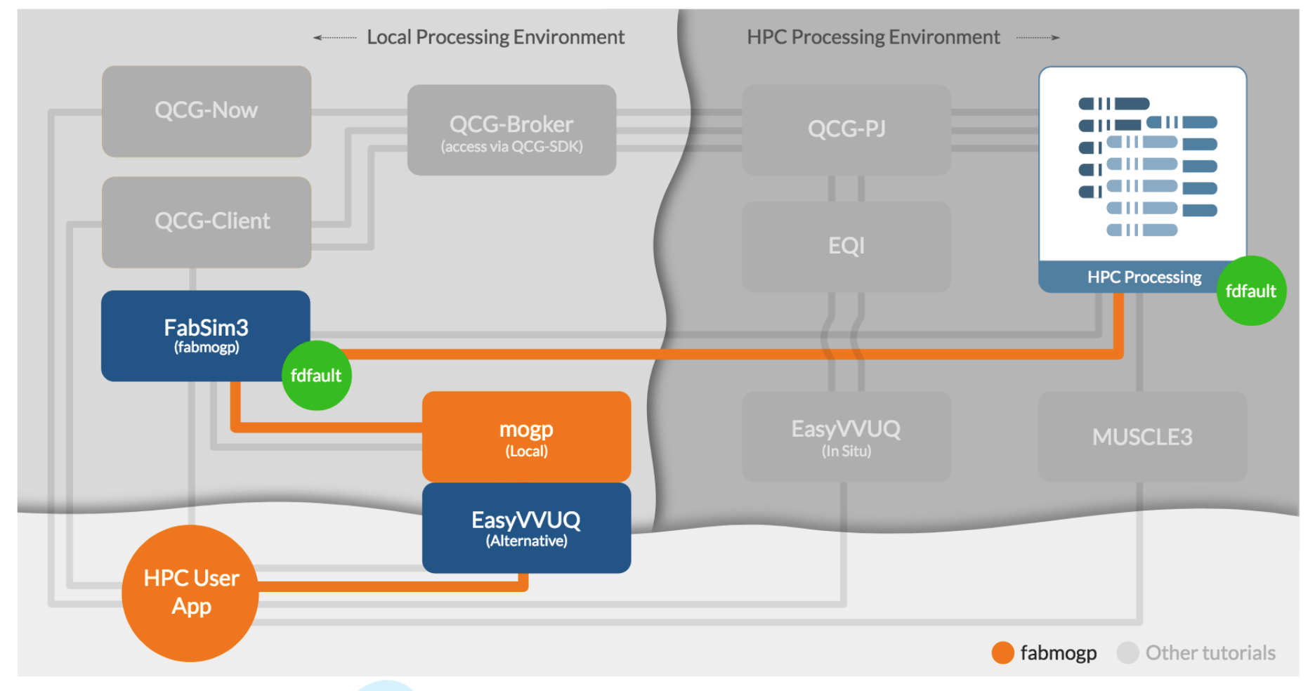
VECMAtk: a generic toolkit for (VV)UQ
Coupling FabSim with MOGP in collaboration with Eric Daub from ATI
Uncertainty Quantification of Dynamic Earthquake Rupture Simulations
Tutorial: https://github.com/alan-turing-institute/fabmogp_paper

