Slide 1

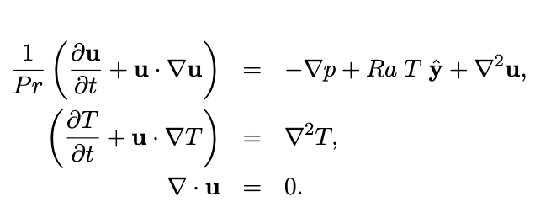
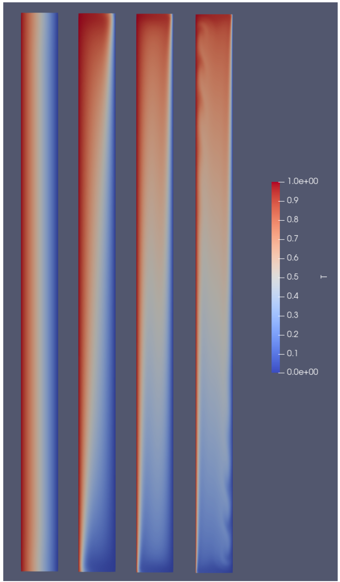
EasyVVUQ+FabNEPTUNE
Variance-based sensitivity analysis
Convection 2D
Sobol method
[Convection is triggered by maintaining a constant temperature difference across the space between the two largest faces]
selected model outputs
Aero Forces (left hot, Boundary regions)
Output values of aerodynamic forces during time-stepping
['F1-press_L', 'F1-visc_L', 'F1-total_L', 'F2-press_L', 'F2-visc_L', 'F2-total_L’]
Aero Forces (right cold, Boundary regions)
System of equations describing vertical natural convection is, for fluid velocity u, temperature T and pressure p
['F1-pres_R', 'F1-visc_R', 'F1-total_R', 'F2-press_R', 'F2-visc_R', 'F2total_R']

Slide 2


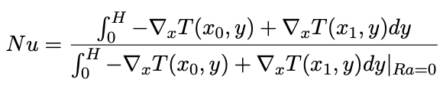
Convection 2D
Sobol method
Selected model inputs
<?xml version="1.0" encoding="utf-8" ?>
<NEKTAR>
<EXPANSIONS>
…
</GLOBALSYSSOLNINFO>
<PARAMETERS>
<P> TimeStep = 0.01 </P>
<P> T_Final = 1.0 </P>
<P> NumSteps = T_Final/TimeStep </P>
<P> IO_infoSteps = 10 </P>
<P> Ra = ${Rayleigh}E2 </P>
<P> Pr = ${Prandtl} </P>
<P> Kinvis = Pr </P>
</PARAMETERS>
…
<FUNCTION NAME="DiffusionCoefficient">
<E VAR="T" VALUE="${DiffusionCoefficient}" />
…
</NEKTAR>
Rayleigh number:
(proportional to the applied temperature difference)
Prandtl number:
(fixed by the choice
of fluid in the tank)
Nusselt number:
amount of heat transfer, mean of the integrals of the heat flux on the heated / cooled boundaries

Slide 3
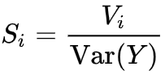
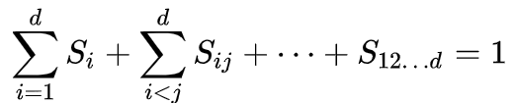
First-order indices
Sobol method
(varying X_{i} ) averaged over variations in other input parameters
F1-visc_L
Selected model outputs
Selected model inputs
Rayleigh
F1-visc_R
Prandtl
DiffusionCoefficient
variance of Y_{i}
PCESampler, polynomial_order: 3

Slide 4
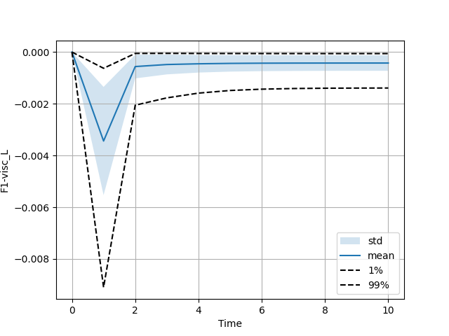
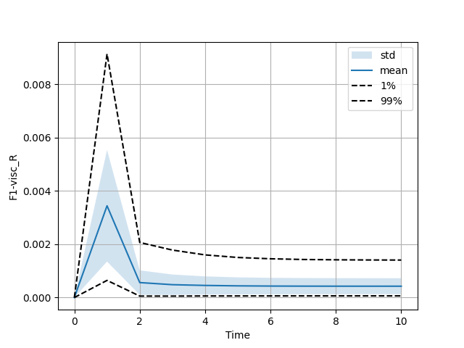
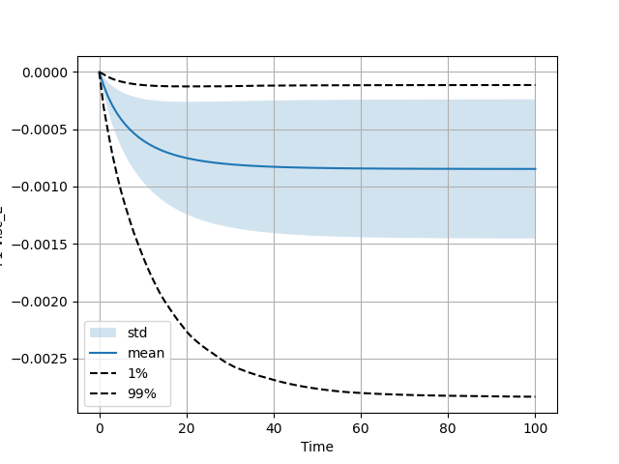
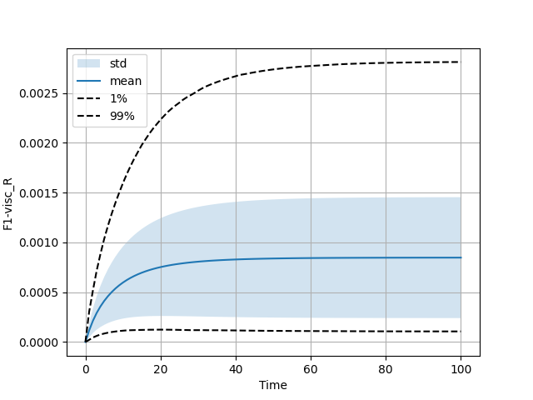
Moments
F1-visc_L
F1-visc_R
TimeStep= 0.01
T_Final = 1.0
NumSteps= T_Final/TimeStep
F1-visc_L
F1-visc_R
TimeStep= 0.001
T_Final = 1.0
NumSteps= T_Final/TimeStep

Slide 5
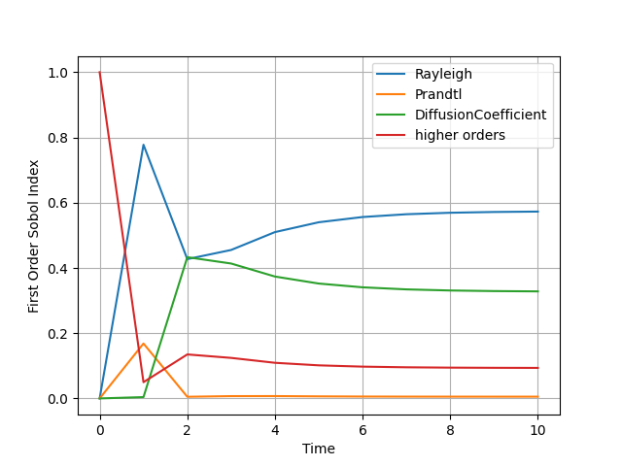

First-order indices
Sobol method
F1-visc_L
F1-visc_R
PCESampler, polynomial order: 3

Slide 6
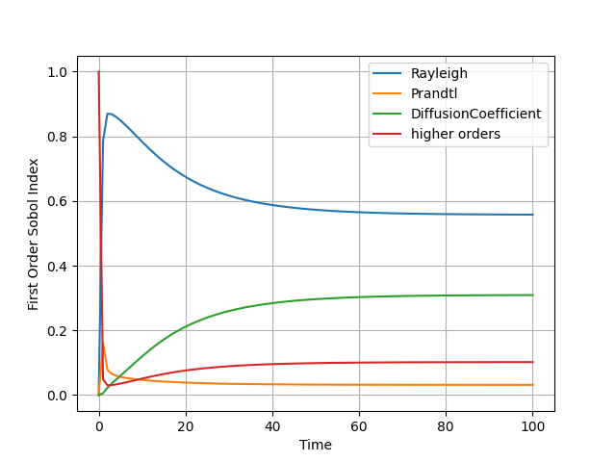

First-order indices
Sobol method
F1-visc_L
F1-visc_R
PCESampler, polynomial order: 3

Slide 7
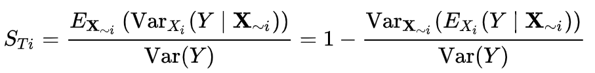
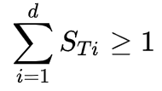
Total indices
Sobol method
(varying X_{i} ) including all variance caused by its interactions, of any order, with any other input variables
F1-visc_L
Selected model inputs
Rayleigh
Selected model outputs
F1-visc_R
Prandtl
DiffusionCoefficient
variance of Y_{i}
PCESampler, polynomial_order: 3

Slide 8
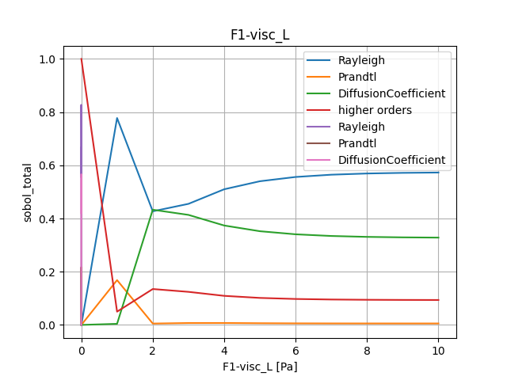

Total indices
Sobol method
PCESampler, polynomial order: 3

Slide 9
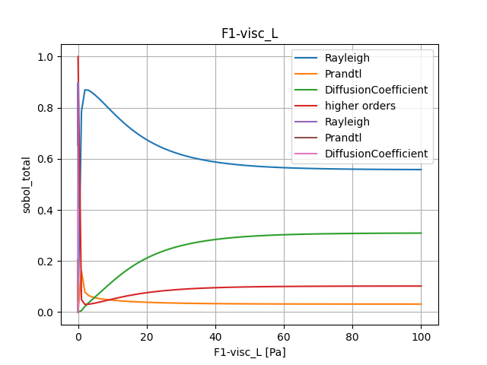

Total indices
Sobol method
PCESampler, polynomial order: 3

Slide 10
What can FabNeptune do?
Simple Neptune simulation:
- fabsim machine Neptune:Neptune_test*
Ensemble Neptune simulation (input script with different topology):
- fabsim machine Neptune_ensemble:Neptune_ensemble_example*
EasyVVUQ + FabNeptune simulation:
- Using Dask, Dynamic task scheduling optimized for parallel computing
(https://docs.dask.org/en/stable/)
- fabsim machine Neptune_init_run_analyse_campaign:fabNeptune_easyvvuq_InRuAn*_dask
- Using QCG-PilotJob, Dynamic execution of many tasks inside a single allocation
(https://qcg-pilotjob.readthedocs.io/en/latest/)
- fabsim machine Neptune_init_run_analyse_campaign:fabNeptune_easyvvuq_InRuAn*_QCGPJ
- Using ThreadPoolExecutor, Dynamic execution of each submitted task using one of possibly several pooled threads
(https://docs.python.org/3/library/concurrent.futures.html)
- fabsim machine Neptune_init_run_analyse_campaign:fabNeptune_easyvvuq_InRuAn*_ThreadPoolExecutor
EasyVVUQ + easysurrogate + FabNeptune simulation ← current activity
Machine (Localhost or remote)

