Slide 1
LaserTag Tournament
Table View
Artificial Intelligence & Software Agents
Summer term 2020
Prof. Dr. Clemen

Slide 2
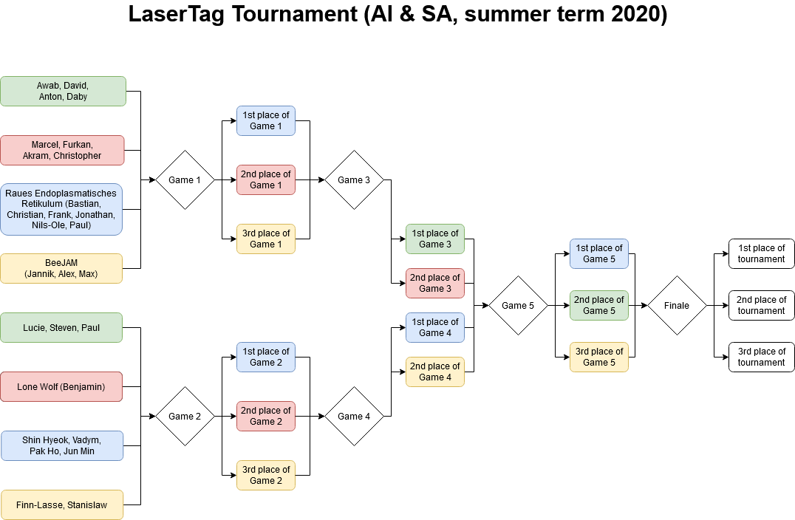

Slide 3


Slide 4


Slide 5
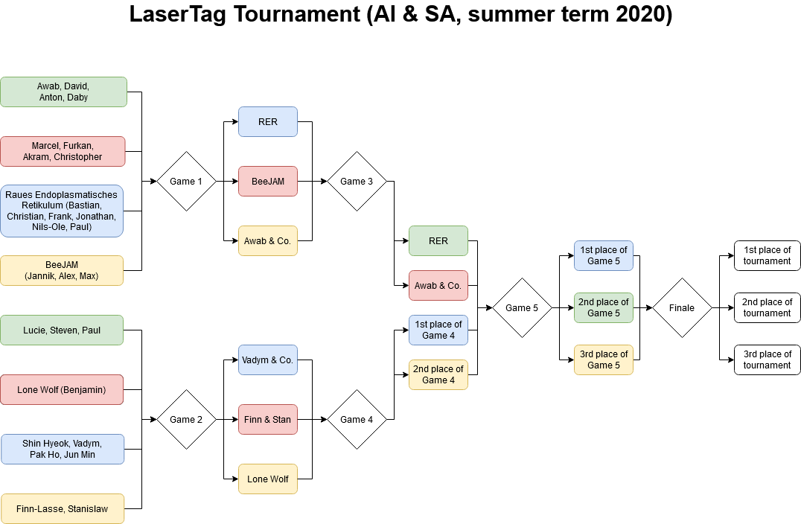

Slide 6
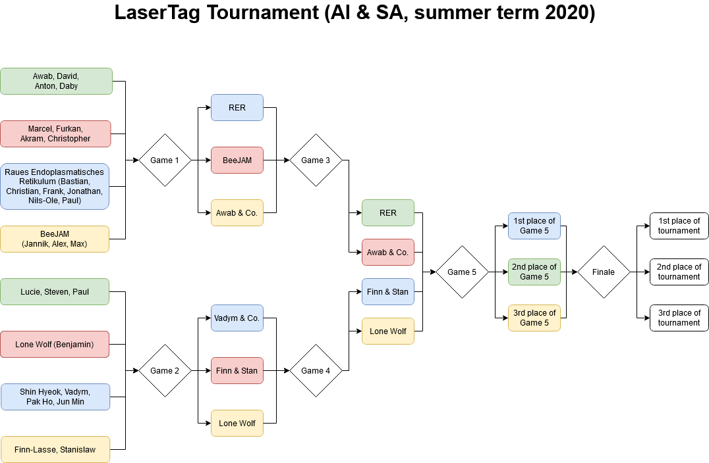

Slide 7
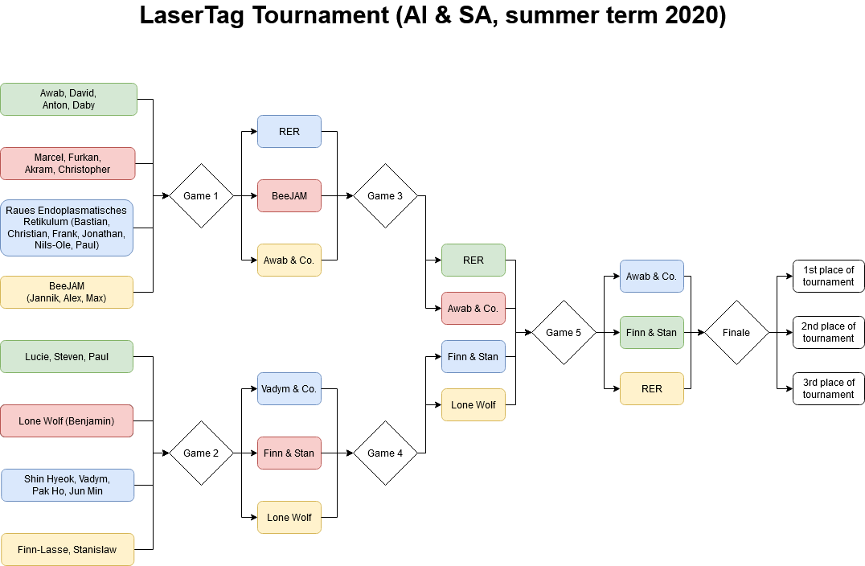

Slide 8


Slide 9
Congratulations to the winners!
Thank you all for your participation!

