Slide 1

https://github.com

Slide 2
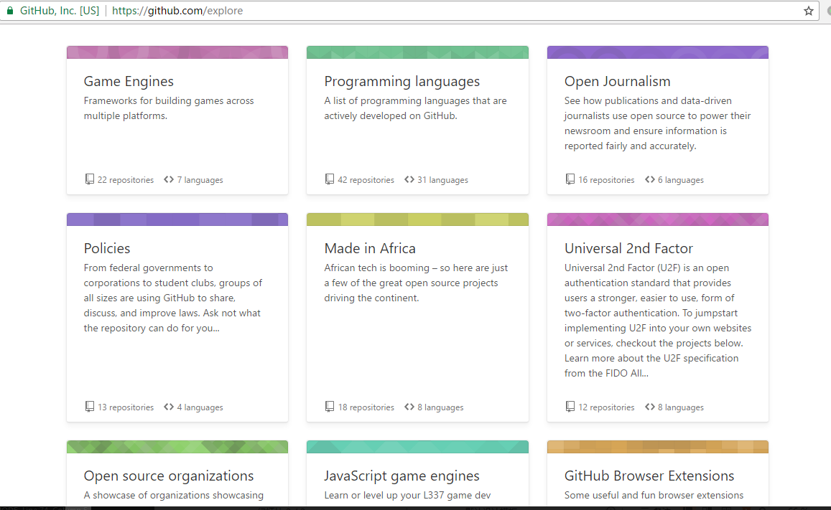
https://github.com/explore

Slide 3
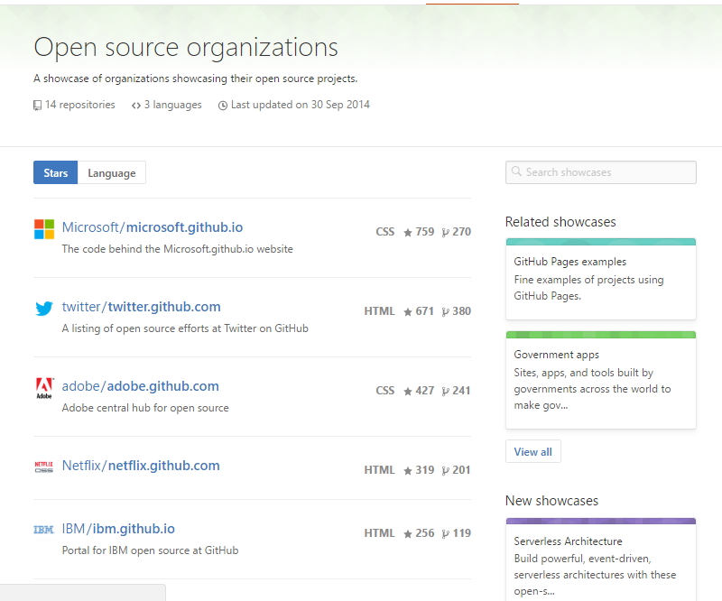
https://github.com/showcases/open-source-organizations

Slide 4
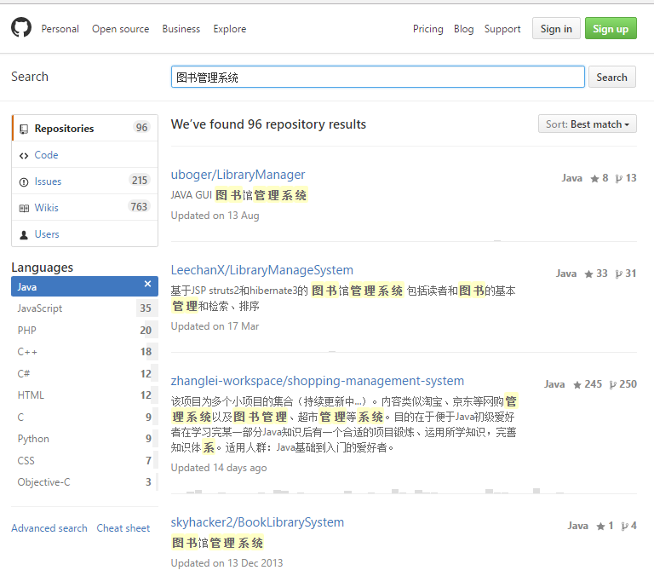

Slide 5
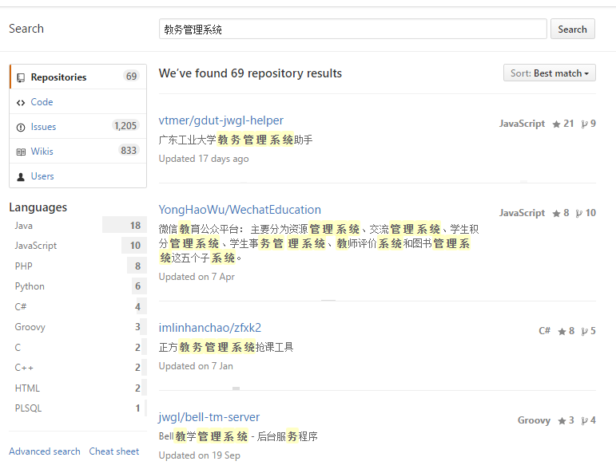

Slide 6
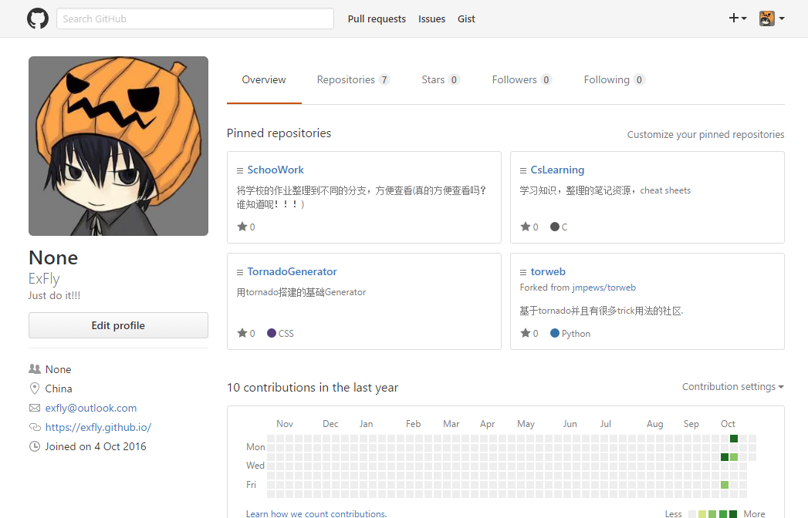
https://github.com/ExFly

