Slide 1
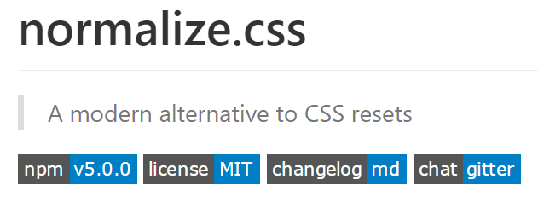

https://segmentfault.com/a/1190000003021766

Slide 2
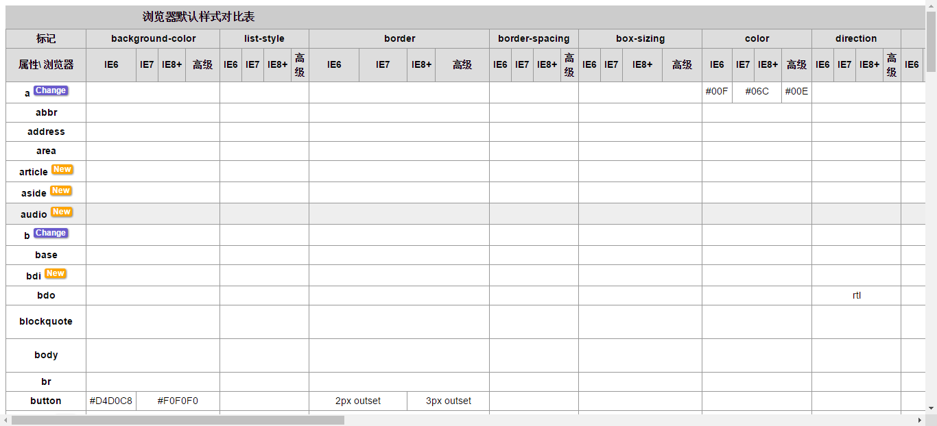
http://developer.doyoe.com/default-style/

Slide 3
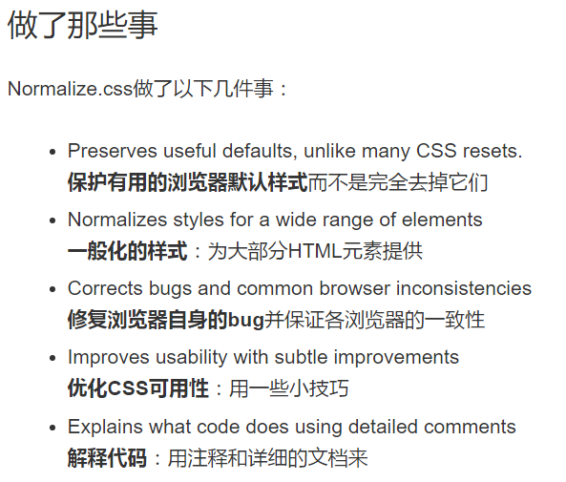
https://github.com/necolas/normalize.css/

Slide 4
