Slide 1
What is Spring?

Slide 2
Spring
A Container
  Creates objects, handles their life cycle, and makes them available to your application
A Framework
  Provides an infrastructure of classes that guides the developer to accomplish tasks

Slide 3
Spring (main) modules
Core - Inversion of Control (IoC) and Dependency Injection
AOP - Aspect-oriented programming
DAO - Data Access Object support, transaction management, JDBC-abstraction
ORM - Object Relational Mapping data access, integration layers for JPA, JDO, Hibernate, and iBatis
MVC - Model-View-Controller implementation for web-applications
Other - Remote Access, Authentication and Authorization, Remote Management, Messaging Framework, Web Services, Email, Testing, …

Slide 4
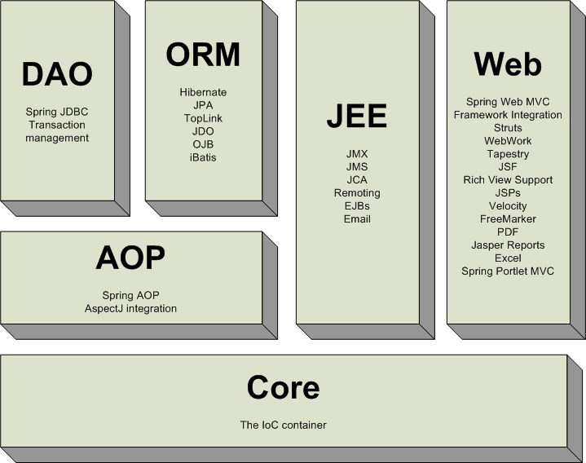
Spring

Slide 5
Spring
Lightweight container and framework
  Most of your code will be unaware of the Spring framework
  Use only the parts you of Spring you want
Manages dependencies between your objects
  Encourages use of interfaces
  Lessens “coupling” between objects

Slide 6
Spring configuration
Specify beans and dependencies
External (xml) or
Internal (classes) or
Mixed

Slide 7
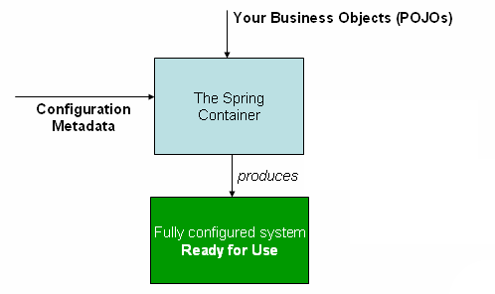
Spring

Slide 8
Spring configuration
Demo eoc-di

Slide 9
Spring
Separation of responsibilities
  Put logic that applies to many objects in one single place
  isolate the class’s core responsibility

Slide 10
Spring Separation of Responsibilities
Aspect-Oriented Programming (AOP)
Put a concern (logic) that applies to many different objects in one single place
  Logging, security, performance testing, transaction management

Slide 11
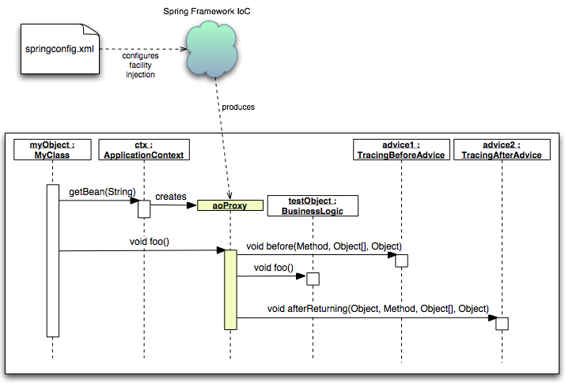
Spring AOP

Slide 12
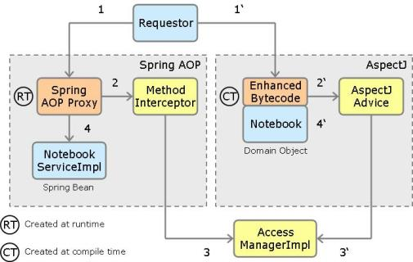
Spring AOP

Slide 13
Spring
Simplifies database integration
  Spring JDBC
  Hibernate
  Java Persistence API
  Spring Data

Slide 14
Spring
Demo eoc-jpa

Slide 15
Questions?

