Slide 1
Spring MVC

Slide 2
MVC
Model
View
Controller
In an MVC architecture the controllers handle all requests.

Slide 3
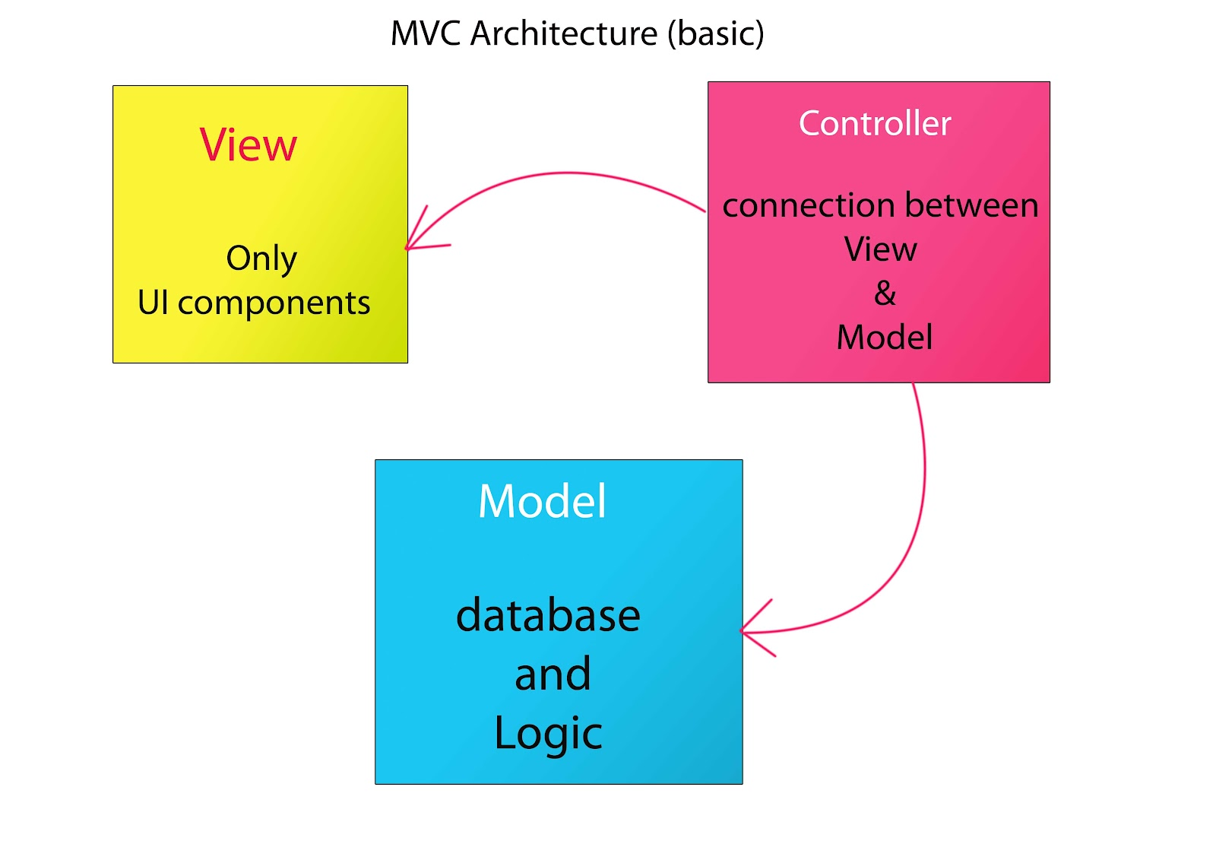
MVC

Slide 4
Spring
Uses a Front controller (or 'DispatcherServlet')
defined in the web.xml file
analyze a request URL pattern and then pass control to the correct Controller (as defined in the configuration)

Slide 5
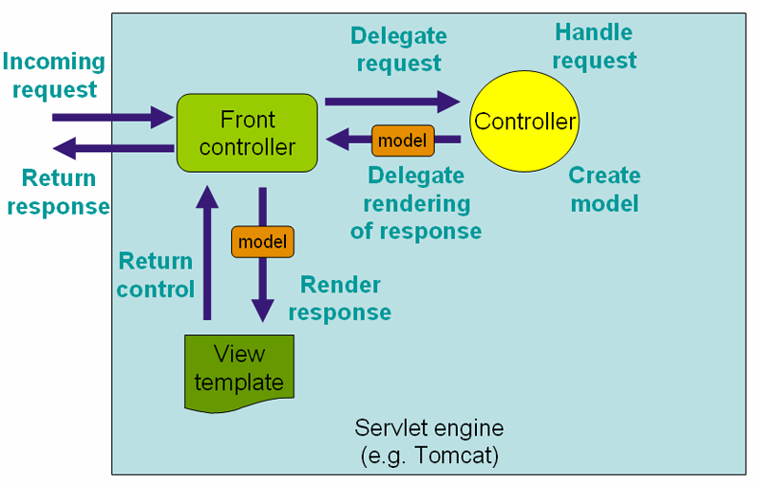
Front controller

Slide 6
DispatcherServlet
Used to handle all incoming requests and route them through Spring
Uses customizable logic to determine which controllers should handle which requests
Forwards all responses through view handlers to determine the correct views to route responses to
Exposes all beans defined in Spring to controllers for dependency injection

Slide 7
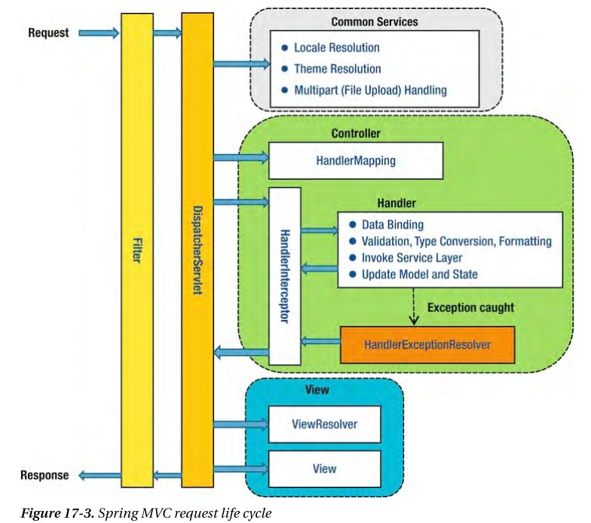

Slide 8
Spring
Spring can make use of RESTful URLs
  Commonly without any extension such as .html
  Collections are accessed like: /customer
  Individual entries are accessed like: /customer/id
CRUD operations are done via HTTP methods PUT, POST, GET, DELETE

Slide 9
Spring
Demo mvc-config
Demo spring-mvc-showcase

Slide 10
Questions?

