Slide 1
Module 3: Bandwidth and Power Efficient AM Systems

Slide 2
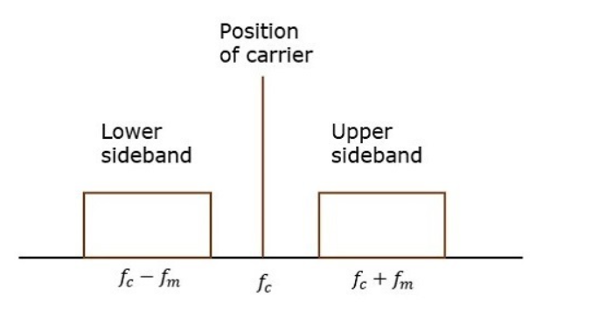
Need for Double side Band suppressed carrier system
AM
DSBFC

Slide 3
Need for Double side Band suppressed carrier system
Two-thirds of the power is being wasted in the carrier, which carries no information
If this carrier is suppressed and the saved power is distributed to the two sidebands, then such a process is called as Double Sideband Suppressed Carrier system or simply DSBSC.

Slide 4
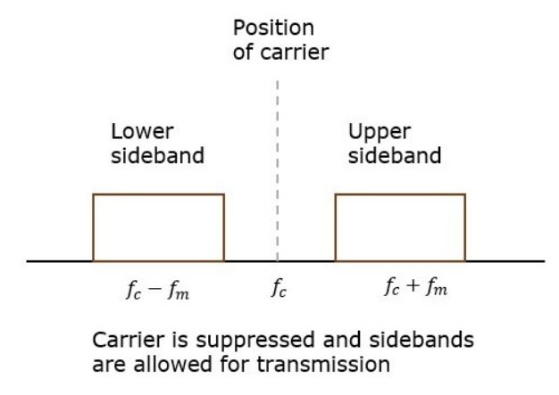

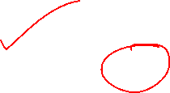
DSB-SC

Slide 5

Mathematical Expressions for DSBSC
Modulating Signal: m(t)=A_{m}cos(2πf_{m}t)
Carrier signal: c(t)=A_{c}cos(2πf_{c}t)
equation of DSBSC wave is the product of modulating and carrier signals.
s(t)=m(t)c(t) s(t)=A_{m}A_{c}cos(2πf_{m}t)cos(2πf_{c}t)

Slide 6
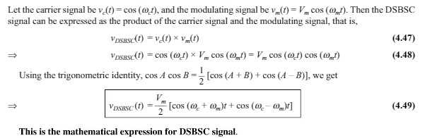
Mathematical Expressions for DSBSC

Slide 7
Bandwidth of DSBSC Wave
BW=f_{max}−f_{min}
s(t)=A_{m}A_{c}cos(2πf_{m}t)cos(2πf_{c}t)
s(t)=A_{m}A_{c}/2cos[2π(f_{c}+f_{m})t]+A_{m}A_{c}2cos[2π(f_{c}−f_{m})t]
The DSBSC modulated wave has only two frequencies
the maximum and minimum frequencies are f_{c}+f_{m} and f_{c}−f_{m} respectively

Slide 8
Bandwidth of DSBSC Wave
f_{max}=f_{c}+f_{m} and f_{min}=f_{c}−f_{m}
BW=f_{c}+f_{m}−(f_{c}−f_{m})
BW=2f_{m}
the bandwidth of DSBSC wave is same as that of AM wave and it is equal to twice the frequency of the modulating signal

Slide 9
Power Calculations of DSBSC Wave
Consider the following equation of DSBSC modulated wave
S(t)=A_{m}A_{c}2cos[2π(f_{c}+f_{m})t]+A_{m}A_{c}2cos[2π(f_{c}−f_{m})t]
Power of DSBSC wave is equal to the sum of powers of upper sideband and lower sideband frequency components
P_{t}=P_{USB}+P_{LSB}

Slide 10
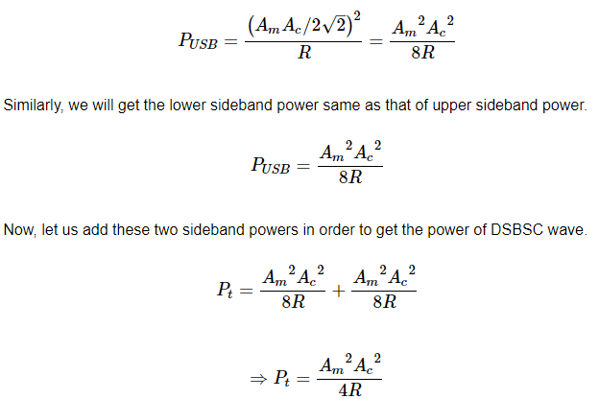

Power Calculations of DSBSC Wave
P=V_{rms}²/R=(v_{m} / √2)²/R

Slide 11
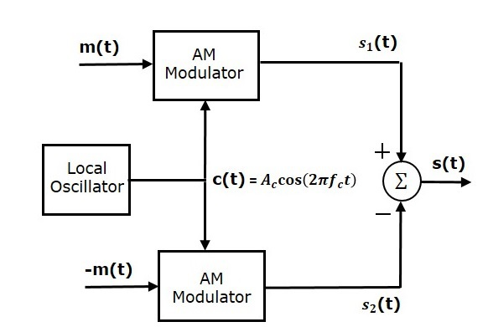




BALANCED MODULATOR

Slide 12
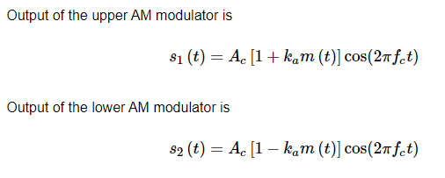





BALANCED MODULATOR

Slide 13
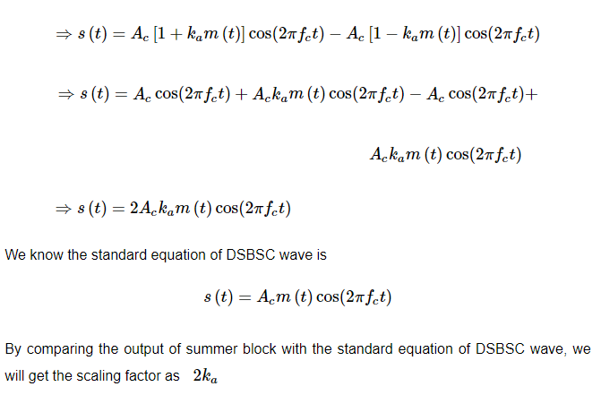


BALANCED MODULATOR

Slide 14
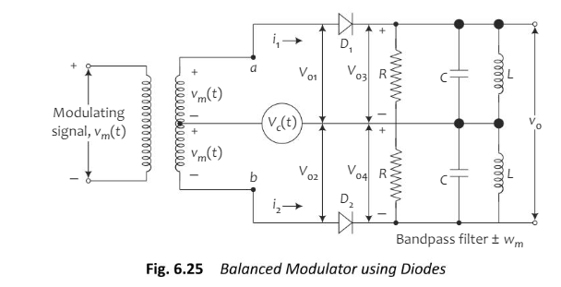
Balanced modulator circuit using diodes

Slide 15
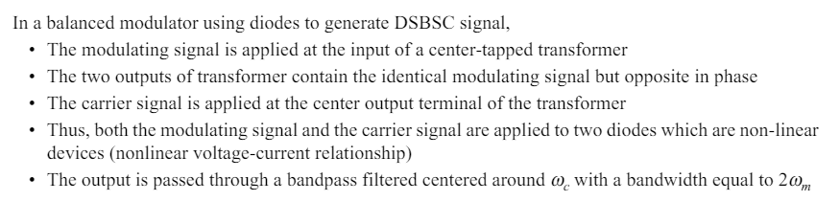
In fig 6.25

Slide 16
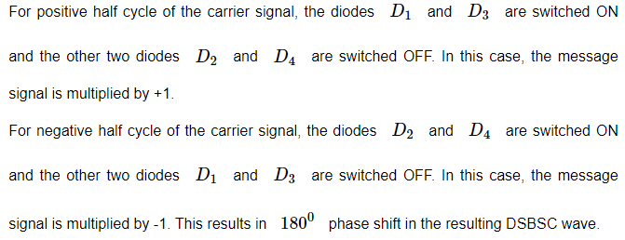

Ring Modulator

Slide 17
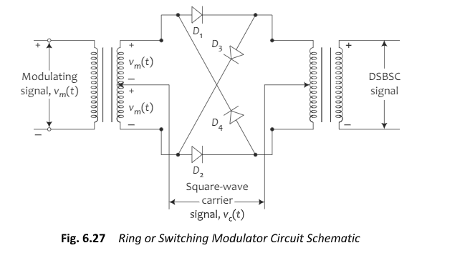
Ring modulator

Slide 18
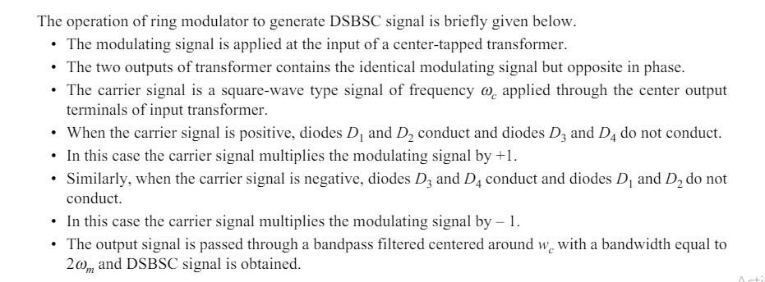

Slide 19
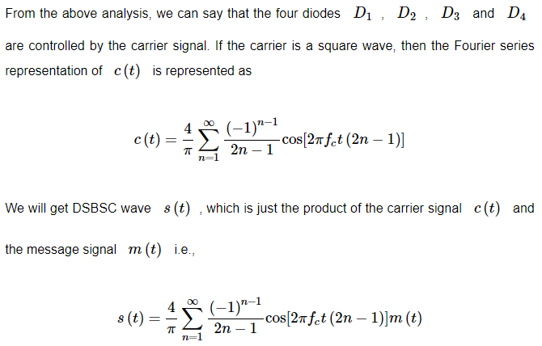
Ring Modulator

Slide 20
DSBSC DEMODULATORS
The process of extracting an original message signal from DSBSC wave is known as detection or demodulation of DSBSC
demodulators (detectors) are used for demodulating DSBSC wave:
Coherent Detector
Costas Loop

Slide 21
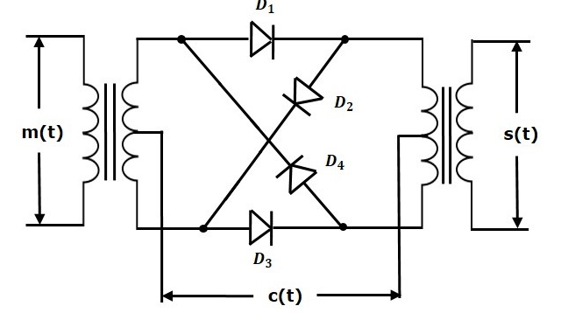

Ring Modulator

Slide 22
Coherent Detector
the same carrier signal (which is used for generating DSBSC signal) is used to detect the message signal. Hence, this process of detection is called as coherent or synchronous detection

Slide 23
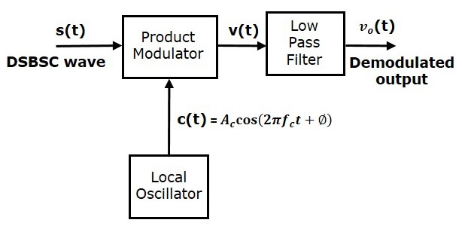
Coherent Detector

Slide 24
Coherent Detector
Let the DSBSC wave be
s(t)=A_{c}cos(2πf_{c}t)m(t)
The output of the local oscillator is
c(t)=A_{c}cos(2πf_{c}t+ϕ)
Where, ϕ is the phase difference between the local oscillator signal and the carrier signal, which is used for DSBSC modulation.

Slide 25
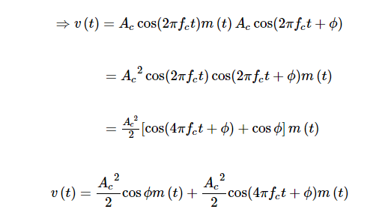
Coherent Detector
we can write the output of product modulator as
v(t)=s(t)c(t)

Slide 26

Coherent Detector
the output of low pass filter is

Slide 27
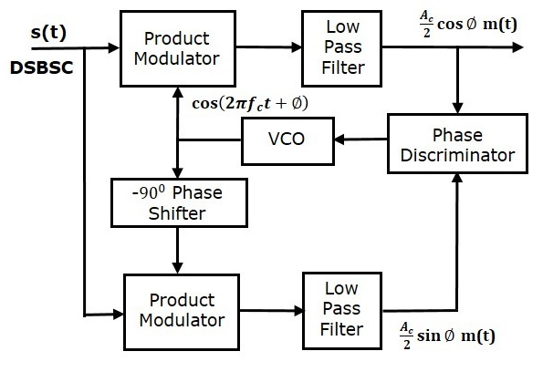
Costas Loop
Costas loop is used to make both the carrier signal (used for DSBSC modulation) and the locally generated signal in phase

Slide 28
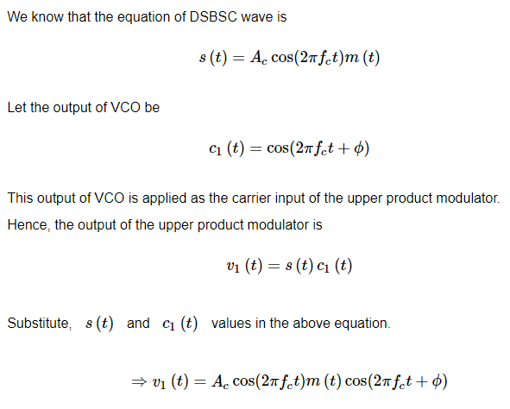
Costas Loop

Slide 29
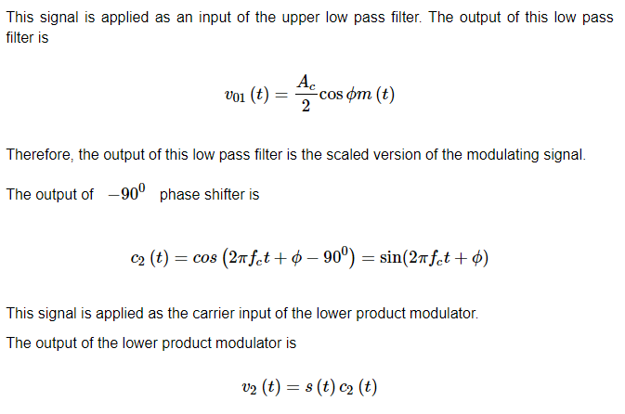
Costas Loop

Slide 30
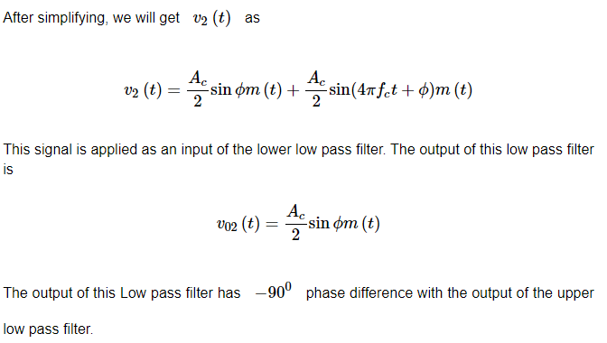
Costas Loop

Slide 31
Costas Loop
The outputs of these two low pass filters are applied as inputs of the phase discriminator. Based on the phase difference between these two signals, the phase discriminator produces a DC control signal.
This signal is applied as an input of VCO to correct the phase error in VCO output. Therefore, the carrier signal (used for DSBSC modulation) and the locally generated signal (VCO output) are in phase.

Slide 32
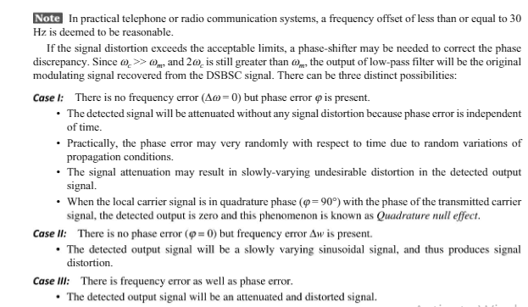
Effect of Frequency and Phase Error

Slide 33
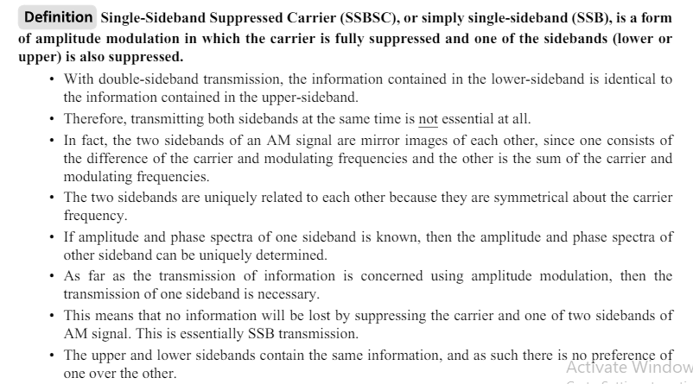
SSBSC

Slide 34
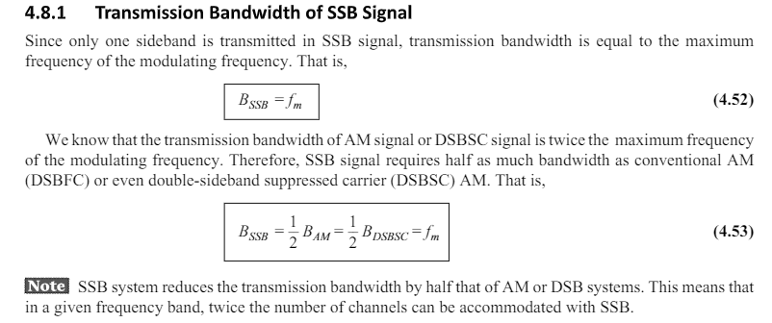

Slide 35
Example

Slide 36
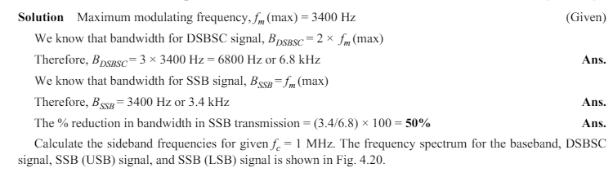
Solution

Slide 37
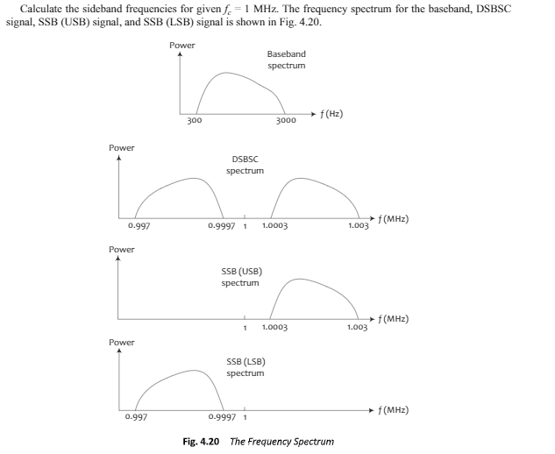
Continue -SSB

Slide 38
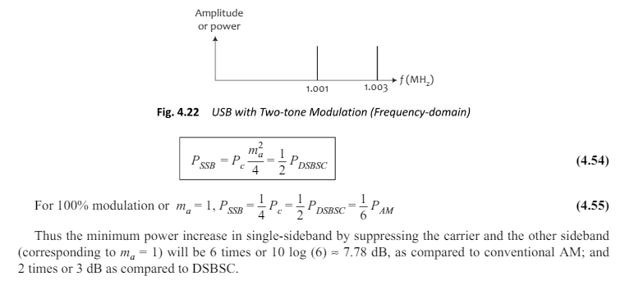
SSB- power

Slide 39
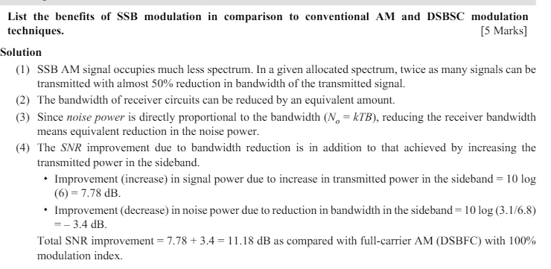
Benefits of SSB

Slide 40
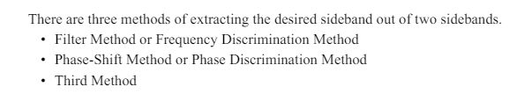
SSB- Modulation

Slide 41
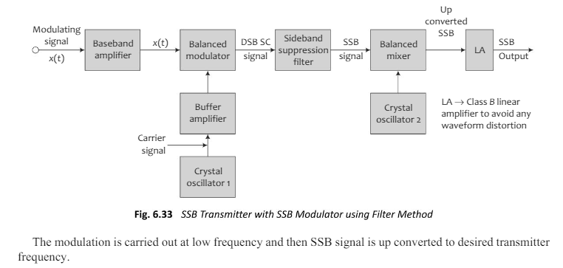
SSB Modulation – Filter method

Slide 42
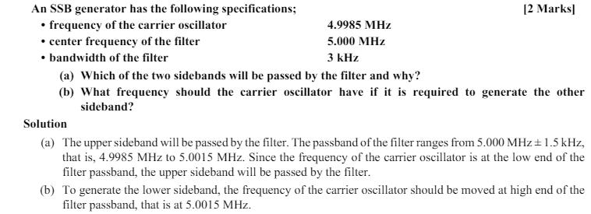
Example

Slide 43
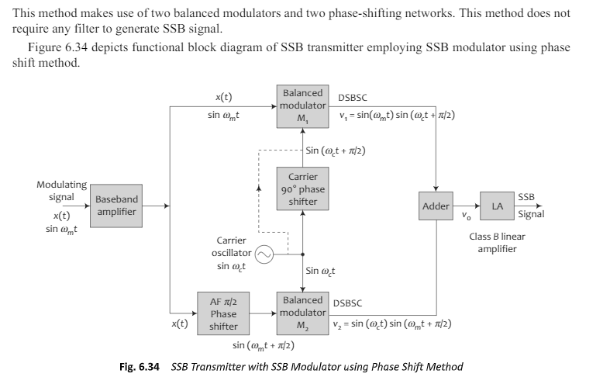
SSB-Modulation –Phase shift method

Slide 44
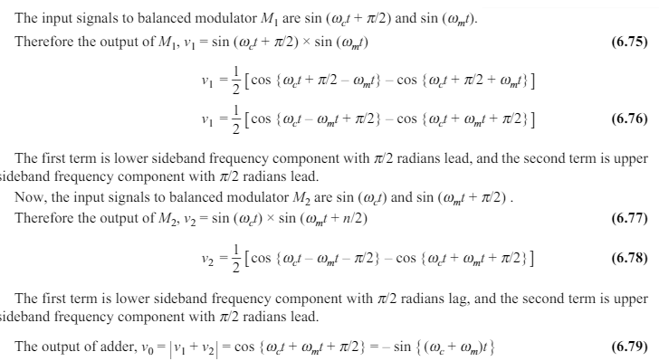
Mathematical modulating –phase shift method

Slide 45
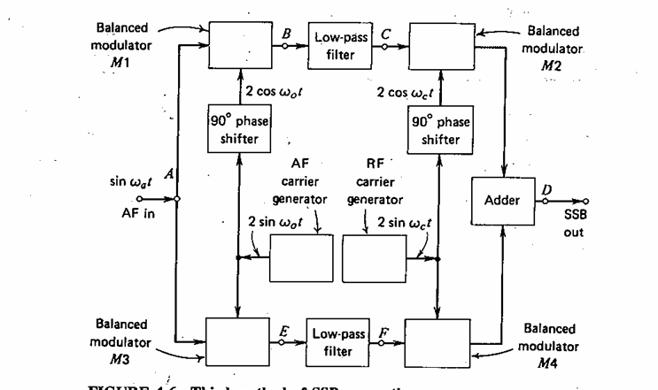
Third method

