Slide 1
Modulation Techniques
Module IV
Angle Modulation

Slide 2
Module 4 Syllabus
Module 4 | Angle Modulation | 10 hours | CO4
Principle of frequency and phase modulation – Relation between FM and PM waves – Frequency deviation, Bandwidth of FM – Narrow band and wide band FM, FM transmitter, Bessel functions and Carson’s rule –FM Generation and Detection- Comparison of AM and Angle Modulation.

Slide 3
Angle modulation
Angle modulation is a method of analog modulation in which either the phase or frequency of the carrier wave is varied according to the message signal.
In this method of modulation the amplitude of the carrier wave is maintained constant.
Angle Modulation is a method of modulation in which either Frequency or Phase of the carrier wave is varied according to the message signal.

Slide 4
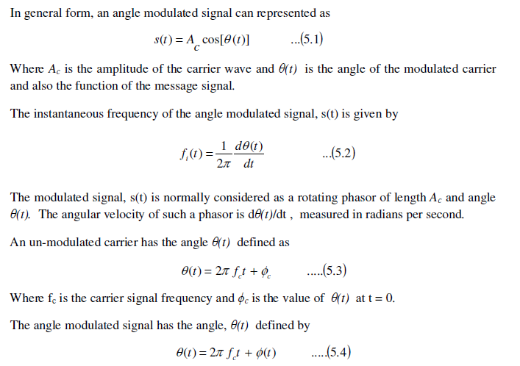
Angle modulation

Slide 5
Angle modulation
There are two commonly used methods of angle modulation:
1. Frequency Modulation, and
2. Phase Modulation.

Slide 6
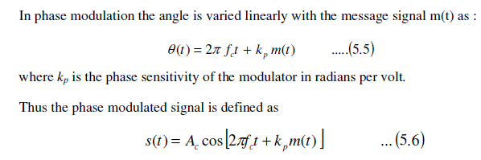
Phase Modulation (PM)

Slide 7
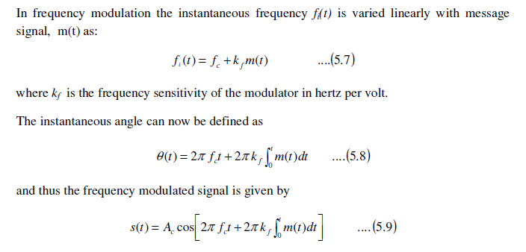
Frequency Modulation (FM)

Slide 8
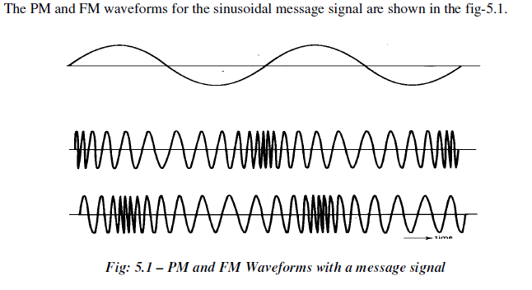

Slide 9
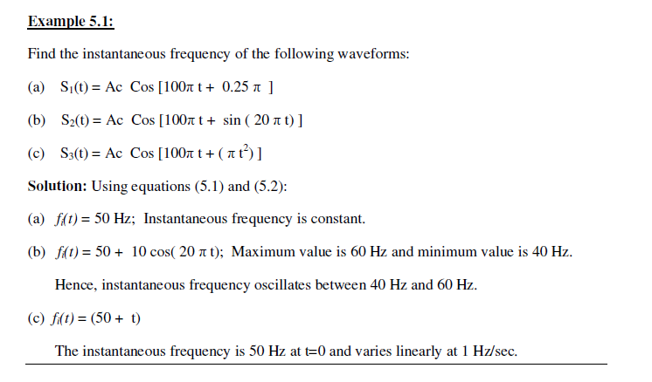
Problem

Slide 10
Relation between Frequency Modulation and Phase Modulation
A frequency modulated signal can be generated using a phase modulator by first integrating m(t) and using it as an input to a phase modulator.
This is possible by considering FM signal as phase modulated signal in which the modulating wave is integral of m(t) in place of m(t). This is shown in the fig-5.2(a).
Similarly, a PM signal can be generated by first differentiating m(t) and then using the resultant signal as the input to a FM modulator, as shown in fig-5.2(b).

Slide 11
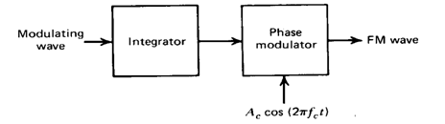
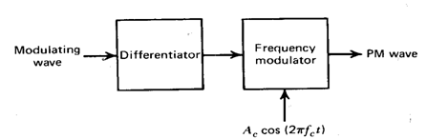
Scheme for generation of FM and PM Waveforms

Slide 12
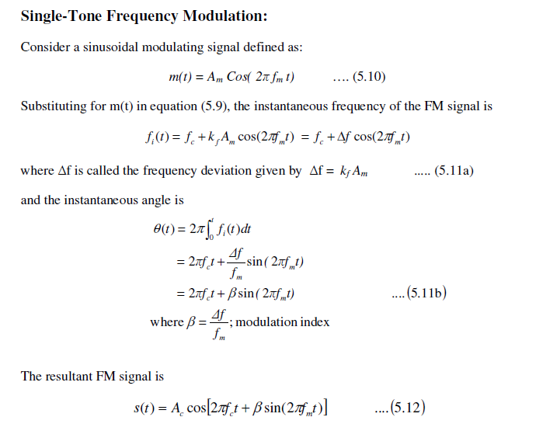
Single Tone Frequency Modulation

Slide 13

Single Tone Frequency Modulation
The frequency deviation factor indicates the amount of frequency change in the FM signal from the carrier frequency fc on either side of it.
Thus FM signal will have the frequency components between (fc - Δf ) to (fc +Δf ).
The modulation index, β represents the phase deviation of the FM signal and is measured in radians. Depending on the value of , FM signal can be classified into two types:

Slide 14
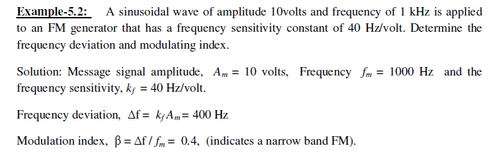
Problems

Slide 15
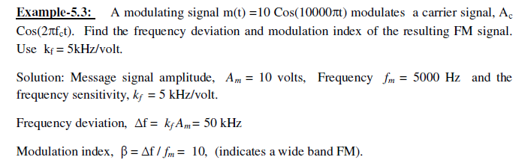

Slide 16
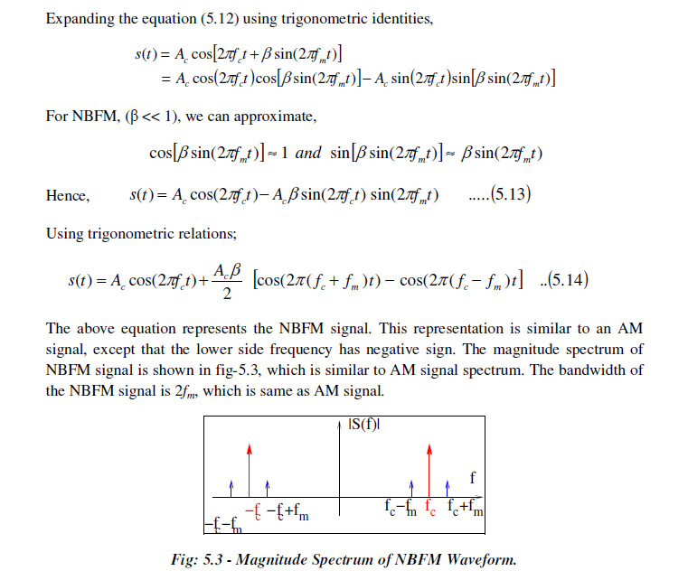
Frequency Domain Representation of Narrow Band FM signal

Slide 17
Frequency Domain Representation of Narrow Band FM signal

Slide 18
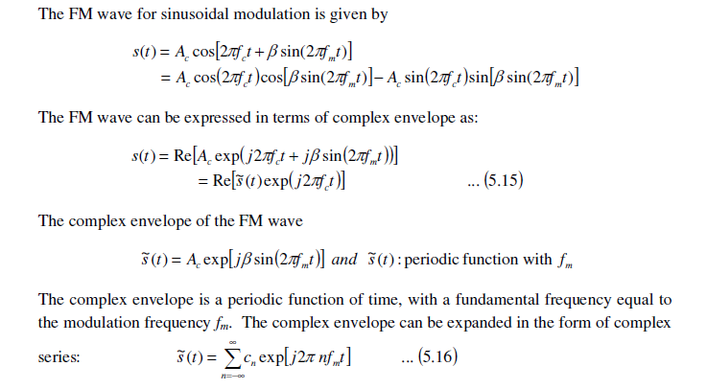
Frequency Domain Representation of Wide-Band FM signals

Slide 19
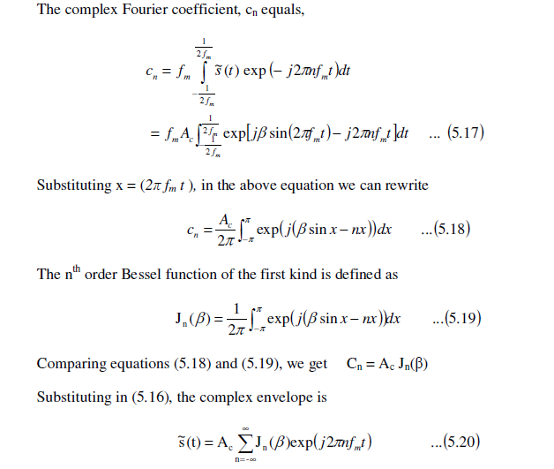
Frequency Domain Representation of Wide-Band FM signals

Slide 20
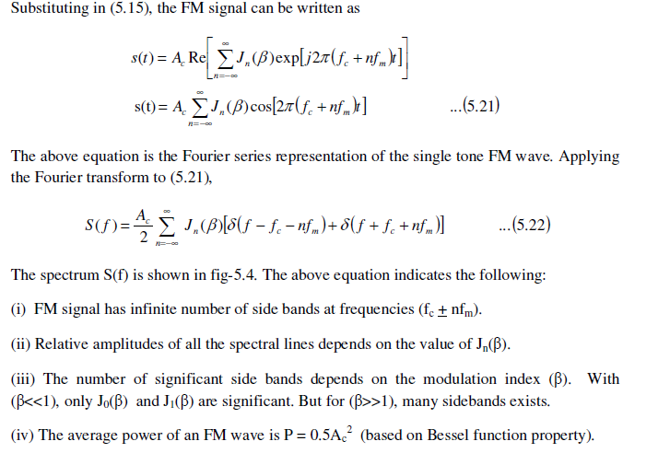
Frequency Domain Representation of Wide-Band FM signals

Slide 21
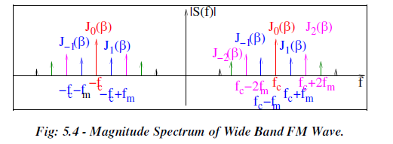
Frequency Domain Representation of Wide-Band FM signals

Slide 22
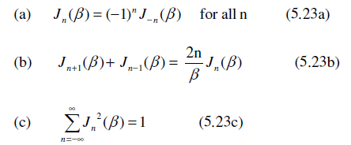
Bessel’s Function
Bessel function is an useful function to represent the FM wave spectrum.
The general plots of Bessel functions are shown in fig-5.5 and table (5.1) gives the values for Bessel function coefficients.
Some of the useful properties of Bessel functions are given below:

Slide 23
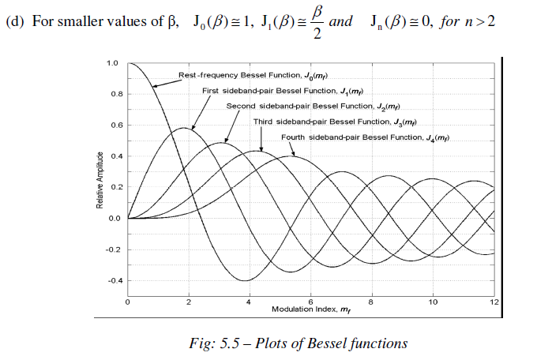
Bessel’s Function

Slide 24
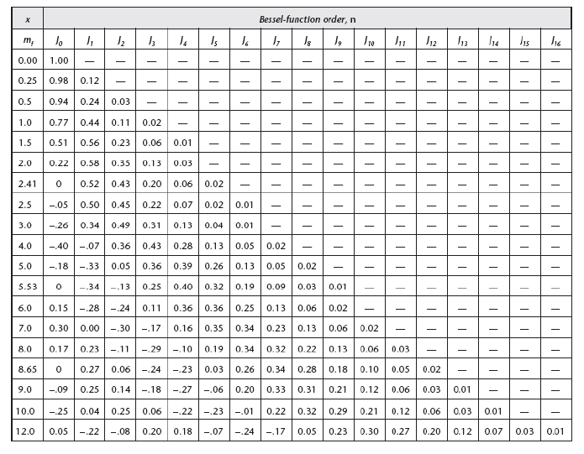
Bessel’s Function

Slide 25
Bessel’s Function
The Spectrum of FM signals for three different values of are shown in the fig-5.6.
In this spectrum the amplitude of the carrier component is kept as a unity constant.
The variation in the amplitudes of all the frequency components is indicated.

Slide 26
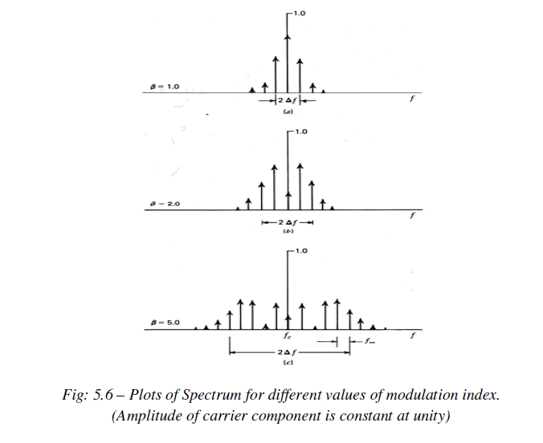
Bessel’s Function

Slide 27
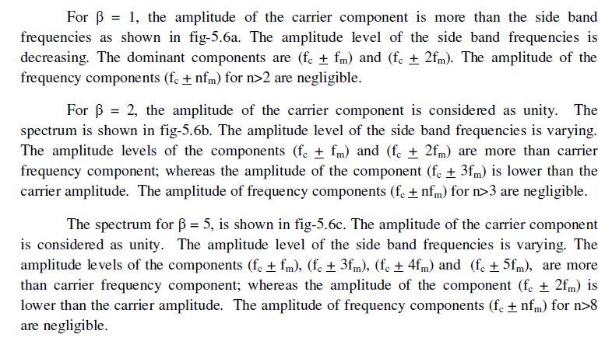
Bessel’s Function

Slide 28
Transmission Bandwidth of FM waves
An FM wave consists of infinite number of side bands so that the bandwidth is theoretically infinite.
But, in practice, the FM wave is effectively limited to a finite number of side band frequencies compatible with a small amount of distortion.
There are many ways to find the bandwidth of the FM wave.

Slide 29
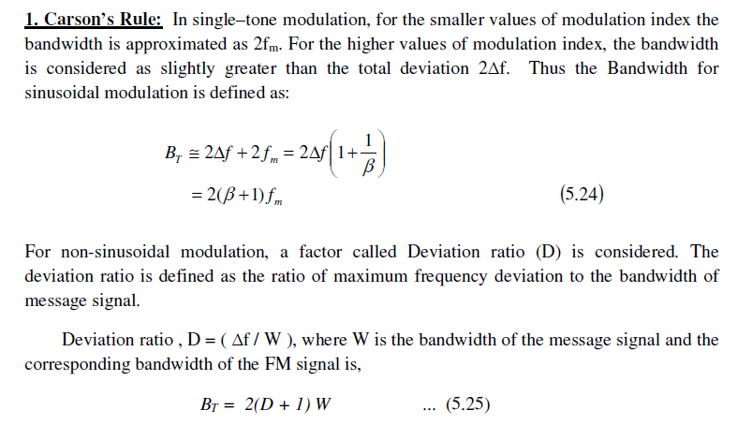
Transmission Bandwidth of FM waves

Slide 30
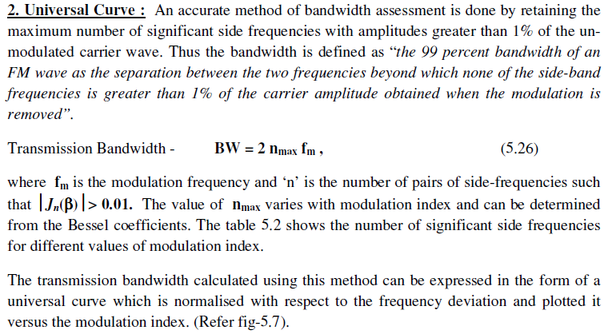
Transmission Bandwidth of FM waves

Slide 31
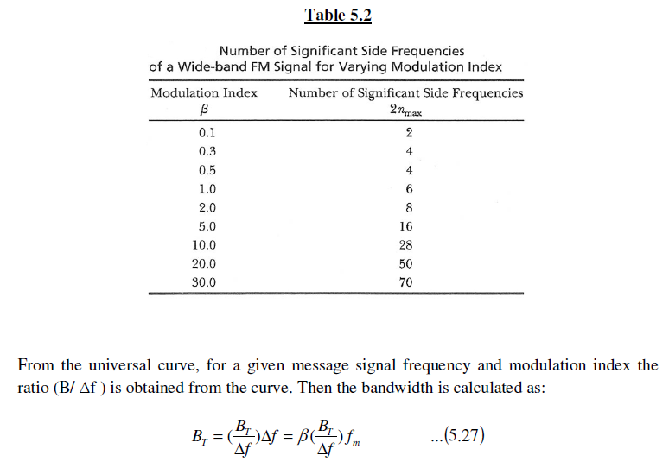
Transmission Bandwidth of FM waves

Slide 32
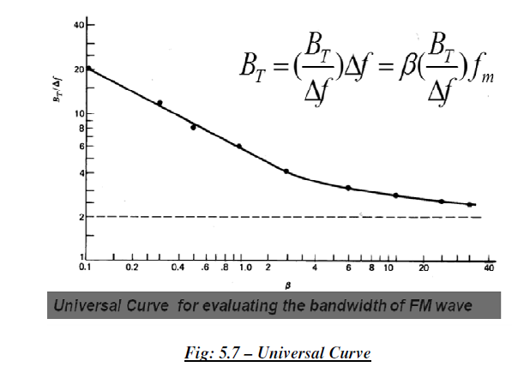
Transmission Bandwidth of FM waves

