Slide 1
Module 5

Slide 2
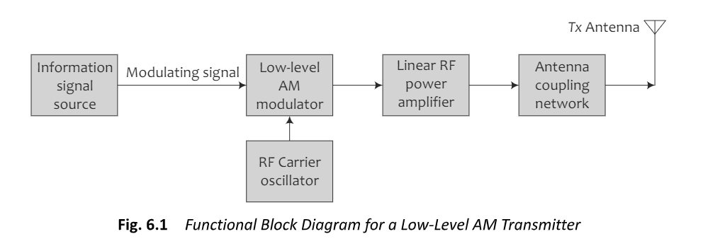
AM Radio Transmission-Low level transmission

Slide 3
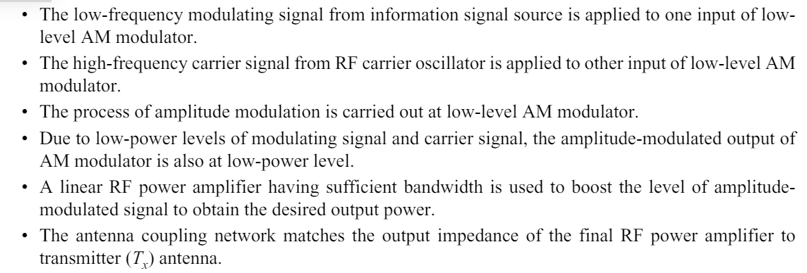
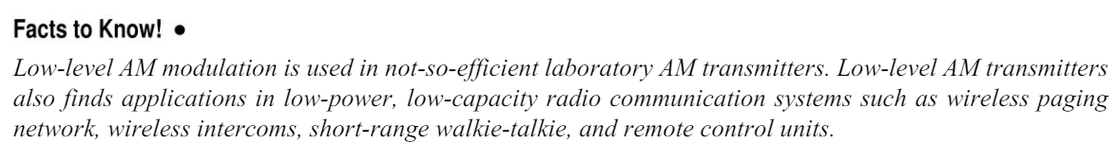

Slide 4
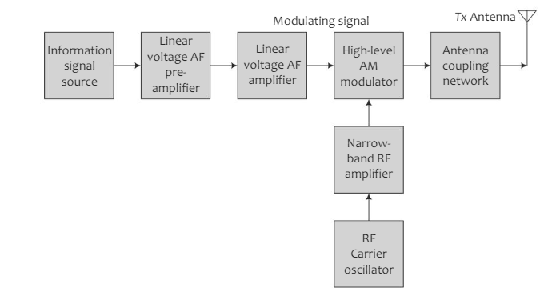
AM Radio-High level transmitter

Slide 5
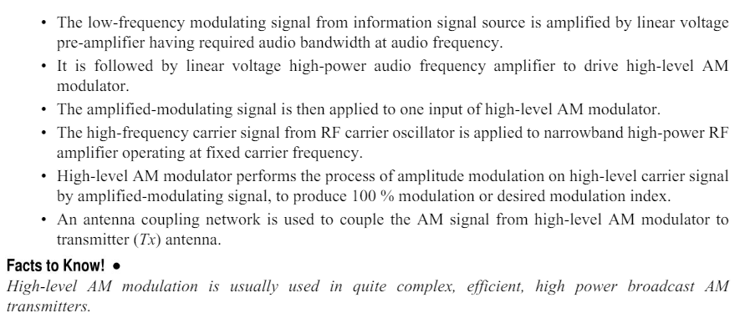

Slide 6
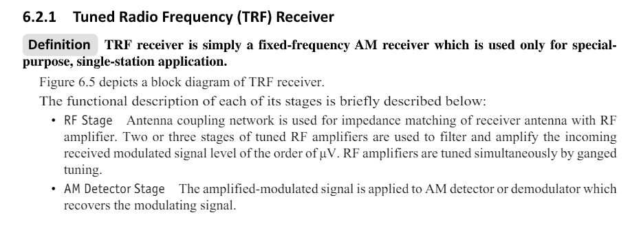
AM Radio Receiver-Tuned Radio Receiver

Slide 7
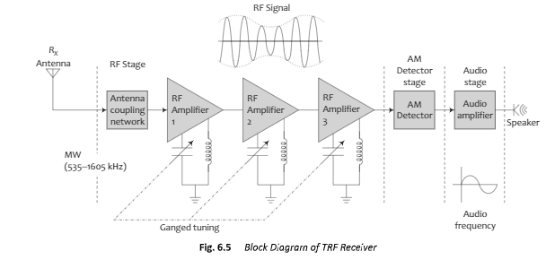
Block diagram of TRF receiver

Slide 8
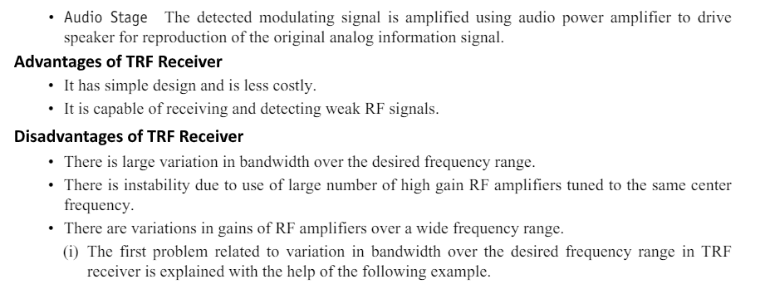

Slide 9
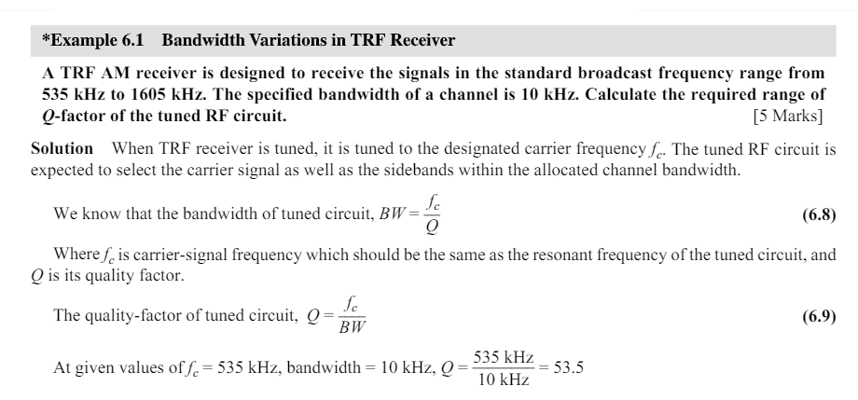


Slide 10
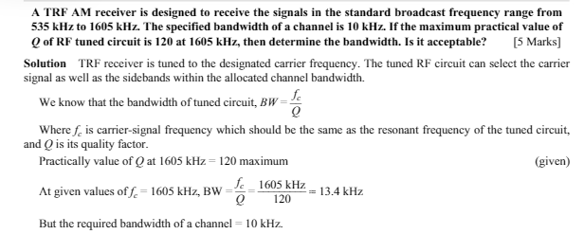
Bandwidth –Transceiver

Slide 11
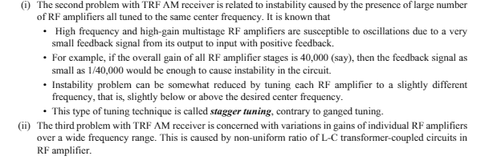

Slide 12
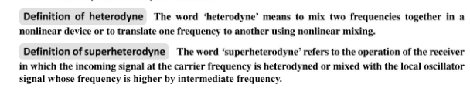
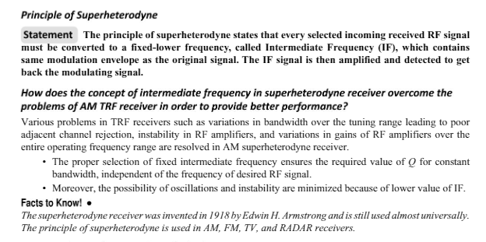
AM Super heterodyne Receiver

Slide 13
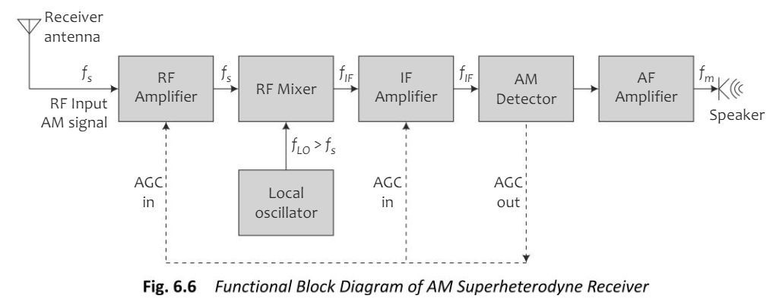

Slide 14
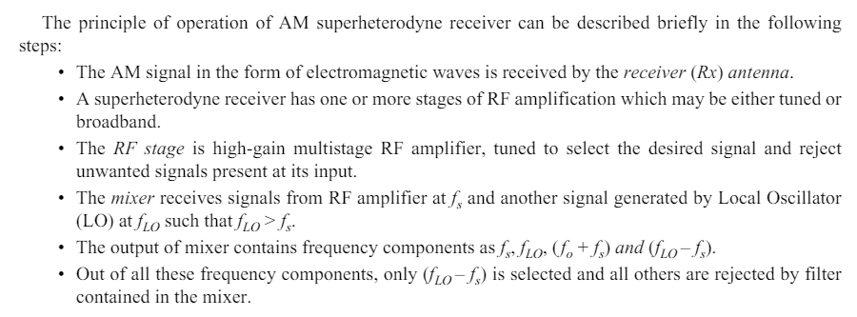

Slide 15
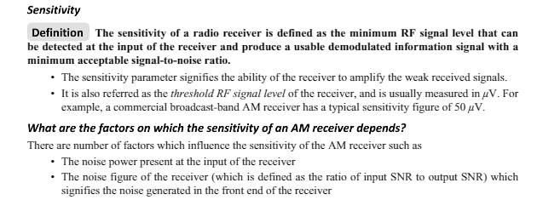
Receiver Characteristics- Sensitivity

Slide 16
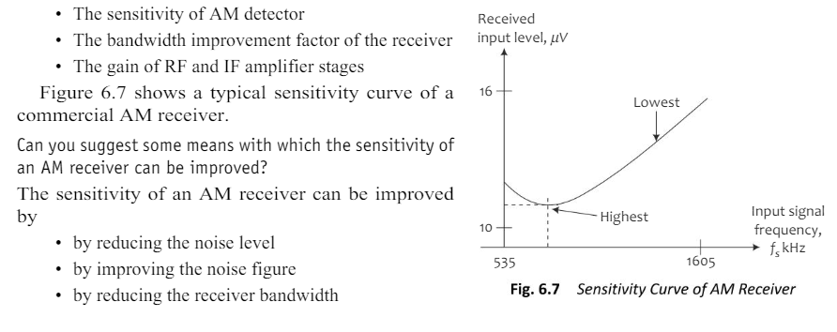

Slide 17
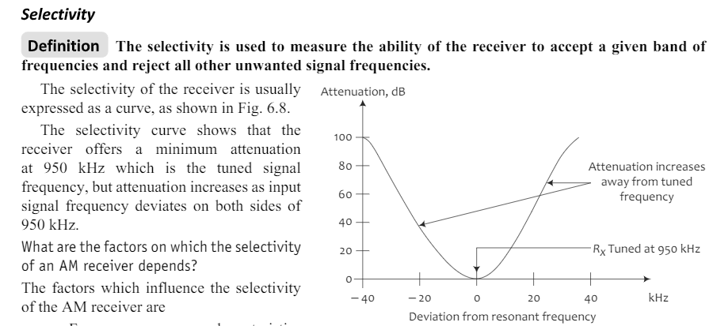

Slide 18
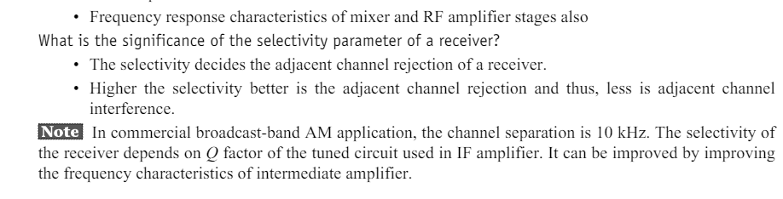

Slide 19
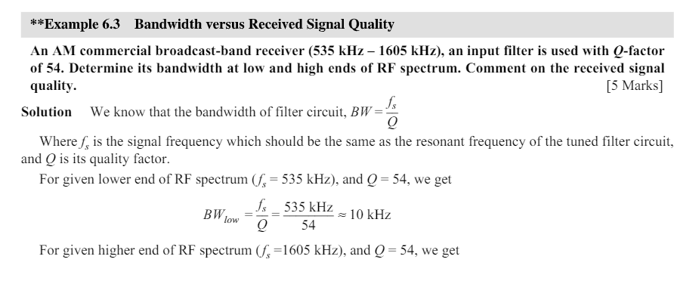
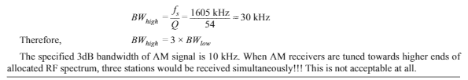

Slide 20
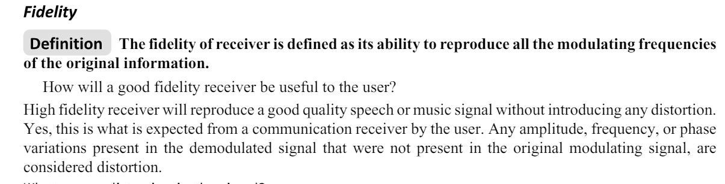
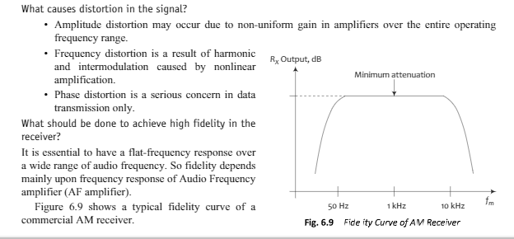

Slide 21
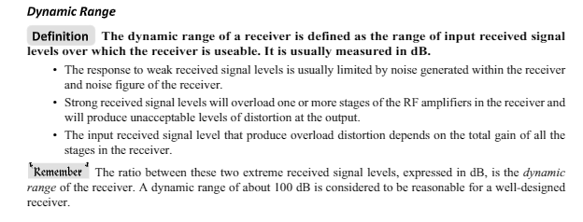

Slide 22
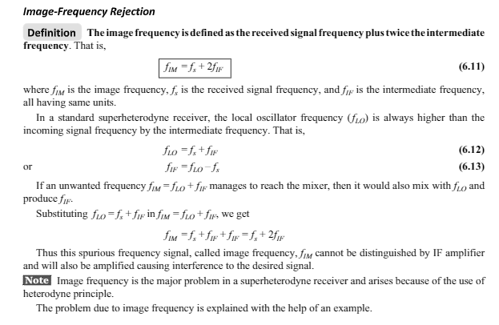

Slide 23
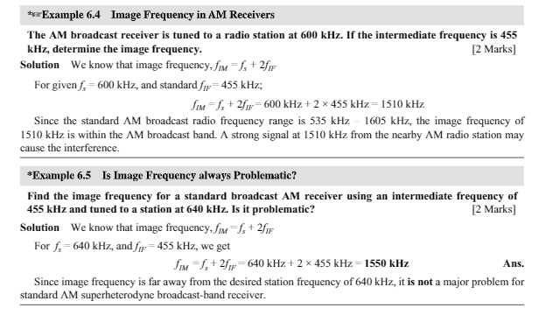

Slide 24
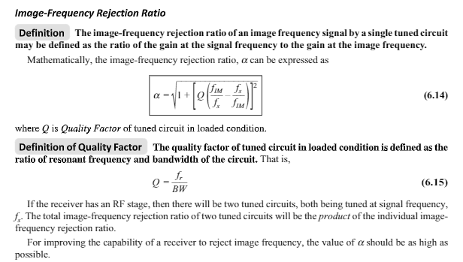

Slide 25
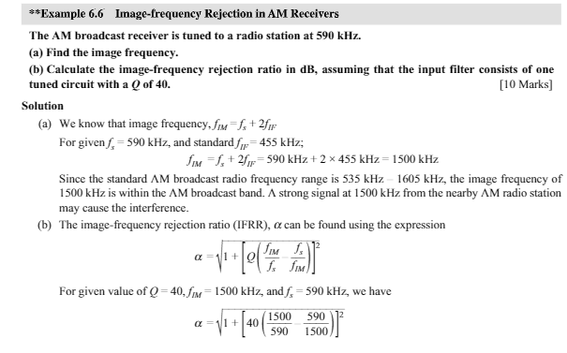

Slide 26
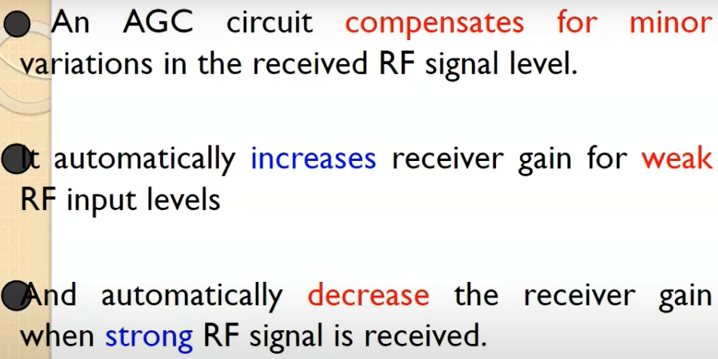
AGC Automatic Gain control
Simple AGC
Delayed AGC
Forward AGC

Slide 27
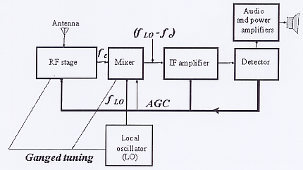
Automatic Gain Control

Slide 28
Cont..
A dc level proportional to the received signal’s strength is extracted from the detector stage and fed back to the IF and sometimes to the mixer and/or the RF amplifier.
This is the automatic gain control (AGC) level, which allows relatively constant receiver output for widely variable received signals.
The AGC help to maintain a constant output voltage level over a wide range of RF input signal levels
Without AGC, to not miss a weak station, you would probably blow out your speaker while a weak station may not be audible.
The received signal from the tuned station is constantly changing as a result of changing weather and atmospheric conditions.
The AGC allows you to listen to a station without constantly monitoring the volume control.

Slide 29
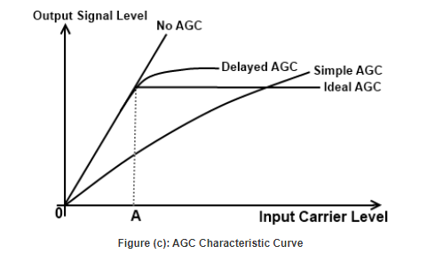
AGC characteristics

Slide 30
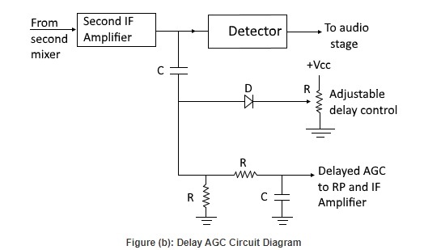
Delayed AGC

Slide 31
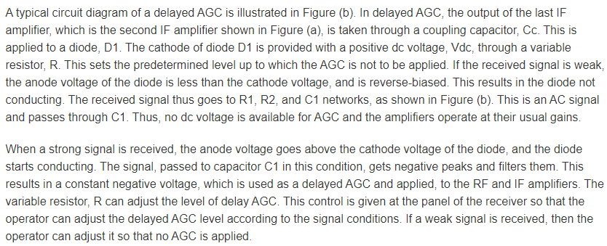

Slide 32
AFC
It is a technique used in communication systems to ensure that the carrier frequency of a transmitted signal remains at a constant and accurate frequency.
AFC uses a feedback mechanism to detect any changes in the carrier frequency of the received signal and then adjust the frequency of the local oscillator at the transmitter accordingly to maintain a constant frequency.
The feedback mechanism works by comparing the received signal's frequency with a reference frequency generated at the receiver. Any difference between these two frequencies is used to generate an error signal, which is fed back to the transmitter's local oscillator to adjust its frequency.

Slide 33
Pre-emphasis and De-emphasis
Pre-emphasis
As we already know that in FM, the noise has a greater effect on the higher modulating frequencies. This effect can be reduced by increasing the value of modulation index (m_{f} ) for higher modulating frequencies (f_{m}).
This can be done by increasing the deviation Δf and Δf can be increased by increasing the amplitude of modulating signal at higher modulating frequencies.
Thus, if we boost the amplitude of higher frequency modulating signals artificially then it will be possible to improve the noise immunity at higher modulating frequencies.
The artificial boosting of higher modulating frequencies is called as pre-emphasis.
Boosting of higher frequency modulating signal is achieved by using the pre-emphasis circuit as shown in fig.1(a).

Slide 34
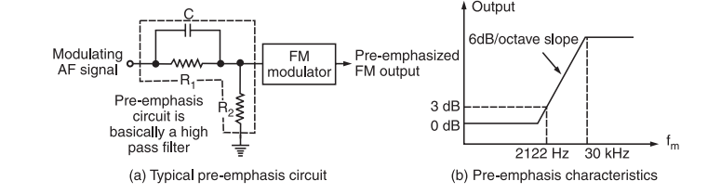
Pre-emphasis ckt
Fig.1 (a)

Slide 35
Cont..
As shown in the fig.1, the modulating AF signal is passed through a high pass RC filter, before applying it to the FM modulator.
As f_{m} increases, reactance of C decreases and modulating voltage applied to FM modulator goes on increasing.
The frequency response characteristics of the RC high pass network is shown in fig.1(b).
The boosting is done according to this pre arranged curve.
The amount of pre-emphasis in US FM transmission and sound transmission in TV has been standardized at 75 μ sec.
The pre-emphasis circuit is basically a high pass filter. The pre-emphasis is carried out at the transmitter. The frequency for the RC high pass network is 2122 Hz as shown in fig.1 (b). Hence, the pre-emphasis circuit is used at the transmitter as shown in fig.2.

Slide 36
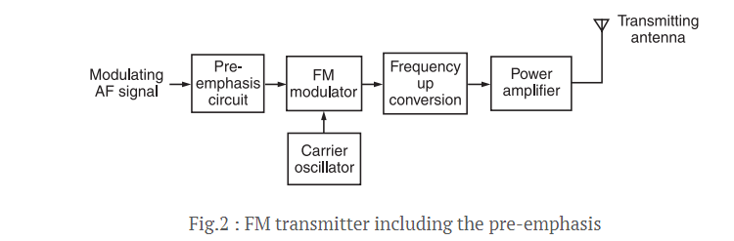
Pre-emphasis CKT in the Transmitter-module
fig.1(b).

Slide 37
De-emphasis
De-emphasis
The process that is used at the receiver end to nullify or compensate the artificial boosting given to the higher modulating frequencies in the process of pre-emphasis is called De-emphasis.
That means, the artificially boosted high frequency signals are brought to their original amplitude using the de-emphasis circuit.
The 75 μsec de-emphasis circuit is standard and it is as shown in fig. 3.
The demodulated FM is applied to the De-emphasis circuit. With increase in f_{m} the reactance of C goes on decreasing and the output of de-emphasis circuit will also reduce as shown in fig.3.

Slide 38
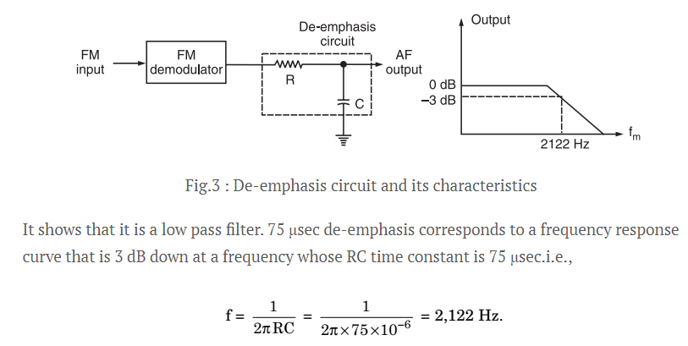
De-emphasis

