Slide 1
Transport Layer
Data Communictions and Networking1/ 94

Slide 2

Contents
Introduction to Transport Layer Process-to-Process Delivery Protocols in Transport Layer
TCP - Transmission Control Protocol UDP - User Datagram Protocol
Congestion Control
Data Communictions and Networking2/ 94

Slide 3
Introduction to Transport Layer
It is located between the Application layer and the Network layer.
It provides a process-to-process communication between two application layers, one at the local host and the other at the remote host.
Communication is provided using a logical connection, which means that the two application layers, which can be located in different parts of the globe, assume that there is an imaginary direct connection through which they can send and receive messages.
All modules and procedures pertaining to transportation of data or data stream are categorized into this layer.
It offers peer-to-peer and end-to-end connection between two processes on remote hosts.
It takes data from upper layer (i.e. Application layer) and then breaks it into smaller size segments, numbers each byte, and hands over to lower layer (Network Layer) for delivery.
Data Communictions and Networking3/ 94

Slide 4
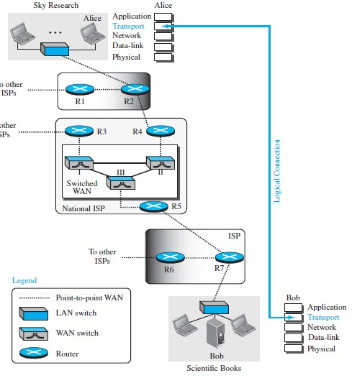
Example..
Messages to Segments
Segments to Messages
Data Communictions and Networking4/ 94

Slide 5
Transport layer Functionalities
Functionalities:
It facilitates the communicating hosts to carry on a conversation.
It provides an interface for the users to the underlying network.
It can provide for a reliable connection. It can also carry out error checking, flow control, and verification.
Protocols used in Transport Layer
Transmission Control Protocol (TCP): It is a reliable
connection-oriented protocol that transmits data from the source to the destination machine without any error. [reliable, in-order delivery]
User Datagram Protocol (UDP): It is a message-oriented protocol that provides a simple unreliable, connectionless, unacknowledged service. [unreliable, unordered delivery]
Stream Control Transmission Protocol (SCTP): It combines the features of both TCP and UDP. It is message oriented like the UDP, which providing the reliable, connection-oriented service like TCP.
Data Communictions and Networking5/ 94

Slide 6
Process-to-Process Delivery
The Data Link Layer is responsible for delivery of frames between two neighboring nodes over a link. This is called Node-to-Node delivery.
The Network layer is responsible for delivery of datagrams between two hosts. This is called Host-to-Host delivery.
Communication on the Internet is not defined as the exchange of data between two nodes or between two hosts.
Real communication takes place between two processes. So that we need Process-to-Process delivery.
However, at any moment, several processes may be running on the source host and several on the destination host.
To complete the delivery, we need a mechanism to deliver data from one of these processes running on the source host to the corresponding process running on the destination host.
Data Communictions and Networking6/ 94

Slide 7
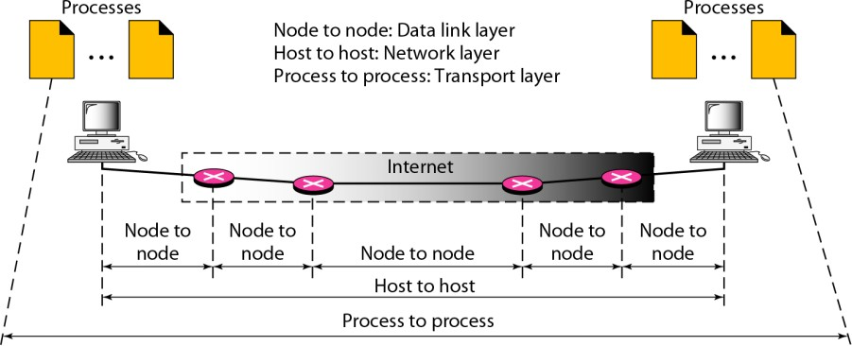
Process-to-Process Delivery
The transport layer is responsible for process-to-process delivery-the delivery of a packet, part of a message, from one process to another
Data Communictions and Networking7/ 94

Slide 8
Client/Server Paradigm
There are several ways to achieve process-to-process communication; the most common one is through the client/server paradigm.
A process on the local host, called a Client, needs services from a process usually on the remote host, called a Server.
Both processes (Client/Server) have the same name. For example, to get the day and time from a remote machine, we need a Daytime client process running on the local host and a Daytime server process running on a remote machine.
A remote computer can run several server programs at the same time, just as local computers can run one or more client programs at the same time.
For Communication, need to define the following:
Local Host & Local Process Remote Host & Remote process
Data Communictions and Networking8/ 94

Slide 9
Addressing
Whenever we need to deliver something to one specific destination among many, we need an address
At the DLL, need a MAC address to choose one node among several nodes if the connection is not point-to-point. A frame in the data link layer needs a destination MAC address for delivery and a source address for the next node’s reply.
At the NL, need an IP address to choose one host among millions. A datagram in the network layer needs a destination IP address for delivery and a source IP address for the destination’s reply.
At the TL, we need a transport layer address, called a port number, to choose among multiple processes running on the destination host. The destination port number is needed for delivery; the source port number is needed for the reply.
Data Communictions and Networking9/ 94

Slide 10
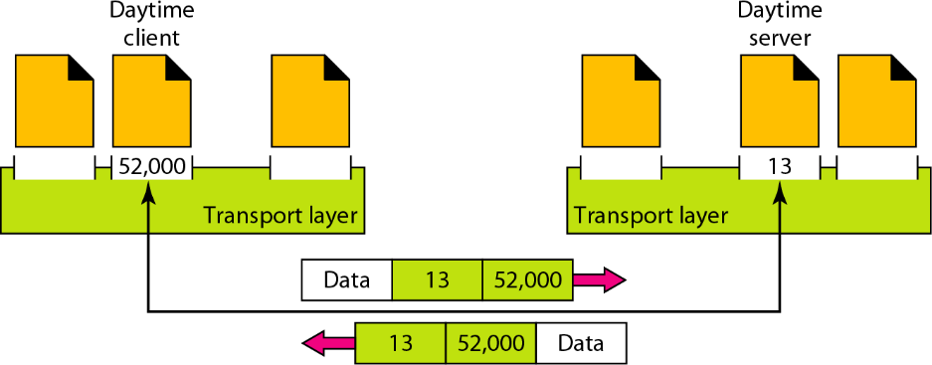
Addressing
Data Communictions and Networking10/ 94

Slide 11
IP Address and Port Numbers
In Internet, port numbers are 16-bit integers between 0 and 65,535.
The client program defines itself with a port number, chosen randomly by the transport layer software running on the client host. This is the ephemeral port number.
The server process also defines its port number. However, cannot be chosen randomly.
If the computer at the server site runs a server process and assigns a random number as the port number, the process at the client site that wants to access that server and use its services will not know the port number.
Every client process knows the well-known port number of the corresponding server process.
Example : The Daytime client process, can use an ephemeral (temporary) port number 52,000 to identify itself, the Daytime server process must use the well-known (permanent) port number 13.
Both the IP addresses and port numbers play different roles in selecting the final destination of data
Data Communictions and Networking11/ 94

Slide 12
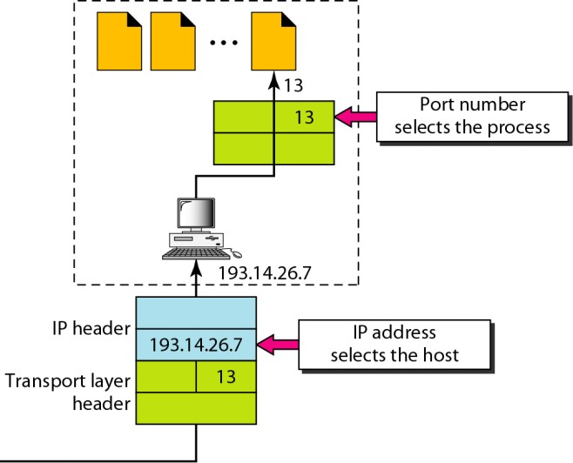
IP Address and Port Numbers
Data Communictions and Networking12/ 94

Slide 13
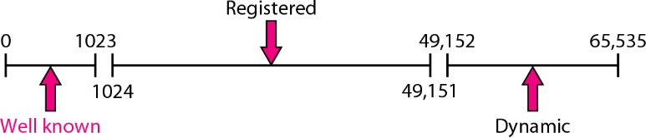
IANA Ranges
The lANA (Internet Assigned Number Authority) has divided the port numbers into three ranges:
Well-known ports: The ports ranging from 0 to 1023 are assigned and controlled by lANA.
Registered ports: The ports ranging from 1024 to 49,151 are not assigned or controlled by lANA. They can only be registered with lANA to prevent duplication.
Dynamic ports: The ports ranging from 49,152 to 65,535 are neither controlled nor registered. They can be used by any process. These are the ephemeral ports that can be used for private, customized services and temporary services.
Data Communictions and Networking13/ 94

Slide 14
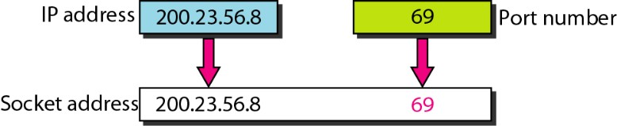
Socket Address
Process-to-Process delivery needs two identifiers,IP addressand the Port number, at each end to make a connection. The combination of an IP address and a port number is called a socket address.
The client socket address defines the client process uniquely just as the server socket address defines the server process uniquely.
Data Communictions and Networking14/ 94

Slide 15
Multiplexing and DeMultiplexing
The addressing mechanism allows multiplexing and demultiplexing by the transport layer.
Multiplexing:
At the sender site, there may be several processes that need to send packets.
However, there is only one transport layer protocol at any time. This is a many-to-one relationship and requires multiplexing.
The protocol accepts messages from different processes, differentiated by their assigned port numbers.
After adding the header, the transport layer passes the packet to the network layer.
DeMultiplexing:
At the receiver site, the relationship is one-to-many and requires demultiplexing.
The transport layer receives datagrams from the network layer. After error checking and dropping of the header, the transport layer delivers each message to the appropriate process based on the port number.
Data Communictions and Networking15/ 94

Slide 16
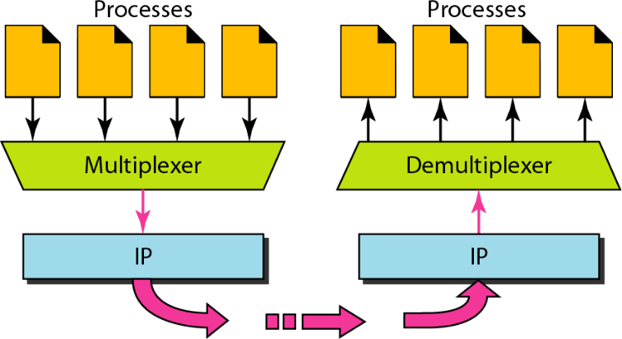
Multilexing and DeMultiplexing
Data Communictions and Networking16/ 94

Slide 17
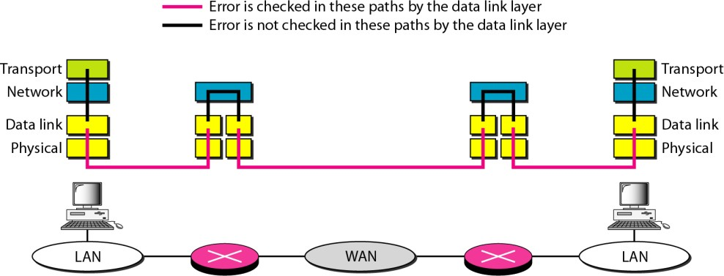
Error Control in Transport Layer
Data Communictions and Networking17/ 94

Slide 18
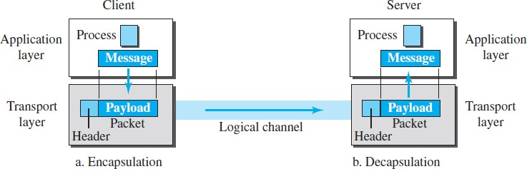
Encapsulation and Decapsulation
Data Communictions and Networking18/ 94

Slide 19
Connectionless Versus Connection-Oriented Ser
vice
A transport layer protocol can either be connectionless or connection-oriented.
Connectionless Service: In a connectionless service, the packets are sent from one party to another with no need for connection establishment or connection release. The packets are not numbered; they may be delayed or lost or may arrive out of sequence. There is no acknowledgment either. UDP, is connectionless.
Connection-Oriented Service: In a connection-oriented service, a connection is first established between the sender and the receiver. Data are transferred. At the end, the connection is released. The TCP and SCTP are connection-oriented protocols.
Data Communictions and Networking19/ 94

Slide 20
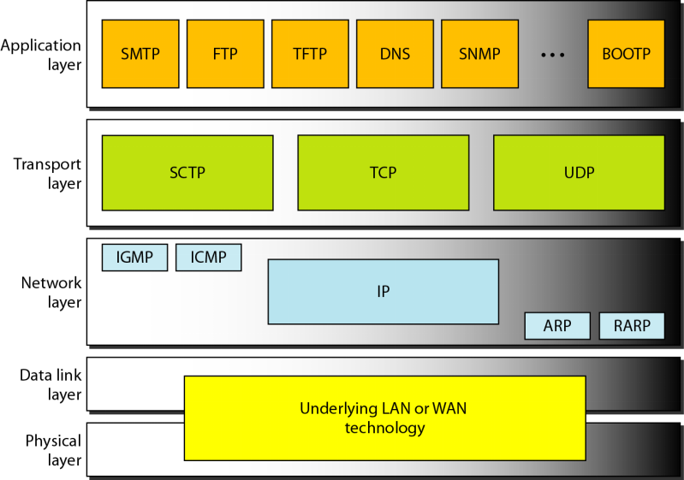
Protocols in Transport Layer
Data Communictions and Networking20/ 94

Slide 21
Data Communictions and Networking
TCP - Transmission Control Protocol
Data Communictions and Networking21/ 94

Slide 22
Transmission Control Protocol
It is one of the most important protocols of Internet Protocols suite. It is most widely used protocol for data transmission in communication network such as internet.
Features :
TCP is reliable protocol (Acknowledgement(+ve/-ve)).
TCP ensures that the data reaches intended destination in the same order it was sent.
TCP is connection oriented, provides error-checking, recovery mechanism and end-to-end communication.
TCP provides flow control and quality of service. TCP operates in Client/Server point-to-point mode.
TCP provides full duplex server, i.e. it can perform roles of both receiver and sender.
Data Communictions and Networking22/ 94

Slide 23
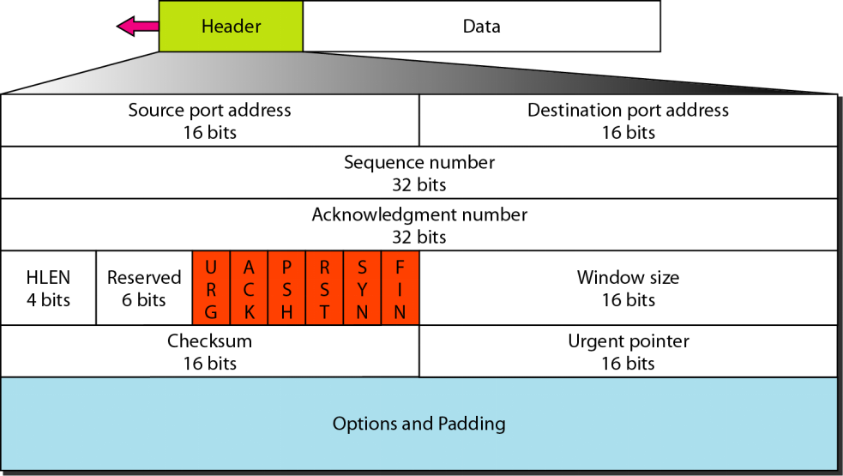
TCP Header
Data Communictions and Networking23/ 94

Slide 24
TCP Header....
The length of TCP header is minimum 20 bytes long and maximum 60 bytes
Source Port(16-bits) - It identifies source port of the application process on the sending device.
Destination Port(16-bits) - It identifies destination port of the application process on the receiving device.
Sequence Number(32-bits) - Sequence number of data bytes of a segment in a session.
Acknowledgement Number(32-bits) - When ACK flag is set, this number contains the next sequence number of the data byte expected and works as acknowledgement of the previous data received.
Data Offset(4-bits) - This field implies both, the size of TCP header (32-bit words) and the offset of data in current packet in the whole TCP segment.
Data Communictions and Networking24/ 94

Slide 25
TCP Header...
Reserved(3-bits) - Reserved for future use and all are set zero by default.
Flags(1-bit each) :
NS- Nonce Sum bit is used by Explicit Congestion Notification signaling process.
CWR- When a host receives packet with ECE bit set, it sets Congestion Windows Reduced to acknowledge that ECE received. ECE-It has two meanings:
If SYN bit is clear to 0, then ECE means that the IP packet has its CE (congestion experience) bit set.
If SYN bit is set to 1, ECE means that the device is ECT capable.
URG- It indicates that Urgent Pointer field has significant data and should be processed.
ACK- It indicates that Acknowledgement field has significance. If ACK is cleared to 0, it indicates that packet does not contain any acknowledgement.
Data Communictions and Networking25/ 94

Slide 26
TCP Header...
Flags(1-bit each) :
PSH- When set, it is a request to the receiving station to PUSH data (as soon as it comes) to the receiving application without buffering it.
RST- Reset flag has the following features:
It is used to refuse an incoming connection. It is used to reject a segment.
It is used to restart a connection.
SYN- This flag is used to set up a connection between hosts.
FIN- This flag is used to release a connection and no more data is exchanged thereafter. Because packets with SYN and FIN flags have sequence numbers, they are processed in correct order.
Windows Size- This field is used for flow control between two stations and indicates the amount of buffer (in bytes) the receiver has allocated for a segment,
Data Communictions and Networking26/ 94

Slide 27
TCP Header...
Checksum- This field contains the checksum of Header, Data and Pseudo Headers.
Urgent Pointer- It points to the urgent data byte if URG flag is set to 1.
Options- It facilitates additional options which are not covered by the regular header. Option field is always described in 32-bit words. If this field contains data less than 32-bit, padding is used to cover the remaining bits to reach 32-bit boundary.
Addressing: TCP communication between two remote hosts is done by means of port numbers (TSAPs).
Ports numbers can range from 0 – 65535 which are divided as:
System Ports (0 – 1023)
User Ports ( 1024 – 49151)
Private/Dynamic Ports (49152 – 65535)
Data Communictions and Networking27/ 94

Slide 28
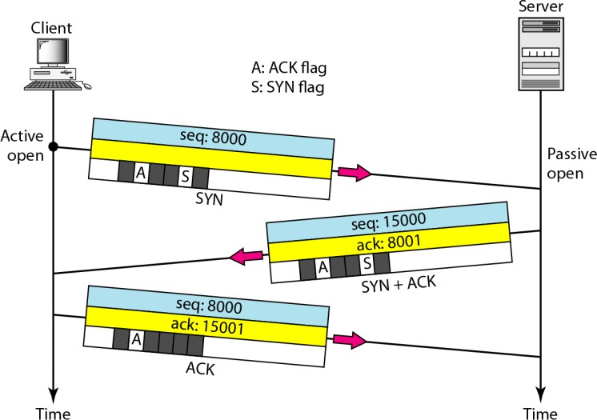
TCP Connection Establishment
It uses Three-way handshaking is used for connection management.
ASYNsegment cannot carry data, but it consumes one sequence number.
ASYN + ACKseqgment can’t carry data, but does consume one sequence number.
AnACKsegment, if carrying no data, consumes no sequence number.
Data Communictions and Networking28/ 94

Slide 29
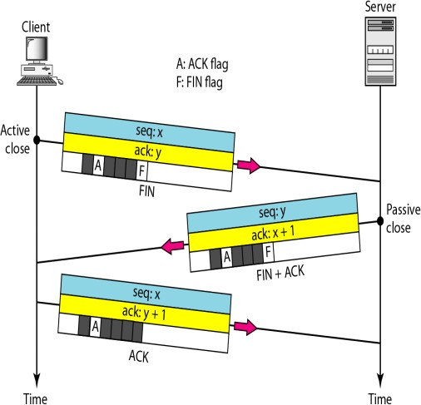
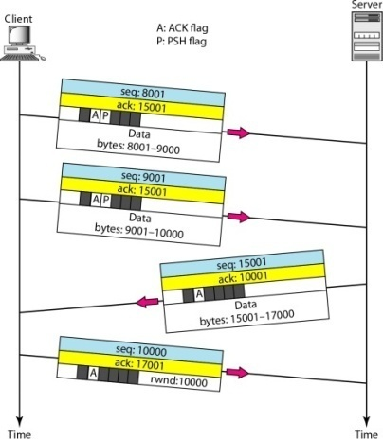
Data Transfer and Connection Termination
Non Persistant TCP connection
Data transfer
Connection Termination
TheFINsegment consumes one sequence number if it doesn’t carry data.
Data Communictions and Networking29/ 94

Slide 30
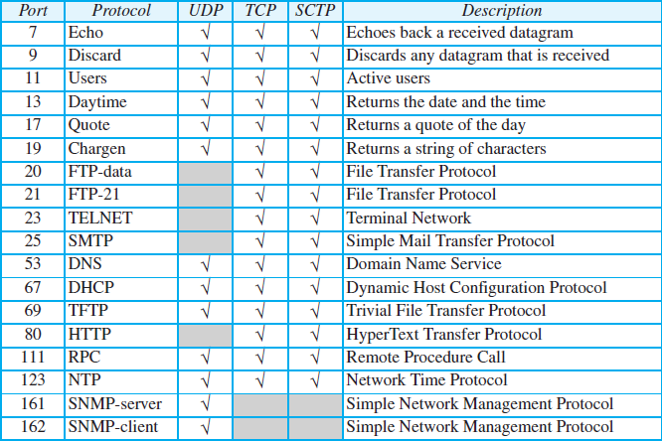
TCP Well Defined Ports
Data Communictions and Networking30/ 94

Slide 31
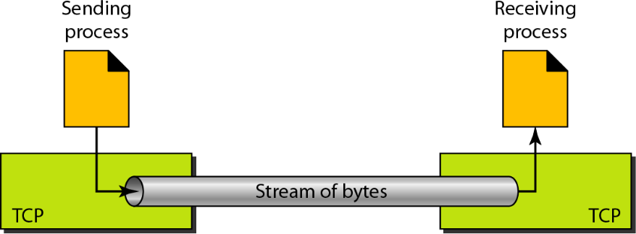
Stream Delivary in TCP
Imaginary Environment
Data Communictions and Networking31/ 94

Slide 32
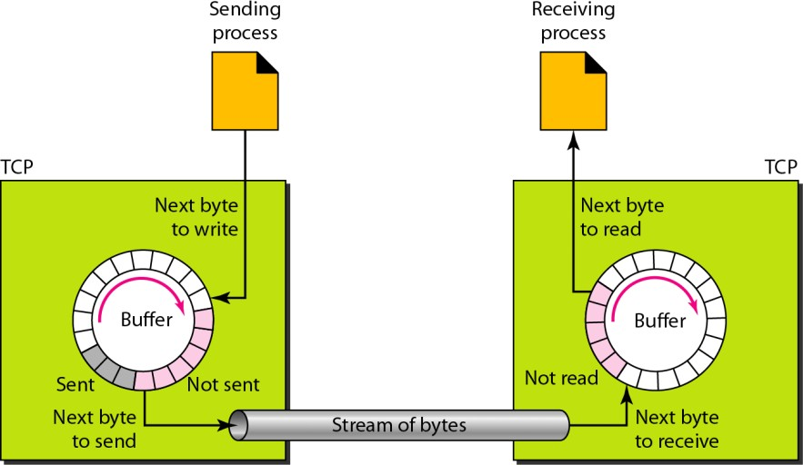
Sending and Receiving Buffers
Once the acknowledgement is received, the TCP buffer recycles and get available for the sending process
Data Communictions and Networking32/ 94

Slide 33
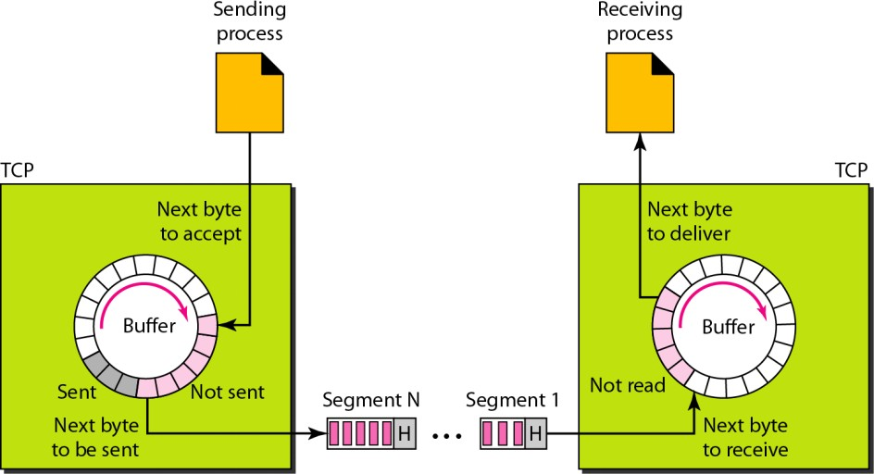
TCP Segments
Data Communictions and Networking33/ 94

Slide 34
Error Control & Flow Control
TCP uses port numbers to know what application process it needs to handover the data segment.
Along with that, it uses sequence numbers to synchronize itself with the remote host.
All data segments are sent and received with sequence numbers.
The Sender knows which last data segment was received by the Receiver when it gets ACK.
The Receiver knows about the last segment sent by the Sender by referring to the sequence number of recently received packet.
If the sequence number of a segment recently received does not match with the sequence number the receiver was expecting, then it is discarded and NACK is sent back.
If two segments arrive with the same sequence number, the TCP timestamp value is compared to make a decision.
Data Communictions and Networking34/ 94

Slide 35
Multiplexing in TCP
The technique to combine two or more data streams in one session is called Multiplexing.
When a TCP client initializes a connection with Server, it always refers to a well-defined port number which indicates the application process. The client itself uses a randomly generated port number from private port number pools.
Using TCP Multiplexing, a client can communicate with a number of different application process in a single session.
For example, a client requests a web page which in turn contains different types of data (HTTP, SMTP, FTP etc.) the TCP session timeout is increased and the session is kept open for longer time so that the three-way handshake overhead can be avoided.
This enables the client system to receive multiple connection over single virtual connection. These virtual connections are not good for Servers if the timeout is too long.
Data Communictions and Networking35/ 94

Slide 36
Congestion Control
When large amount of data is fed to system which is not capable of handling it, congestion occurs.
TCP controls congestion by means of Window mechanism. TCP sets a window size telling the other end how much data segment to send.
TCP may use three algorithms for congestion control:
Additive increase, Multiplicative Decrease (AIMD) AIMD combines linear growth of the congestion window when there is no congestion with an exponential reduction when congestion is detected. Decrease Slow Start TCP slow start is an algorithm which balances the speed of a network connection. Slow start gradually increases the amount of data transmitted until it finds the network's maximum carrying capacity.
Data Communictions and Networking36/ 94
Notes:
Timeout react

Slide 37
Timer Management
TCP uses different types of timer to control and manage various tasks:
Keep-alive timer:
This timer is used to check the integrity and validity of a connection. When keep-alive time expires, the host sends a probe to check if the connection still exists.
Timed-Wait:
After releasing a connection, either of the hosts waits for a Timed-Wait time to terminate the connection completely.
This is in order to make sure that the other end has received the acknowledgement of its connection termination request.
Timed-out can be a maximum of 240 seconds (4 minutes).
Data Communictions and Networking37/ 94

Slide 38
Timer Management
TCP uses different types of timer to control and management various tasks:
Retransmission timer:
This timer maintains stateful session of data sent.
If the acknowledgement of sent data does not receive within the Retransmission time, the data segment is sent again.
Persist timer:
TCP session can be paused by either host by sending Window Size 0. To resume the session a host needs to send Window Size with some larger value.
If this segment never reaches the other end, both ends may wait for each other for infinite time.
When the Persist timer expires, the host re-sends its window size to let the other end know.
Persist Timer helps avoid deadlocks in communication.
Data Communictions and Networking38/ 94

Slide 39
Crash Recovery
TCP is very reliable protocol. It provides sequence number to each of byte sent in segment.
It provides the feedback mechanism i.e. when a host receives a packet, it is bound to ACK that packet having the next sequence number expected (if it is not the last segment).
When a TCP Server crashes mid-way communication and re-starts its process it sends TPDU (Transaction protocol data unit) broadcast to all its hosts.
The hosts can then send the last data segment which was never unacknowledged and carry onwards.
Data Communictions and Networking39/ 94

Slide 40
Data Communictions and Networking
UDP - User Datagram Protocol
Data Communictions and Networking40/ 94

Slide 41
User Datagram Protocol
The User Datagram Protocol (UDP) is simplest Transport Layer communication protocol available of the TCP/IP protocol suite.
It involves minimum amount of communication mechanism.
UDP is said to be an unreliable transport protocol but it uses IP services which provides best effort delivery mechanism.
In UDP, the receiver does not generate an acknowledgement of packet received and in turn, the sender does not wait for any acknowledgement of packet sent.
This shortcoming makes this protocol unreliable as well as easier on processing.
Data Communictions and Networking41/ 94

Slide 42
Requirement of UDP
A question may arise, why do we need an unreliable protocol to transport the data?
We deploy UDP where the acknowledgement packets share significant amount of bandwidth along with the actual data.
For Example, in case of video streaming, thousands of packets are forwarded towards its users. Acknowledging all the packets is troublesome and may contain huge amount of bandwidth wastage.
The best delivery mechanism of underlying IP protocol ensures best efforts to deliver its packets, but even if some packets in video streaming get lost, the impact is not calamitous and can be ignored easily.
Loss of few packets in video and voice traffic sometimes goes unnoticed
Data Communictions and Networking42/ 94

Slide 43
Features of UDP
UDP is used when acknowledgement of data does not hold any significance.
UDP is good protocol for data flowing in one direction. UDP is simple and suitable for query based communications.
UDP is not connection oriented (Connectionless).
UDP does not provide congestion control mechanism.
UDP does not guarantee ordered delivery of data.
UDP is stateless.
UDP is suitable protocol for streaming applications such as VoIP, multimedia streaming.
Data Communictions and Networking43/ 94

Slide 44
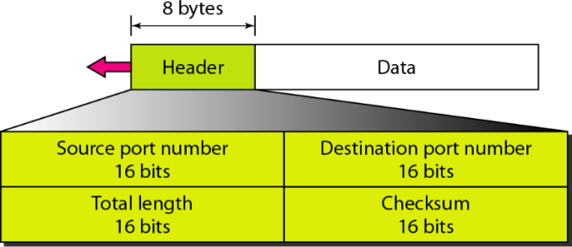
User Datagram format
Source Port- is 16 bits information, used to identify the source port. Destination Port- is 16 bits information, used identify application level service on destination machine.
Length- specifies the length of UDP packet (including header). It is 16-bits field and minimum value is 8-byte, i.e. the size of UDP header itself.
Checksum- It stores the checksum value generated by the sender before sending. IPv4 has this field as optional so when checksum field does not contain any value it is made 0 and all its bits are set to zero.
Data Communictions and Networking44/ 94

Slide 45
UDP Applications
UDP is suitable for a process that requires simple request-response communication with little concern for flow and error control. It is not usually used for a process such as FTP that needs to send bulk data.
UDP is suitable for a process with internal flow and error-control mechanisms. For example, the Trivial File Transfer Protocol (TFTP) process includes flow and error control. It can easily use UDP.
UDP is a suitable transport protocol for multicasting. Multicasting capability is embedded in the UDP software but not in the TCP software.
UDP is used for management processes such as SNMP.
UDP is used for some route updating protocols such as Routing Information Protocol (RIP).
UDP is normally used for interactive real-time applications that cannot tolerate uneven delay between sections of a received message
.
Data Communictions and Networking45/ 94

Slide 46
UDP Services
ConnectionLess Service:
UDP provides a connectionless service. This means that each user datagram sent by UDP is an independent datagram.
There is no relationship between the different user datagrams even if they are coming from the same source process and going to the same destination program.
The user datagrams are not numbered.
Flow Control:
UDP is a very simple protocol. There is no flow control, and hence no window mechanism.
The receiver may overflow with incoming messages. The lack of flow control means that the process using UDP should provide for this service, if needed.
Data Communictions and Networking46/ 94

Slide 47
UDP Services...
Error Control
There is no error control mechanism in UDP except for the checksum. This means that the sender does not know if a message has been lost or duplicated.
When the receiver detects an error through the checksum, the user datagram is silently discarded.
The lack of error control means that the process using UDP should provide for this service, if needed.
Encapsulation and Decapsulation
To send a message from one process to another, the UDP protocol encapsulates and decapsulates messages.
Check Sum:
UDP checksum calculation includes three sections: a pseudoheader, the UDP header, and the data coming from the application layer.
Data Communictions and Networking47/ 94

Slide 48
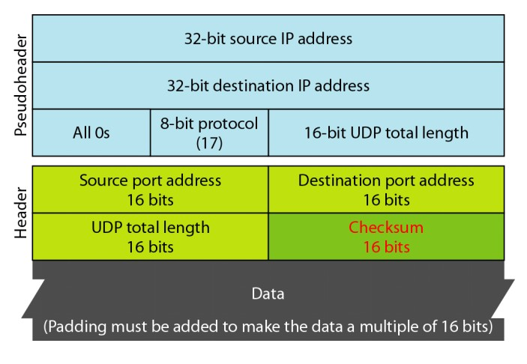
Pseudo Header for Checksum Calculation
Checksum....!
Data Communictions and Networking48/ 94

Slide 49
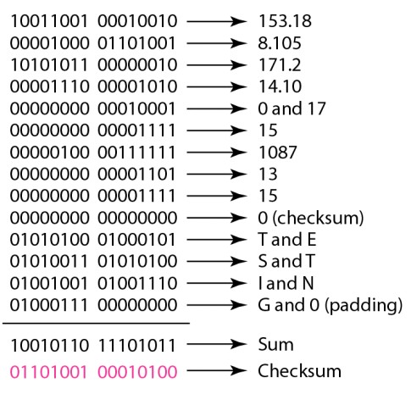
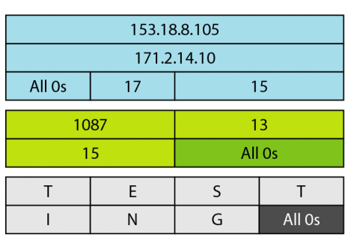
Checksum calculation for Simple UDP
Checksum Calculation
Checksum....!
Data Communictions and Networking49/ 94

Slide 50
TCP versus UDP
TCP | UDP
Connection-oriented protocol. | Connectionless protocol.
Reads data as streams of bytes, and the message is transmitted to segment boundaries. | Messages contain packets that were sent one by one. It also checks for integrity at the arrival time.
TCP messages make their way across the internet from one computer to another. | It is not connection-based, so one program can send lots of packets to another.
TCP rearranges data packets in the specific order. | UDP protocol has no fixed order because all packets are independent of each other.
The speed for TCP is slower. | UDP is faster as error recovery is not attempted.
Header size is 20 bytes | Header size is 8 bytes.
Data Communictions and Networking50/ 94

Slide 51
TCP versus UDP
TCP | UDP
TCP is heavy-weight. TCP needs three packets to set up a socket connection before any user data can be sent. | UDP is lightweight. No tracking connections, Ordering of messages, etc.
It does error checking and also makes error recovery. | UDP performs error checking, but it discards erroneous packets.
Acknowledgment segments | No Acknowledgment segments
Using handshake protocol like SYN, SYN-ACK, ACK | No handshake (so connectionless protocol)
TCP is reliable as it guarantees delivery of data to the destination router. | The delivery of data to the destination can’t be guaranteed in UDP.
It offers extensive error checking mechanisms because it provides flow control and acknowledgment of data. | UDP has just a single error checking mechanism which is used for checksums.
Data Communictions and Networking51/ 94

Slide 52
Data Communictions and Networking
Congestion Control and Quality of Service
Data Communictions and Networking52/ 94

Slide 53
Congestion Control and QoS
Congestion control and Quality of Service(QoS) are two issues so closely bound together that improving one means improving the other and ignoring one usually means ignoring the other.
The techniques to prevent or eliminate congestion also improve the QoS in a network.
Goals of Data Traffic: is the amount of data moving across a network at a given point of time.
In Congestion Control - Avoid Traffic Congestion
In QoS : creates an appropriate environment for the traffic.
Data Communictions and Networking53/ 94

Slide 54
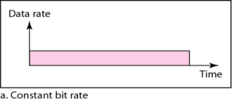
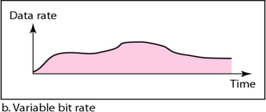
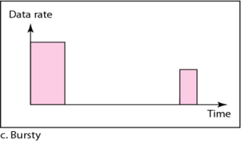
Trafic Profiles
Constant-bit-rate(CBR), or a fixed-rate - Data rate that doesn’t change.
Variable-bit-rate(VBR) - the rate of the data flow changes in time, with the changes smooth instead of sudden and sharp.
Bursty Data rate- the data rate changes suddenly in a very short time.
Data Communictions and Networking54/ 94

Slide 55
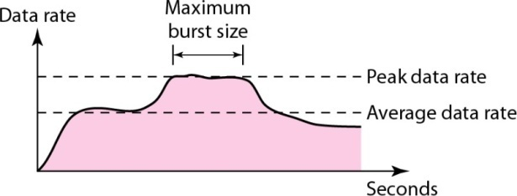
Traffic Descriptors -I
Traffic descriptors are qualitative values that represent a data flow
Average Rate: is the number of bits sent during a period of time, divided by the number of seconds in that period.
It indicates the average bandwidth needed by the traffic.
Average_Data_Rate : ^{Amount_of _Data}
Time
Maximum Burst Rate: refers to the maximum length of time the traffic is generated at the peak rate.
Data Communictions and Networking55/ 94

Slide 56
Traffic Descriptors -II
Peak Rate: defines the maximum data rate of the traffic.
Maximum Burst Rate: refers to the maximum length of time the traffic is generated at the peak rate.
Effective Bandwidth: is the bandwidth that the network needs to allocate for the flow of traffic.
It is a function of three values:
Average data rate Peak data rate, and Maximum burst size.
Data Communictions and Networking56/ 94

Slide 57
Congestion
It is an Important issue in a packet-switched network.
Congestion in a network may occur
if the load on the network, i.e., The number of packets sent to the network is greater than the capacity of the network
The number of packets a network can handle.
Congestion Control...
It refers to the mechanisms and techniques to control the congestion and keep the load below the capacity.
Data Communictions and Networking57/ 94

Slide 58
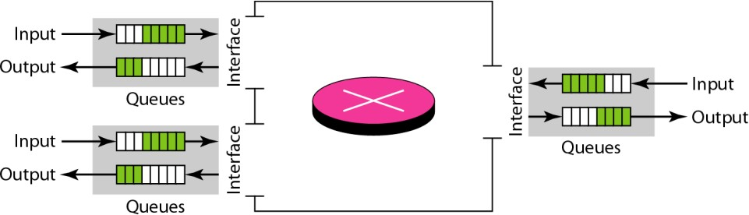
Queues in Router/Switches
Congestion in a network occurs because routers and switches have
queues-buffers that hold the packets before and after processing.
Data Communictions and Networking58/ 94

Slide 59
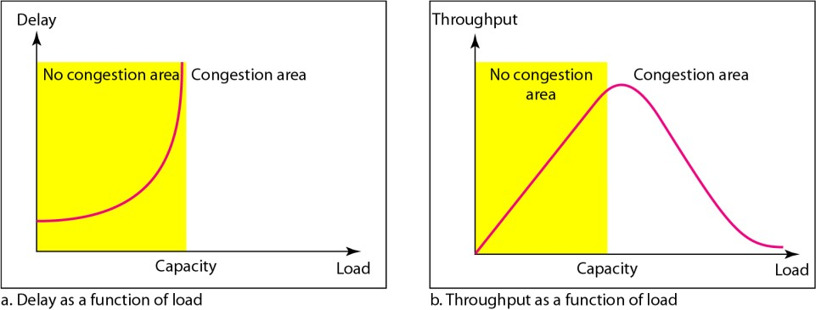
Network Performance
Congestion control involves 2 factors to measure the Network Performance :
Delay: refers to the amount of time it takes for a packet to go from point A to point B
Throughput: refers to how much data (No. of Packets) can be transferred from source to destination within a given timeframe
Data Communictions and Networking59/ 94

Slide 60
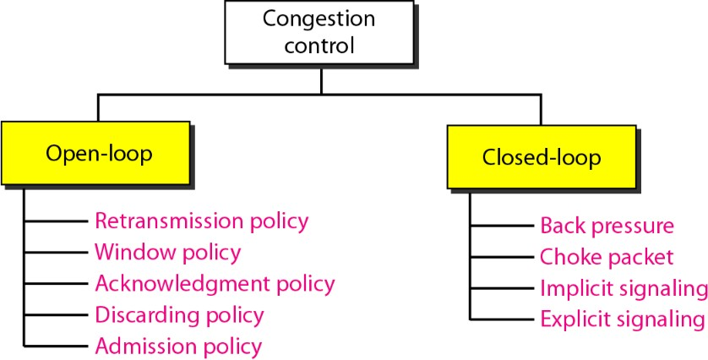
Congestion Control
Congestion Control...
It refers to the mechanisms and techniques to control the congestion and keep the load below the capacity.
In general, we can divide congestion control mechanisms into two broad categories: open-loop congestion control (prevention) and closed-loop congestion control (removal).
Data Communictions and Networking60/ 94

Slide 61
Open-loop Congestion Control
Re-transmission Policy:
If the sender feels that a sent packet is lost or corrupted, the packet needs to be retransmitted.
Re-transmission may increase congestion in the network. However, a good re-transmission policy can prevent congestion.
Window Policy:
The type of window at the sender may also affect congestion. The Selective Repeat window is better than the Go-Back-N window
for congestion control.
In the Go-Back-N window, when the timer for a packet times out, several packets may be resent, although some may have arrived safe and sound at the receiver. This duplication may make
the congestion worse.
The Selective Repeat window, on the other hand, tries to send the specific packets that have been lost or corrupted.
Data Communictions and Networking61/ 94

Slide 62
Open-loop Congestion Control
Acknowledgment Policy:
It imposed by the receiver, may also affect congestion.
If the receiver does not acknowledge every packet it receives, it may slow down the sender and help prevent congestion.
A receiver may decide to acknowledge only N packets at a time. We need to know that the acknowledgments are also part of the load in a network. Sending fewer acknowledgments means imposing less load on the network.
Discarding Policy:
A good discarding policy by the routers may prevent congestion and at the same time may not harm the integrity of the transmission.
For example, in audio transmission, if the policy is to discard less sensitive packets when congestion is likely to happen, the quality of sound is still preserved and congestion is prevented or alleviated.
Data Communictions and Networking62/ 94

Slide 63
Open-loop Congestion Control
Admission Policy:
It is a QoS mechanism can also prevent congestion in virtual-circuit networks.
Switches in a flow first check the resource requirement of a flow before admitting it to the network.
A router can deny establishing a virtual-circuit connection if there is congestion in the network or if there is a possibility of
future congestion.
Data Communictions and Networking63/ 94

Slide 64
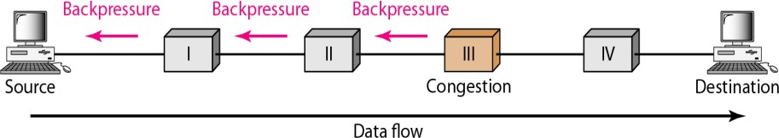
Closed-loop Congestion Control (Removal)
Backpressure:
It refers to a congestion control mechanism in which a congested node stops receiving data from the immediate node or nodes.
This may cause the upstream node or nodes to become congested, and they, in turn, reject data from their upstream nodes or nodes.
Buffer full
Data Communictions and Networking64/ 94

Slide 65
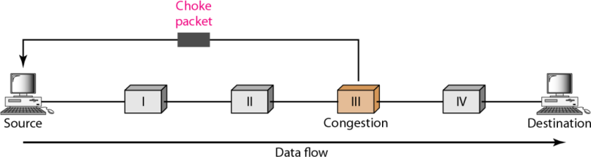
Closed-loop Congestion Control
Choke Packets:
It is a packet sent by a node to the source to inform it of congestion. When a router in the Internet is overwhelmed with IP datagrams, it may discard some of them; but it informs the source host, using a source quench ICMP(Internet Control Message Protocol) message.
The warning message goes directly to the source station; the intermediate routers, and does not take any action.
Data Communictions and Networking65/ 94

Slide 66
Choke Packets:
Difference b/w Choke Packets and Backpressure
The warning is from the router, which has encountered congestion, to the source station directly. The inter-mediate nodes through which the packet has traveled are not warned.
Back Pressure:
The warning is from one node to its upstream node, although the warning may eventually reach the source station.
Data Communictions and Networking66/ 94

Slide 67
Closed-loop Congestion Control
Implicit Signaling:
There is no communication b/w the congested node and source. The source guesses that there is a congestion somewhere in the network from other symptoms.
For Eg: when a source sends several packets and no acknowledgment for a while, one assumption is that the network is congested.
The delay in receiving an acknowledgment is interpreted
as congestion in the network; the source should slow down.
Explicit Signaling:
The node that experiences congestion can explicitly send a signal to the source or destination.
In this method, however, is different from the choke packet method.
In the choke packet method, a separate packet is used for this purpose; In the explicit signaling method, the signal is included in the packets that carry data.
It can occur in either the forward or the backward direction.
Data Communictions and Networking67/ 94

Slide 68
Closed-loop Congestion Control
Backward Signaling:
A bit can be set in a packet moving in the direction opposite to the congestion.
This bit can warn the source that there is congestion and that it needs to slow down to avoid the discarding of packets.
Forward Signaling:
A bit can be set in a packet moving in the direction of the congestion.
This bit can warn the destination that there is congestion.
The receiver in this case can use policies, such as slowing down the acknowledgments, to alleviate the congestion
Data Communictions and Networking68/ 94

Slide 69
Example - Congestion Control in TCP
TCP General Policy
Congestion Control is based on three phases:
Slow start
Congestion avoidance and Congestion detection.
Note: The size of the congestion window increases exponentially until it reaches a threshold.
Slow-start phase,
The sender starts with a very slow rate of transmission, but increases the rate rapidly to reach a threshold.
When the threshold is reached, the data rate is reduced to avoid congestion.
Finally if congestion is detected, the sender goes back to the slow-start or congestion avoidance phase based on how the congestion is detected.
Data Communictions and Networking69/ 94

Slide 70
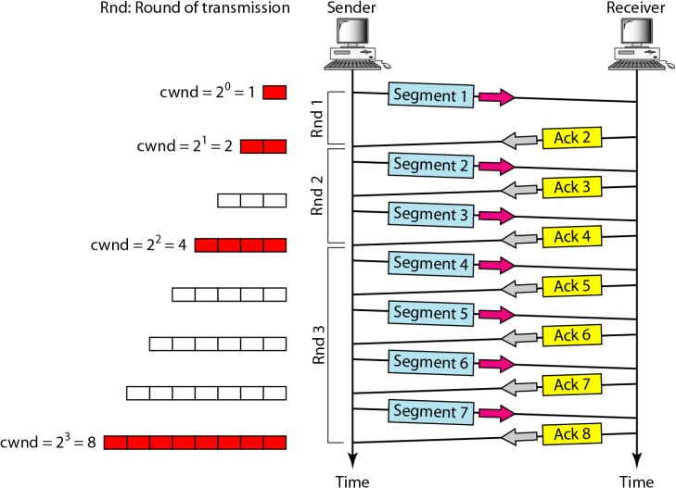
Slowstart - Exponential Increase
Figure:Slow Start Phase
Data Communictions and Networking70/ 94

Slide 71
Congestion Avoidance - Additive Increase
Congestion Avoidance: Additive Increase:
It start with the Slow-start algorithm, the size of the congestion window increases exponentially.
To avoid congestion before it happens, one must slow down this exponential growth.
TCP defines another algorithm called congestion avoidance, which undergoes an additive increase instead of an exponential one.
When the size of the congestion window reaches the slow-start threshold, the slow-start phase stops and the additive phase begins.
In this algorithm, each time the whole window of segments is acknowledged (one round), the size of the congestion window is increased by 1
Data Communictions and Networking71/ 94

Slide 72
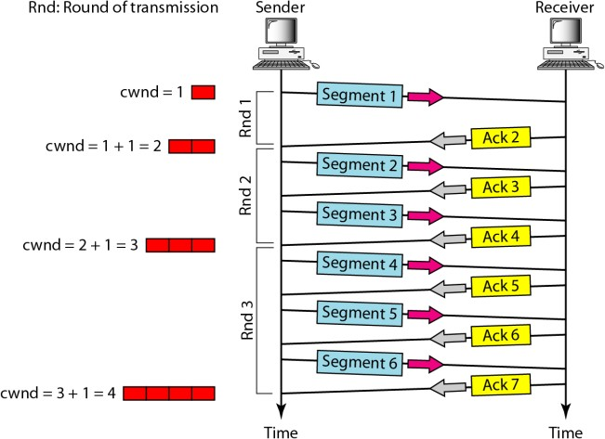
Congestion Avoidance - Additive Increase
Figure:Congestion Avoidance
Data Communictions and Networking72/ 94

Slide 73
Congestion Detection - Multiplicative Decrease
Congestion Detection: Multiplicative Decrease:
If congestion occurs, the congestion window size must be decreased.
The only way the sender can guess that congestion has occurred is by the need to retransmit a segment. However, retransmission can occur in one of two cases:
When a timer times out :
When three ACKs are received.
In both cases, the size of the threshold is dropped to one-half, a multiplicative decrease.
Implementation Reaction to Congestion Detection
If detection is by time-out, a new slow-start phase starts.
If detection is by three ACKs, a new congestion avoidance phase starts.
Data Communictions and Networking73/ 94

Slide 74
Congestion Detection - Multiplicative Decrease
TCP implementations have two reactions:
1
If a time-out occurs, there is a stronger possibility of congestion; a segment has probably been dropped in the network, and there is no news about the sent segments.
It sets the value of the threshold to one-half of the current window size.
It sets cwnd to the size of one segment.
It starts the slow-start phase again.
If three ACKs are received, there is a weaker possibility of congestion; a segment may have been dropped, but some segments after that may have arrived safely since three ACKs are received.
This is called fast transmission and fast recovery. In this case, TCP
has a weaker reaction:
It sets the value of the threshold to one-half of the current window size.
It sets cwnd to the value of the threshold (some implementations add three segment sizes to the threshold).
It starts the congestion avoidance phase
2
Data Communictions and Networking74/ 94

Slide 75
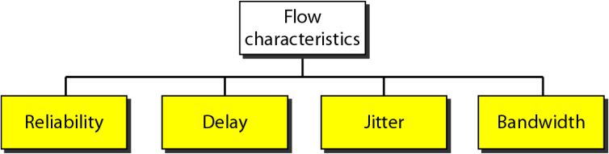
Quality of Service
QoS is an Internetworking Issue
It refers to a set of techniques & mechanisms that guarantee the performance of the n/w to deliver predictable service to an application program.
Techniques to Improve QoS
Scheduling Traffic Shaping
Resource Reservation Admission Control
Data Communictions and Networking75/ 94

Slide 76
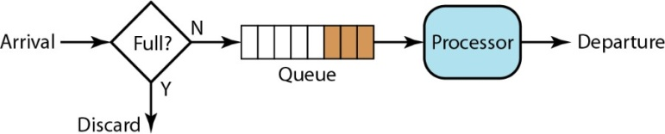
QoS - Scheduling -I
Packets from different flows arrive at a switch/router for processing.
A good scheduling technique treats the different flows in a fair and appropriate manner.
Several scheduling techniques are designed to improve the QoS. We discuss three of them here:
FIFO queuing:
Data Communictions and Networking76/ 94

Slide 77
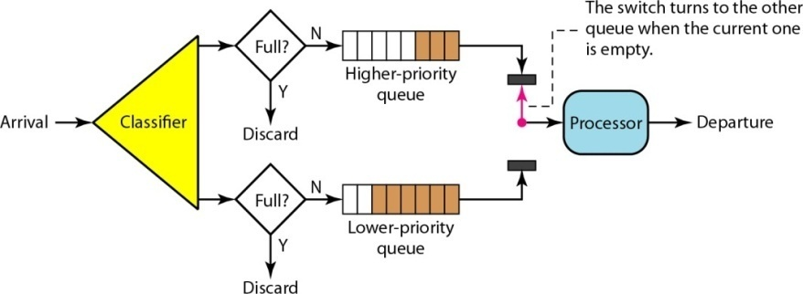
QoS - Scheduling -II
Priority queuing:
Data Communictions and Networking77/ 94

Slide 78
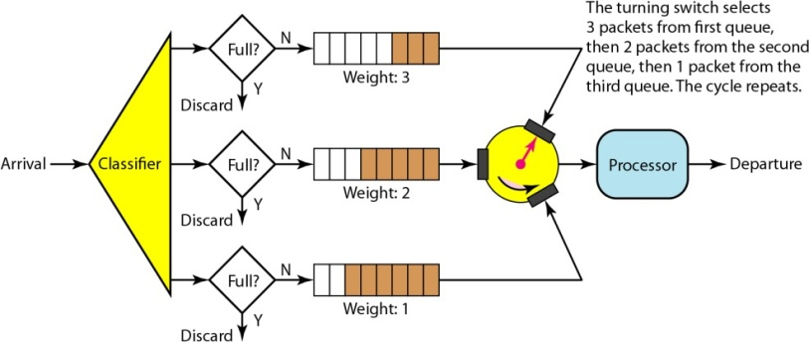
QoS - Scheduling -III
Weighted fair queuing:
Data Communictions and Networking78/ 94

Slide 79
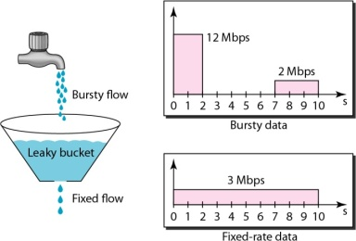
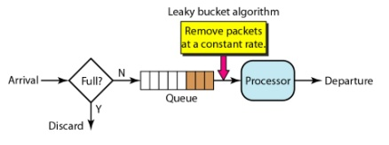
QoS - Traffic Shapping -I
It is a mechanism to control the amount and the rate of the traffic sent to the network.
Two techniques can shape traffic: Leaky bucket and Token bucket.
Leaky bucket :
1
Implementation of Leaky Bucket
Data Communictions and Networking79/ 94

Slide 80
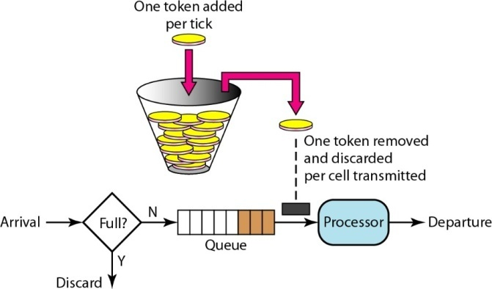
QoS - Traffic Shapping -II
2
Token bucket :
Data Communictions and Networking80/ 94

Slide 81
QoS - Traffic Shapping
Leaky Bucket
It shapes bursty traffic into fixed-rate traffic by averaging the data rate. It may drop the packets if the bucket is full.
Token Bucket
It allows bursty traffic at a regulated maximum rate.
Conclusion
The two techniques can be combined to credit an idle host and at the same time regulate the traffic.
The leaky bucket is applied after the token bucket;
The rate of the leaky bucket needs to be higher than the rate of tokens dropped in the bucket.
Data Communictions and Networking81/ 94

Slide 82

Thanks
Data Communictions and Networking82/ 94

