Slide 1
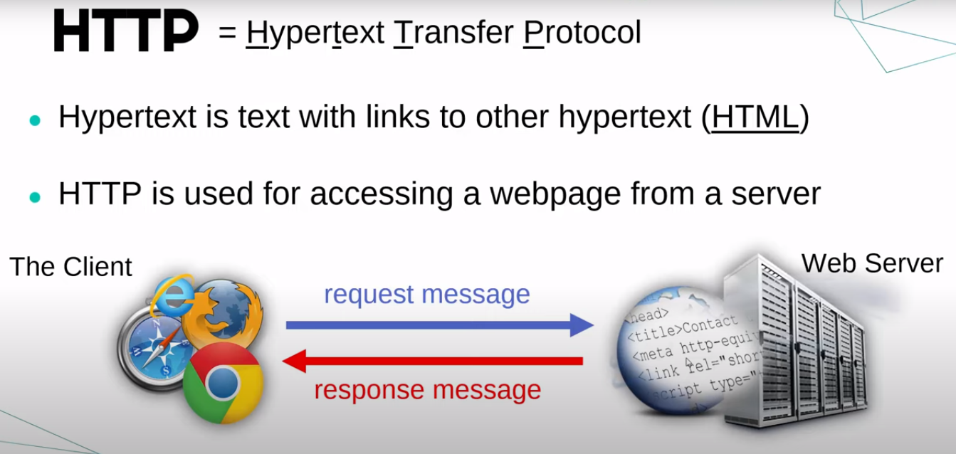
HTTP

Slide 2
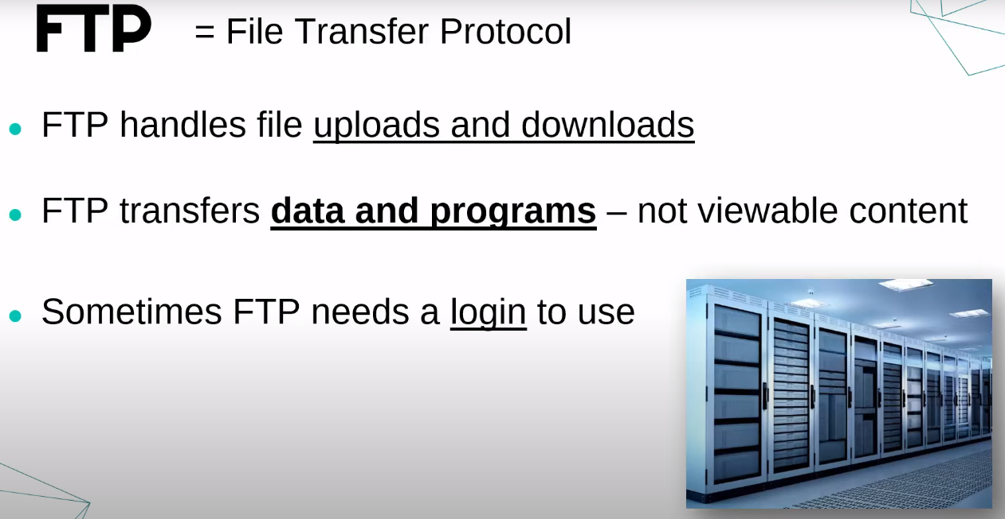

Slide 3
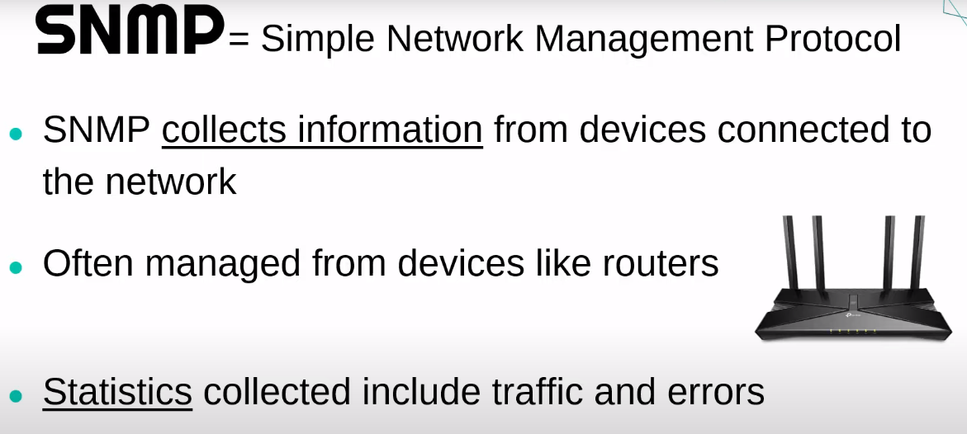
Manager – Host, Agent - Router
Simple protocol to manage and monitor network elements.→ Done with the help of network agents.

Slide 4
