Slide 1
Module 1
INTRODUCTION

Slide 2
What is an Operating System?
A program that acts as an intermediary between a user of a computer and the computer hardware.
Operating system goals:
Execute user programs and make solving user problems easier.
Make the computer system convenient to use.
Use the computer hardware in an efficient manner

Slide 3
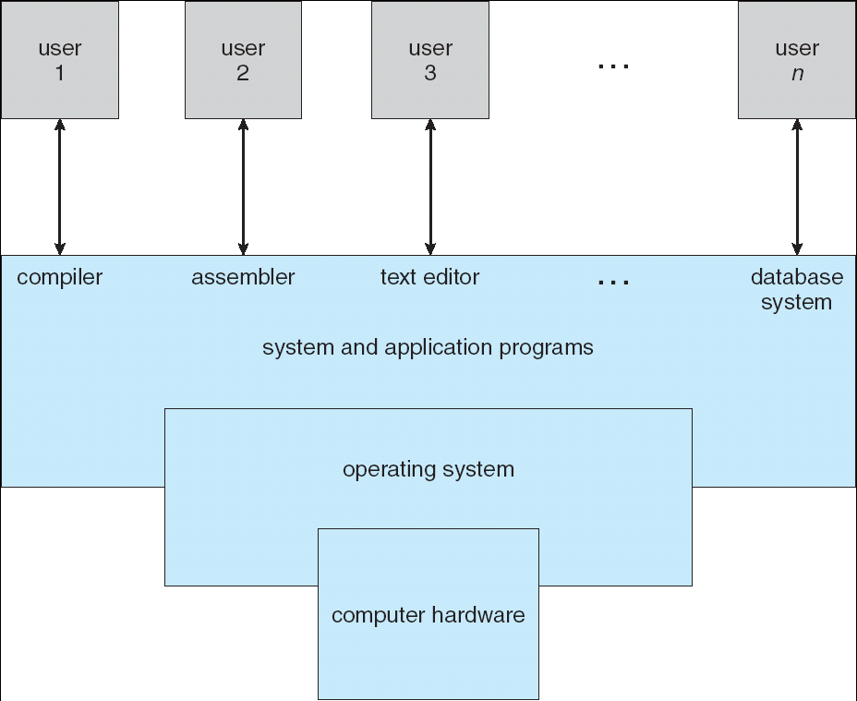
Four Components of a Computer System

Slide 4
System Boot
Booting – starting a computer by loading the kernel
Bootstrap program – code stored in ROM that is able to locate the kernel, load it into memory, and start its execution
Bootstrap program is loaded at power-up or reboot
Typically stored in ROM or EEPROM, generally known as firmware
Initializates all aspects of system
Loads operating system kernel and starts execution

Slide 5
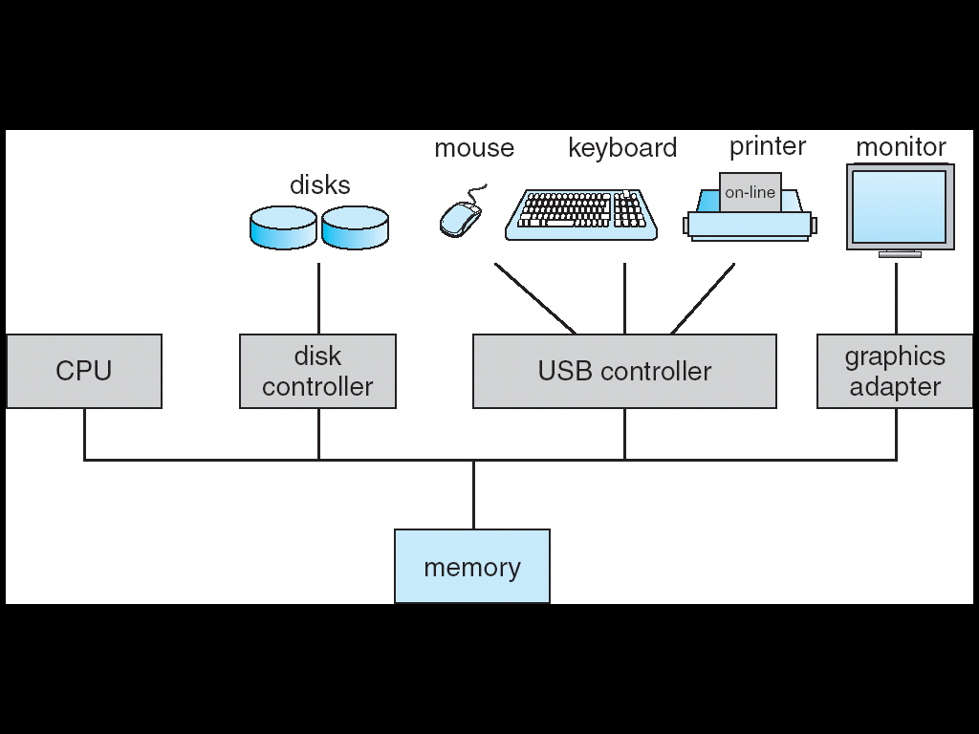
Computer System Organization

Slide 7
OS Services
Operating systems provide an environment for execution of programs and services to programs and users
One set of operating-system services provides functions that are helpful to the user:
User interface - Almost all operating systems have a user interface (UI).
Varies between Command-Line (CLI), Graphics User Interface (GUI)
Program execution - The system must be able to load a program into memory and to run that program, end execution, either normally or abnormally (indicating error)
I/O operations - A running program may require I/O, which may involve a file or an I/O device

Slide 8
OS Services (cont…)
One set of operating-system services provides functions that are helpful to the user (Cont.):
File-system manipulation - The file system is of particular interest. Programs need to read and write files and directories, create and delete them, search them, list file Information, permission management.
Communications – Processes may exchange information, on the same computer or between computers over a network
Communications may be via shared memory or through message passing (packets moved by the OS)
Error detection – OS needs to be constantly aware of possible errors
May occur in the CPU and memory hardware, in I/O devices, in user program
For each type of error, OS should take the appropriate action to ensure correct and consistent computing
Debugging facilities can greatly enhance the user’s and programmer’s abilities to efficiently use the system

Slide 9
OS Services (cont…)
Another set of OS functions exists for ensuring the efficient operation of the system itself via resource sharing
Resource allocation - When multiple users or multiple jobs running concurrently, resources must be allocated to each of them
Many types of resources - CPU cycles, main memory, file storage, I/O devices.
Accounting - To keep track of which users use how much and what kinds of computer resources
Protection and security - The owners of information stored in a multiuser or networked computer system may want to control use of that information, concurrent processes should not interfere with each other
Protection involves ensuring that all access to system resources is controlled
Security of the system from outsiders requires user authentication, extends to defending external I/O devices from invalid access attempts

Slide 10
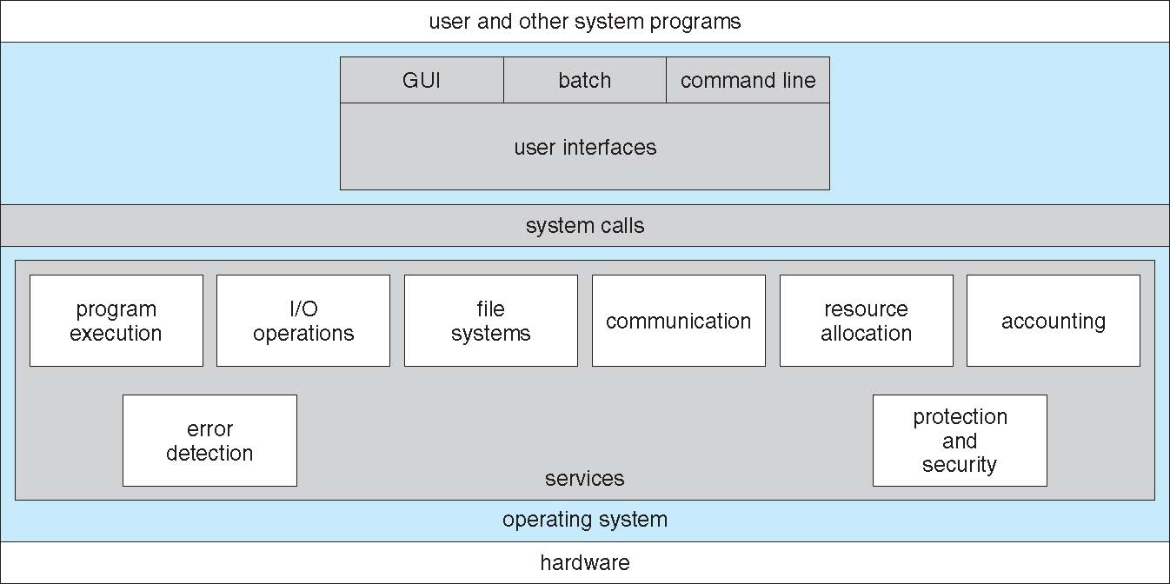
View of OS Services

Slide 11
OS Structuring methods
Monolithic
All functionalities in the kernel (one layer)
Layered
Lower levels independent of upper levels
Microkernel
OS built from many user-level processes
Kernel
Core kernel with Dynamically loadable modules

Slide 12
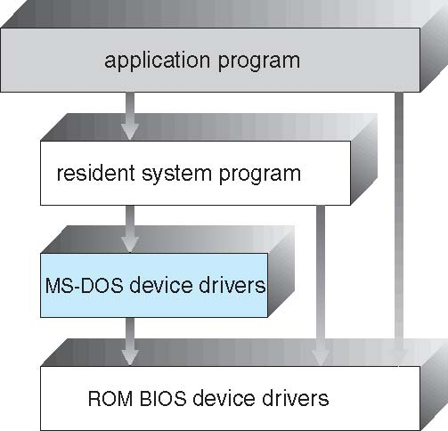
Simple OS (MS-DOS)

Slide 13
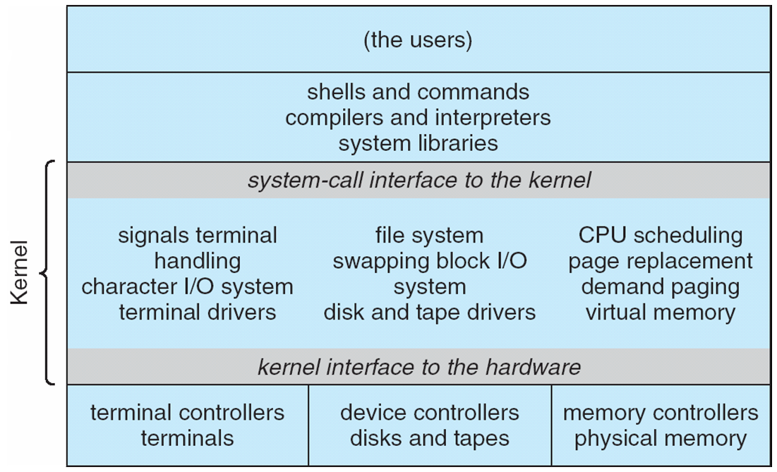
Monolithic OS – beyond simple
Traditional UNIX

Slide 14
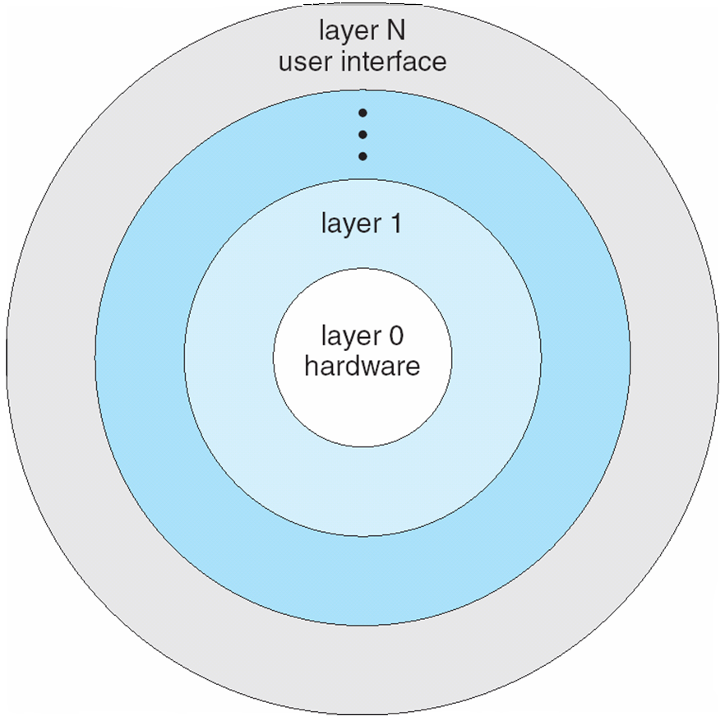
Layered OS
The operating system is divided into a number of layers (levels), each built on top of lower layers. The bottom layer (layer 0), is the hardware; the highest (layer N) is the user interface.
With modularity, layers are selected such that each uses functions (operations) and services of only lower-level layers
Ex. The Windows NT operating system

Slide 15
Layered OS

Slide 16
Microkernel OS
Moves as much from the kernel into user space
Mach example of microkernel
Mac OS X kernel (Darwin) partly based on Mach
Communication takes place between user modules using message passing
Benefits:
Easier to extend a microkernel
Easier to port the operating system to new architectures
More reliable (less code is running in kernel mode)
More secure
Detriments:
Performance overhead of user space to kernel space communication

Slide 17
Layered Vs Microkernel

Slide 18
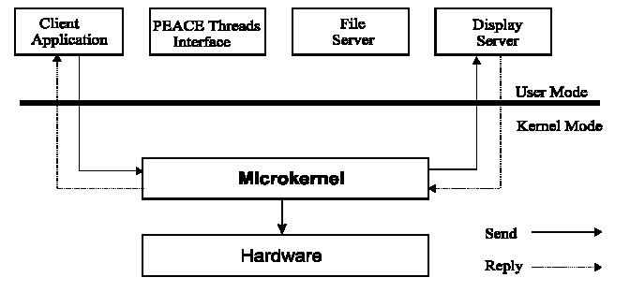
Microkernel OS

Slide 19
Windows XP Architecture

Slide 20
Kernel Modular OS
Most modern operating systems implement loadable kernel modules:
Uses object-oriented approach.
Each core component is separate.
Each talks to the others over known interfaces.
Each is loadable as needed within the kernel.
Overall, similar to layers but with more flexibility.
LINUX, Solaris, etc.

Slide 21
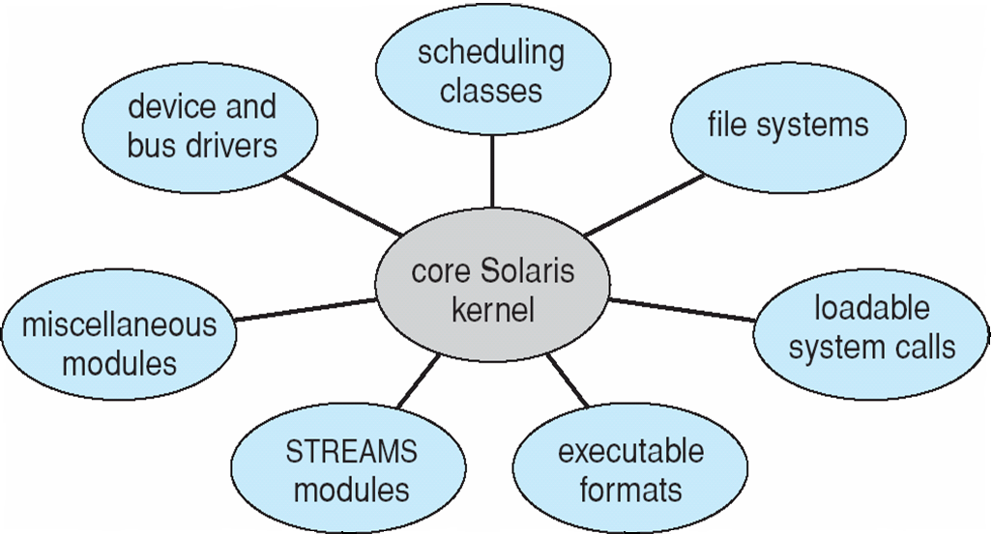
Kernel OS

Slide 22
OS Design issues
Though all the Major Design Issues will be applicable to most of the Operating Systems. The important issues related to Operating system are transparency, flexibility, reliability, performance, scalability, replication, synchronization, security.

Slide 23
Abstraction
Abstract Machine
Hides complex details of the underlying hardware
Provides common API to applications and services
Simplifies application writing
Command Interpreter
Part of a OS that understands and executes commands that are entered interactively by a human being or from a program
Shell

Slide 24
Why Abstraction?
Without OSs and abstract interfaces, application writers must program all device access directly
Load device command codes into device registers
Understand physical characteristics of the devices
Applications suffer!
Very complicated maintenance and upgrading
No portability

Slide 25
What OS does?
OS is a resource allocator
Manages all resources
Decides between conflicting requests for efficient and fair resource use
OS is a control program
Controls execution of programs to prevent errors and improper use of the computer

Slide 26
How OS executes a program?
Program - In secondary memory
Process - in Main Memory
To execute a program, OS with the help of “Process Management” module will create a process
Process : Space allocated in main memory for the program
Three segments : Code (CS), Data(DS) and Stack(SS)
Segment is a logical collection of memory. In turn it is mapped to blocks of main memory. A segment can include non-contiguous blocks
CS : Code Segment contains instructions to be executed
DS : Data Segment contains data to be used in the program
SS : Stack Segment used for procedure calls

Slide 27
Security : How using segments protection is guaranteed?
When process is allocated segments, a segment selector (kind of register) is used to monitor the privilege level
For example, CS always have privilege level to be CL (current level)
So if the process is from user space, it is impossible for it to use memory beyond its existence or leave open files etc.
Every time a process tries to access a memory address or IO, these registers will be checked for and will be accordingly allowed to access depending on the privilege

Slide 28
Protection and Security
Protection –any mechanism for controlling access of processes or users to resources defined by the OS
Security –defense of the system against internal and external attacks
Huge range, including denial-of-service, worms, viruses, identity theft, theft of service
Systems generally first distinguish among users, to determine who can do what
User identities (userIDs, securityIDs) include name and associated number, one per user
UserID then associated with all files, processes of that user to determine access control
Group identifier (groupID) allows set of users to be defined and controls managed, then also associated with each process, file
Privilege escalation allows user to change to effective ID with more rights

Slide 29
Network and Multimedia
Computing Environments - Traditional
Stand-alone general purpose machines
But blurred as most systems interconnect with others (i.e., the Internet)
Portals provide web access to internal systems
Network computers (thin clients) are like Web terminals
Mobile computers interconnect via wireless networks
Networking becoming ubiquitous –even home systems use firewalls to protect home computers from Internet attacks

Slide 30
Network and Multimedia
Computing Environments - Distributed
Collection of separate, possibly heterogeneous, systems networked together
Network is a communications path, TCP/IP most common
Local Area Network (LAN)
Wide Area Network (WAN)
Metropolitan Area Network (MAN)
Network Operating System provides features between systems across network
Communication scheme allows systems to exchange messages

Slide 31
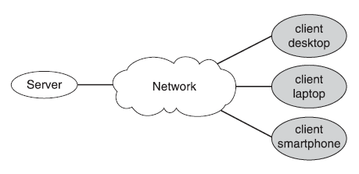
Network and Multimedia
Computing Environments – Client Server
Dumb terminals supplanted by smart PCs
Many systems now servers, responding to requests generated by clients
Compute-server system provides an interface to client to request services (i.e., database)
File-server system provides interface for clients to store and retrieve files

Slide 32
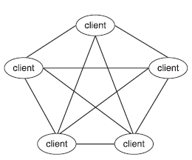
Network and Multimedia
Computing Environments: Peer to Peer
Another model of distributed system
P2P does not distinguish clients and servers
Instead all nodes are considered peers
May each act as client, server or both
Node must join P2P network
Registers its service with central lookup service on network, or
Broadcast request for service and respond to requests for service via discovery protocol
Examples include Napster and Gnutella, Voice over IP (VoIP) such as Skype

Slide 33
Network and Multimedia
Computing Environments – Mobile
Handheld smartphones, tablets, etc
What is the functional difference between them and a “traditional” laptop?
Extra feature –more OS features (GPS, gyroscope)
Allows new types of apps like augmented reality
Use IEEE 802.11 wireless, or cellular data networks for connectivity
Leaders are Apple iOS and Google Android

Slide 34
Network and Multimedia
Computing Environments – Virtualization
Allows operating systems to run applications within other OSes
Vast and growing industry
Emulation used when source CPU type different from target type (i.e. PowerPC to Intel x86)
Generally slowest method
When computer language not compiled to native code –Interpretation
Virtualization – OS natively compiled for CPU, running guest OSes also natively compiled
Consider VMware running WinXP guests, each running applications, all on native WinXP host OS
VMM (virtual machine Manager) provides virtualization services

Slide 35
Network and Multimedia
Computing Environments – Cloud Computing
Delivers computing, storage, even apps as a service across a network
Logical extension of virtualization because it uses virtualization as the base for it functionality.
Amazon EC2 has thousands of servers, millions of virtual machines, petabytes of storage available across the Internet, pay based on usage
Many types
Public cloud – available via Internet to anyone willing to pay
Private cloud – run by a company for the company’s own use
Hybrid cloud – includes both public and private cloud components
Software as a Service (SaaS) – one or more applications available via the Internet (i.e., word processor)
Platform as a Service (PaaS) – software stack ready for application use via the Internet (i.e., a database server)
Infrastructure as a Service (IaaS) – servers or storage available over Internet (i.e., storage available for backup use)

Slide 36
Network and Multimedia
Computing Environments – Real Time Embedded Systems
Real-time embedded systems most prevalent form of computers
Vary considerable, special purpose, limited purpose OS, real-time OS
Use expanding
Many other special computing environments as well
Some have OSes, some perform tasks without an OS
Real-time OS has well-defined fixed time constraints
Processing must be done within constraint
Correct operation only if constraints met

Slide 37
Network and Multimedia
Computing Environments – Open Source OS
Operating systems made available in source-code format rather than just binary closed-source
Counter to the copy protection and Digital Rights Management (DRM) movement
Started by Free Software Foundation (FSF), which has “copyleft” GNU Public License (GPL)
Examples include GNU/Linux and BSD UNIX (including core of Mac OS X), and many more
Can use VMM like VMware Player (Free on Windows), Virtualbox (open source and free on many platforms - http://www.virtualbox.com)
Use to run guest operating systems for exploration

Slide 38
Any Questions ?

Slide 39
References
http://www.digilife.be/quickreferences/qrc/linux%20system%20call%20quick%
Silberschatz, Gagne, Galvin: Operating System Concepts, 6th Edition
http://docs.cs.up.ac.za/programming/asm/derick_tut/syscalls.html

Slide 40
Thank You!

