Slide 1
Module 4
Concurrency

Slide 2
Inter Process Communication

Slide 3
IPC- process executing concurrently in os either
Independent Process
Cooperating process
information sharing.
computation speedup.
Modularity
convenience

Slide 4
Interprocess Communication
Used to exchange data and information among cooperating process
2 Models for IPC
Shared Memory
A region of memory is shared among cooperating processes
Data can be exchanged by reading and writing it in the shared region
Faster
System call used to create a shared memory
Message Passing
Small size data exchange
Easier to implement
Uses System Calls. More kernel intervention when compare to shared memory

Slide 5
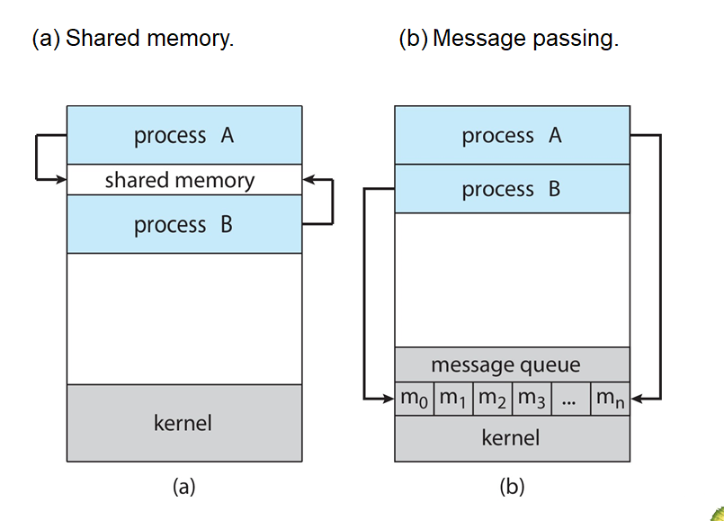
Communication Models

Slide 6
Shared Memory
Shared memory region resides in the address space of the process creating the shared memory
Other processes can attach with this shared memory segment for communication
This concept allow one process to access the memory space of others
Reading and writing data in the shared memory creates the exchange of information between the processes
Simultaneous writing on the same location should be avoided
Ex of Cooperating Processes: Producer – Consumer Problem
Producer process produces the product that consumed by the Consumer process

Slide 7
Shared Memory – Producer Consumer Problem
Producer – Consumer problem can be solved by Shared Memory
It allows Producer and Consumer run simultaneously by sharing the buffer space where items are placed and consumed
Buffer memory region is shared by two processes
These two processes must be synchronized → consumer should not try to consume an item if produced has not yet produced the items
2 types of Buffer
Bounded buffer – fixed buffer size
Unbounded buffer – no limit in the buffer size

Slide 8
Processes can execute concurrently
May be interrupted at any time, partially completing execution
Concurrent access to shared data may result in data inconsistency
Maintaining data consistency requires mechanisms to ensure the orderly execution of cooperating processes.
Illustration of the problem: Suppose that we wanted to provide a solution to the consumer-producer problem that fills all the buffers. We can do so by having an integer counter that keeps track of the number of full buffers. Initially, counter is set to 0. It is incremented by the producer after it produces a new buffer and is decremented by the consumer after it consumes a buffer.

Slide 9
Process Synchronization
Background
The Critical-Section Problem
Peterson’s Solution
Synchronization Hardware
Mutex Locks
Semaphores
Classic Problems of Synchronization
Monitors
Synchronization Examples

Slide 10
Objectives
To present the concept of process synchronization.
To introduce the critical-section problem, whose solutions can be used to ensure the consistency of shared data
To present both software and hardware solutions of the critical-section problem
To examine several classical process-synchronization problems
To explore several tools that are used to solve process synchronization problems

Slide 11
Background
Processes can execute concurrently
May be interrupted at any time, partially completing execution
Concurrent access to shared data may result in data inconsistency
Maintaining data consistency requires mechanisms to ensure the orderly execution of cooperating processes
Illustration of the problem: Suppose that we wanted to provide a solution to the consumer-producer problem that fills all the buffers. We can do so by having an integer counter that keeps track of the number of full buffers. Initially, counter is set to 0. It is incremented by the producer after it produces a new buffer and is decremented by the consumer after it consumes a buffer.

Slide 12
Producer
while (true) { /* produce an item in next produced */
while (counter == BUFFER_SIZE) ;
/* do nothing */
buffer[in] = next_produced;
in = (in + 1) % BUFFER_SIZE;
counter++;
}

Slide 13
Consumer
while (true) {
while (counter == 0)
; /* do nothing */
next_consumed = buffer[out];
out = (out + 1) % BUFFER_SIZE;
counter--;
/* consume the item in next consumed */
}

Slide 14
Race Condition
A race condition is an undesirable situation that occurs when a device
or system attempts to perform two or more operations at the same time

Slide 15
Critical Section Problem
Consider system of n processes {p₀, p₁, … p_{n-1}}
Each process has critical section segment of code
Process may be changing common variables, updating table, writing file, etc
When one process in critical section, no other may be in its critical section
Critical section problem is to design protocol to solve this
Each process must ask permission to enter critical section in entry section, may follow critical section with exit section, then remainder section

Slide 16
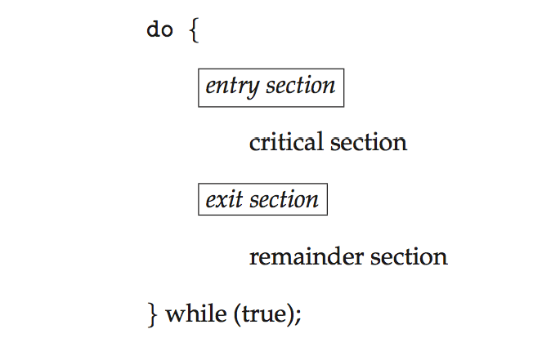
Critical Section
General structure of process P_{i}

Slide 17
Algorithm for Process P_{i}
do {
while (turn == j);
critical section
turn = j;
remainder section
} while (true);

Slide 18
Solution to Critical-Section Problem
1. Mutual Exclusion - If process P_{i} is executing in its critical section, then no other processes can be executing in their critical sections
2. Progress - If no process is executing in its critical section and there exist some processes that wish to enter their critical section, then the selection of the processes that will enter the critical section next cannot be postponed indefinitely
3. Bounded Waiting - A bound must exist on the number of times that other processes are allowed to enter their critical sections after a process has made a request to enter its critical section and before that request is granted.

Slide 19
Critical-Section Handling in OS
Two approaches depending on if kernel is preemptive or non- preemptive
Preemptive – allows preemption of process when running in kernel mode
Non-preemptive – runs until exits kernel mode, blocks, or voluntarily yields CPU
Essentially free of race conditions in kernel mode

Slide 20
Peterson’s Solution
Good algorithmic description of solving the problem
Two process solution
Assume that the load and store machine-language instructions are atomic; that is, cannot be interrupted
The two processes share two variables:
int turn;
Boolean flag[2]
The variable turn indicates whose turn it is to enter the critical section
The flag array is used to indicate if a process is ready to enter the critical section. flag[i] = true implies that process P_{i} is ready!

Slide 21
Algorithm for Process P_{i}
do {
flag[i] = true;
turn = j;
while (flag[j] && turn = = j);
critical section
flag[i] = false;
remainder section
} while (true);

Slide 22
Peterson’s Solution (Cont.)
Provable that the three CS requirement are met:
1. Mutual exclusion is preserved
P_{i} enters CS only if:
either flag[j] = false or turn = i
2. Progress requirement is satisfied
3. Bounded-waiting requirement is met

Slide 23
Synchronization Hardware
Many systems provide hardware support for implementing the critical section code.
All solutions below based on idea of locking
Protecting critical regions via locks
Uniprocessors – could disable interrupts
Currently running code would execute without preemption
Generally too inefficient on multiprocessor systems
Operating systems using this not broadly scalable
Modern machines provide special atomic hardware instructions
Atomic = non-interruptible
Either test memory word and set value
Or swap contents of two memory words

Slide 24
Solution to Critical-section Problem Using Locks
do {
acquire lock
critical section
release lock
remainder section
} while (TRUE);

Slide 25
test_and_set Instruction
Definition:
boolean test_and_set (boolean *target)
{
boolean rv = *target;
*target = TRUE;
return rv:
}
Executed atomically
Returns the original value of passed parameter
Set the new value of passed parameter to “TRUE”.

Slide 26
Solution using test_and_set()
Shared Boolean variable lock, initialized to FALSE
Solution:
do { while (test_and_set(&lock))
; /* do nothing */
/* critical section */
lock = false;
/* remainder section */
} while (true);

Slide 27
compare_and_swap Instruction
Definition:
int compare _and_swap(int *value, int expected, int new_value) {
int temp = *value;
if (*value == expected)
*value = new_value;
return temp;
}
Executed atomically
Returns the original value of passed parameter “value”
Set the variable “value” the value of the passed parameter “new_value” but only if “value” ==“expected”. That is, the swap takes place only under this condition.

Slide 28
Solution using compare_and_swap
Shared integer “lock” initialized to 0;
Solution:
do { while (compare_and_swap(&lock, 0, 1) != 0)
; /* do nothing */
/* critical section */
lock = 0;
/* remainder section */
} while (true);

Slide 29
Mutex Locks
OS designers build software tools to solve critical section problem
Simplest is mutex lock
Protect a critical section by first acquire() a lock then release() the lock
Boolean variable indicating if lock is available or not
Calls to acquire() and release() must be atomic
Usually implemented via hardware atomic instructions
But this solution requires busy waiting
This lock therefore called a spinlock

Slide 30
acquire() and release()
acquire() { while (!available)
; /* busy wait */
available = false;
}
release() {
available = true;
}
do {
acquire lock
critical section
release lock
remainder section
} while (true);

Slide 31
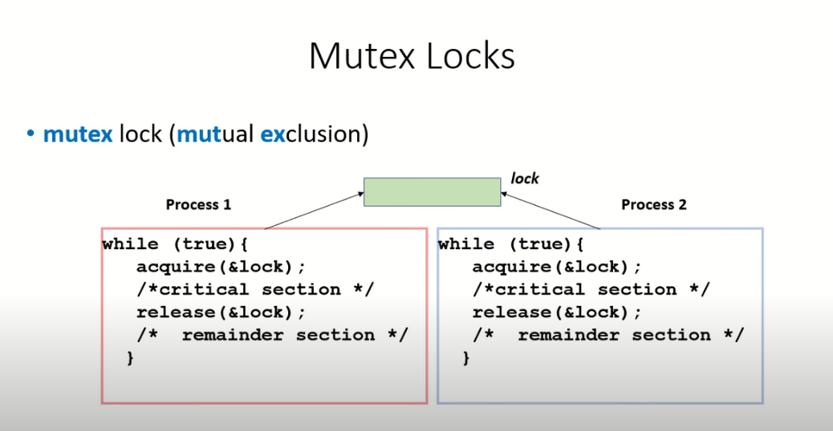

Slide 32
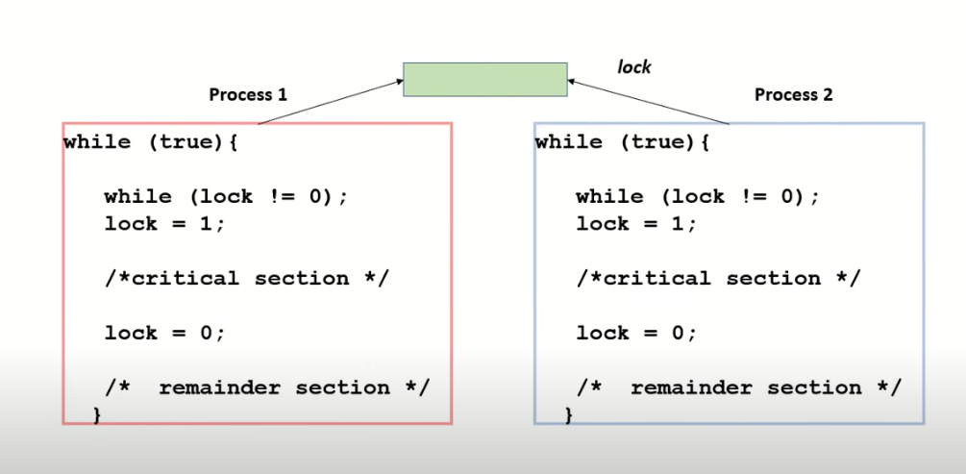

Slide 33
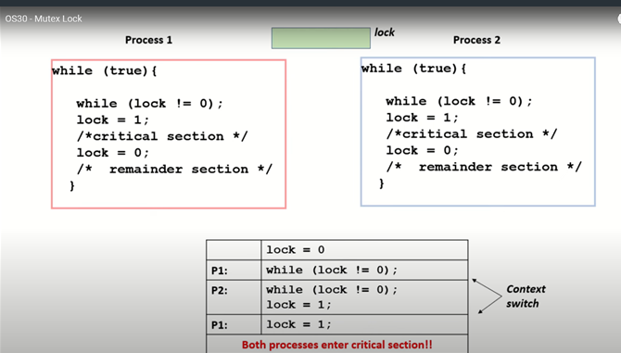

Slide 34
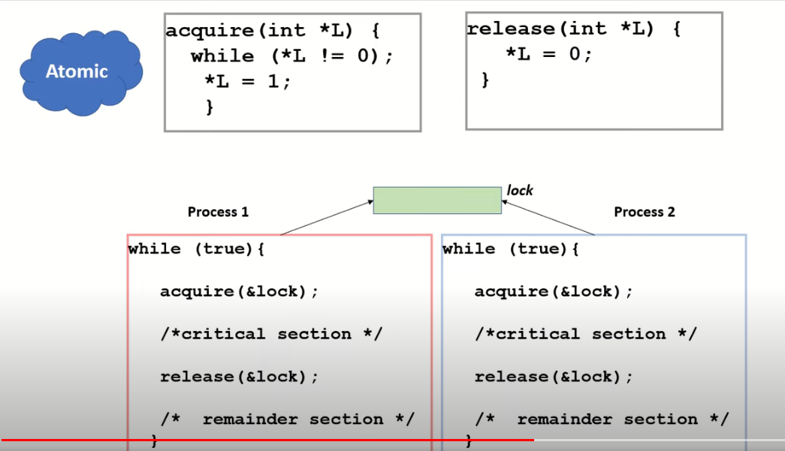

Slide 35

Bakery Algorithm
Critical Section for n processes:
Before entering its critical section, a process receives a number (like in a bakery). Holder of the smallest number enters the critical section.
The numbering scheme here always generates numbers in increasing order of enumeration;
If processes P_{i} and P_{j} receive the same number,
if i < j, then P_{i} is served first;
else
P_{j} is served first (PID assumed unique).

Slide 36
Bakery Algorithm (2)
Choosing a number:
max (a₀,…, a_{n-1}) is a number k, such that k ≥ a_{i} for i = 0, …, n – 1
Notation for lexicographical order (ticket #, PID #)
Shared data:
boolean choosing[n];
int number[n];
Data structures are initialized to FALSE and 0, respectively.

Slide 37
Bakery Algorithm for Pi
do {
choosing[i] = TRUE;
number[i] = max(number[0], …, number[n – 1]) +1;
choosing[i] = FALSE;
for (j = 0; j < n; j++) {
while (choosing[j]) ;
while ((number[j] != 0) && ((number[j],j) < (number[i],i))) ;
}
critical section
number[i] = 0;
remainder section
} while (TRUE);

Slide 38
Semaphore
Synchronization tool that provides more sophisticated ways (than Mutex locks) for process to synchronize their activities.
Semaphore S – integer variable
Can only be accessed via two indivisible (atomic) operations
wait() and signal()
Originally called P() and V()
Definition of the wait() operation
wait(S) {
while (S <= 0); // busy wait
S--;
}
Definition of the signal() operation
signal(S) {
S++;
}

Slide 39
Semaphore Usage
Counting semaphore – integer value can range over an unrestricted domain
Binary semaphore – integer value can range only between 0 and 1

Slide 40
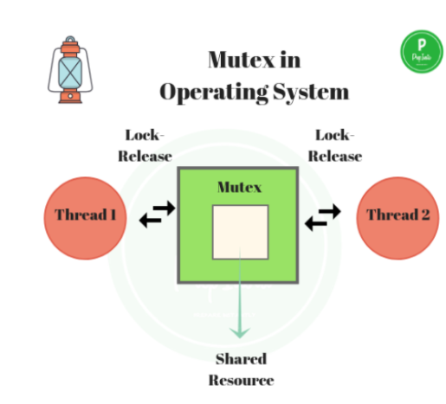

Slide 41
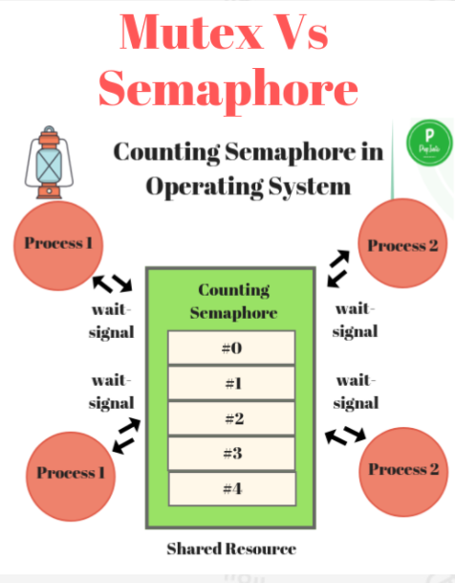

Slide 42
Semaphore Implementation
Must guarantee that no two processes can execute the wait() and signal() on the same semaphore at the same time
Thus, the implementation becomes the critical section problem where the wait and signal code are placed in the critical section
Could now have busy waiting in critical section implementation
But implementation code is short
Little busy waiting if critical section rarely occupied
Note that applications may spend lots of time in critical sections and therefore this is not a good solution

Slide 43
Deadlock – two or more processes are waiting indefinitely for an event that can be caused by only one of the waiting processes
Starvation – indefinite blocking
A process may never be removed from the semaphore queue in which it is suspended
Priority Inversion – Scheduling problem when lower-priority process holds a lock needed by higher-priority process
Solved via priority-inheritance protocol

Slide 44
Classical Problems of Synchronization
Classical problems used to test newly-proposed synchronization schemes
Bounded-Buffer Problem
Readers and Writers Problem
Dining-Philosophers Problem

Slide 45
Bounded-Buffer Problem
n buffers, each can hold one item
Semaphore mutex initialized to the value 1
Semaphore full initialized to the value 0
Semaphore empty initialized to the value n

Slide 46
Bounded Buffer Problem (Cont.)
The structure of the producer process
do {
... /* produce an item in next_produced */
...
wait(empty);
wait(mutex);
... /* add next produced to the buffer */
...
signal(mutex);
signal(full);
} while (true);

Slide 47
Bounded Buffer Problem (Cont.)
The structure of the consumer process
Do {
wait(full);
wait(mutex);
... /* remove an item from buffer to next_consumed */
...
signal(mutex);
signal(empty);
... /* consume the item in next consumed */
... } while (true);

Slide 48
Readers-Writers Problem
A data set is shared among a number of concurrent processes
Readers – only read the data set; they do not perform any updates
Writers – can both read and write
Problem – allow multiple readers to read at the same time
Only one single writer can access the shared data at the same time
Several variations of how readers and writers are considered – all involve some form of priorities
Shared Data
Data set
Semaphore rw_mutex initialized to 1
Semaphore mutex initialized to 1
Integer read_count initialized to 0

Slide 49
Readers-Writers Problem (Cont.)
The structure of a writer process
do { wait(rw_mutex);
... /* writing is performed */
...
signal(rw_mutex);
} while (true);

Slide 50
Readers-Writers Problem (Cont.)
The structure of a reader process
do { wait(mutex); read_count++; if (read_count == 1)
wait(wrt);
signal(mutex);
... /* reading is performed */
...
wait(mutex); read count--; if (read_count == 0)
signal(wrt);
signal(mutex);
} while (true);
The structure of a writer process
do { wait(wrt);
... /* writing is performed */
...
signal(wrt);
} while (true);

Slide 51
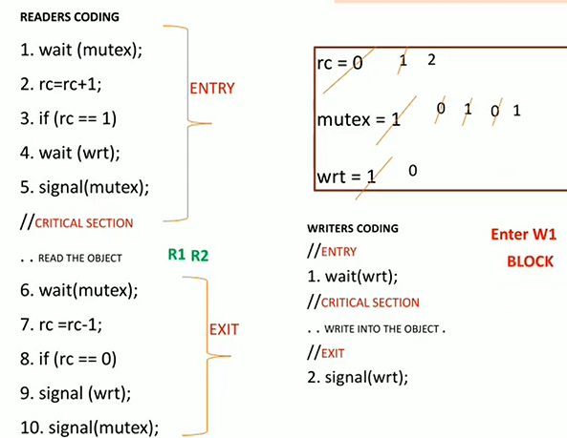

Slide 52
Readers-Writers Problem Variations
First variation – no reader kept waiting unless writer has permission to use shared object
Second variation – once writer is ready, it performs the write ASAP
Both may have starvation leading to even more variations
Problem is solved on some systems by kernel providing reader-writer locks

Slide 53
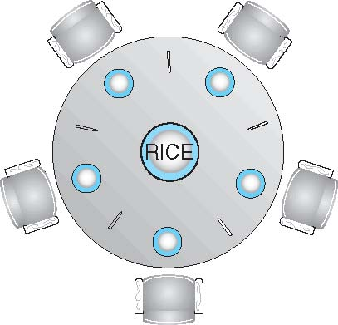
Dining-Philosophers Problem
Philosophers spend their lives alternating thinking and eating
Don’t interact with their neighbors, occasionally try to pick up 2 chopsticks (one at a time) to eat from bowl
Need both to eat, then release both when done
In the case of 5 philosophers
Shared data
Bowl of rice (data set)
Semaphore chopstick [5] initialized to 1

Slide 54
Dining-Philosophers Problem Algorithm
The structure of Philosopher i:
do {
wait (chopstick[i] );
wait (chopStick[ (i + 1) % 5] );
// eat
signal (chopstick[i] );
signal (chopstick[ (i + 1) % 5] );
// think
} while (TRUE);
What is the problem with this algorithm?

Slide 55
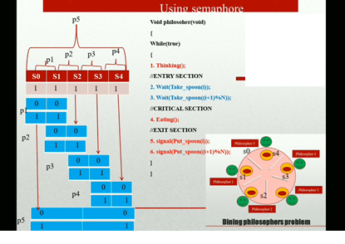

Slide 56
Dining-Philosophers Problem Algorithm (Cont.)
Deadlock handling
Allow at most 4 philosophers to be sitting simultaneously at the table.
Allow a philosopher to pick up the forks only if both are available (picking must be done in a critical section.
Use an asymmetric solution -- an odd-numbered philosopher picks up first the left chopstick and then the right chopstick. Even-numbered philosopher picks up first the right chopstick and then the left chopstick.

Slide 57
Problems with Semaphores
Incorrect use of semaphore operations:
signal (mutex) …. wait (mutex)
wait (mutex) … wait (mutex)
Omitting of wait (mutex) or signal (mutex) (or both)
Deadlock and starvation are possible.

Slide 58
Monitors
A high-level abstraction that provides a convenient and effective mechanism for process synchronization
Abstract data type, internal variables only accessible by code within the procedure
Only one process may be active within the monitor at a time
monitor monitor-name
{
// shared variable declarations
procedure P1 (…) { …. }
procedure Pn (…) {……}
Initialization code (…) { … }
}
}

Slide 59
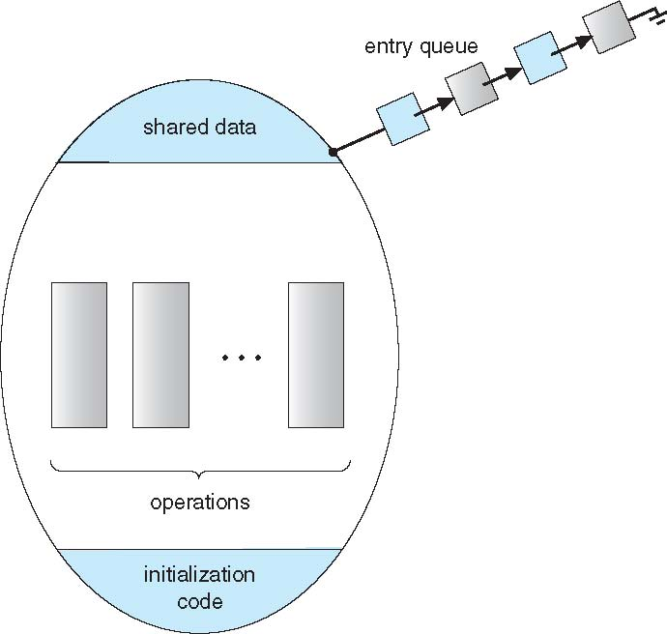
Schematic view of a Monitor

Slide 60
Condition Variables
condition x, y;
Two operations are allowed on a condition variable:
x.wait() – a process that invokes the operation is suspended until x.signal()
x.signal() – resumes one of processes (if any) that invoked x.wait()
If no x.wait() on the variable, then it has no effect on the variable

Slide 61
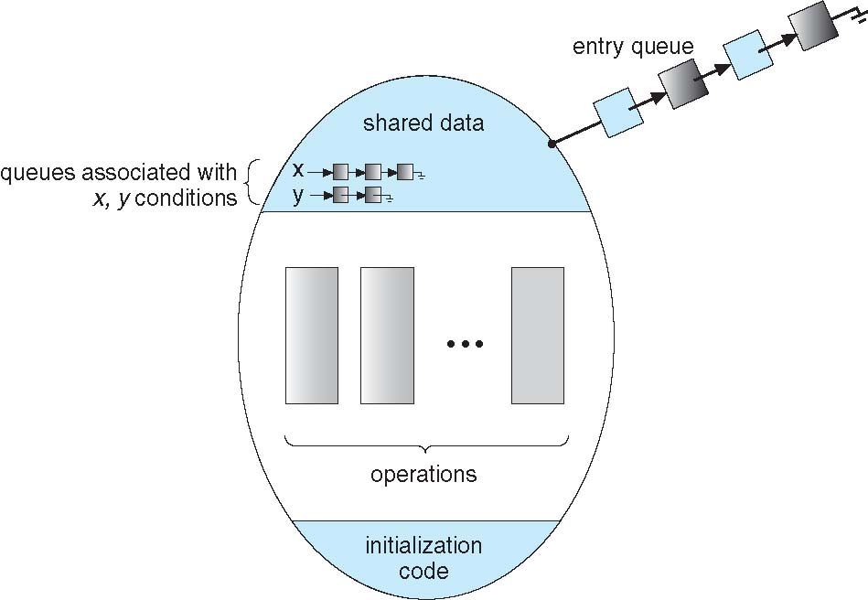
Monitor with Condition Variables

Slide 62
Condition Variables Choices
If process P invokes x.signal(), and process Q is suspended in x.wait(), what should happen next?
Both Q and P cannot execute in paralel. If Q is resumed, then P must wait
Options include
Signal and wait – P waits until Q either leaves the monitor or it waits for another condition
Signal and continue – Q waits until P either leaves the monitor or it waits for another condition
Both have pros and cons – language implementer can decide
Monitors implemented in Concurrent Pascal compromise
P executing signal immediately leaves the monitor, Q is resumed
Implemented in other languages including C#, Java

Slide 63
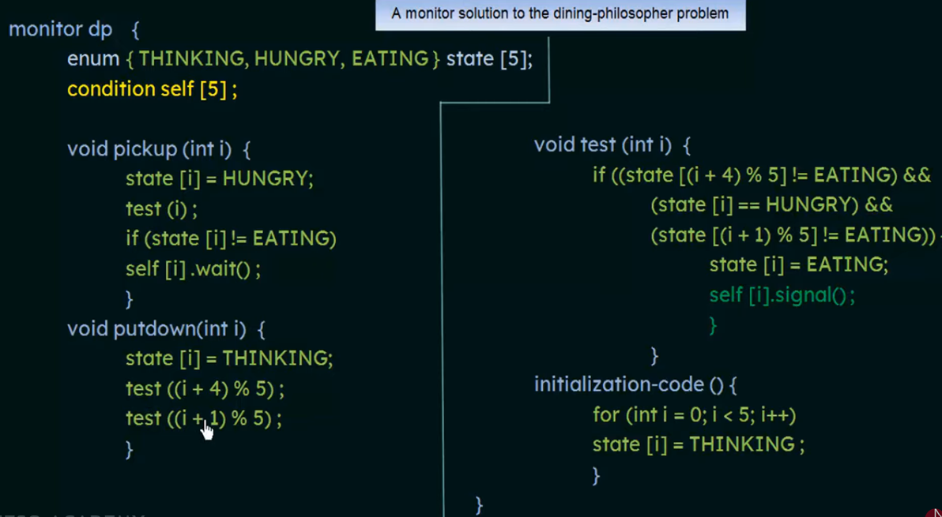

Slide 64
Solution to Dining Philosophers (Cont.)
Each philosopher i invokes the operations pickup() and putdown() in the following sequence:
DiningPhilosophers.pickup(i);
EAT
DiningPhilosophers.putdown(i);
No deadlock, but starvation is possible

Slide 65
Resuming Processes within a Monitor
If several processes queued on condition x, and x.signal() executed, which should be resumed?
FCFS frequently not adequate
conditional-wait construct of the form x.wait(c)
Where c is priority number
Process with lowest number (highest priority) is scheduled next

Slide 66
Bakery Algorithm in Process Synchronization
The Bakery algorithm is one of the simplest known solutions to the mutual exclusion problem for the general case of N process.
Bakery Algorithm is a critical section solution for N processes. The algorithm preserves the first come first serve property.

Slide 67
Before entering its critical section, the process receives a number. Holder of the smallest number enters the critical section.
If processes Pi and Pj receive the same number
if i < j
Pi is served first;
else
Pj is served first.
The numbering scheme always generates numbers in increasing order of enumeration; i.e., 1, 2, 3, 3, 3, 3, 4, 5

Slide 68
IPC in Unix
Inter process communication (IPC) refers to the coordination of activities among cooperating processes. A common example of this need is managing access to a given system resource.
Pipes are a simple synchronized way of passing information between two processes.
A simple mechanism for one-way communication between related processes, where the output of one process becomes the input of another.

Slide 69
A pipe can be viewed as a special file that can store only a limited amount of data and uses a FIFO access scheme to retrieve data.
In a logical view of a pipe, data is written to one end and read from the other.
The processes on the ends of a pipe have no easy way to identify what process is on the other end of the pipe.
Message Queues:
Allow processes to send and receive messages, providing a more flexible communication method compared to pipes.
Signals:
Asynchronous notifications sent to a process to signal an event, used for tasks like interrupting or terminating a process.

Slide 70
Multi processor and locking
Scalable locks
Lock free coordination
Lock-free synchronization avoids many serious problems caused by locks: considerable overhead, concurrency bottlenecks, deadlocks, and priority inversion in real-time scheduling.

Slide 71
References
Silberschatz, Gagne, Galvin: Operating System Concepts, 6th Edition

