Slide 1
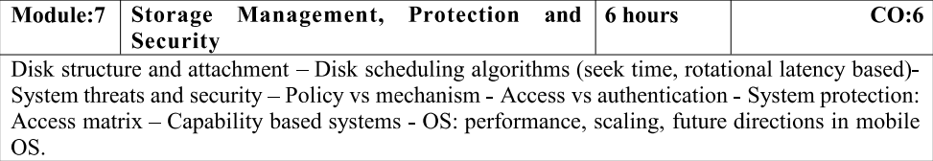
Module-7

Slide 2
Chapter 10: Mass-Storage Systems
Overview of Mass Storage Structure
Disk Structure
Disk Attachment
Disk Scheduling
Disk Management
Swap-Space Management
RAID Structure
Stable-Storage Implementation

Slide 3
Objectives
To describe the physical structure of secondary storage devices and its effects on the uses of the devices
To explain the performance characteristics of mass-storage devices
To evaluate disk scheduling algorithms
To discuss operating-system services provided for mass storage, including RAID

Slide 4
Overview of Mass Storage Structure
Magnetic disks provide bulk of secondary storage of modern computers
Drives rotate at 60 to 250 times per second
Transfer rate is rate at which data flow between drive and computer
Positioning time (random-access time) is time to move disk arm to desired cylinder (seek time) and time for desired sector to rotate under the disk head (rotational latency)
Head crash results from disk head making contact with the disk surface -- That’s bad
Disks can be removable
Drive attached to computer via I/O bus
Busses vary, including EIDE, ATA, SATA, USB, Fibre Channel, SCSI, SAS, Firewire
Host controller in computer uses bus to talk to disk controller built into drive or storage array

Slide 5
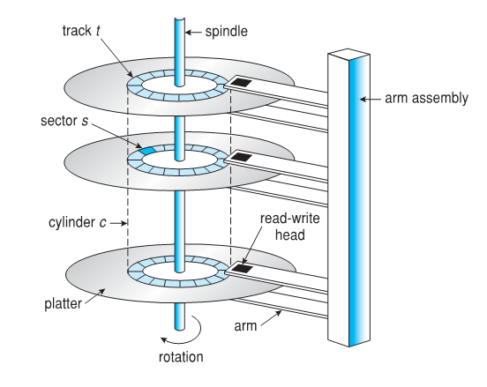
Moving-head Disk Mechanism

Slide 6
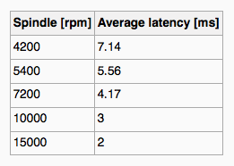
Hard Disks
Platters range from .85” to 14” (historically)
Commonly 3.5”, 2.5”, and 1.8”
Range from 30GB to 3TB per drive
Performance
Transfer Rate – theoretical – 6 Gb/sec
Effective Transfer Rate – real – 1Gb/sec
Seek time from 3ms to 12ms – 9ms common for desktop drives
Average seek time measured or calculated based on 1/3 of tracks
Latency based on spindle speed
1 / (RPM / 60) = 60 / RPM
Average latency = ½ latency
(From Wikipedia)

Slide 7
Hard Disk Performance
Access Latency = Average access time = average seek time + average latency
For fastest disk 3ms + 2ms = 5ms
For slow disk 9ms + 5.56ms = 14.56ms
Average I/O time = average access time + (amount to transfer / transfer rate) + controller overhead
For example to transfer a 4KB block on a 7200 RPM disk with a 5ms average seek time, 1Gb/sec transfer rate with a .1ms controller overhead =
5ms + 4.17ms + 0.1ms + transfer time =
Transfer time = 4KB / 1Gb/s * 8Gb / GB * 1GB / 1024²KB = 32 / (1024²) = 0.031 ms
Average I/O time for 4KB block = 9.27ms + .031ms = 9.301ms

Slide 8
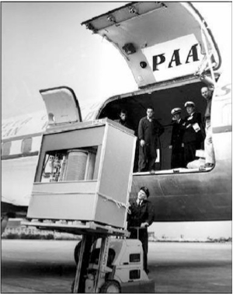
The First Commercial Disk Drive
1956
IBM RAMDAC computer included the IBM Model 350 disk storage system
5M (7 bit) characters
50 x 24” platters
Access time = < 1 second

Slide 9
Solid-State Disks
Nonvolatile memory used like a hard drive
Many technology variations
Can be more reliable than HDDs
More expensive per MB
Maybe have shorter life span
Less capacity
But much faster
Busses can be too slow -> connect directly to PCI for example
No moving parts, so no seek time or rotational latency

Slide 10
Magnetic Tape
Was early secondary-storage medium
Evolved from open spools to cartridges
Relatively permanent and holds large quantities of data
Access time slow
Random access ~1000 times slower than disk
Mainly used for backup, storage of infrequently-used data, transfer medium between systems
Kept in spool and wound or rewound past read-write head
Once data under head, transfer rates comparable to disk
140MB/sec and greater
200GB to 1.5TB typical storage
Common technologies are LTO-{3,4,5} and T10000

Slide 11
Disk Structure
Disk drives are addressed as large 1-dimensional arrays of logical blocks, where the logical block is the smallest unit of transfer
Low-level formatting creates logical blocks on physical media
The 1-dimensional array of logical blocks is mapped into the sectors of the disk sequentially
Sector 0 is the first sector of the first track on the outermost cylinder
Mapping proceeds in order through that track, then the rest of the tracks in that cylinder, and then through the rest of the cylinders from outermost to innermost
Logical to physical address should be easy
Except for bad sectors
Non-constant # of sectors per track via constant angular velocity

Slide 12
Disk Attachment
Host-attached storage accessed through I/O ports talking to I/O busses
SCSI itself is a bus, up to 16 devices on one cable, SCSI initiator requests operation and SCSI targets perform tasks
Each target can have up to 8 logical units (disks attached to device controller)
FC is high-speed serial architecture
Can be switched fabric with 24-bit address space – the basis of storage area networks (SANs) in which many hosts attach to many storage units
I/O directed to bus ID, device ID, logical unit (LUN)

Slide 13
Storage Array
Can just attach disks, or arrays of disks
Storage Array has controller(s), provides features to attached host(s)
Ports to connect hosts to array
Memory, controlling software (sometimes NVRAM, etc)
A few to thousands of disks
RAID, hot spares, hot swap (discussed later)
Shared storage -> more efficiency
Features found in some file systems
Snaphots, clones, thin provisioning, replication, deduplication, etc

Slide 14
Storage Area Network
Common in large storage environments
Multiple hosts attached to multiple storage arrays - flexible

Slide 15
Storage Area Network (Cont.)
SAN is one or more storage arrays
Connected to one or more Fibre Channel switches
Hosts also attach to the switches
Storage made available via LUN Masking from specific arrays to specific servers
Easy to add or remove storage, add new host and allocate it storage
Over low-latency Fibre Channel fabric
Why have separate storage networks and communications networks?
Consider iSCSI, FCOE

Slide 16
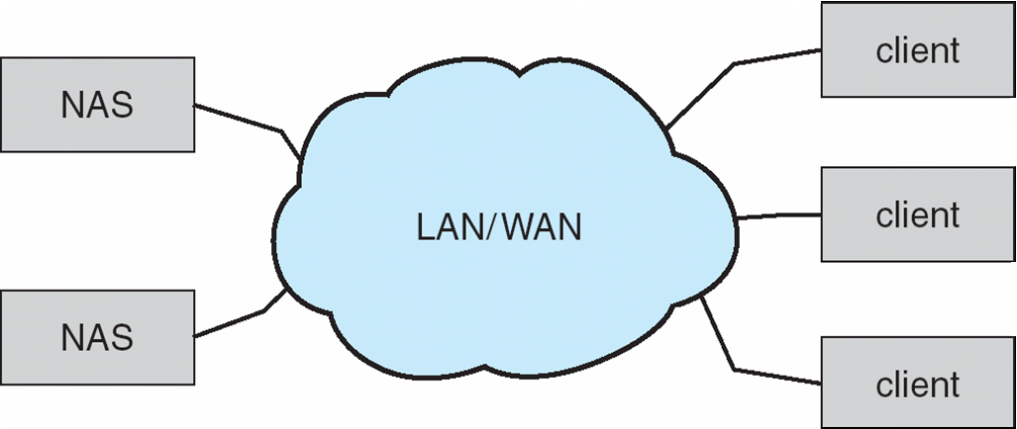
Network-Attached Storage
Network-attached storage (NAS) is storage made available over a network rather than over a local connection (such as a bus)
Remotely attaching to file systems
NFS and CIFS are common protocols
Implemented via remote procedure calls (RPCs) between host and storage over typically TCP or UDP on IP network
iSCSI protocol uses IP network to carry the SCSI protocol
Remotely attaching to devices (blocks)

Slide 17
Disk Scheduling
The operating system is responsible for using hardware efficiently — for the disk drives, this means having a fast access time and disk bandwidth
Minimize seek time
Seek time ≈ seek distance
Disk bandwidth is the total number of bytes transferred, divided by the total time between the first request for service and the completion of the last transfer

Slide 18
Disk Scheduling (Cont.)
There are many sources of disk I/O request
OS
System processes
Users processes
I/O request includes input or output mode, disk address, memory address, number of sectors to transfer
OS maintains queue of requests, per disk or device
Idle disk can immediately work on I/O request, busy disk means work must queue
Optimization algorithms only make sense when a queue exists

Slide 19
Disk Scheduling (Cont.)
Note that drive controllers have small buffers and can manage a queue of I/O requests (of varying “depth”)
Several algorithms exist to schedule the servicing of disk I/O requests
The analysis is true for one or many platters
We illustrate scheduling algorithms with a request queue (0-199)
98, 183, 37, 122, 14, 124, 65, 67
Head pointer 53

Slide 20
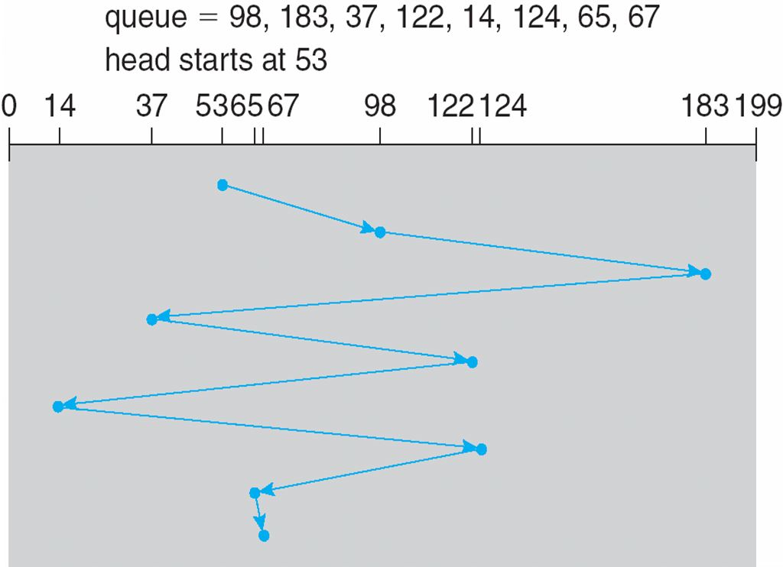
FCFS
Illustration shows total head movement of 640 cylinders

Slide 21
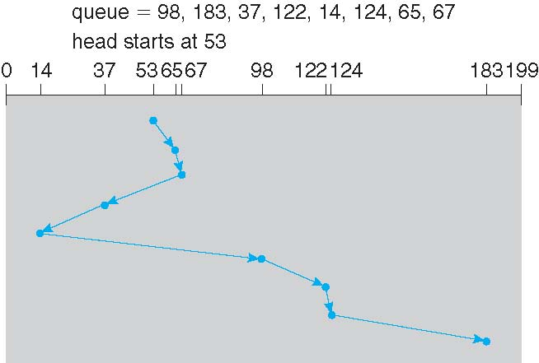
SSTF
Shortest Seek Time First selects the request with the minimum seek time from the current head position
SSTF scheduling is a form of SJF scheduling; may cause starvation of some requests
Illustration shows total head movement of 236 cylinders

Slide 22
SCAN
The disk arm starts at one end of the disk, and moves toward the other end, servicing requests until it gets to the other end of the disk, where the head movement is reversed and servicing continues.
SCAN algorithm Sometimes called the elevator algorithm
Illustration shows total head movement of 236 cylinders
But note that if requests are uniformly dense, largest density at other end of disk and those wait the longest

Slide 23
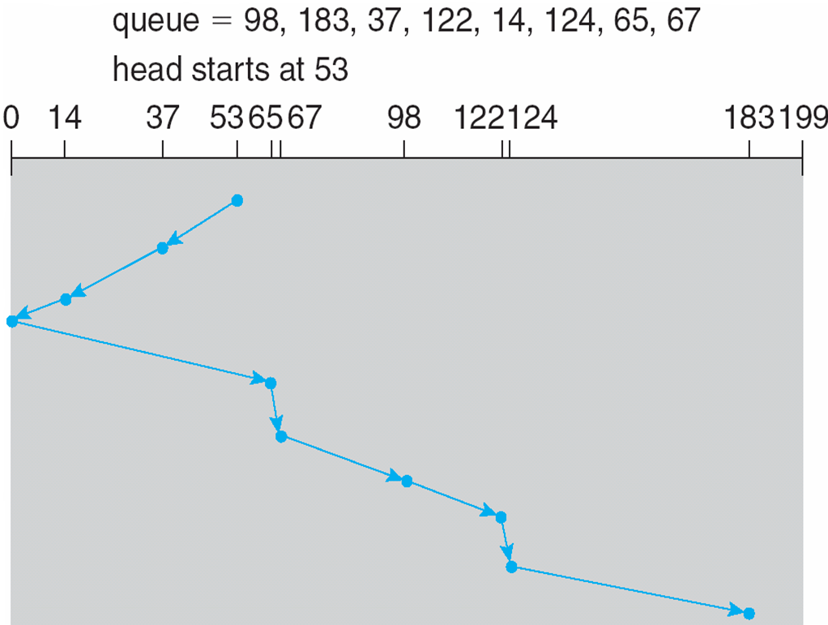
SCAN (Cont.)

Slide 24
C-SCAN
Provides a more uniform wait time than SCAN
The head moves from one end of the disk to the other, servicing requests as it goes
When it reaches the other end, however, it immediately returns to the beginning of the disk, without servicing any requests on the return trip
Treats the cylinders as a circular list that wraps around from the last cylinder to the first one
Total number of cylinders?

Slide 25
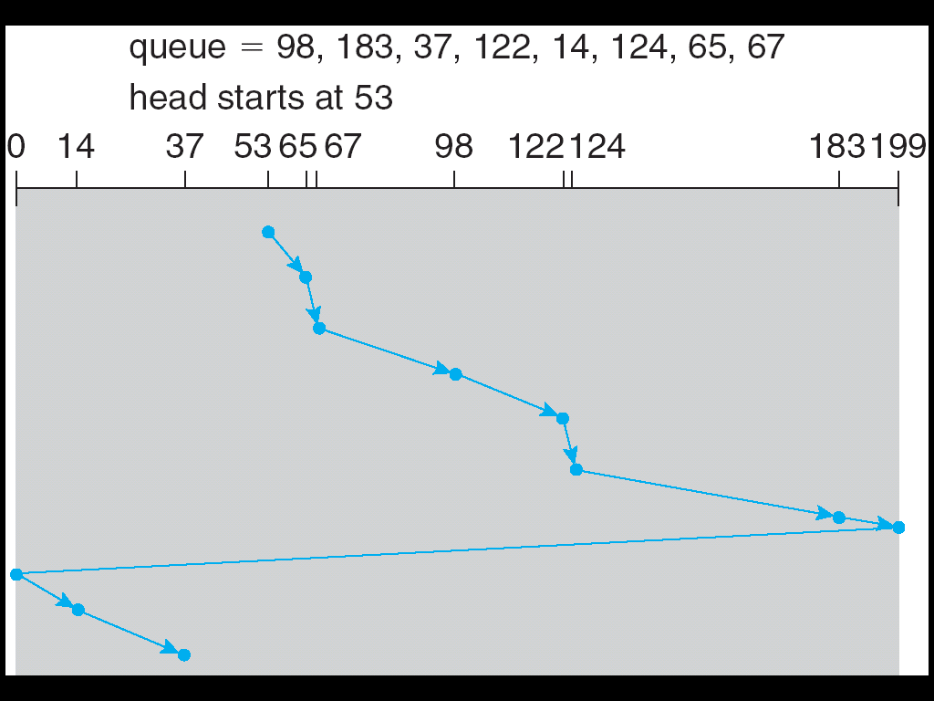
C-SCAN (Cont.)

Slide 26
C-LOOK
LOOK a version of SCAN, C-LOOK a version of C-SCAN
Arm only goes as far as the last request in each direction, then reverses direction immediately, without first going all the way to the end of the disk
Total number of cylinders?

Slide 27
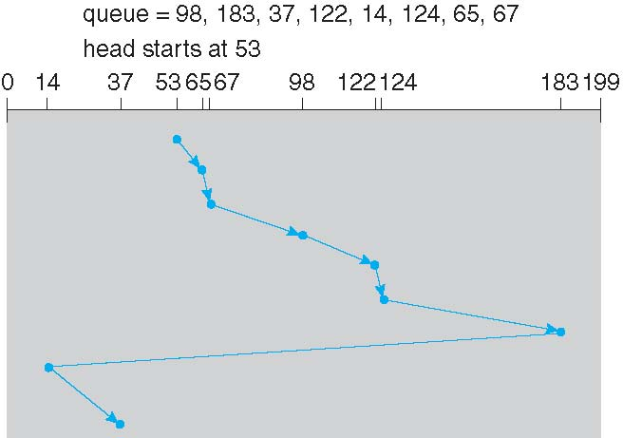
C-LOOK (Cont.)

Slide 28
Disk Scheduling Example
Consider the following disk request sequence for a disk with 100 tracks 45, 21, 67, 90, 4, 50, 89, 52, 61, 87, 25
Head pointer starting at 50

Slide 29
Selecting a Disk-Scheduling Algorithm
SSTF is common and has a natural appeal
SCAN and C-SCAN perform better for systems that place a heavy load on the disk
Less starvation
Performance depends on the number and types of requests
Requests for disk service can be influenced by the file-allocation method
And metadata layout
The disk-scheduling algorithm should be written as a separate module of the operating system, allowing it to be replaced with a different algorithm if necessary
Either SSTF or LOOK is a reasonable choice for the default algorithm
What about rotational latency?
Difficult for OS to calculate
How does disk-based queueing effect OS queue ordering efforts?

Slide 30
Operating System – Security & Threats
Security refers to providing a protection system to computer system resources such as
CPU
Memory
Disk
Software programs
Data/Information

Slide 31
If a computer program is run by an unauthorized user, then he/she may cause severe damage to computer or data stored in it.
Authentication
One Time passwords
Program Threats
System Threats
Computer Security Classifications

Slide 32
Authentication
Authentication refers to identifying each user of the system and associating the executing programs with those users.
Operating Systems generally identifies/authenticates users using following three ways −
Username / Password
User card/key
User attribute - fingerprint/ eye retina pattern/ signature

Slide 33
One Time passwords
Random numbers-Users are provided cards having numbers printed along with corresponding alphabets.
Secret key-User are provided a hardware device which can create a secret id mapped with user id.
Network password-Some commercial applications send one-time passwords to user on registered mobile/ email which is required to be entered prior to login.

Slide 34
Program Threats
Operating system's processes and kernel do the designated task as instructed. If a user program made these process do malicious tasks, then it is known as Program Threats.
One of the common example of program threat is a program installed in a computer which can store and send user credentials via network to some hacker.

Slide 35
Some well-known program threats
Trojan Horse- user login credentials and stores them to send to malicious user
Trap Door-perform illegal action without knowledge of user then it is called to have a trap door.
Logic Bomb- is a situation when a program misbehaves only when certain conditions met
Virus-highly dangerous and can modify/delete user files, crash systems

Slide 36
System Threats
Refers to misuse of system services and network connections to put user in trouble.
Worm - is a process which can choked down a system performance by using system resources to extreme levels.
Port Scanning -hacker can detects system vulnerabilities
Denial of Service
For example, a user may not be able to use internet if denial of service attacks browser's content settings.

Slide 37
Policy vs Mechanism
Policies are ways to choose which activities to perform. Mechanisms are the implementations that enforce policies, and often depend to some extent on the hardware on which the operating system runs

Slide 38
Access vs Authentication
Authentication is the first step of the process.
to make sure the identity is who they say they are
Access control is the addition of extra authentication steps to further protect important segments.

Slide 39
System Protection in Operating System
Protection refers to a mechanism which controls the access of programs, processes, or users to the resources defined by a computer system.
We can take protection as a helper to multi programming operating system, so that many users might safely share a common logical name space such as directory or files.

Slide 40
Need of Protection:
To prevent the access of unauthorized users
To ensure that each active programs or processes in the system uses resources only as the stated policy
To improve reliability by detecting latent errors

Slide 41
Access Matrix
Access Matrix is a security model of protection state in computer system. It is represented as a matrix.
Access matrix is used to define the rights of each process executing in the domain with respect to each object.
The rows of matrix represent domains and columns represent objects.

Slide 42
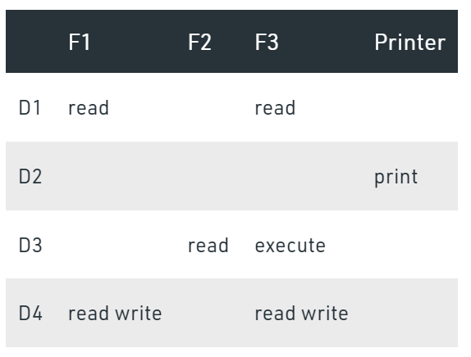
Access Matrix

Slide 43
capability-based system
The capabilities themselves are passed between processes and storage using a mechanism that is known by the operating system to maintain the integrity of those capabilities.

Slide 44
Future Direction in Mobile OS

