Slide 1
BECE204L – MICROPROCESSORS AND MICROCONTROLLERS
MODULE-1
OVERVIEW OF MICROPROCESSORS
MODULE-1
BECE204L – MICROPROCESSORS AND MICROCONTROLLERS
1

Slide 2
MODULE-1
Overview of Microprocessors
Introduction to Microprocessors
8-bit /16-bit Microprocessor
Overview of Intel Pentium, I (i3, i5, i7) Series Processor.
MODULE-1
BECE204L – MICROPROCESSORS AND MICROCONTROLLERS
2

Slide 3
INTRODUCTION TO MICROPROCESSOR
MODULE-1
BECE204L – MICROPROCESSORS AND MICROCONTROLLERS
3

Slide 4
INTRODUCTION TO MICROPROCESSOR
COMPUTER SYSTEM
A computer is a programmable machine that receives input, stores and manipulates data/information, and provides output in a useful format.
Basic computer system consist of a Central processing unit (CPU)/ Microprocessor (μP), memory (RAM and ROM), input/output (I/O) unit.
CPU/μP
Input Device
Control Unit
Output Device
ALU
Register Array
Memory
BLOCK DIAGRAM OF A BASIC COMPUTER SYSTEM
MODULE-1
BECE204L – MICROPROCESSORS AND MICROCONTROLLERS
4

Slide 5
INTRODUCTION TO MICROPROCESSOR
MICROPROCESSOR
A microprocessor is a controlling unit of a computer, fabricated on a small chip capable of performing Arithmetic Logical Unit (ALU) operations and communicating with the other devices connected to it.
Microprocessor is a Programmable, Clock driven, Register based, Electronic device that reads instruction from a storage device, takes the data from input unit and process the data according to the instructions and provides the result to the output unit.
Programmable- Perform Different set operation on the digital data depending on the sequence of instructions supplied by the programmer.
Clock Driven – Whole task is divided into basic operations, are divided into precise system clock periods.
Register Based – Storage element
Electronic Device – fabricated on a chip
MODULE-1
BECE204L – MICROPROCESSORS AND MICROCONTROLLERS
5

Slide 6
INTRODUCTION TO MICROPROCESSOR
How does a Microprocessor Work?
The microprocessor follows a sequence: Fetch, Decode, and then Execute.
Initially, the instructions are stored in the memory in a sequential order.
The microprocessor fetches those instructions from the memory, then decodes it and executes those instructions till STOP instruction is reached.
Later, it sends the result in binary to the output port. Between these processes, the register stores the temporarily data and ALU performs the computing functions.
CPU must equipped with necessary resource. Important resources of CPU:
Registers – to store the information temporarily
ALU – to carryout Arithmetic and Logical operation
Program Counter (instruction Pointer) – to point the next instruction to be executed
Instruction decoder – to interpret the instruction fetched into the CPU
MODULE-1
BECE204L – MICROPROCESSORS AND MICROCONTROLLERS
6

Slide 7
INTRODUCTION TO MICROPROCESSOR
MICROPROCESSOR – IMPORTANT TERMS
Instruction Set − It is the set of instructions that the microprocessor can understand.
Bandwidth/Data size − It is the number of bits processed in a single instruction.
Clock Speed − It determines the number of operations per second the processor can perform. It is expressed in megahertz (MHz) or gigahertz (GHz).It is also known as Clock Rate.
Word Length − It depends upon the width of internal data bus, registers, ALU, etc. An 8-bit microprocessor can process 8-bit data at a time. The word length ranges from 4 bits to 64 bits depending upon the type of the microcomputer.
Data Types − The microprocessor has multiple data type formats like binary, BCD, ASCII, signed and unsigned numbers.
MODULE-1
BECE204L – MICROPROCESSORS AND MICROCONTROLLERS
7

Slide 8
INTRODUCTION TO MICROPROCESSOR
MICROPROCESSOR – FEATURES
Cost-effective − The microprocessor chips are available at low prices and results its low cost.
Size − The microprocessor is of small size chip, hence is portable.
Low Power Consumption − Microprocessors are manufactured by using metaloxide semiconductor technology, which has low power consumption.
Versatility − The microprocessors are versatile as we can use the same chip in a number of applications by configuring the software program.
Reliability − The failure rate of an IC in microprocessors is very low, hence it is reliable.
MODULE-1
BECE204L – MICROPROCESSORS AND MICROCONTROLLERS
8

Slide 9
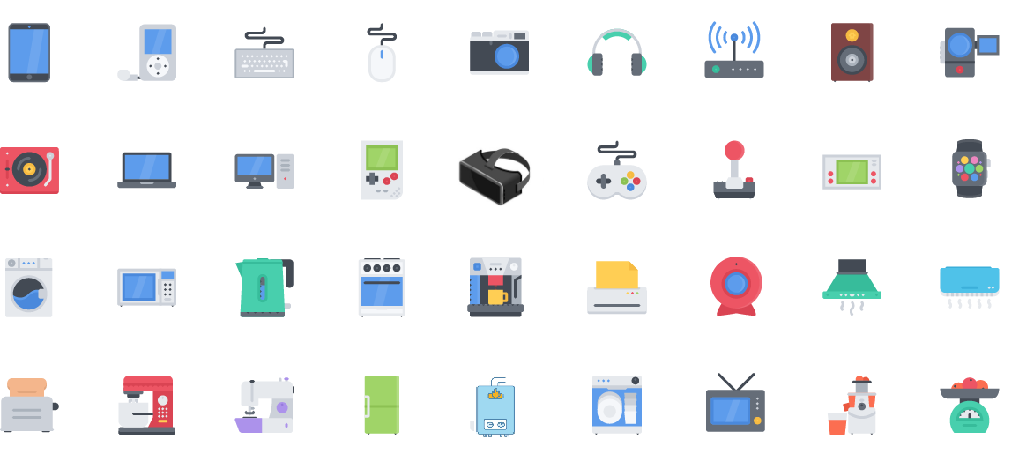
INTRODUCTION TO MICROPROCESSOR
APPLICATIONS OF MICROPROCESSOR
MODULE-1
BECE204L – MICROPROCESSORS AND MICROCONTROLLERS
9

Slide 10
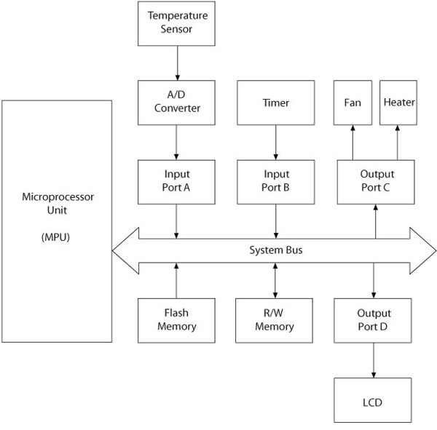
INTRODUCTION TO MICROPROCESSOR
MICROPROCESSOR BASED TEMPERATURE MONITORING SYSTEM
MODULE-1
BECE204L – MICROPROCESSORS AND MICROCONTROLLERS
10

Slide 11
EVOLUTION OF MICROPROCESSORS
MODULE-1
BECE204L – MICROPROCESSORS AND MICROCONTROLLERS
11

Slide 12
EVOLUTION OF MICROPROCESSORS
WORLD’S FIRST MICROPROCESSOR -
INTEL 4004
1969 - The assignment: Nippon Calculating Machine Corporation approached Intel to design 12 custom chips for its new Busicom 141-PF* printing calculator.
The Intel solution: lntel designed a set of four chips known as the MCS-4.
ROM(4001) - To support the custom applications programs
RAM(4002) - For processing data
Shift registers(4003) - For the input/output (I/O) port
CPU(4004) - Central Processing Unit
1971- Era of integrated electronics: Intel purchased the rights from Nippon Calculating Machine Corporation and launched the Intel 4004 processor and its chipset in the November 15, 1971.
MODULE-1
BECE204L – MICROPROCESSORS AND MICROCONTROLLERS
12

Slide 13
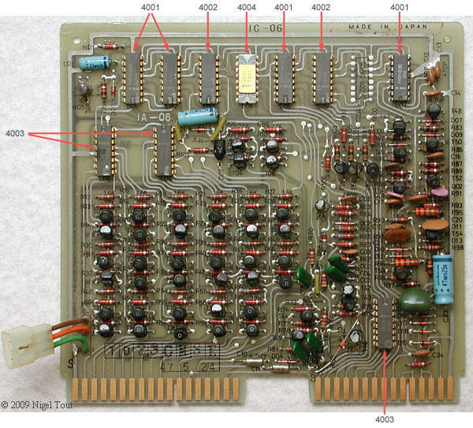
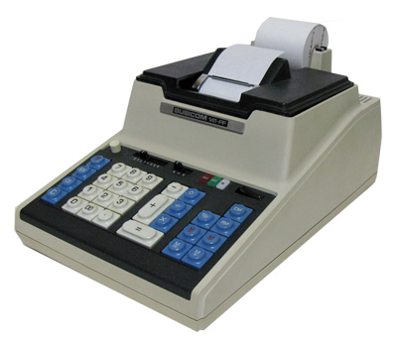
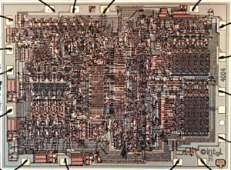
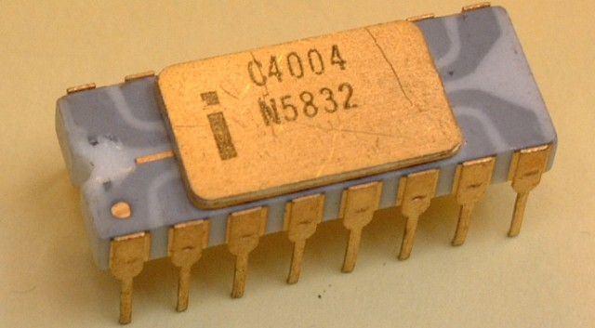

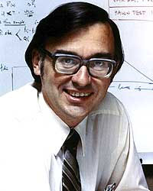

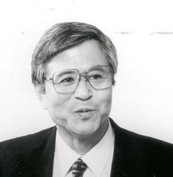
EVOLUTION OF MICROPROCESSORS
WORLD’S FIRST MICROPROCESSOR -
INTEL 4004
INTEL 4004 IC
DIE VIEW OF INTEL 4004 IC
INTERAL VIEW OF BUSICOM 141-PF
BUSICOM 141-PF PRINTING CALCULATOR
FEDERICO FAGGIN
MARCIAN "TED" HOFF
STANLEY MAZOR
MASATOSHI SHIMA
INVENTERS OF INTEL 4004 MICROPROCESSOR
MODULE-1
BECE204L – MICROPROCESSORS AND MICROCONTROLLERS
13

Slide 14
EVOLUTION OF MICROPROCESSORS
WORLD’S FIRST MICROPROCESSOR -
INTEL 4004
We can categorize the microprocessor according to the generations or according to the size of the microprocessor:
First Generation (4 - bit Microprocessors):
The first generation microprocessors were introduced in the year 1971-1972 by Intel Corporation. It was named Intel 4004 since it was a 4-bit processor.
It was a processor on a single chip. It could perform simple arithmetic and logical operations such as addition, subtraction, Boolean OR and Boolean AND.
Second Generation (8 - bit Microprocessor):
The second generation microprocessors were introduced in 1973 again by Intel.
It was a first 8 - bit microprocessor which could perform arithmetic and logic operations on 8-bit words. It was Intel 8008, and another improved version was Intel 8088.
MODULE-1
BECE204L – MICROPROCESSORS AND MICROCONTROLLERS
14

Slide 15
EVOLUTION OF MICROPROCESSORS
WORLD’S FIRST MICROPROCESSOR -
INTEL 4004
Third Generation (16 - bit Microprocessor):
The third generation microprocessors, introduced in 1978 were represented by Intel's 8086, Zilog Z800 and 80286, which were 16 - bit processors with a performance like minicomputers.
Fourth Generation (32 - bit Microprocessors):
Several different companies introduced the 32-bit microprocessors, but the most popular one is the Intel 80386.
Fifth Generation (64 - bit Microprocessors):
After 80856, Intel came out with a new processor namely Pentium processor followed by Pentium Pro CPU, which allows multiple CPUs in a single system to achieve multiprocessing.
Other improved 64-bit processors are Celeron, Dual, Quad, Octa Core processors.
MODULE-1
BECE204L – MICROPROCESSORS AND MICROCONTROLLERS
15

Slide 16
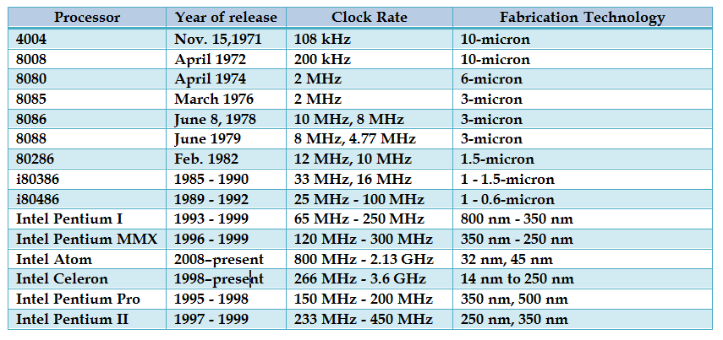
EVOLUTION OF MICROPROCESSORS
EVOLUTION OF INTEL PROCESSORS (1)
MODULE-1
BECE204L – MICROPROCESSORS AND MICROCONTROLLERS
16

Slide 17
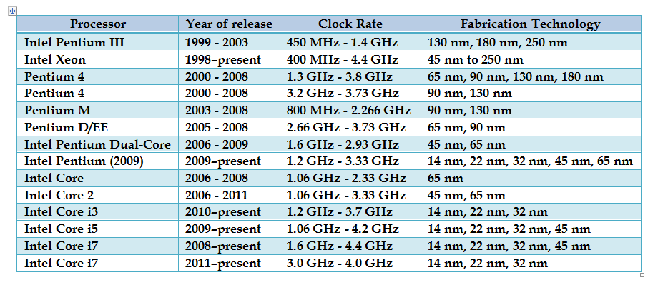
EVOLUTION OF MICROPROCESSORS
EVOLUTION OF INTEL PROCESSORS (2)
MODULE-1
BECE204L – MICROPROCESSORS AND MICROCONTROLLERS
17

Slide 18
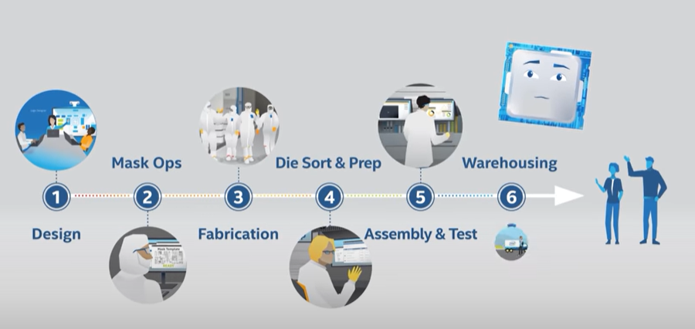
EVOLUTION OF MICROPROCESSORS
HOW INTEL MANUFACTURES CHIPS
https://www.youtube.com/watch?v=4oQoZF_KRCc
MODULE-1
BECE204L – MICROPROCESSORS AND MICROCONTROLLERS
18

Slide 19
THANK YOU

