Slide 2

MICROCONTROLLERS
MODULE-5
I-O -PERIPHERAL INTERFACING

Slide 3

MODULE-5
LCD
Peripheral
Interfacing
LED
KEYPAD

Slide 4
LCD
INTERFACE

Slide 5
LCD INTERFACE
Display units are the most important output devices in embedded projects and electronics products.
LCD is finding widespread use replacing LEDs
The decreasing prices of LCD
The ability to display numbers, characters and graphics
Incorporation of a refreshing controller into the LCD, thereby relieving the CPU of the task of refreshing LCD
Ease of programming for characters and graphics

Slide 6
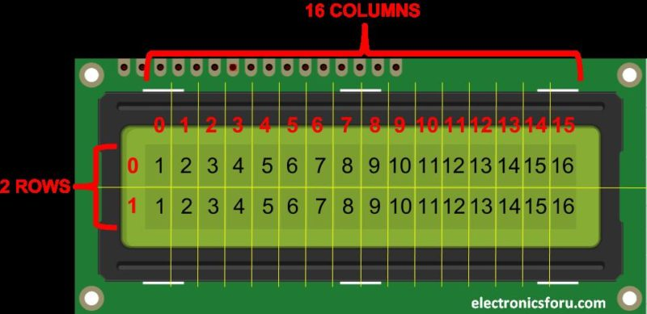
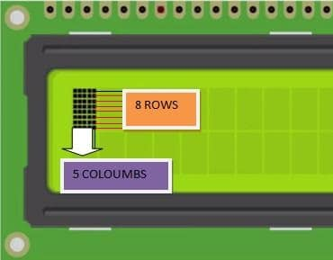
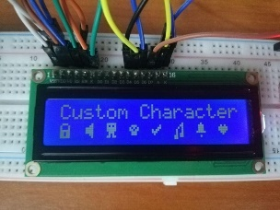
LCD INTERFACE
2x16 LCD is one of the most used display unit.
As per the name the 2x16 has 2 lines with 16 characters on each lines.
It supports all the ASCII chars and is basically used for displaying the alpha numeric characters.
Here each character is displayed in a matrix of 5x7 pixels.
Apart from alpha numeric chars it also provided with the provision to display by creating the pattern.
3

Slide 7
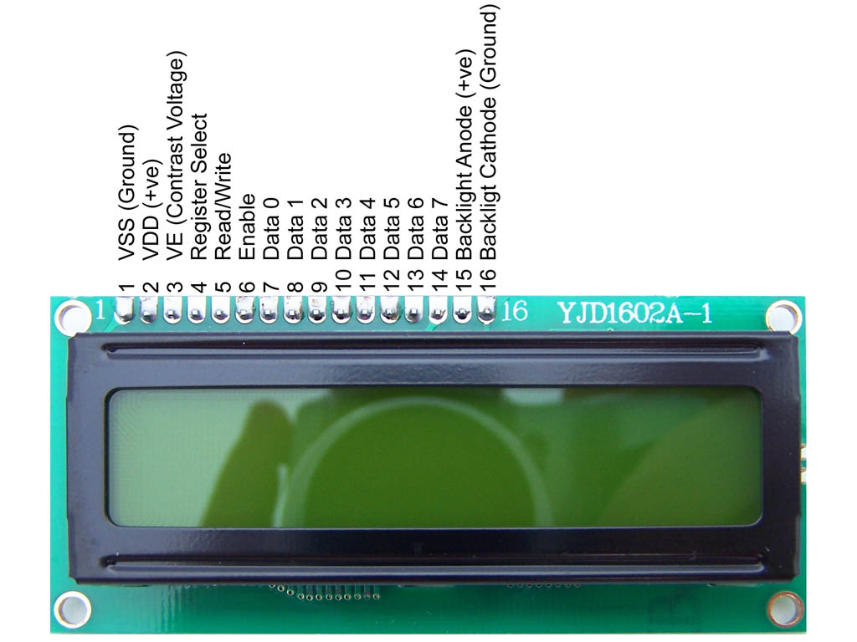
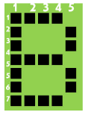
LCD INTERFACE

Slide 8
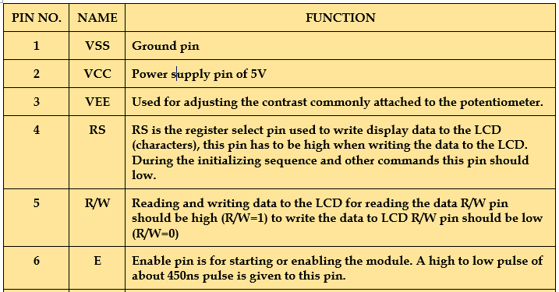
LCD INTERFACE

Slide 9
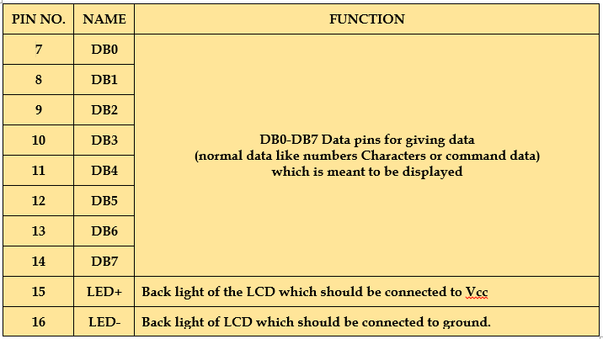
LCD INTERFACE

Slide 10
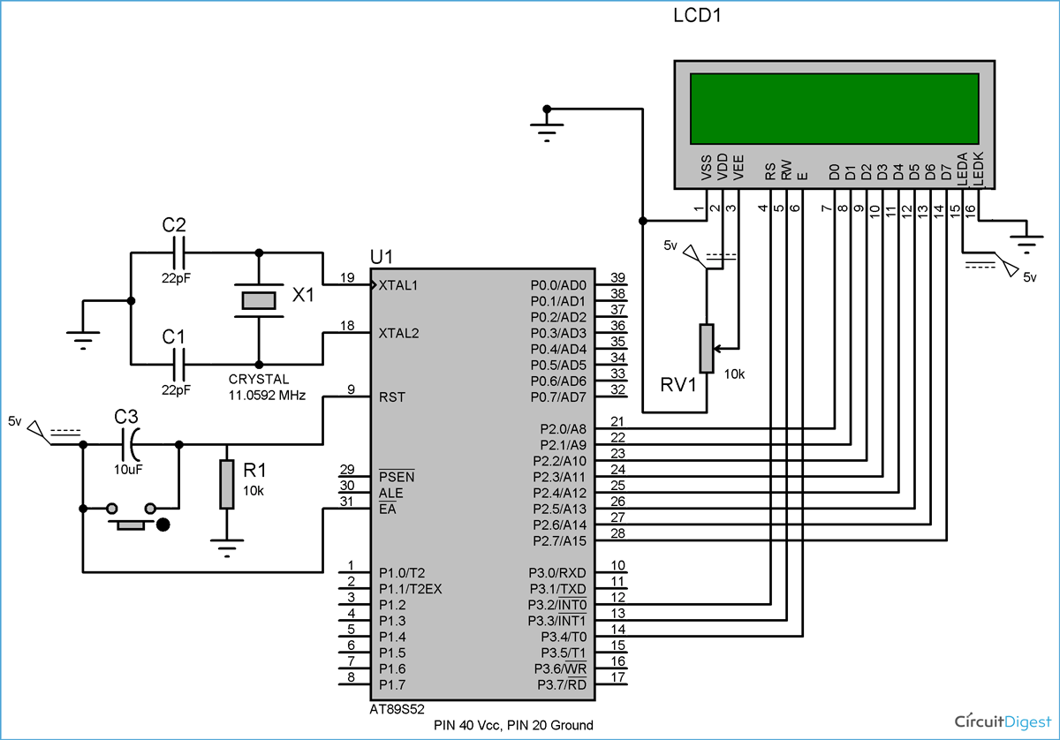
LCD INTERFACE

Slide 11
LCD INTERFACE
The 16X2 LCD has two built in registers namely data register and command register.
Command Register - stores the command instructions given to the LCD. A command is an instruction given to LCD to do a predefined task like initializing, clearing the screen, setting the cursor position, controlling display etc.
Data Register - stores the data to be displayed on the LCD. The data is the ASCII value of the character to be displayed on the LCD.

Slide 12
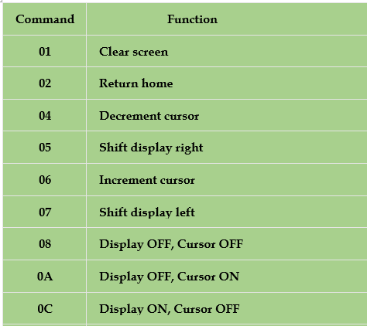
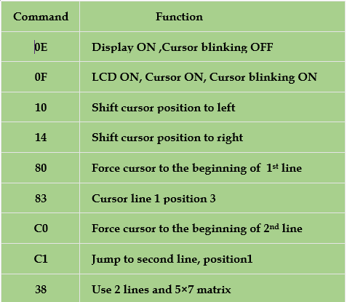
LCD INTERFACE

Slide 13
LCD INTERFACE
For programming LCD follow these steps:
STEP1: Initialization of LCD.
STEP2: Sending command to LCD.
STEP3: Writing the data to LCD.
Step1: LCD initialization (common for almost all applications)
Send 38H to the 8 bit data line for initialization
Send 0FH for making LCD ON, cursor ON and cursor blinking ON.
Send 06H for incrementing cursor position.
Send 01H for clearing the display and return the cursor.

Slide 14
LCD INTERFACE
Step2: Sending command to LCD
Send the command data to command register
Make R/W low.
Make RS=0 if data byte is a command
Pulse E from high to low with some delay.
Repeat above steps for sending another data.
Step3: Writing the data to LCD
Place data byte on the data register.
Make R/W low.
make RS=1 if the data byte is a data to be displayed.
Pulse E from high to low with some delay.
Repeat above steps for sending another data.

Slide 15
LCD INTERFACE
Write an 8051 assembly language program to display the message “N” and “O” on LCD display.
;calls a time delay before sending next data/command
;P1.0-P1.7 are connected to LCD data pins D0-D7
;P2.0 is connected to RS pin of LCD
;P2.1 is connected to R/W pin of LCD
;P2.2 is connected to E pin of LCD

Slide 16
LCD INTERFACE
ORG 0000H
MOV A, #38H ; INITIALIZE 2x16 LCD
ACALL COMNWRT ; call command subroutine
ACALL DELAY ; give LCD some time
MOV A, #0EH ; display on, cursor on
ACALL COMNWRT ; call command subroutine
ACALL DELAY ; give LCD some time
MOV A, #01 ; clear LCD
ACALL COMNWRT ; call command subroutine
ACALL DELAY ; give LCD some time
MOV A, #06H ; shift cursor right
ACALL COMNWRT ; call command subroutine
ACALL DELAY ; give LCD some time

Slide 17
LCD INTERFACE
MOV A, #84H ; cursor at line 1, pos. 4
ACALL COMNWRT ; call command subroutine
ACALL DELAY ; give LCD some time
MOV A, #’N’ ; display letter N (data)
ACALL DATAWRT ; call display subroutine
ACALL DELAY ; give LCD some time
MOV A, #’O’ ; display letter O
ACALL DATAWRT ; call display subroutine
AGAIN: SJMP AGAIN ; stay here

Slide 18
LCD INTERFACE
COMNWRT: ; send command to LCD
MOV P1, A ; copy reg A to port 1
CLR P2.0 ; RS=0 for command
CLR P2.1 ; R/W=0 for write
SETB P2.2 ; E=1 for high pulse
ACALL DELAY ; give LCD some time
CLR P2.2 ; E=0 for H-to-L pulse
RET

Slide 19
LCD INTERFACE
DATAWRT: ; write data to LCD
MOV P1, A ; copy reg A to port 1
SETB P2.0 ; RS=1 for data
CLR P2.1 ; R/W=0 for write
SETB P2.2 ; E=1 for high pulse
ACALL DELAY ; give LCD some time
CLR P2.2 ; E=0 for H-to-L pulse
RET

Slide 20
LCD INTERFACE
DELAY: MOV R3, #50 ; 50 or higher for fast CPUs
HERE2: MOV R4, #255 ; R4 = 255
HERE: DJNZ R4, HERE ; stay until R4 becomes 0
DJNZ R3, HERE2 ; stay until R3 becomes 0
RET
END

Slide 21
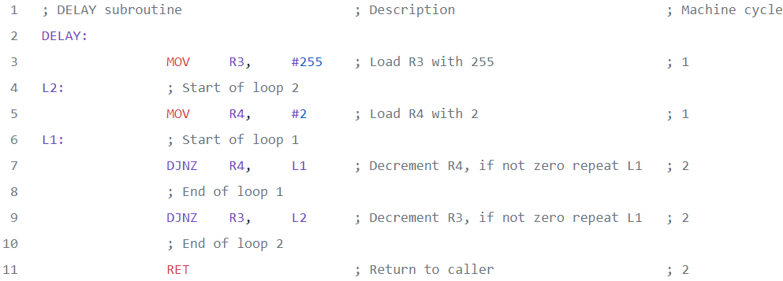

Slide 22
Write an 8051 assembly language program to display the message “HELLO” on LCD display using DPTR.

Slide 23
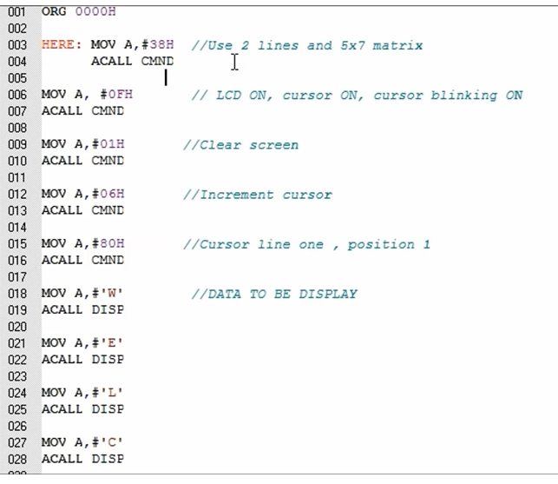

Slide 24
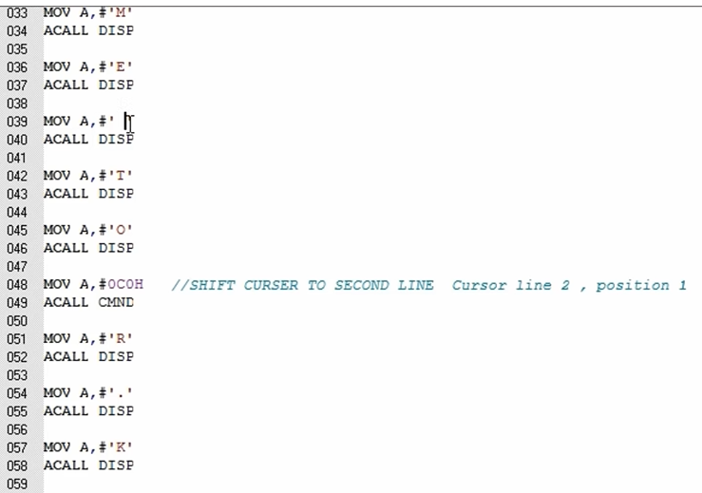

Slide 25
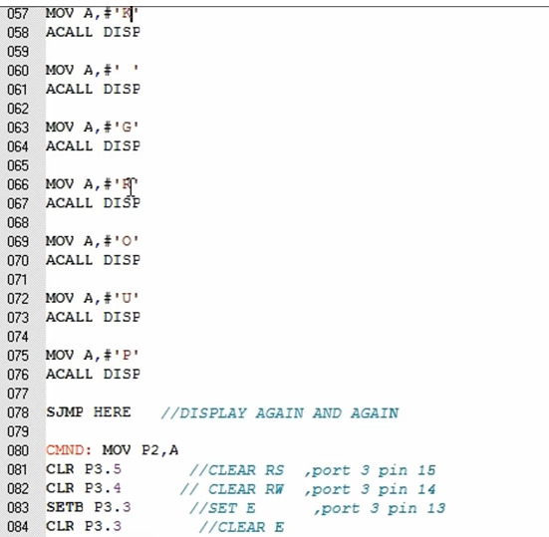

Slide 26
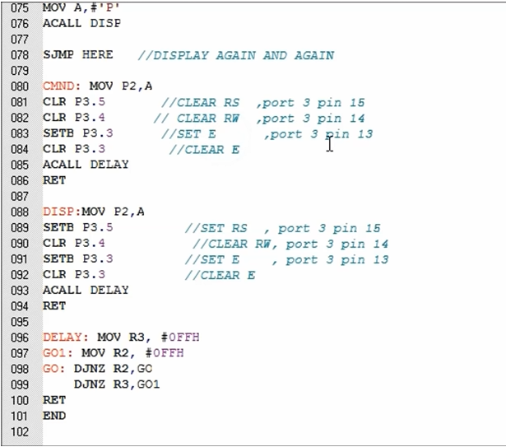

Slide 27
LCD INTERFACE
Write an 8051 assembly language program to display the message “HELLO” on LCD display using DPTR.
; P1.0-P1.7=D0-D7, P2.0=RS, P2.1=R/W, P2.2=E
ORG 0000H
MOV DPTR, #MYCOM
C1: CLR A
MOVC A,@A+DPTR
ACALL COMNWRT
ACALL DELAY
INC DPTR
JZ SEND_DAT
SJMP C1
ORG 0000H
MOV DPTR, #MYCOM
C1: CLR A
MOVC A,@A+DPTR
ACALL COMNWRT
ACALL DELAY
INC DPTR
JZ SEND_DAT
SJMP C1

Slide 28
LCD INTERFACE
SEND_DAT:
MOV DPTR, #MYDATA
D1: CLR A
MOVC A,@A+DPTR
ACALL DATAWRT
ACALL DELAY
INC DPTR
JZ AGAIN
SJMP D1
AGAIN: SJMP AGAIN

Slide 29
LCD INTERFACE
COMNWRT: ; send command to LCD
MOV P1, A ; copy reg A to P1
CLR P2.0 ; RS=0 for command
CLR P2.1 ; R/W=0 for write
SETB P2.2 ; E=1 for high pulse
ACALL DELAY ; give LCD some time
CLR P2.2 ; E=0 for H-to-L pulse
RET

Slide 30
LCD INTERFACE
DATAWRT: ; write data to LCD
MOV P1, A ; copy reg A to port 1
SETB P2.0 ; RS=1 for data
CLR P2.1 ; R/W=0 for write
SETB P2.2 ; E=1 for high pulse
ACALL DELAY ; give LCD some time
CLR P2.2 ; E=0 for H-to-L pulse
RET

Slide 31
LCD INTERFACE
DELAY: MOV R3, #250 ; 50 or higher for fast CPUs
HERE2: MOV R4, #255 ; R4 = 255
HERE: DJNZ R4, HERE ; stay until R4 becomes 0
DJNZ R3, HERE2
RET
ORG 300H
MYCOM: DB 38H, 0EH, 01, 06, 84H, 0 ; commands and null
MYDATA: DB “HELLO”, 0 ;Define byte
END

Slide 32
KEYPAD
INTERFACE
23

Slide 33
KEYPAD INTERFACE
Keyboards are organized in a matrix of rows and columns
The CPU accesses both rows and columns through ports
When a key is pressed, a row and a column make a contact
A 4x4 matrix connected to two ports
The rows are connected to an output port and the columns are connected to an input port
24

Slide 34
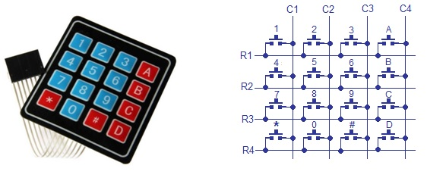
KEYPAD INTERFACE
25

Slide 35
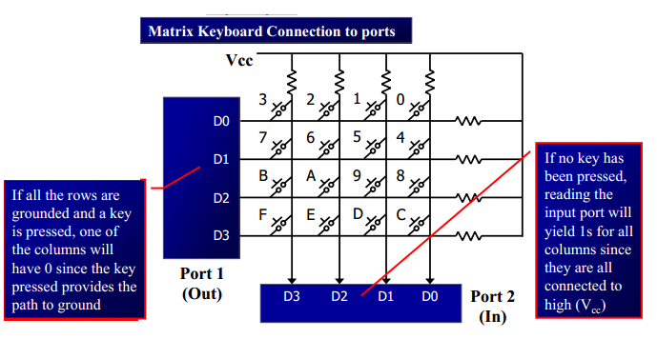
KEYPAD INTERFACE
26

Slide 36
KEYPAD INTERFACE
It is the function of the microcontroller to scan the keyboard continuously to detect and identify the key pressed
To detect a pressed key, the microcontroller grounds all rows by providing 0 to the output latch, then it reads the columns
If the data read from columns is D3 –D0 = 1111, no key has been pressed and the process continues till key press is detected
If one of the column bits has a zero, this means that a key press has occurred
27

Slide 37
KEYPAD INTERFACE
It grounds the next row, reads the columns, and checks for any zero, this process continues until the row is identified
After identification of the row in which the key has been pressed it find out which column the pressed key belongs to.
Identify the row and column of the pressed key for
(a) D3 – D0 = 1110 for the row, D3 – D0 = 1011 for the column
(b) D3 – D0 = 1101 for the row, D3 – D0 = 0111 for the column
Answer : (a). 2 (b). 7
28

Slide 38
KEYPAD INTERFACE
It grounds the next row, reads the columns, and checks for any zero, this process continues until the row is identified
After identification of the row in which the key has been pressed it find out which column the pressed key belongs to.
Identify the row and column of the pressed key for
(a) D3 – D0 = 1110 for the row, D3 – D0 = 1011 for the column
(b) D3 – D0 = 1101 for the row, D3 – D0 = 0111 for the column
Answer : (a). 2 (b). 7
29

Slide 39
KEYPAD INTERFACE
Steps for key press identification
Initially all switches are assumed to be released. So there is no connection between the rows and columns.
When any one of the switches are pressed, the corresponding row and column are connected (short circuited). This will drive that column pin (initially high) low.
Using this logic, the button press can be detected. The colors red and black is for logic high and low respectively.
30

Slide 40
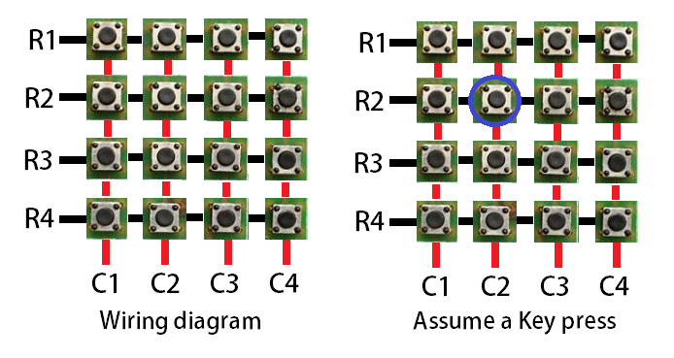
KEYPAD INTERFACE
Steps for key press identification
Step 1: The first step involved in interfacing the matrix keypad is to write all logic 0’s to the rows and all logic 1’s to the columns. In the image, black line symbolizes logic 0 and red line symbolizes logic 1.
31

Slide 41
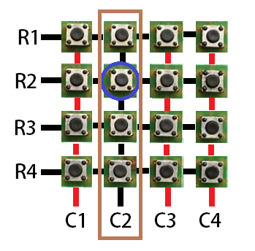
KEYPAD INTERFACE
Steps for key press identification
Step 2: Now the program has to scan the pins connected to columns of the keypad. If it detects a logic 0 in any one of the columns, then a key press was made in that column. This is because the event of the switch press shorts the C2 line with R2. Hence C2 is driven low.
32

Slide 42
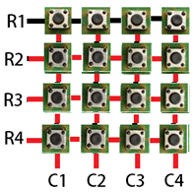
KEYPAD INTERFACE
Steps for key press identification
Step 3: Once the column corresponding to the key pressed is located, start writing logic 0’s to the rows sequentially (one after the other) and check if C2 becomes low.
33

Slide 43
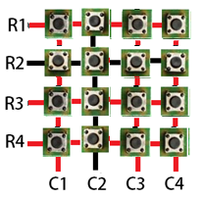
KEYPAD INTERFACE
Steps for key press identification
Step 4: The procedure is followed till C2 goes low when logic low is written to a row. In this case, a logic low to the second row will be reflected in the second column.
34

Slide 44
KEYPAD INTERFACE
We already know that the key press happened at column 2. Now we have detected that the key is in row 2. So, the position of the key in the matrix is (2,2).
Once this is detected, its up to us to name it or provide it with a task on the event of the key press.
35

Slide 45
KEYPAD INTERFACE
Program for detection and identification of key activation goes through the following stages:
To make sure that the preceding key has been released, 0s are output to all rows at once, and the columns are read and checked repeatedly until all the columns are high
To see if any key is pressed, the columns are scanned over and over in an infinite loop until one of them has a 0 on it
To detect which row key press belongs to, it grounds one row at a time, reading the columns each time
To identify the key press, it rotates the column bits, one bit at a time, into the carry flag and checks to see if it is low
36

Slide 46
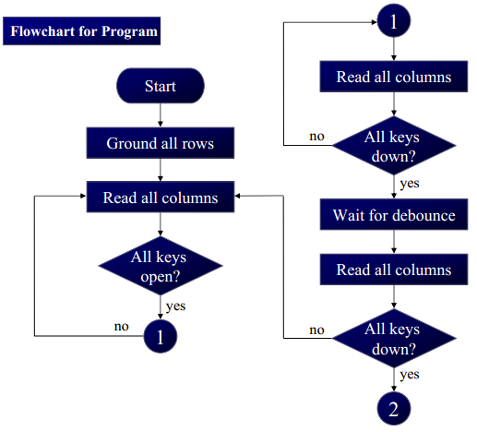
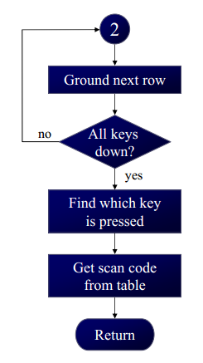
KEYPAD INTERFACE
37

Slide 47
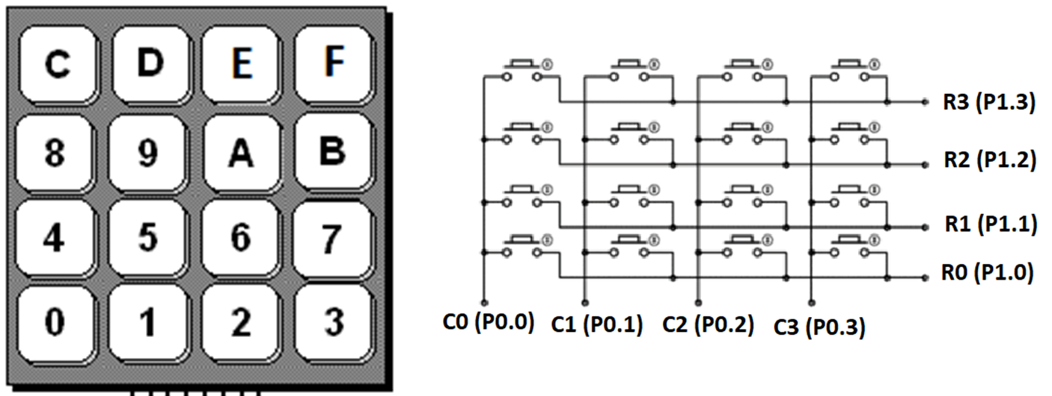
KEYPAD INTERFACE
Keyboard Program
Write an assembly language program for the 8051 to interface the 4x4 matrix keypad and LCD. Any key pressed on the Keypad must be display in LCD.
38

Slide 48
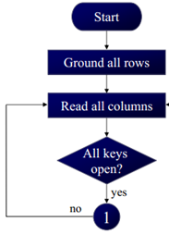
KEYPAD INTERFACE
ORG 000H
SJMP START
ORG 0030H
START: MOV P0,#0FFH ;MAKE P0 AN INPUT PORT(column)
ACALL LCD_INITIALIZE
K1: MOV P1,#0 ;GROUND ALL ROWS AT ONCE
MOV A,P0 ;READ ALL COL.
ANL A,#00001111B ;MASKED UNUSED BIT
CJNE A,#00001111B,K2 ;CHECK ALL KEYS RELEASED
SJMP K1
39

Slide 49
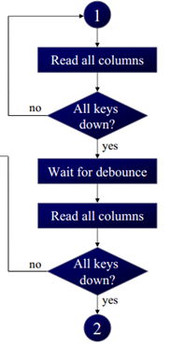
KEYPAD INTERFACE
K2: ACALL DELAY ;CALL 20 MS DELAY
MOV A,P0 ;SEE IF ANY KEY IS PRESSED
ANL A,#00001111B ;MASKED UNUSED BIT
CJNE A,#00001111B,OVER(check row) ;KEY PRESSED, WAIT
SJMP K2 ;CHECK TILL KEY PRESSED
OVER(check row): ACALL DELAY ;WAIT 20 ms Key DEBOUNCE TIME
MOV A,P0 ;CHECK KEY CLOSURE
ANL A,#00001111B ;MASKED UNUSED BIT
CJNE A,#00001111B,OVER1 ;KEY PRESSED, FIND ROW
SJMP K2 ;IF NONE, KEEP POLLING
40

Slide 50
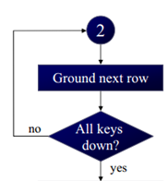
KEYPAD INTERFACE
OVER1: MOV P1,#1111110B ;GROUND ROW 0
MOV A,P0 ;READ ALL COLUMNS
ANL A,#00001111B ;MASKED UNUSED BIT
CJNE A,#00001111B,ROW_0 ;ROW0, FIND COL
MOV P1,#11111101B ;GROUND ROW 1
MOV A,P0 ;READ ALL COL.
ANL A,#00001111B ;MASKED UNUSED BIT
CJNE A,#00001111B,ROW_1 ;ROW 1, FIND THE COL
41

Slide 51
KEYPAD INTERFACE
MOV P1,#11111011B ;GROUND ROW 2
MOV A,P0 ;READ ALL COL.
ANL A,#00001111B ; MASKED UNUSED BIT
CJNE A,#00001111B,ROW_2 ;ROW 2, FIND COL
MOV P1,#11110111B ;GROUND ROW 3
MOV A,P0 ;READ ALL COL.
ANL A,#00001111B ;MASKED UNUSED BIT
CJNE A,#00001111B,ROW_3 ;ROW 3, FIND COL
LJMP K1 ;IF NONE, FALSE INPUT, REPEAT
42

Slide 52

KEYPAD INTERFACE
ROW_0: MOV DPTR, #KCODE0 ;SET DPTR=START OR ROW 0
SJMP FIND ;FIND COLUMN BELONGS TO
ROW_1: MOV DPTR, #KCODE1 ;SET DPTR=START OR ROW 1
SJMP FIND ;FIND COLUMN BELONGS TO
ROW_2: MOV DPTR, #KCODE2 ;SET DPTR=START OR ROW 2
SJMP FIND ;FIND COLUMN BELONGS TO
ROW_3: MOV DPTR, #KCODE3 ;SET DPTR=START OR ROW 3
43

Slide 53
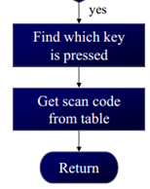
KEYPAD INTERFACE
FIND: RRC A ;SEE IF ANY CY BIT LOW
JNC MATCH ;IF ZERO GET ASCII CODE
INC DPTR ;POINT TO NEXT COLUMN
SJMP FIND ;KEEP SEARCHING
MATCH: CLR A
MOVC A,@A+DPTR read data from Rom
ACALL LCD_DATA ;GET CODE FROM LOOK-UP TABLE
LJMP K1 ;LOOP
44

Slide 54
KEYPAD INTERFACE
DELAY: MOV R4,#40
REPEAT: MOV R5,#230
REPEATT: DJNZ R5,REPEATT
DJNZ R4,REPEAT
RET
ORG 300H
KCODE3: DB 'C','D','E','F‘ ;ROW 3
KCODE2: DB '8','9','A','B‘ ;ROW 2
KCODE1: DB '4','5','6','7‘ ;ROW 1
KCODE0: DB '0','1','2','3‘ ;ROW 0
END
20ms DELAY PROGRAM
LOOK-UP TABLE FOR KEYPAD
(Modify based on key position on keypad)
45

Slide 55
KEYPAD INTERFACE
LCD_INITIALIZE: MOV A,#38H
ACALL LCD_COMMAND
MOV A,#0EH
ACALL LCD_COMMAND
MOV A,#01H
ACALL LCD_COMMAND
MOV A,#06H
ACALL LCD_COMMAND
MOV A,#80H
ACALL LCD_COMMAND
RET
46

Slide 56
KEYPAD INTERFACE
LCD_COMMAND: MOV P2,A
CLR P3.7
CLR P3.6
SETB P3.5
ACALL DELAY
CLR P3.5
RET
47

Slide 57
KEYPAD INTERFACE
LCD_DATA: MOV P2,A
SETB P3.7
CLR P3.6
SETB P3.5
ACALL DELAY
CLR P3.5
RET
48

Slide 58
MODULE-5
ADC
Peripheral
Interfacing
DAC
SENSOR with Signal Conditioning Interface

Slide 59
ANALOG TO DIGITAL CONVERTER (ADC)
1

Slide 60
ADC INTERFACE
ADCs (analog-to-digital converters) are among the most widely used devices for data acquisition(recovery)
A physical quantity, like temperature, pressure, humidity, and velocity, etc., is converted to electrical (voltage, current) signals using a device called a transducer, or sensor
We need an analog-to-digital converter to translate the analog signals to digital numbers, so microcontroller can read them
2

Slide 61
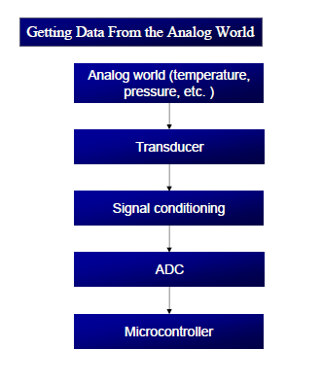
ADC INTERFACE
3

Slide 62
ADC INTERFACE
The ADC chip can be either parallel or serial.
In parallel ADC (0804, 0808 and 0809) we have 8 or more dedicated pins to bringing out the binary data but in serial ACD (MAX1112) we have only one pin for data out.
An ADC has n-bit resolution where n can be 8,10,12,16 or even 24 bits
The higher resolution ADC provides high accuracy by having a smaller step size where Step size is the smallest change that can be discerned by an ADC
4

Slide 63
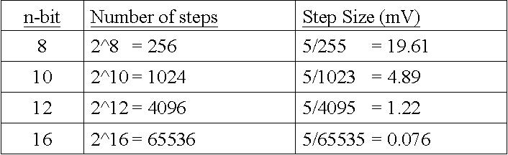
ADC INTERFACE
5

Slide 64
ADC INTERFACE
ADC804 IC is A 8-bit parallel an analog-to-digital converter
successive approximation ADC
It works with +5 volts and has a resolution of 8 bits
Conversion time is another major factor in judging an ADC
Conversion time is defined as the time it takes the ADC to convert the analog input to a digital (binary) number
In ADC804 conversion time varies depending on the clocking signals applied to CLK R and CLK IN pins, but it cannot be faster than 110 µs
6

Slide 65
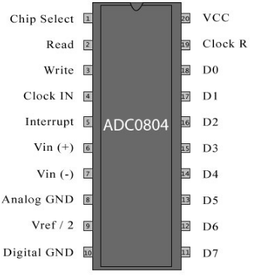
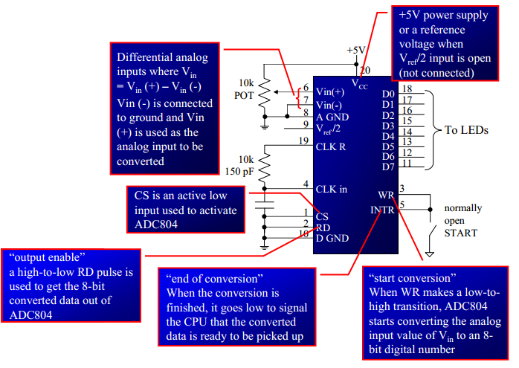
ADC INTERFACE
ADC 0804 PIN DIAGRAM
7

Slide 66

ADC INTERFACE
CLK IN and CLK R:
CLK IN is an input pin connected to an external clock source
To use the internal clock generator (also called self-clocking), CLK IN and CLK R pins are connected to a capacitor and a resistor, and the clock frequency is determined by
Typical values are R = 10K ohms and C = 150 pF
We get f= 606 kHz and the conversion time is 110 µs
ECE3003 - Microcontroller and Application
8

Slide 67
ADC INTERFACE
Vref/2:
It is used for the reference voltage
If this pin is open (not connected), the analog input voltage is in the range of 0 to 5 volts (the same as the Vcc pin)
If the analog input range needs to be 0 to 4 volts, Vref/2 is connected to 2 volt
9

Slide 68
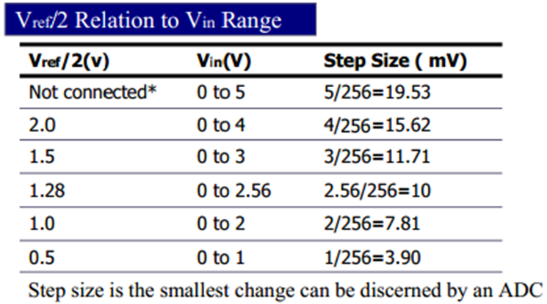
ADC INTERFACE
For 8-bit ADC
10

Slide 69

ADC INTERFACE
D0-D7:
The digital data output pins and these are tri-state buffered
The converted data is accessed only when CS =0 and RD is forced low
To calculate the output voltage, use the following formula
Dout= digital data output (in decimal),
Vin= analog voltage, and
step size(resolution) is the smallest change
11

Slide 70
ADC INTERFACE
The following steps must be followed for data conversion by the ADC804 chip
Make CS = 0 and send a low-to-high pulse to pin WR to start conversion
Keep monitoring the INTR pin
If INTR is low, the conversion is finished
If the INTR is high, keep polling until it goes low
After the INTR has become low, we make CS = 0 and send a high-to-low pulse to the RD pin to get the data out of the ADC804
12

Slide 71
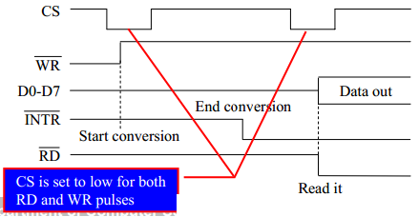
ADC INTERFACE
13

Slide 72
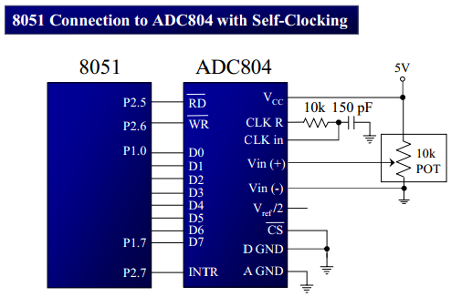
ADC INTERFACE
Examine the ADC804 connection to the 8051 in Figure. Write a program to monitor the INTR pin and bring an analog input into register A. Then call a hex-to ASCII conversion and data display subroutines. Do this continuously.
14

Slide 73
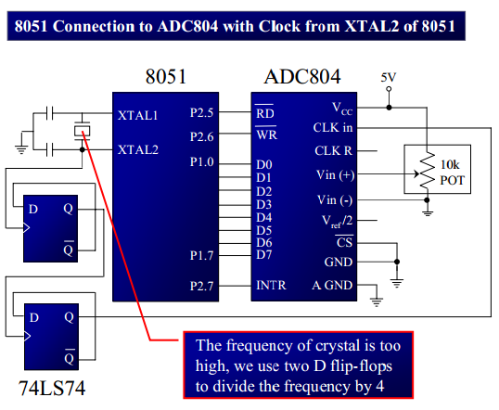
ADC INTERFACE
15

Slide 74
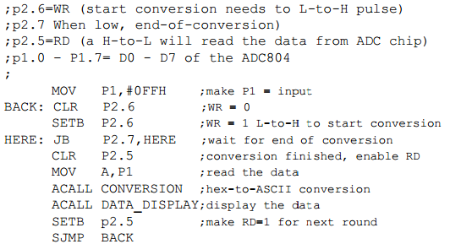
ADC INTERFACE
16

Slide 75
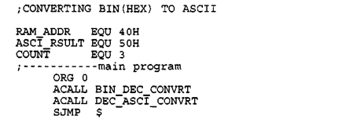
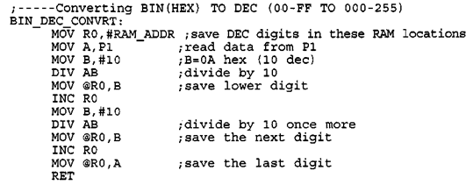
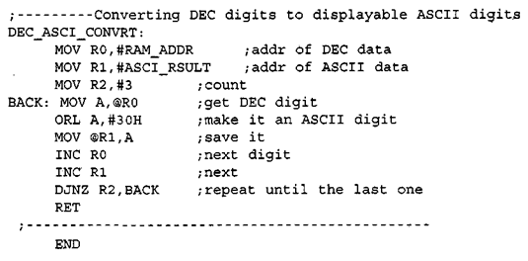
ADC INTERFACE
17

Slide 76
ADC INTERFACE
INTERFACING LM35 WITH 8051
The ADC804 has 8-bit resolution with a maximum of 256 steps and the LM35 (or LM34) produces 10 mV for every degree of temperature Change
we can condition Vin of the ADC804 to produce a Vout of 2560 mV full-scale output. Therefore, in order to produce the fullscale Vout of 2.56 V for the ADC804
We need to set Vref/2 = 1.28.This makes Vout of the ADC804 correspond directly to the temperature as monitored by the LM35.
18

Slide 77
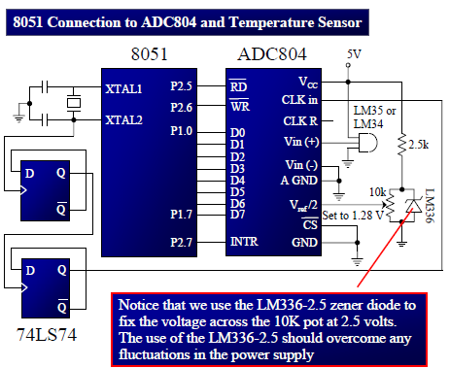
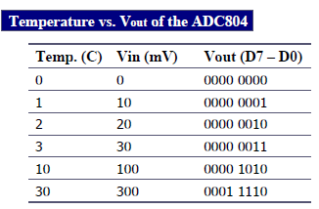
ADC INTERFACE
19

Slide 78
DIGITAL TO ANALOG CONVERTER (DAC)
20

Slide 79
DAC INTERFACE
Microcontroller are used in wide variety of applications like for measuring and control of physical quantity like temperature, pressure, speed, distance, etc.
In these systems microcontroller generates output which is in digital form but the controlling system requires analog signal as they don't accept digital data thus making it necessary to use DAC which converts digital data into equivalent analog voltage.
The 8-bit DAC 0808 converts digital data into equivalent analog Current. Hence we require an I to V converter to convert this current into equivalent voltage.
ECE3003 - Microcontroller and Application
21

Slide 80
DAC INTERFACE
The digital-to-analog converter (DAC) is a device widely used to convert digital pulses to analog signals.
The vast majority of integrated circuit DACs, use the R/2R method since it can achieve a much higher degree of precision.
The first criterion for judging a DAC is its resolution, which is a function of the number of binary inputs.
The common ones are 8, 10, and 12 bits.
ECE3003 - Microcontroller and Application
22

Slide 81
DAC INTERFACE
The number of data bit inputs decides the resolution of the DAC since the number of analog output levels is equal to 2^{n}, where n is the number of data bit inputs.
Therefore, an 8-input DAC such as the DAC0808 provides 256 discrete voltage (or current) levels of output. Similarly, the 12-bit DAC provides 4096 discrete voltage levels.
In the MC1408 (DAC0808), the digital inputs are converted to current (I_{out}), and by connecting a resistor to the I_{out} pin, we convert the result to voltage.
ECE3003 - Microcontroller and Application
23

Slide 82
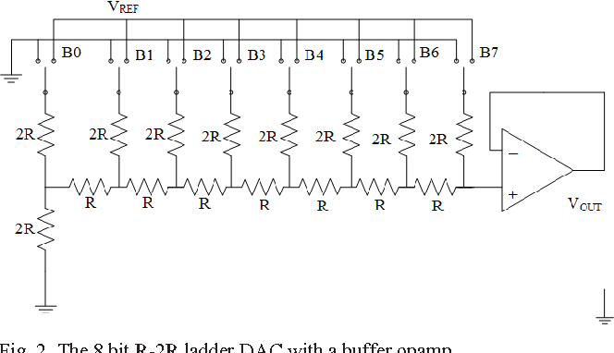

Slide 83

DAC INTERFACE
The total current provided by the I_{out} pin is a function of the binary numbers at the DO – D7 inputs of the DAC0808 and the reference current (I_{re}f), and is as follows:
where DO is the LSB, D7 is the MSB for the inputs, and I_{re}f is the input current that must be applied to pin 14.
The I_{re}f current is generally set to 2.0 mA.
ECE3003 - Microcontroller and Application
24

Slide 84
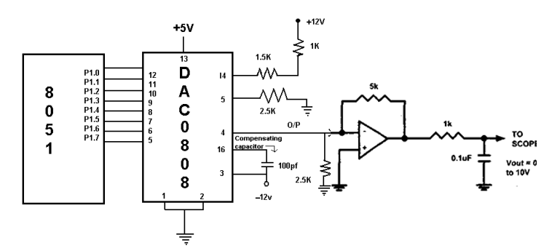
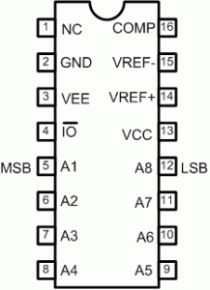
DAC INTERFACE
ECE3003 - Microcontroller and Application
25

Slide 85
DAC INTERFACE
Write a program to send data to the DAC to generate a Sawtooth, triangle and staircase waveforms.
ORG 0000H
SAWTOOTH: MOV A, #00H
BACK: MOV P1,A
INC A
CJNE A,#255, BACK
MOV A,#00
SJMP SAWTOOTH RET
ECE3003 - Microcontroller and Application
26

Slide 86
DAC INTERFACE
TRIANGLE: MOV A,#00
INCR: MOV P1,A
INC A
CJNE A,#255, INCR
DECR: MOV P1,A
DEC A
CJNE A,#00, DECR
SJMP TRIANGLE
ECE3003 - Microcontroller and Application
27

Slide 87
DAC INTERFACE
STAIRCASE: MOV A,#00
MOV P1,A
RPT: ADD A,#51
MOV P1,A
CJNE A,#255, RPT
SJMP STAIRCASE
ECE3003 - Microcontroller and Application
28

Slide 88
DAC INTERFACE
Generating a sine wave
To generate a sine wave, we first need a table whose values represent the magnitude of the sine of angles between 0 and 360 degrees.
The values for the sine function vary from -1.0 to +1.0 for 0- to 360-degree angles.
Table shows the angles, the sine values, the voltage magnitudes, and the integer values representing the voltage magnitude for each angle (with 30-degree increments).
ECE3003 - Microcontroller and Application
29

Slide 89
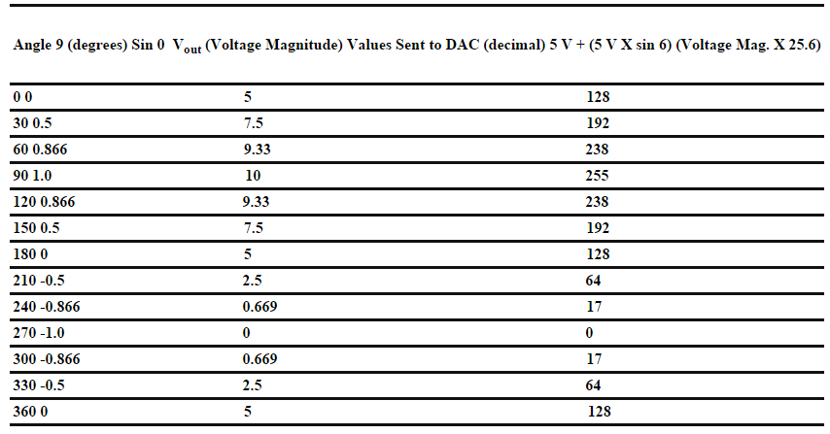
DAC INTERFACE
Generating a sine wave
ECE3003 - Microcontroller and Application
30

Slide 90
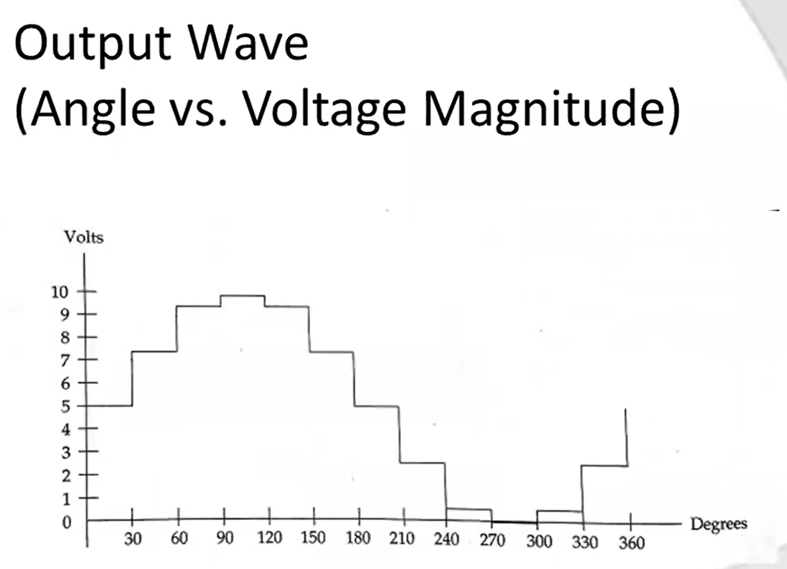

Slide 91
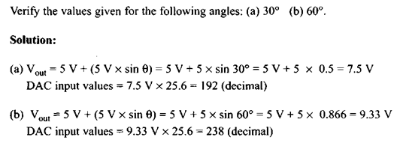
DAC INTERFACE
Generating a sine wave
ECE3003 - Microcontroller and Application
31

Slide 92
DAC INTERFACE
Generating a sine wave
This program sends the values to the DAC continuously (in an infinite loop) to produce a sine wave
SINEWAVE: MOV DPTR, #SINE
MOV R2,#13
NEXT: CLR A
MOVC A, @A+DPTR
MOV P1,A
INC DPTR
DJNZ R2, NEXT
SJMP SINEWAVE
ORG 050H
SINE : DB 128,192,238,255,238,192,128, 67,17,0,17,67,128
END
ECE3003 - Microcontroller and Application
32

Slide 93
SENSOR WITH SIGNAL CONDITIONING INTERFACE
33

Slide 94
SIGNAL CONDITIONING CIRCUITS
Signal conditioning circuits are used to process the output signal from sensors of a measurement system to be suitable for the next stage of operation
The function of the signal conditioning circuits include the following items: Signal amplification (op-amp), Filtering (op-amp), Interfacing with µc (ADC), Protection (Zener & photo isolation), Linearization, Current – voltage change circuits, resistance change circuits (Wheatstone bridge), error compensation
34

Slide 95
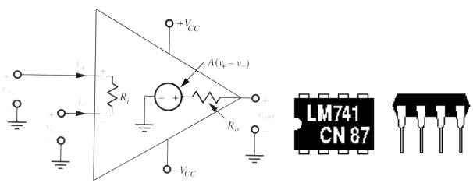
SIGNAL CONDITIONING CIRCUITS
Operational amplifiers are the basic element of many signal conditioning modules
Generally the op-amp has the following properties:
Gain: being of the order greater than 100000, ideally = infinite
Input impedance: ideally infinite
Output impedance: ideally zero; practical values 20-100Ω
35

Slide 96
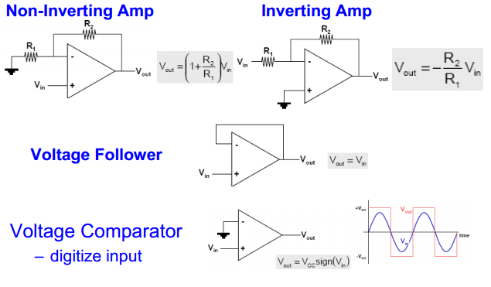
SIGNAL CONDITIONING CIRCUITS
36

Slide 97

SIGNAL CONDITIONING CIRCUITS
37

Slide 98

SIGNAL CONDITIONING CIRCUITS
38

Slide 99

SIGNAL CONDITIONING CIRCUITS
39

Slide 100

SIGNAL CONDITIONING CIRCUITS
40

Slide 101

SIGNAL CONDITIONING CIRCUITS
41

Slide 102

SIGNAL CONDITIONING CIRCUITS
Operational amplifiers as comparator: The output indicates which of the two voltages is high (V1 or V2), When used with no feedback connection
42

Slide 103


SIGNAL CONDITIONING CIRCUITS
Signal conditioning: Wheatstone Bridge, One of the most used signal conditioning circuit. It can be used to convert a resistance change to a voltage change as in the following example:
43

Slide 104


SIGNAL CONDITIONING CIRCUITS
Heart rate monitor using 8051
44

Slide 105
SIGNAL CONDITIONING CIRCUITS
Heart rate monitor using 8051
This circuit senses the heart rate from the finger tip using IR reflection method and displays it on LCD display in beats per minute.
When the finger tip is placed over the LTH1550-01 is simply a IR diode – photo transistor pair sensor the volumetric pulsing of the blood volume inside the finger tip due to heart beat varies the intensity of the reflected beam and this variation in intensity is according to the heart beat.
When more light falls on the photo transistor it conducts more, its collector current increases and so its collector voltage decreases.
45

Slide 106
SIGNAL CONDITIONING CIRCUITS
Heart rate monitor using 8051
When less light falls on the photo transistor it conducts less, its collector current decreases and so its collector voltage decreases. This variation in the collector voltage will be proportional to the heart rate.
Any way this voltage variation is so feeble and additional signal conditioning stages are necessary to convert it into a microcontroller recognizable form.
The next part of the circuit consists of a two active low pass filters using opamp LM324. The LM324 is a quad opamp that can be operated from a single rail supply.
46

Slide 107
SIGNAL CONDITIONING CIRCUITS
Heart rate monitor using 8051
Resistor R12, R13 and capacitor C12 sets the gain and cut off frequency of the first filter.
With the given component values, gain will be 11 and cut off frequency will be 2.5Hz. The gain and cut off frequency are determined using the following equations.
Voltage gain Av =1 + (R12 / R13)
Cut off frequency Fc= 1/(2π *R12*C12)
Capacitor C15 is used to by-pass noise if any may cause false triggering of the comparator.
47

Slide 108
SIGNAL CONDITIONING CIRCUITS
Heart rate monitor using 8051
The second low pass filter also have same gain and cut off frequency.The two low pass filters form a very critical part of the circuit as any noise or false signals passing to the microcontroller stage will produce disastrous results.
The output of the filter stage will be a voltage level fluctuating between 0 and 0.35 volts and this fluctuation is converted into a 0 to 5V swing using the comparator based on the third opamp (IC1c).
The reference voltage of the comparator is set to 0.3V. When ever the output voltage of the filter stage goes above 0.3V, the output of the comparator goes to zero.
48

Slide 109
SIGNAL CONDITIONING CIRCUITS
Heart rate monitor using 8051
Whenever the output voltage of the filter stage goes below 0.3V, the output of the comparator goes to positive saturation.
The result will be a neat pulse fluctuating between 0 and 5V at a rate equal to the heart rate. This pulse is fed to the microcontroller for counting.
For counting the number of beats Timer0 and Timer1 are used.
Timer1 is set as an 8 bit auto reload counter for counting the number of pulses (indicating the heart beat) and Timer0 is set as a 16 bit timer which generates a 65536uS delay.
49

Slide 110
SIGNAL CONDITIONING CIRCUITS
Heart rate monitor using 8051
When looped 230 times it will produce a 15 seconds time span (230 x 65536uS =15S) for the Timer 1 to count. The number of counts obtained in 15 seconds is multiplied by 4 to obtain the heart rate in beats per minute.
Data/command input pin DB0 to DB7 of the display is interfaced to Port0 of the microcontroller.
Resistor network R17 is used for pulling up thePort0. Port0 needs external pull up for proper functioning. Preset resistor R1 is used for adjusting the contrast of the display. R2 limits the current through the back light LED.
50

Slide 111



SIGNAL CONDITIONING CIRCUITS
Heart rate monitor using 8051
#04D
51

Slide 112




SIGNAL CONDITIONING CIRCUITS
Heart rate monitor using 8051
52

Slide 113




SIGNAL CONDITIONING CIRCUITS
Heart rate monitor using 8051
53

Slide 114



SIGNAL CONDITIONING CIRCUITS
Heart rate monitor using 8051
Output on LCD
Heart Rate (Text1)
Counting... (Text3)
Heart Rate (Text1)
bpm XX (Text2)
54

Slide 115
THANK YOU

