Slide 1
BECE204L – MICROPROCESSORS AND MICROCONTROLLERS
MODULE-7
ARM Instruction Set
MODULE-7
BECE204L – MICROPROCESSORS AND MICROCONTROLLERS
1

Slide 2
MODULE-7
ARM Instruction Set
ARM Instruction- data processing instructions, branch instructions, load store instructions, SWI Instruction, Loading instructions, conditional Execution, Assembly Programming.
MODULE-7
BECE204L – MICROPROCESSORS AND MICROCONTROLLERS
2

Slide 3
ARM INSTRUCTION SET
MODULE-7
BECE204L – MICROPROCESSORS AND MICROCONTROLLERS
3

Slide 4
ARM INSTRUCTION SET
FEATURES
Load-store architecture
Conditional execution of every instruction
Possible to load/store multiple registers at once
Possible to combine shift and ALU operations in a single instruction
3-address instructions
2 or 3 operand field
Number representation: Hexa-0x, Binary-0b
The processor operations is illustrated using examples with pre- and post-conditions, describing registers and memory before and after the instruction are executed
PRE <pre-conditions>
<instruction/s>
POST <post-conditions>
MODULE-7
BECE204L – MICROPROCESSORS AND MICROCONTROLLERS
4

Slide 5
ARM INSTRUCTION SET
ARM Instruction Set (ARMv5E) Classification
Load store instructions : LDR, STR
Data processing instructions
Move instructions : MOV, MVN
Barrel shift instructions : LSL, LSR, ASR, ROR, RRX
Arithmetic instructions : ADD, ADC, SUB, SBC, RSB, RSC
Multiply instructions : MUL, MLA
Logical instructions : AND, ORR, EOR, BIC
Comparison instructions : CMP, CMN
Branch instructions : B, BL
Conditional execution instructions : EQ, NE, CS, CC, MI, PL, VS, VC, HI, LS, GE, LT, GT, LE, AL
Software interrupts instruction
Status register transfer instruction
Coprocessor instructions
MODULE-7
BECE204L – MICROPROCESSORS AND MICROCONTROLLERS
5

Slide 6
ARM INSTRUCTION SET
1. LOAD STORE INSTRUCTIONS
Load-store instructions transfer data between memory and processor registers or immediately load the value to registers.
There are three types of load-store instructions:
Single-register transfer - used for moving a single data item in and out of a register
Multiple-register transfer - enable transfer of large quantities of data
Swap - allow exchange between a register and memory in one instruction
However, Single-Register Transfer instructions are most commonly used to perform load store operation.
Syntax: <LDR|STR>{<cond>}{B} Rd,addressing1
Instruction | Meaning | Example | Operation
LDR | Load word into a register | LDR r0, =0x0000000f | r0 := 0x0000000f
 |  | LDR r0, [r1] | r0 := mem32[r1]
STR | Store word into a register | STR r0, [r1] | mem32[r1] := r0
 |  | STR r2, [r5], #8 | mem32[r5] = r2, r5 = r5 + 8
MODULE-7
BECE204L – MICROPROCESSORS AND MICROCONTROLLERS
6

Slide 7
ARM INSTRUCTION SET
2. DATA PROCESSING INSTRUCTIONS (a) MOVE INSTRUCTIONS
Data processing instructions are manipulate data within registers.
Move copies N into a destination register Rd, where N is a register or immediate value.
This instruction is useful for setting initial values and transferring data between registers.
If suffix S used on a data processing instruction, then it updates the flags in the CPSR.
Syntax: <instruction>{<cond>}{S} Rd, N
Instruction | Meaning | Operation | Example | Description
MOV | Move a 32-bit value into register | Rd=N | PRE r5=0x00000005, r7=0x00000008 MOV r7, r5 POST r5=0x00000005, r7=0x00000005 | Move r5 value into r7
MVN | Move the NOT of the 32-bit value into register | Rd=~N | PRE r5=0x00000005, r7=0x00000008 MVN r7, r5 POST r5=0x00000005, r7=0xFFFFFFFA | NOT r5 value then move to r7
MODULE-7
BECE204L – MICROPROCESSORS AND MICROCONTROLLERS
7

Slide 8
ARM INSTRUCTION SET
2. DATA PROCESSING INSTRUCTIONS (b) BARREL SHIFT INSTRUCTIONS
A unique and powerful feature of the ARM processor is the ability to shift the 32-bit binary pattern in one of the source registers left or right by a specific number of positions before it enters the ALU.
This shift increases the power and flexibility of many data processing operations.
This is particularly useful for loading constants into a register and achieving fast multiplies or division by a power of 2.
Most data processing instructions can process one of their operands using the barrel shifter.
It is possible to directly specify the number of bits to be shifted in the instruction itself.
MODULE-7
BECE204L – MICROPROCESSORS AND MICROCONTROLLERS
8

Slide 9
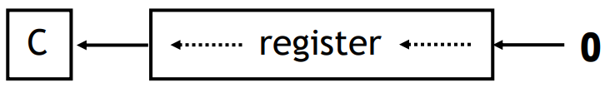
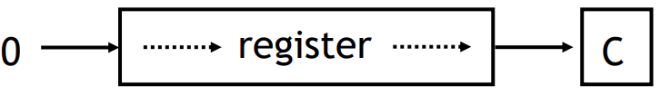
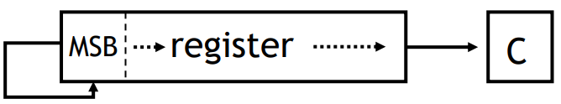
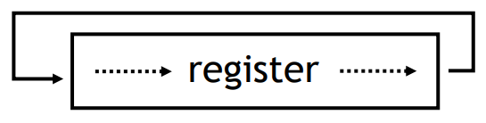
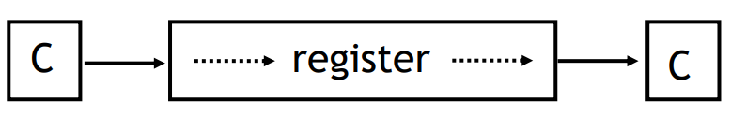
ARM INSTRUCTION SET
2. DATA PROCESSING INSTRUCTIONS (b) BARREL SHIFT INSTRUCTIONS
Instruction | Meaning | Shift | Example
LSL | Logical Shift Left |  | PRE R2=0x00000030 MOV R0, R2, LSL #2 ; R0:=R2<<2 POST R0=0x000000C0, R2=0x00000030
LSR | Logical Shift Right |  | PRE R2=0x00000030 MOV R0, R2, LSR #2 ; R0:=R2>>2 POST R0=0x0000000C, R2=0x00000030
ASR | Arithmetic Shift Right |  | PRE R2=0x80000030 MOV R0, R2, ASR #2 ; R0:=R2>>2 POST R0=0xE000000C, R2=0x80000030
ROR | ROtate Right |  | PRE R2=0x00000031 MOV R0, R2, ROR #2 ; R0:=R2 rotate 2 POST R0=0x4000000C, R2=0x00000031
RRX | Rotate Right eXtended |  | PRE R2=0x00000031,C=1 MOV R0, R2, RRX ; R0:=R2 rotate 2, C POST R0=0x00000018,C=1,R2=0x00000031
MODULE-7
BECE204L – MICROPROCESSORS AND MICROCONTROLLERS
9

Slide 10
ARM INSTRUCTION SET
2. DATA PROCESSING INSTRUCTIONS (c) ARITHMETIC INSTRUCTIONS
The arithmetic instructions implement addition and subtraction of 32-bit values.
Syntax: <instruction>{<cond>}{S} Rd, Rn, N
Instruction | Meaning | Operation | Example
ADD | Add two 32-bit values | Rd = Rn + N | PRE r1=0x00000005 ADD r0, r1, r1, LSL #1 ; r0=(r1<<1)+r1 POST r0=0x0000000F, r1=0x00000005
ADC | Add two 32-bit values and carry | Rd = Rn + N + C | PRE r1=0x00000005, C=1 ADC r0, r1, r1, LSL #1 ; r0=(r1<<1)+r1+C POST r0=0x00000010, r1=0x00000005
SUB | Subtract two 32-bit values | Rd = Rn - N | PRE r1=0x00000002, r2=0x00000001 SUB r0, r1, r2 ; r0=r1-r2 POST r0=0x00000001
N is the result of the shifter operation
MODULE-7
BECE204L – MICROPROCESSORS AND MICROCONTROLLERS
10

Slide 11
ARM INSTRUCTION SET
2. DATA PROCESSING INSTRUCTIONS (c) ARITHMETIC INSTRUCTIONS
Instruction | Meaning | Operation | Example
SBC | Subtract with carry of two 32-bit values | Rd = Rn - N - !C | PRE r1=0x00000002, r2=0x00000001, C=0 SBC r0, r1, r2 ; r0=r1-r2-!C POST r0=0x00000000
RSB | Reverse Subtract two 32-bit values | Rd = N - Rn | PRE r1=0x00000002, r2=0x00000005 RSB r0, r1, r2 ; r0=r2-r1 POST r0=0x00000003
RSC | Reverse Subtract with carry of two 32-bit values | Rd = N - Rn - !C | PRE r1=0x00000002, r2=0x00000005, C=0 RSC r0, r1, r2 ; r0=r2-r1-!C POST r0=0x00000002
N is the result of the shifter operation
MODULE-7
BECE204L – MICROPROCESSORS AND MICROCONTROLLERS
11

Slide 12
ARM INSTRUCTION SET
2. DATA PROCESSING INSTRUCTIONS (d) MULTIPLY INSTRUCTIONS
The multiply instructions multiply the contents of a pair of registers and, depending upon the instruction, accumulate the results in with another register.
Syntax: MUL{<cond>}{S} Rd, Rm
MLA{<cond>}{S} Rd, Rm, Rs, Rn
Instruction | Meaning | Operation | Example
MUL | Multiply two 32-bit values | Rd=Rm*Rs | PRE r1=0x00000002, r2=0x00000002 MUL r0, r1, r2 ; r0=r1*r2 POST r0=0x00000004, r1=0x00000002, r2=0x00000002
MLA | Multiply two 32-bit values and accumulate | Rd=(Rm*Rs)+Rn | PRE r1=0x00000002, r2=0x00000002, r3=0x00000005 MUL r0, r1, r2, r3 ; r0=(r1*r2)+r3 POST r0=0x00000009, r1=0x00000002, r2=0x00000002, r3=0x00000005
MODULE-7
BECE204L – MICROPROCESSORS AND MICROCONTROLLERS
12

Slide 13
ARM INSTRUCTION SET
2. DATA PROCESSING INSTRUCTIONS (e) LOGICAL INSTRUCTIONS
Logical instructions perform bitwise logical operations on the two source registers.
Syntax: <instruction>{<cond>}{S} Rd, Rn, N
Instruction | Meaning | Operation | Example
AND | Logical bitwise AND of two 32-bit values | Rd = Rn & N | PRE r1=0x0000002F, r2=0x00000005 AND r0, r1, r2 ; r0=r1&r2 POST r0=0x00000005
ORR | Logical bitwise OR of two 32-bit values | Rd = Rn | N | PRE r1=0x0000002F, r2=0x00000005 ORR r0, r1, r2 ; r0=r1|r2 POST r0=0x0000002F
EOR | Logical bitwise XOR of two 32-bit values | Rd = Rn ^ N | PRE r1=0x0000002F, r2=0x00000005 EOR r0, r1, r2 ; r0=r1^r2 POST r0=0x0000002A
BIC | Logical bit clear (AND NOT) | Rd = Rn & ~ N | PRE r1=0x0000002F, r2=0x00000005 BIC r0, r1, r2 ; r0=r1&~r2 POST r0=0x0000002A
MODULE-7
BECE204L – MICROPROCESSORS AND MICROCONTROLLERS
13

Slide 14
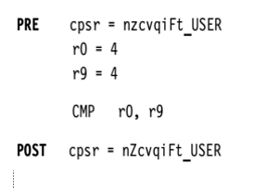
ARM INSTRUCTION SET
2. DATA PROCESSING INSTRUCTIONS (f) COMPARISON INSTRUCTIONS
The comparison instructions are used to compare or test a register with a 32-bit value.
They update the CPSR flag bits according to the result, but do not affect register content.
After the bits have been set, the information can then be used to change program flow by using conditional execution
Syntax: <instruction>{<cond>} Rn, N
Instruction | Meaning | Operation | Example | Description
CMP | Compare | CPSR flag sets as a result of Rn-N | PRE CPSR=nzcvqiFt_USER, r0=0x00000008, r9=0x00000008 CMP r0, r9 POST CPSR=nZcvqiFt_USER | Since r0-r9 result is zero, “Z” flag is SET
CMN | Compare negate | CPSR flag sets as a result of Rn+N | PRE CPSR=nzcvqiFt_USER, r0=0xA0000000, r9=0x80000000 CMN r0, r9 POST CPSR=nzCvqiFt_USER | Since r0+r9 result generate carry, “C” flag is SET
MODULE-7
BECE204L – MICROPROCESSORS AND MICROCONTROLLERS
14

Slide 15
ARM INSTRUCTION SET
3. BRANCH INSTRUCTIONS
A branch instruction changes the flow of execution or is used to call a routine which forces the program counter (pc) to point to a new address.
Branch instructions allows programs to have subroutines, if-then-else structures, and loops.
Syntax: B{<cond>} label
BL{<cond>} label
Instruction | Meaning | Operation | Example | Description
B | Branch | PC=label | B forward …… forward …… | Branching forward
BL | Branch with Link | PC=Label LR=Address of the next instruction after BL | BL calc …… calc <subroutine code> MOV pc, lr | Branching but after executing it return from subroutine using link register copied to PC
MODULE-7
BECE204L – MICROPROCESSORS AND MICROCONTROLLERS
15

Slide 16
ARM INSTRUCTION SET
4. CONDITIONAL INSTRUCTIONS
A beneficial feature of the ARM architecture is that instructions can be made to execute conditionally.
In ARM state, all instructions are conditionally executed according to the state of the CPSR condition codes and the instruction’s condition field.
If the state of the C, N, Z and V flags fulfils the conditions encoded by the field, the instruction is executed, otherwise it is ignored.
There are 16 possible conditions, each represented by a two-character suffix that can be appended to the instruction’s mnemonic. In practice, 15 different conditions may be used.
For example, a Branch (B in assembly language) becomes BEQ for "Branch if Equal", which means the Branch will only be taken if the Z flag is set.
MODULE-7
BECE204L – MICROPROCESSORS AND MICROCONTROLLERS
16

Slide 17
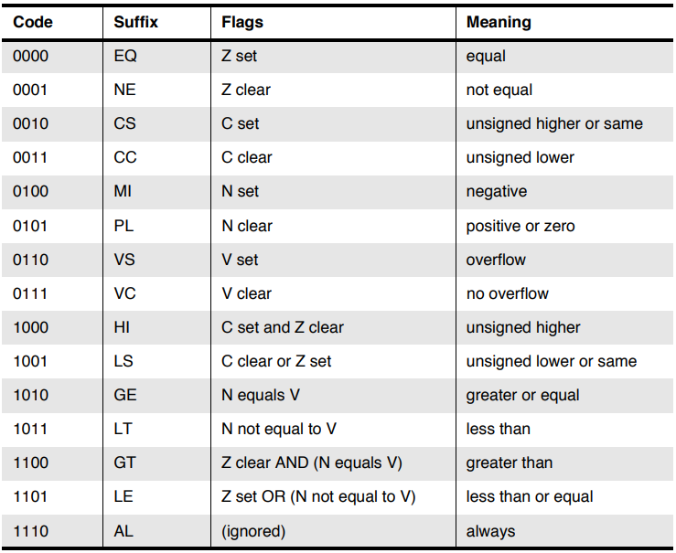
ARM INSTRUCTION SET
4. CONDITIONAL INSTRUCTIONS
MODULE-7
BECE204L – MICROPROCESSORS AND MICROCONTROLLERS
17

Slide 18
ARM INSTRUCTION SET
4. CONDITIONAL INSTRUCTIONS
CMP r0, #5 ; if (a == 5)
MOVEQ r0, #10
BLEQ fn ; fn(10)
Assume a is in R0. Compare R0 to 5. The next two instructions will be executed only if the compare returns EQual. They move 10 into R0, then call ‘fn’ (branch with link, BL)
CMP r0, #0 ; if (x <= 0)
MOVLE r0, #0 ; x = 0;
MOVGT r0, #1 ; else x = 1;
Assume x is in R0. Compare R0 to 0. The next instruction MOVLE will be executed only if the compare returns less than or equal. Later, check for Greater than condition and execute MOVGT instruction.
CMP r0, #'A' ; if (c == 'A‘)
CMPNE r0, #'B' ; || c == 'B')
MOVEQ r1, #1 ; y = 1;
Assume A is in R0. Compare R0 to ‘A’ The next instruction CMPNE will be executed only if the compare returns Not Equal. They move ‘B’ into R0, then check for EQUAL condition for MOVEQ instruction execution.
MODULE-7
BECE204L – MICROPROCESSORS AND MICROCONTROLLERS
18

Slide 19
ASSEMBLY PROGRAMMING
MODULE-7
BECE204L – MICROPROCESSORS AND MICROCONTROLLERS
19

Slide 20
ASSEMBLY PROGRAMMING
EXAMPLE – 1
Write an ARM assembly language program to compute sum of first “n” numbers using the formula [n(n+1)/2]. Assume “n” as 5.
area sample, code, READONLY
entry
start
LDR r0, =0x00000005 ; N=5
ADD r2, r0, #1
MUL r3, r2, r0
MOV r3, r3, LSR #1
Stop B stop
END
MODULE-7
BECE204L – MICROPROCESSORS AND MICROCONTROLLERS
20

Slide 21
ASSEMBLY PROGRAMMING
EXAMPLE – 2
Write an ARM assembly language program to compute addition of two 64-bit number.
area sample, code, READONLY
entry
CODE32
start
LDR r0, =0x1111ffff ; LSB 32-bit 1st number
LDR r1, =0x11110000 ; MSB 32-bit 2nd number
LDR r2, =0x1111ffff ; LSB 32-bit 1st number
LDR r3, =0x11110000 ; MSB 32-bit 2nd number
ADDS r4, r2, r0 ; Add LSBs
ADC r5, r3, r1 ; Add MSBs with carry
Stop B stop
END
MODULE-7
BECE204L – MICROPROCESSORS AND MICROCONTROLLERS
21

Slide 22
ASSEMBLY PROGRAMMING
EXAMPLE – 3
Write an ARM assembly language program to find the largest of two 32-bit numbers.
area sample, code, READONLY
entry
start
LDR r0, =0x00000006 ; a
LDR r1, =0x00000005 ; b
CMP r0,r1
MOVLT r4, r1
MOVGT r4, r0
stop B stop
END
MODULE-7
BECE204L – MICROPROCESSORS AND MICROCONTROLLERS
22

Slide 23
ASSEMBLY PROGRAMMING
EXAMPLE – 4
Write an equivalent ARM assembly language program for the “for loop function” given for(i=0;i<15;i++) {j=j+j}.
area sample, code, READONLY
entry
start
LDR r0, =0x00000000 ; i
LDR r1, =0x00000001 ; j
MOV r2, #15 ; count=15
loop ADD r1,r1,r1 ; j=j+j
ADD r0,r0,#1 ; i++
CMP r2,r0 ; r2-r0
BGT loop ; i<15?
stop B stop
END
MODULE-7
BECE204L – MICROPROCESSORS AND MICROCONTROLLERS
23

Slide 24
ASSEMBLY PROGRAMMING
EXAMPLE – 5
Write an equivalent ARM assembly language program for the “if else function” given if(a>5){x=5;y=c+d} else x=c-d
area sample, code, READONLY
entry
start
LDR r0, =0x00000003 ; a
LDR r4, =0x00000001 ; c
LDR r5, =0x00000002 ; d
MOV r1, #5 ; count=5
CMP r0,r1 ; r0-r1
MOVLT r2,#5 ; x
ADDLT r3,r4,r5 ; y=c+d
SUBGT r2,r4,r5 ; y=c-d
stop B stop
END
MODULE-7
BECE204L – MICROPROCESSORS AND MICROCONTROLLERS
24

