Slide 1
EUCALL – wayforlight database
C. Blasetti, Elettra Sincrotrone Trieste

Slide 2


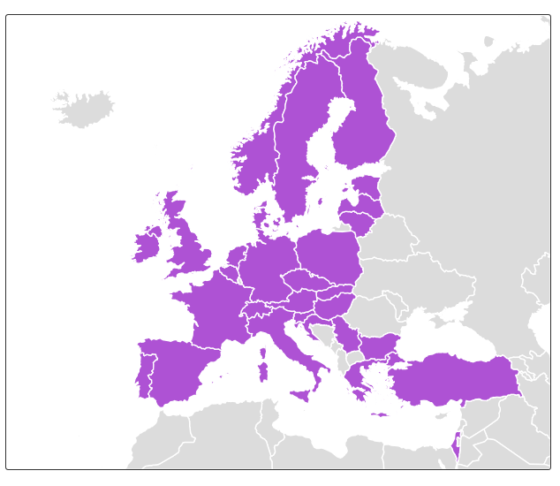

Wayforlight’s past & present
First developed under FP7 Integrating Activity CALIPSO
SR & FELs facilities and BL datasheets (>250 instruments)
Pilot standardised proposal form
European Synchrotron and FEL User Organisation (ESUO)
National delegates from 30 countries, new to come
H2020 Integrating Activity CALIPSOplus
Industry section with multi-language option
ESUO intranet to be developed
Training pillar to be populated

Slide 3
Wayforlight’s present: EUCALL - 1
A full spectrum of standardisation
New sheets designed for Laser facilities
Renewed datasheets for X-ray FELs and IR FELs
Enriched datasheets for SR facilities
> 90% common fields between FELs & Lasers
Techniques & Disciplines in all 3 facility types
SR
FELs
Lasers

Slide 4
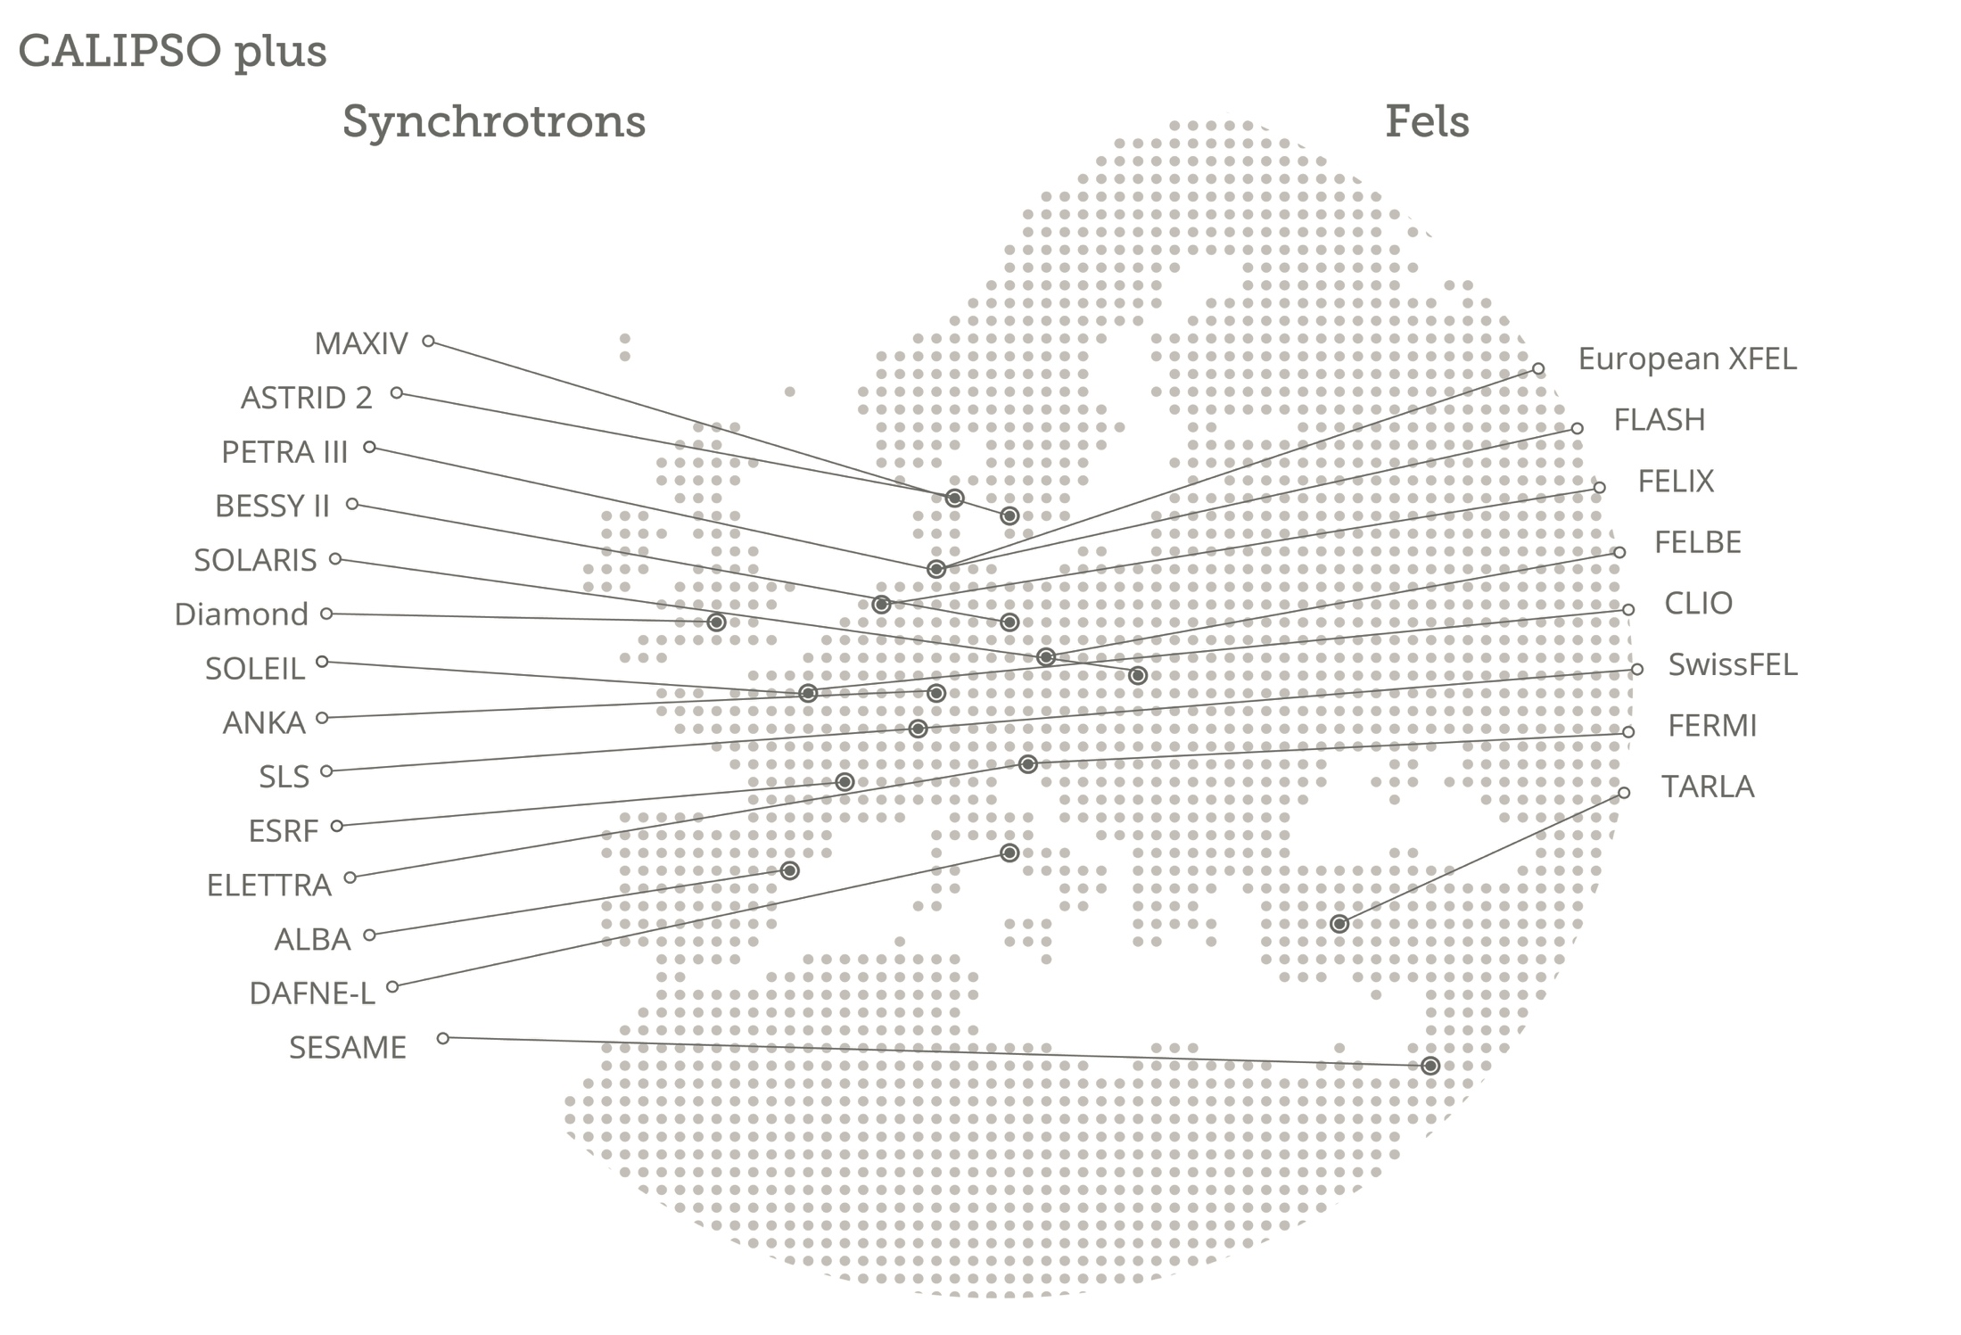
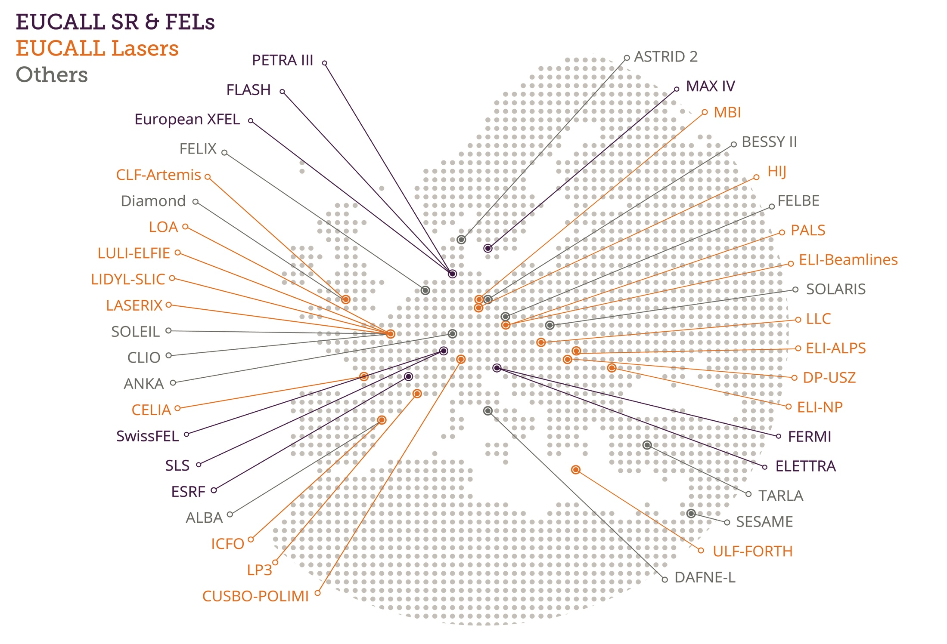
Wayforlight’s present: EUCALL - 2
A full spectrum of facilities

Slide 5
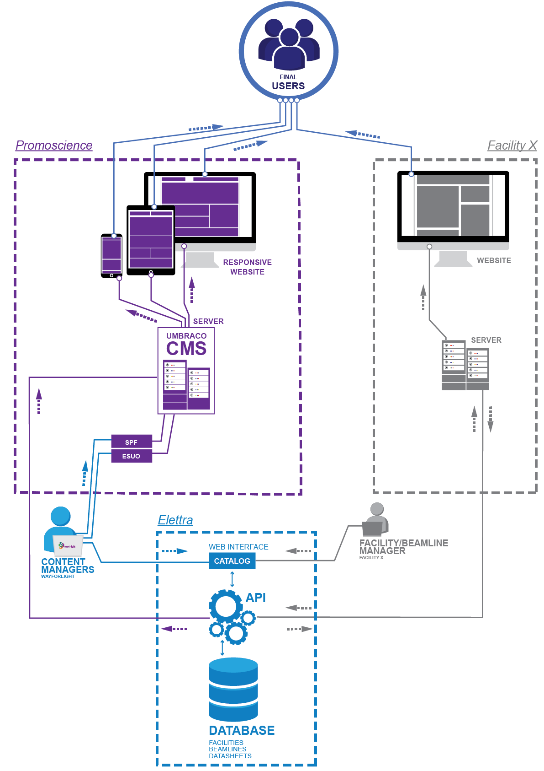
Wayforlight’s present: shared benefits
A smart sustainable system
Designed and created at Elettra
Scientists will have to fill data only once
Elettra provides advanced programming interfaces (APIs) for easy data export
Login is based on Umbrella
Key for any future interface with other websites - facilities and/or project ones

Slide 6




Wayforlight’s future
Jointly developed by complementary projects & communities
→ a portfolio of partner initiatives for growth and sustainability
FELs of Europe: www.fels-of-europe.eu
Laserlab Europe: https://www.laserlab-europe.eu
The global portal: www.lightsources.org
The LEAPS initiative: www.leaps-initiative.eu

Slide 7
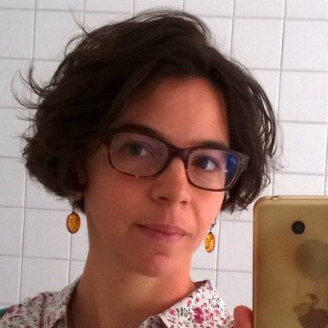












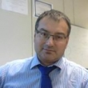
Thanks for your attention !
Wayforlight’s guardians
IT team @Elettra
Scientists @Elettra & FERMI
David Garzella
Cecilia Blasetti
Ivan Andrian
Fulvio Bille’
Carlo Callegari
Elda Osmenaj
Stefano Deiuri
Andrea Lausi
Promoscience Team
Iztok Gregori
Andrea Locatelli
Daniele Favretto
Marco Zangrando
Roberto Pugliese

