Slide 1

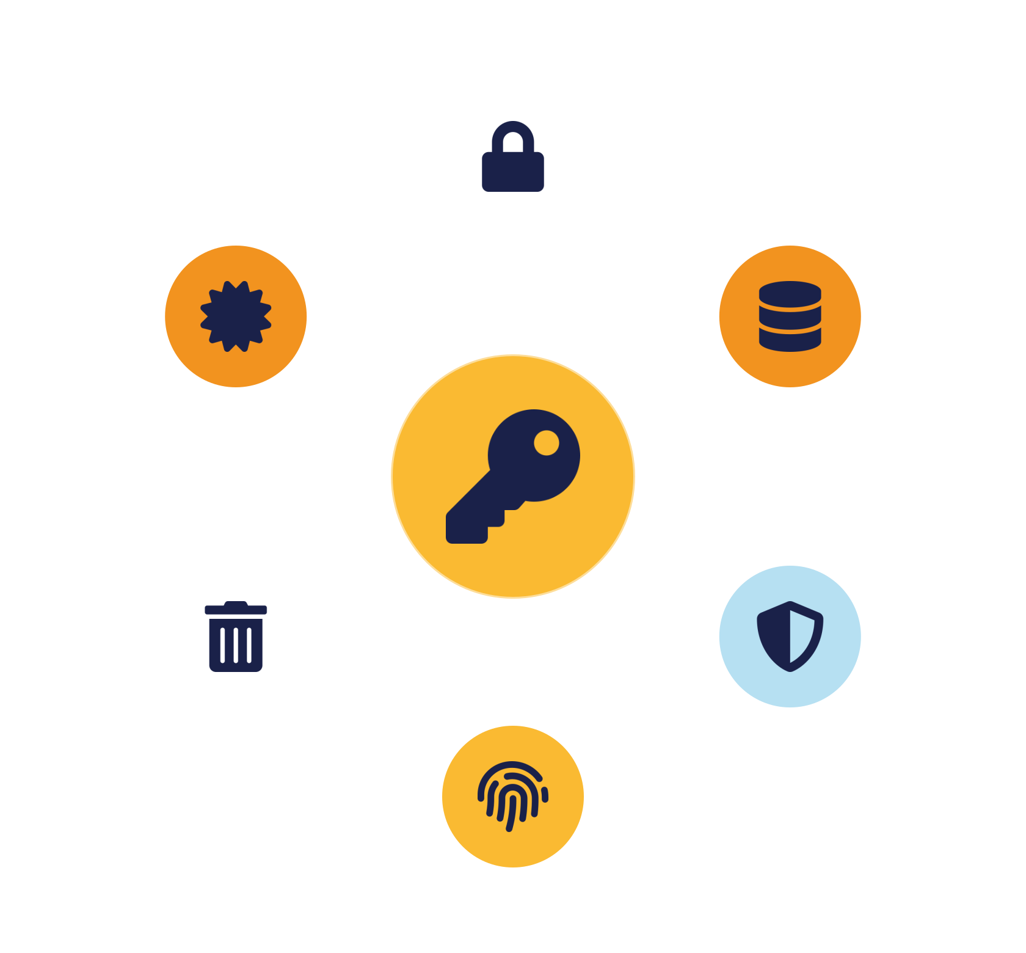
IKB42603 • Cloud Security
WEEK 4 · LESSON 4
Data Protection for Cloud Infrastructure & Services
Information lifecycle · Encryption · Tokenization · PKI & key management · Secure deletion
Universiti Kuala Lumpur · UniKL MIIT | Prof. Dr. Shahrulniza Musa

Slide 2

LEARNING OUTCOMES
What you will be able to do
1. Understand the cloud data lifecycle
2. Apply data protection techniques
Where data lives, and where risk appears.
Encryption, tokenization, redaction, obfuscation.
3. Ensure confidentiality & integrity
4. Explain PKI & key management
The core goals for data.
Certificates, keys, rotation and revocation.
5. Assure secure data deletion
6. Understand retention & archiving
Secure wiping and cryptographic erasure.
Keeping data no longer — and no shorter — than needed.
IKB42603 Cloud Computing Security Essentials
1
Notes:
Welcome to Lesson 4, the second pillar of cloud security: data protection. Frame it directly — data is the asset we are ultimately protecting; isolation, access control and monitoring all exist to keep data safe. Today we look at how to protect data itself, at every stage of its life, using encryption, tokenization, PKI and disciplined key management and deletion. Walk the six outcomes. This lesson carries the VBE3 integrity value and maps to CLO2, assessed in the Lab Assignment — so the encryption and key-management choices we cover are exactly what students must justify there. Note this builds on the 'data at rest / in transit / in use' preview from Lesson 2 and the storage encryption from Lesson 3.

Slide 3



CONSTRUCTIVE ALIGNMENT
Curriculum alignment — CLO · PLO · MQF · clusters
Construct secure cloud computing operations that safeguard data integrity.
CLO 2
Programme outcome
Values & skills
Assessment
PLO2 · Cognitive Skills
MQF Level iii(a)
Bloom P3 (Precision)
VBE3 · Integrity
SC8 · Problem-Solving
Lab Assignment (CLO2)
Constructive alignment: CLO → PLO → MQF, with VBE (values) and SC (skills) clusters, assessed as shown.
IKB42603 Cloud Computing Security Essentials
2
Notes:
This slide makes the constructive alignment explicit for the external examiner and MQF accreditation. Lesson 4 maps to CLO2 — constructing secure cloud operations that safeguard data integrity — which in turn maps to Programme Learning Outcome PLO2, MQF Level iii(a) practical skills, and Bloom's psychomotor level P3. It carries the VBE3 value cluster (integrity — protecting data honestly and correctly) and the SC8 skill cluster (integrated problem-solving). It is assessed through the Lab Assignment. Point students to this so they see how today's encryption and key-management content connects to the outcomes they are graded on, and the graduate attributes it builds.

Slide 4
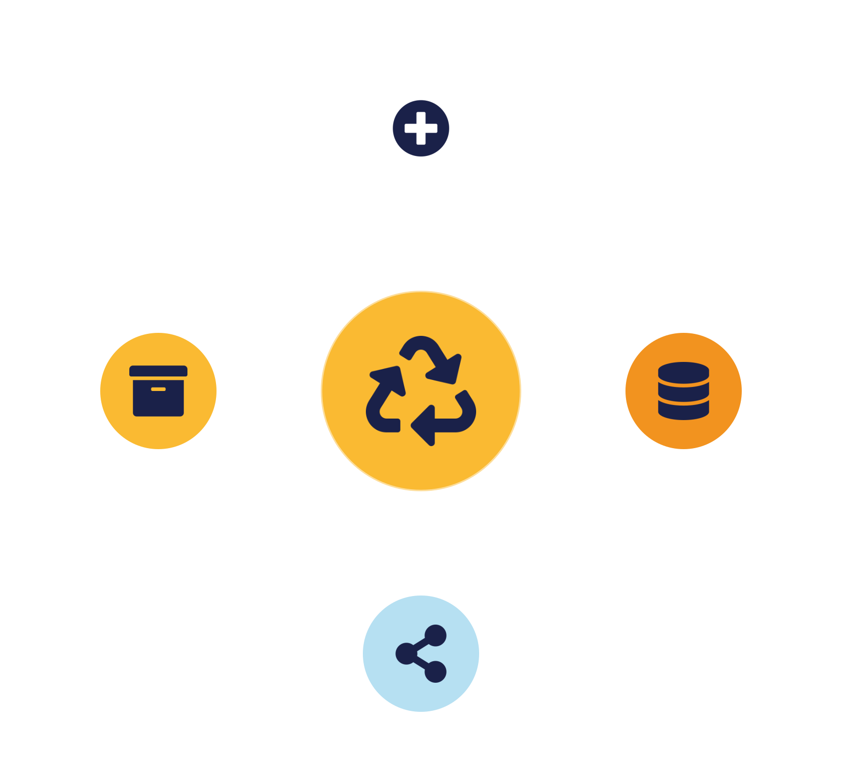
01
PART 1
The Data Lifecycle & Protection Goals
Notes:
Start with a lens: data is not static — it is created, stored, used, shared, archived and deleted, and each stage has its own risks. Protecting data means protecting every stage. We anchor the whole lesson on the CIA triad from Lesson 2, applied specifically to data.

Slide 5

DEFINITION
Data protection in the cloud
The controls that keep data confidential, accurate and available — at every stage of its life.
Applies across the entire data lifecycle
Data is the asset — everything else protects it.
A shared responsibility (provider + customer)
Isolation, access control and monitoring all exist so that data stays confidential, correct and available.
Where security meets compliance
IKB42603 Cloud Computing Security Essentials
3
Notes:
Define it: data protection is the set of controls that safeguard data throughout its life, ensuring it stays confidential, accurate and available. Stress two framing points from the slide. First, it applies across the ENTIRE lifecycle — a gap at any single stage is a gap overall; encrypting storage means little if data leaks while being shared. Second, it is a shared responsibility — the provider secures the storage infrastructure, but classifying, encrypting and controlling access to the data is on you, the customer. Give the stakes: data is what attackers want and what regulators protect, so this pillar is where security meets compliance (Lessons 10 and 11). Preview the lifecycle diagram next.

Slide 6





THE LIFECYCLE
The cloud data lifecycle — six stages
→
→
→
→
→
Create
Store
Use
Share
Archive
Destroy
Why it matters: the lifecycle tells you WHERE risk occurs and WHICH control to apply — and compliance requires knowing your data's whole journey.
IKB42603 Cloud Computing Security Essentials
4
Notes:
Walk the six stages as a cycle: Create — data comes into being and must be classified by sensitivity from the start. Store — it rests on disk or in a bucket and needs encryption and access control. Use — it is processed, the hardest state to protect. Share — it moves to others, where leakage risk is highest. Archive — inactive data moved to cheaper long-term storage, still needing protection and retention rules. Destroy — securely deleted so it cannot be recovered. The teaching value: mapping the lifecycle tells you WHERE risk occurs and therefore WHICH control to apply where — it drives correct protection and supports compliance, which demands you know your data's whole journey. Each remaining part of this lesson attaches controls to these stages.

Slide 7



THE GOALS
Protection goals — the CIA triad for data
Confidentiality
Integrity
Availability
Prevent unauthorised access.
Encryption · access control
Ensure data is unaltered — and prove it.
Hashing · digital signatures
Accessible when needed.
Backups · redundancy
Data protection is not only secrecy — corrupted or unavailable data can be as damaging as leaked data.
IKB42603 Cloud Computing Security Essentials
5
Notes:
Re-apply the CIA triad specifically to data. Confidentiality: prevent unauthorised access — achieved with encryption and access control. Integrity: ensure data is not altered and you can detect if it was — achieved with hashing and digital signatures; this is the VBE3 integrity value at the heart of CLO2. Availability: ensure authorised users can reach data when needed — achieved with backups and redundancy. Emphasise that data protection is not only about secrecy; integrity and availability matter just as much — corrupted or unavailable data can be as damaging as leaked data. This slide sets up the two detail slides on confidentiality and integrity, and connects to the deletion/retention material later, which serves both compliance and availability.

Slide 8
TWO CORE GOALS
Confidentiality & integrity in practice
Confidentiality
Integrity
Keep sensitive data unreadable to the wrong parties.
Ensure data is accurate — and tampering is detectable.
Encryption — unreadable without the key
Hashing — a fingerprint that changes if data changes
Access control — limit who can reach it
Digital signatures — prove origin + no alteration
Classification — know what is sensitive
Version control — track changes over time
IKB42603 Cloud Computing Security Essentials
6
Notes:
Detail the two goals most specific to data. Confidentiality protects sensitive data from being read by the wrong parties; the workhorses are encryption (making data unreadable without the key) and access control (limiting who can reach it). Integrity ensures data is accurate and consistent and that any tampering is detectable; the tools are hashing — a fingerprint of the data that changes if a single bit changes — and digital signatures, which additionally prove WHO produced the data and that it has not been altered in transit. Give the practical link: encryption often provides confidentiality AND, with the right modes, integrity; hashing underpins the tamper-proof logs from Lesson 6. The point for students: name the goal, then name the mechanism — that pairing is exam-ready and design-ready.

Slide 9
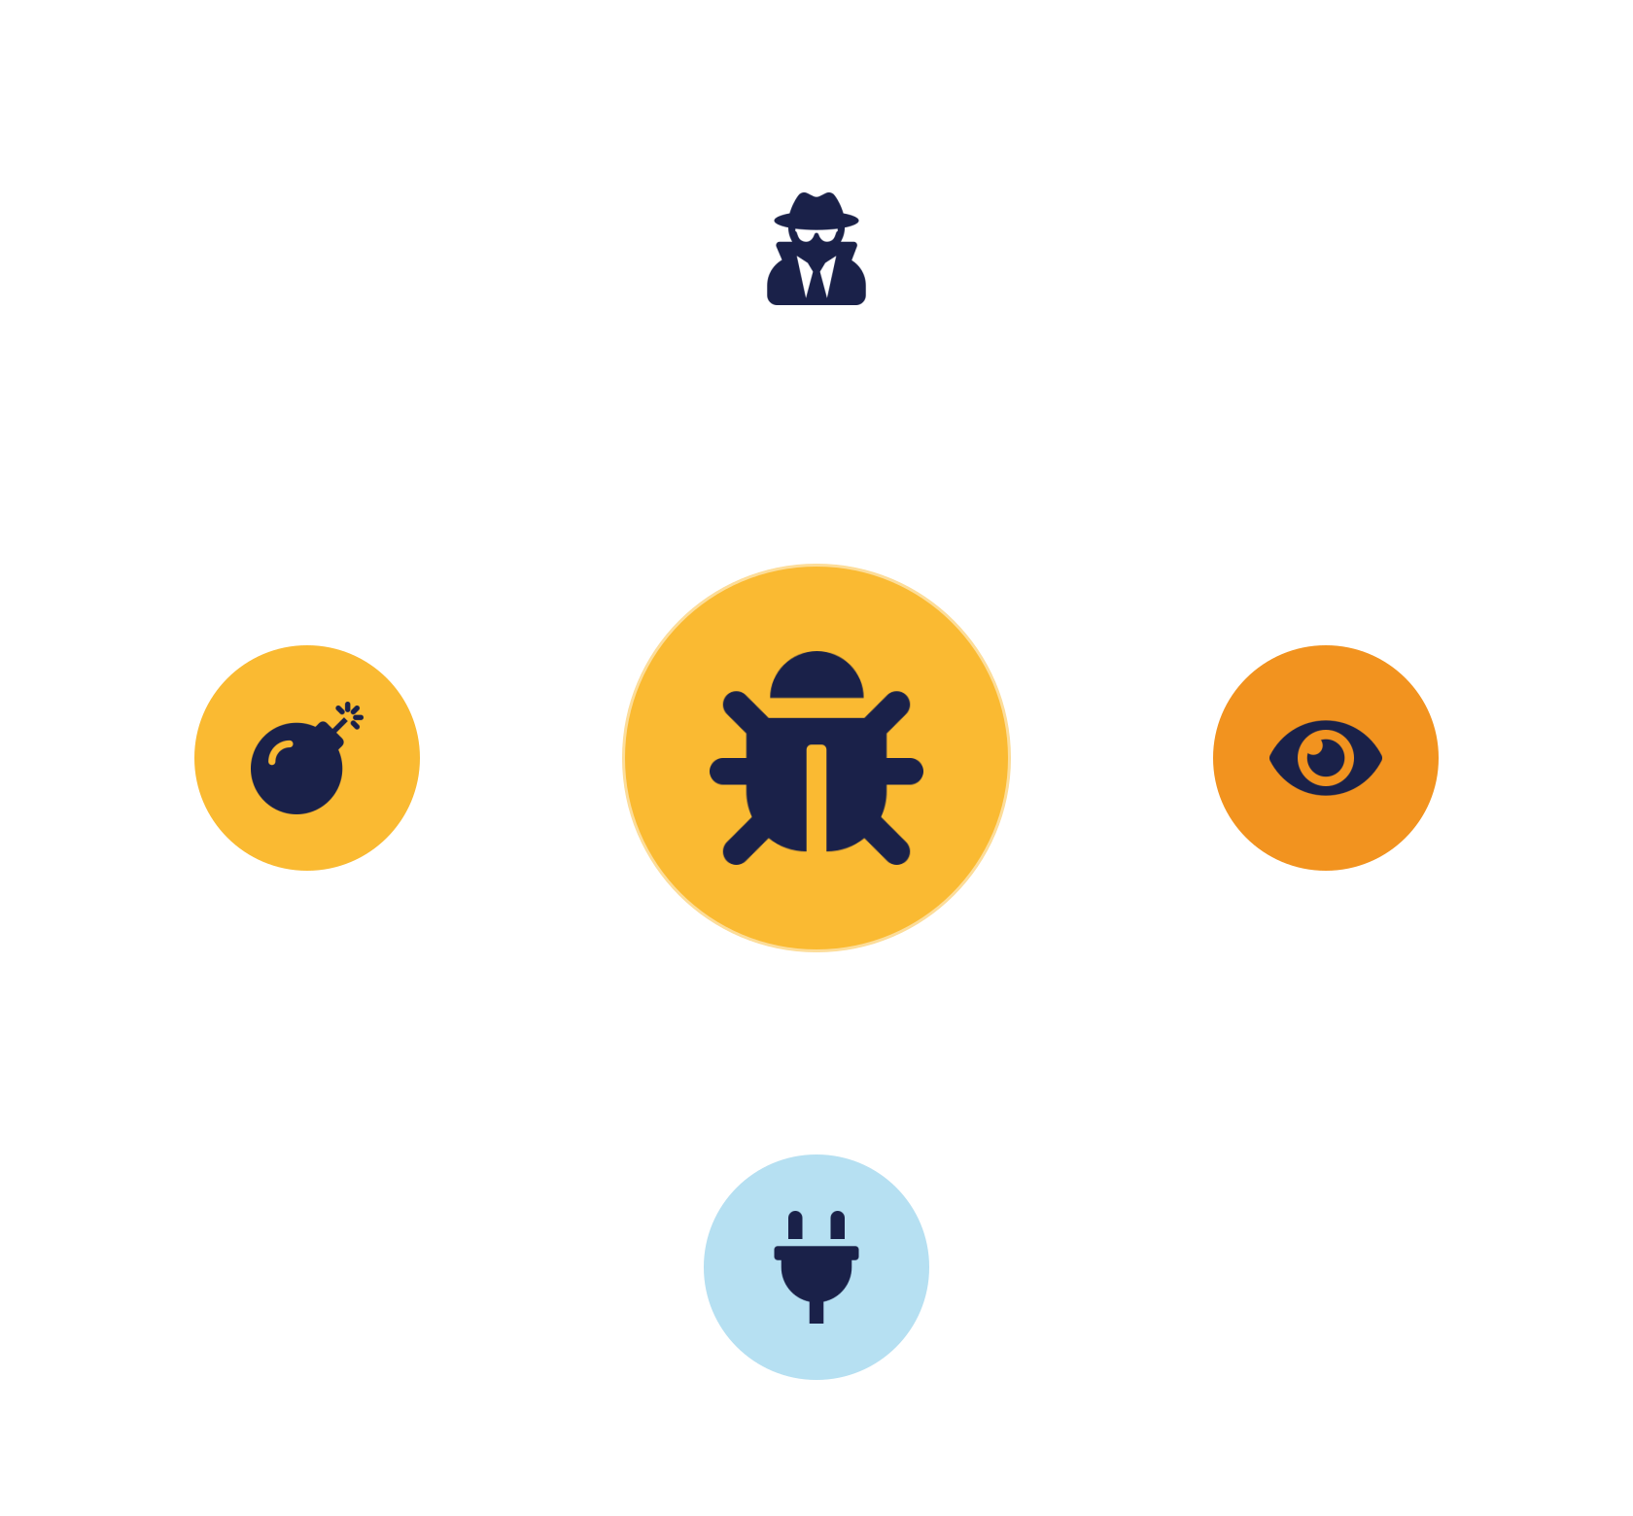
02
PART 2
Threats to Cloud Data
Notes:
Before the controls, name what we are defending against. Data faces both general attack vectors and cloud-specific threats — many familiar from earlier lessons, now viewed through the data lens.

Slide 10


THREAT LANDSCAPE
Attack vectors & cloud data threats
Common attack vectors
Cloud data threats
Data breaches — unauthorised access to data
Insider threats — misuse by staff
Eavesdropping — intercepting data in transit
Misconfiguration — the #1 cause — public buckets
API vulnerabilities — abusing read/write interfaces
Data leakage — weak isolation / over-sharing
Malware — steals or corrupts data
Unauthorised access — weak access control
IKB42603 Cloud Computing Security Essentials
7
Notes:
Two groups. General attack vectors: data breaches (unauthorised access to data), eavesdropping (intercepting data in transit — defeated by encryption), API vulnerabilities (abusing the interfaces that read and write data), and malware (which can steal or corrupt data). Cloud-specific threats: insider threats (misuse by staff on either side), misconfiguration (the recurring number-one cause — a public bucket exposes data directly), data leakage (weak isolation or over-sharing), and unauthorised access (weak access control). Ask students to map each threat to a protection goal it violates and a control that counters it — for example eavesdropping violates confidentiality and is countered by TLS. This mapping is the reasoning the exam rewards, and it motivates every control in the rest of the lesson.

Slide 11
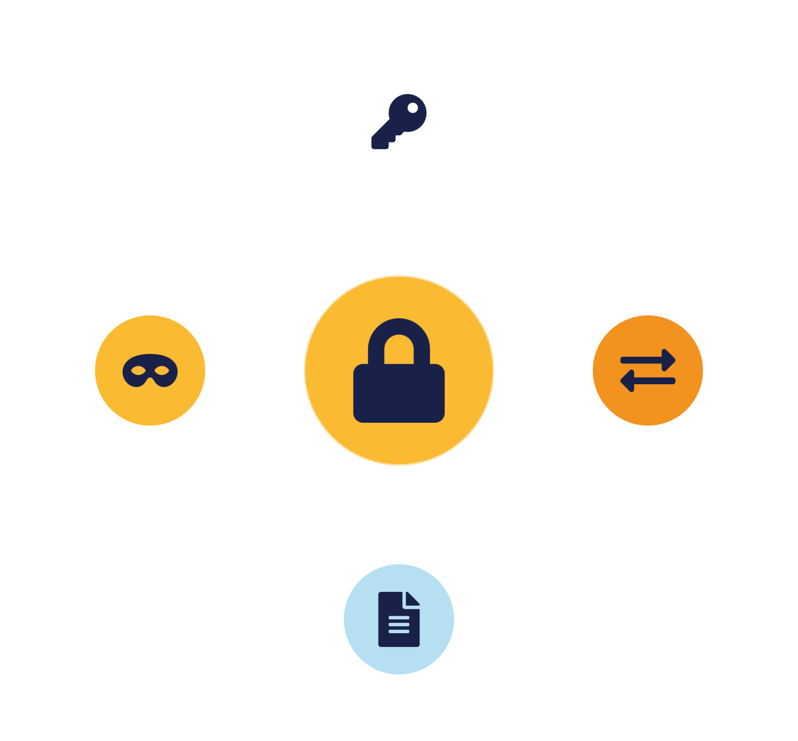
03
PART 3
Encryption & Data Masking
Notes:
The primary tool for confidentiality. We cover how encryption works, where to apply it, and the masking family — tokenization, redaction and obfuscation — that protects data by hiding or replacing it.

Slide 12

THE CORE CONTROL
Encryption — symmetric vs asymmetric
Symmetric
Asymmetric
One shared secret key encrypts and decrypts.
A key pair — public to encrypt, private to decrypt.
Fast — ideal for bulk data, disks, files
Solves key distribution — share the public key freely
Challenge — distributing the key securely
Enables signatures — and identity
Example — AES
Slower — used for small data / key exchange
In practice: asymmetric exchanges a symmetric key, then symmetric encrypts the data — that is how TLS works.
IKB42603 Cloud Computing Security Essentials
8
Notes:
Encryption converts data into an unreadable form that requires a key to decrypt. Two families. Symmetric encryption uses one shared secret key for both encrypt and decrypt — it is fast and ideal for bulk data like files and disks, but the challenge is distributing the key securely. Asymmetric encryption uses a key PAIR — a public key that anyone can use to encrypt, and a private key that only the owner holds to decrypt — which solves key distribution and enables digital signatures, but is slower, so it is used for small data, key exchange and identity. The real-world pattern students should know: systems use asymmetric encryption to securely exchange a symmetric key, then use fast symmetric encryption for the actual data — this is how HTTPS/TLS works. Whichever is used, the security now depends entirely on protecting the keys — which is why key management gets its own section.

Slide 13

WHERE TO APPLY
Encryption use cases — the three states
Data at rest
Data in transit
Backups
Encrypt stored data — a stolen disk yields only ciphertext.
TLS / HTTPS — intercepted traffic stays unreadable.
Encrypt backups too — a common overlooked leak.
Rule: attackers target the weakest link — a single plaintext copy undoes encrypted storage.
IKB42603 Cloud Computing Security Essentials
9
Notes:
Apply encryption to the three data states from Lesson 2, plus backups. Data at rest: encrypt stored data so a stolen disk or accessed bucket yields only ciphertext. Data in transit: use TLS/HTTPS so intercepted traffic is unreadable. Backups: encrypt them too — an unencrypted backup is a common overlooked leak, since it contains all the same data. The unifying rule: encryption is essential for confidentiality, but only if applied everywhere data lives or moves — attackers target the weakest link, so an unencrypted backup or a plaintext internal link undoes encrypted storage. Remind students that in the cloud, providers often offer encryption as a simple toggle, so there is little excuse not to enable it — the harder part is managing the keys, next.

Slide 14



BEYOND ENCRYPTION
Tokenization, redaction & obfuscation
Tokenization
Redaction
Obfuscation
Replace data with a meaningless token; keep the real value in a vault. Backbone of payments.
Remove or mask sensitive fields — e.g. show only the last 4 digits in logs.
Transform data so it is unreadable to attackers — often for non-production data.
Match the technique to the need — recover exact data (encrypt), operate without it (tokenize), hide it (redact).
IKB42603 Cloud Computing Security Essentials
10
Notes:
Encryption is not the only way to protect data — sometimes you hide or replace it instead. Tokenization replaces sensitive data with a meaningless token, keeping the real value in a separate secure vault; it is the backbone of payment systems, where a token stands in for a card number so systems can operate without ever holding the real data — this reduces PCI DSS scope, which matters in Lesson 11. Redaction removes or masks sensitive information outright — for example masking all but the last four digits of a credit-card number in logs and reports. Obfuscation transforms data to make it unreadable or non-obvious to attackers, often used to protect non-production data. The teaching point: choose the technique to the need — encryption when you must recover the exact data, tokenization when systems must operate without holding the real value, redaction when the data should simply not appear. These are complementary, not competing.

Slide 15
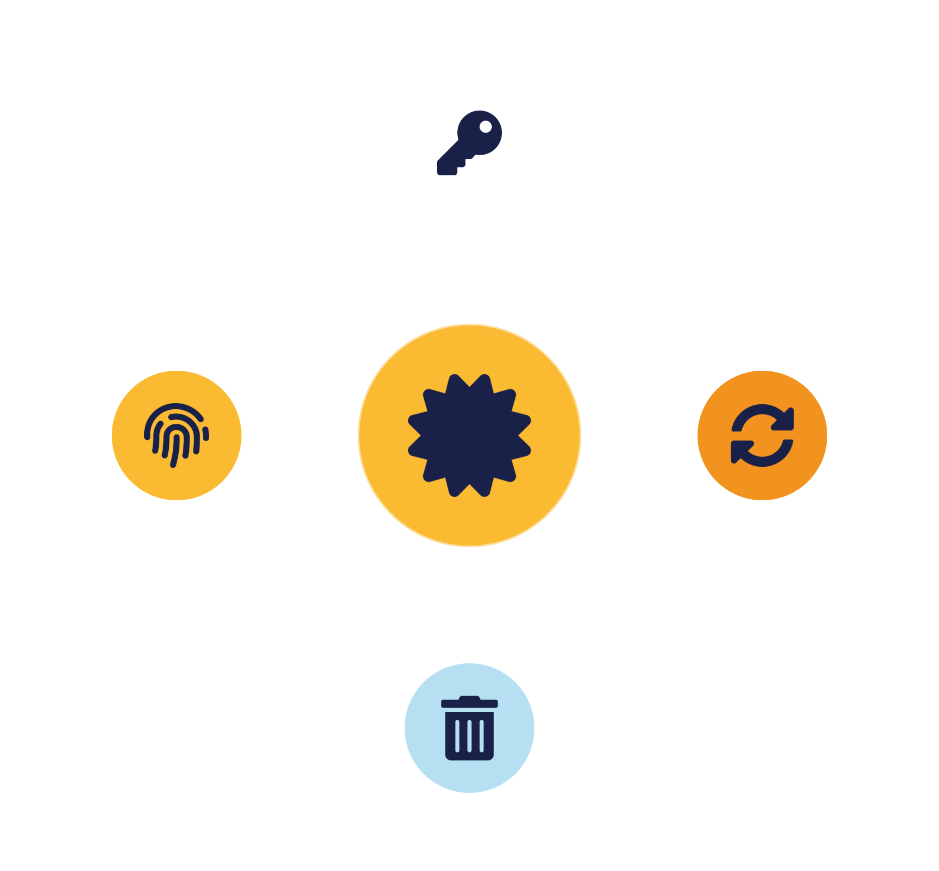
04
PART 4
PKI, Key Management & Deletion
Notes:
Encryption is only as strong as its keys. This part covers the infrastructure that manages keys and certificates, the key lifecycle, and how to provably destroy data through cryptographic erasure.

Slide 16


TRUST INFRASTRUCTURE
Public Key Infrastructure (PKI)
A framework of certificates and keys that lets parties trust each other's public keys — the basis of secure communication.
Public / private keys
Certificate Authority
Digital certificate
Asymmetric pair — encrypt & verify vs decrypt & sign.
Trusted issuer binding a key to a verified identity.
Signed document carrying the public key + identity.
IKB42603 Cloud Computing Security Essentials
11
Notes:
PKI is the framework that manages digital certificates and public keys to enable secure, trusted communication. Explain the three components on the slide. The public and private key pair is the asymmetric cryptography from earlier — public to encrypt/verify, private to decrypt/sign. The Certificate Authority is the trusted third party that issues digital certificates binding a public key to a verified identity — it is what lets your browser trust that a website's key really belongs to that website. The digital certificate itself is the signed document that carries the public key and identity. Together they solve the hardest problem in cryptography: knowing that a public key really belongs to who it claims. Give the everyday example — every HTTPS padlock relies on PKI. In the cloud, PKI underpins TLS, code signing, and service-to-service authentication. This sets up federated authentication in Lessons 7 and 9.

Slide 17

THE WEAKEST LINK
Key management lifecycle
Generate — Strong, random keys.
Encryption is only as strong as its key management.
Store & distribute — Separate from data; use a KMS/HSM, never hard-code.
Rotate — Change periodically to limit exposure.
Leaked key = worthless cipher. Lost key = unrecoverable data.
Revoke & destroy — Retire compromised or expired keys.
IKB42603 Cloud Computing Security Essentials
12
Notes:
Drive home the maxim: encryption is only as strong as its key management — a leaked key makes the strongest cipher worthless, and a lost key makes your own data unrecoverable. Walk the lifecycle. Generation: create strong, random keys. Storage: keep keys separate from the data they protect, ideally in a dedicated key-management service or hardware security module — never hard-coded in code or config. Distribution: get keys to authorised parties securely. Rotation: change keys periodically so a compromised key has a limited window. Revocation and destruction: retire keys when compromised or expired — and recall from Lesson 3 that destroying a key is itself a way to make encrypted data permanently unrecoverable (cryptographic erasure). The cloud angle: providers offer managed key services and let you choose provider-managed or customer-managed keys — customer-managed gives control at the cost of responsibility, a shared-responsibility decision. Poor key management is one of the most common ways good encryption fails.

Slide 18
PROVABLE DESTRUCTION
Assuring data deletion
Secure deletion
Cryptographic erasure
Overwrite storage so the original data is gone.
Destroy the key — the ciphertext becomes unreadable.
Reliable on media you control —
Instant & verifiable —
Hard on shared cloud storage — you can't address blocks
Works on distributed storage —
Verify the wipe —
Needs per-object / per-tenant keys —
Compliance angle: the 'right to be forgotten' makes provable deletion a legal obligation (Lesson 10).
IKB42603 Cloud Computing Security Essentials
13
Notes:
In the cloud, 'delete' rarely means erased — as we saw with data remanence in Lesson 3, freed storage may still hold your data. Assured deletion means ensuring data genuinely cannot be recovered. Two methods. Secure deletion overwrites the storage so the original data is gone — reliable on media you control, but hard to guarantee on shared cloud storage where you cannot address physical blocks. Cryptographic erasure is the cloud-native answer: if the data was encrypted, simply destroy the encryption key and the ciphertext becomes permanently unreadable — instant, verifiable, and it works even on distributed storage you do not physically control. This is another reason per-object or per-tenant encryption keys are valuable. Tie to compliance: regulations increasingly require proof of deletion — the 'right to be forgotten' — so assured deletion is not just hygiene, it is a legal obligation covered in Lesson 10.

Slide 19

KEEP IT RIGHT
Retention & archiving policies
Retention
Archiving
Deletion procedures
How long to keep data — set by legal + business needs. Too long OR too short both carry risk.
Move inactive data to low-cost storage — available for compliance, still encrypted.
Auto-delete after the retention period; secure wipe; verify.
Good governance keeps data no longer — and no shorter — than required.
IKB42603 Cloud Computing Security Essentials
14
Notes:
Deletion has a mirror image: knowing how long to KEEP data. Retention policies define how long data is stored, driven by legal requirements (regulations may mandate keeping financial or health records for years) and business needs. The dual risk students must grasp: keeping data too long increases breach exposure and can violate privacy law, while deleting it too soon can breach retention regulations or destroy evidence — good governance keeps data no longer, and no shorter, than required. Archiving supports this: inactive but still-needed data is moved to lower-cost long-term storage, keeping it available for compliance while reducing cost, and it still needs encryption and access control. Deletion procedures then automate removal once the retention period expires, using secure wiping and verifying the result. The theme: data protection is a full lifecycle discipline — you must plan its birth, its life, and a clean, provable death.

Slide 20

05
PART 5
Strategy, Case Study & Practice
Notes:
We assemble the techniques into a data-protection strategy, add the operational supports of backup and monitoring, and apply everything to a breach scenario.

Slide 21


BRINGING IT TOGETHER
A layered data-protection strategy
Strategy — four layers
Multi-tenant data management
Encryption — confidentiality + integrity
Shared cloud demands per-tenant separation.
Access control — only authorised identities
Isolate each tenant's data — storage isolation + per-tenant keys
Monitoring — detect suspicious access
Ensure privacy & compliance —
Backup & recovery — preserve availability
Defense in depth for data — controls reinforce each other
IKB42603 Cloud Computing Security Essentials
15
Notes:
No single control protects data — a strategy layers several. Encryption keeps data confidential and, with the right modes, intact. Access control ensures only authorised identities reach it (the Lesson 5 pillar). Monitoring detects suspicious access early (the Lesson 6 pillar). Backup and recovery preserves availability against loss and ransomware. Add the multi-tenant dimension on the right: in shared cloud, each tenant's data must be isolated — via the storage isolation and per-tenant keys from Lesson 3 — to keep data private and meet compliance. The unifying message: these controls reinforce each other; encryption limits the damage if access control fails, monitoring catches what prevention misses, and backups recover what is lost. Defense in depth, applied to data. This sets up the case study, which shows the cost of relying on just one — or none.

Slide 22

OPERATIONAL SUPPORTS
Backup, recovery & access monitoring
Backup & recovery
Access monitoring
Survive loss, corruption and ransomware.
See who touches data, and catch misuse.
Regular backups — encrypted, offsite/multi-region
Track access — who, what, when
Disaster recovery plan — tested restores only
Detect anomalies — bulk downloads, new locations
Protects availability —
Feeds the audit trail — for compliance
IKB42603 Cloud Computing Security Essentials
16
Notes:
Two operational supports that keep the strategy working. Backup and recovery: take regular backups and plan for disaster recovery so that data — and the business — survive loss, corruption or ransomware; a backup is only real if you have tested restoring from it, and, as noted earlier, it must be encrypted. This protects the Availability leg of CIA. Monitoring data access: track who accesses data and when, and detect suspicious patterns — an unusual bulk download, access from a new location, or a dormant account suddenly reading sensitive files. This ties directly to the SIEM and monitoring pillar of Lesson 6, and to the audit trail that compliance requires. The combined message: prevention (encryption, access control) reduces the chance of a breach; backup limits the damage of loss; monitoring shrinks the time to detect misuse. Together they cover confidentiality, integrity and availability for data.

Slide 23
APPLY IT
Case study — the unencrypted breach
An organisation stored sensitive customer data in the cloud without encrypting it. An attacker reached the storage and exfiltrated readable data — a full breach.
What went wrong?
How to prevent it?
No encryption made exposed data instantly usable — compounded by weak access control and no monitoring.
Encrypt at rest, in transit & backups · manage keys well · least-privilege access · monitor access.
IKB42603 Cloud Computing Security Essentials
17
Notes:
Run as a think-pair-share. Scenario: an organisation stored sensitive customer data in the cloud without encrypting it. An attacker gained access to the storage and walked away with readable data — a full breach. Ask the two questions. What went wrong? No encryption meant the exposed data was immediately usable; likely compounded by weak access control and no monitoring to detect the exfiltration. How could it be prevented? Encrypt data at rest (and in transit and backups), manage keys properly so the encryption is meaningful, apply least-privilege access control, and monitor access to catch the exfiltration early. The teaching point that answers the discussion question too: encryption alone is not sufficient — it must be paired with key management, access control and monitoring — but the ABSENCE of encryption turns an access incident into a full data breach. Connect to shared responsibility: enabling encryption was the customer's job. Let pairs report before consolidating.

Slide 24
BASELINE
Best practices — protecting data
Encrypt sensitive data
Manage keys rigorously
In every state, backups included.
Separate, rotated, in a KMS/HSM.
Apply least privilege
Monitor access
Few identities reach the data.
Detect misuse early.
Follow retention & deletion
Classify data first
Keep only as long as needed.
Protect the sensitive data most.
IKB42603 Cloud Computing Security Essentials
18
Notes:
Distil the lesson into a checklist. Encrypt sensitive data in every state, and back it up encrypted. Manage keys rigorously — separate from data, rotated, in a KMS. Apply least privilege so few identities can reach the data. Monitor access to detect misuse early. Follow retention and deletion policies to keep data only as long as needed and destroy it provably. And classify data first, so you protect the sensitive data most. Tell students several of these map directly to Lab Assignment (CLO2) criteria. Preview: next week, Lesson 5 covers the access-control pillar in depth — RBAC, MFA and hardening — which decides who can reach the data we protected today.

Slide 25

RECAP
Key takeaways
1 Data protection spans the whole lifecycle — create, store, use, share, archive, destroy — aiming at CIA.
2 Encryption is the core control — but only as strong as its key management.
3 Tokenization, redaction and obfuscation protect data by replacing or hiding it — match technique to need.
4 Provable deletion (cryptographic erasure) and sound retention are legal as well as technical obligations.
IKB42603 Cloud Computing Security Essentials
19
Notes:
Consolidate. One: data protection spans the whole lifecycle — create, store, use, share, archive, destroy — and aims at CIA. Two: encryption is the core control, but only as strong as its key management. Three: tokenization, redaction and obfuscation protect data by replacing or hiding it — match the technique to the need. Four: provable deletion (cryptographic erasure) and sound retention are legal as well as technical obligations. Ask students to name a control for each CIA goal. Preview Lesson 5: access control — who is allowed to reach the data.

Slide 26

Discussion & Q&A
Which data-protection method do you think is most effective — and in what situation?
Is encryption alone sufficient to protect cloud data? Why or why not?
Next week — Lesson 5: Enforcing Access Control for Cloud Infrastructure (RBAC · MFA · hardening)
Notes:
Close with the prompts. The first has no single answer — the value is students justifying a method for a context (tokenization for payments, encryption for storage). The second is the lesson's thesis: encryption is necessary but not sufficient — it needs key management, access control and monitoring around it. Preview Lesson 5. Remind students this lesson carries the VBE3 integrity value assessed in the Lab Assignment (CLO2).

