Slide 1

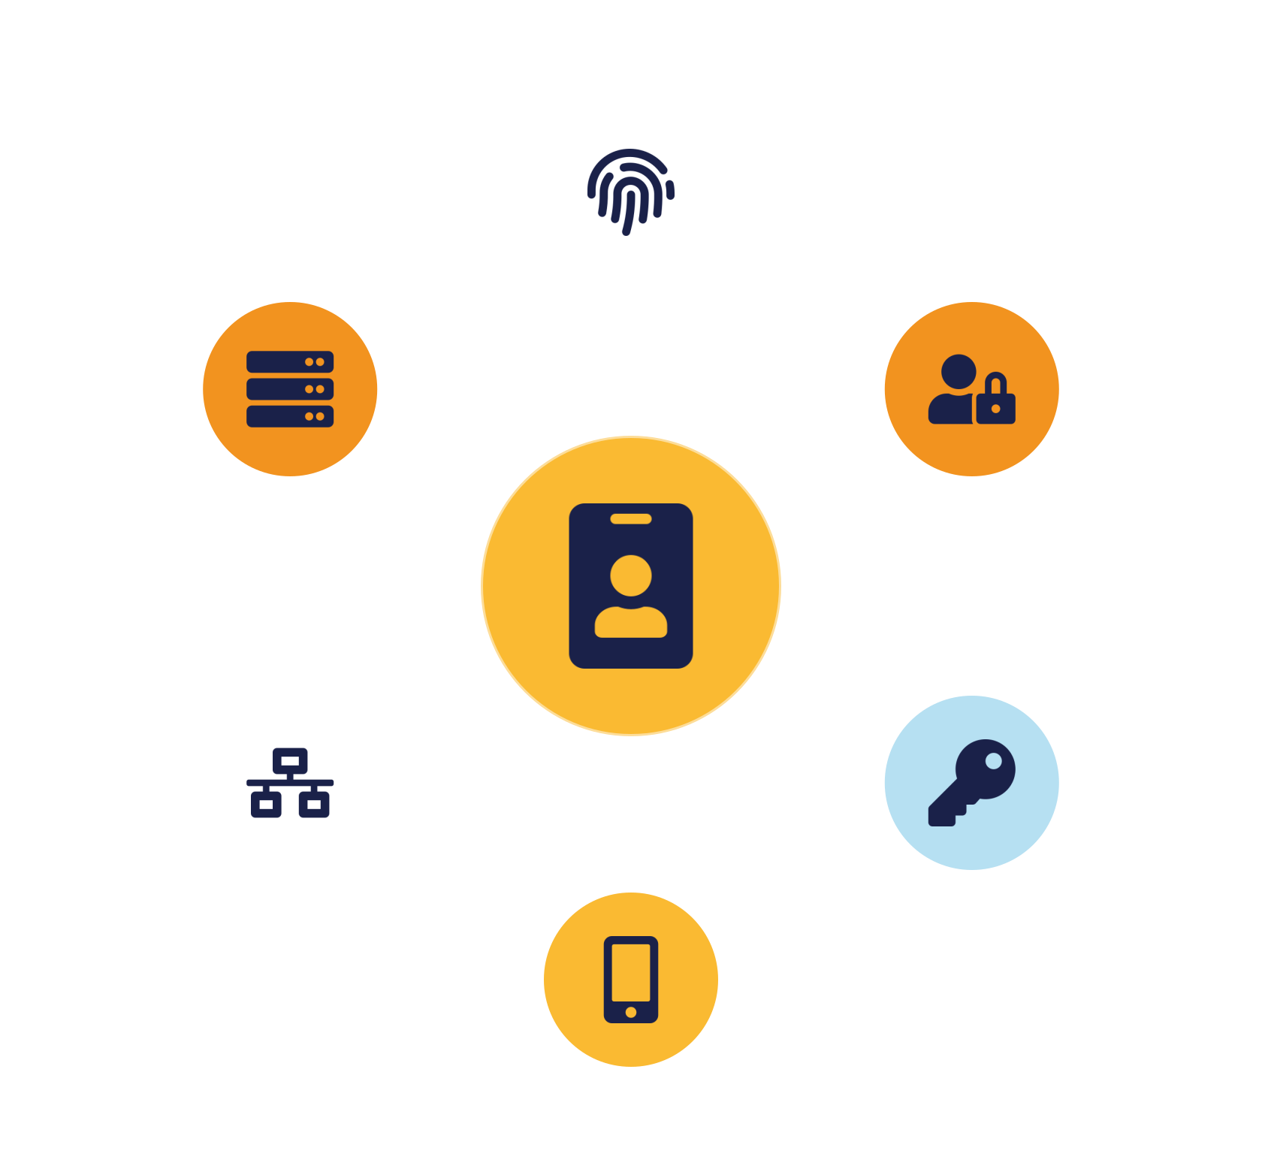
IKB42603 • Cloud Security
WEEK 5 · LESSON 5
Enforcing Access Control for Cloud Infrastructure
AuthN vs AuthZ · RBAC · MFA · Host / network / storage control · Hardening
Universiti Kuala Lumpur · UniKL MIIT | Prof. Dr. Shahrulniza Musa

Slide 2

LEARNING OUTCOMES
What you will be able to do
1. Understand access-control requirements
2. Differentiate authN and authZ
What the cloud demands of identity and access.
Verifying identity vs granting rights.
3. Implement RBAC and MFA
4. Apply the three access domains
Role-based access and multi-factor authentication.
Compute, network and storage controls.
5. Apply system hardening
6. Recognise access threats & detection
OS hardening, minimization, secure boot.
Credential attacks; firewalls, IDS/IPS.
IKB42603 Cloud Computing Security Essentials
1
Notes:
Welcome to Lesson 5, the third pillar: access control. Frame it — we protected the data last week; access control decides WHO may reach it. In the cloud, where resources are reachable from anywhere, identity and access are the effective perimeter, so this pillar is where most breaches are won or lost. Walk the six outcomes. This lesson maps to CLO2 and underpins the Lab Assignment. Note it builds on the IAM preview from Lesson 2 and pairs with the identity-management deep dive in Lesson 7. Give students the mantra we'll use: the right user, with the right access, at the right time.

Slide 3



CONSTRUCTIVE ALIGNMENT
Curriculum alignment — CLO · PLO · MQF · clusters
Construct secure cloud computing operations that safeguard data integrity.
CLO 2
Programme outcome
Values & skills
Assessment
PLO2 · Cognitive Skills
MQF Level iii(a)
Bloom P3 (Precision)
VBE3 · Integrity
SC8 · Problem-Solving
Lab Assignment (CLO2)
Constructive alignment: CLO → PLO → MQF, with VBE (values) and SC (skills) clusters, assessed as shown.
IKB42603 Cloud Computing Security Essentials
2
Notes:
Constructive-alignment slide for the external examiner and MQF accreditation. Lesson 5 maps to CLO2 — constructing secure cloud operations that safeguard data integrity — aligned to PLO2, MQF Level iii(a), and Bloom P3. It carries the VBE3 integrity value and the SC8 integrated-problem-solving skill, and is assessed through the Lab Assignment. Use it to show students how access-control content ties to the outcomes they are graded on.

Slide 4
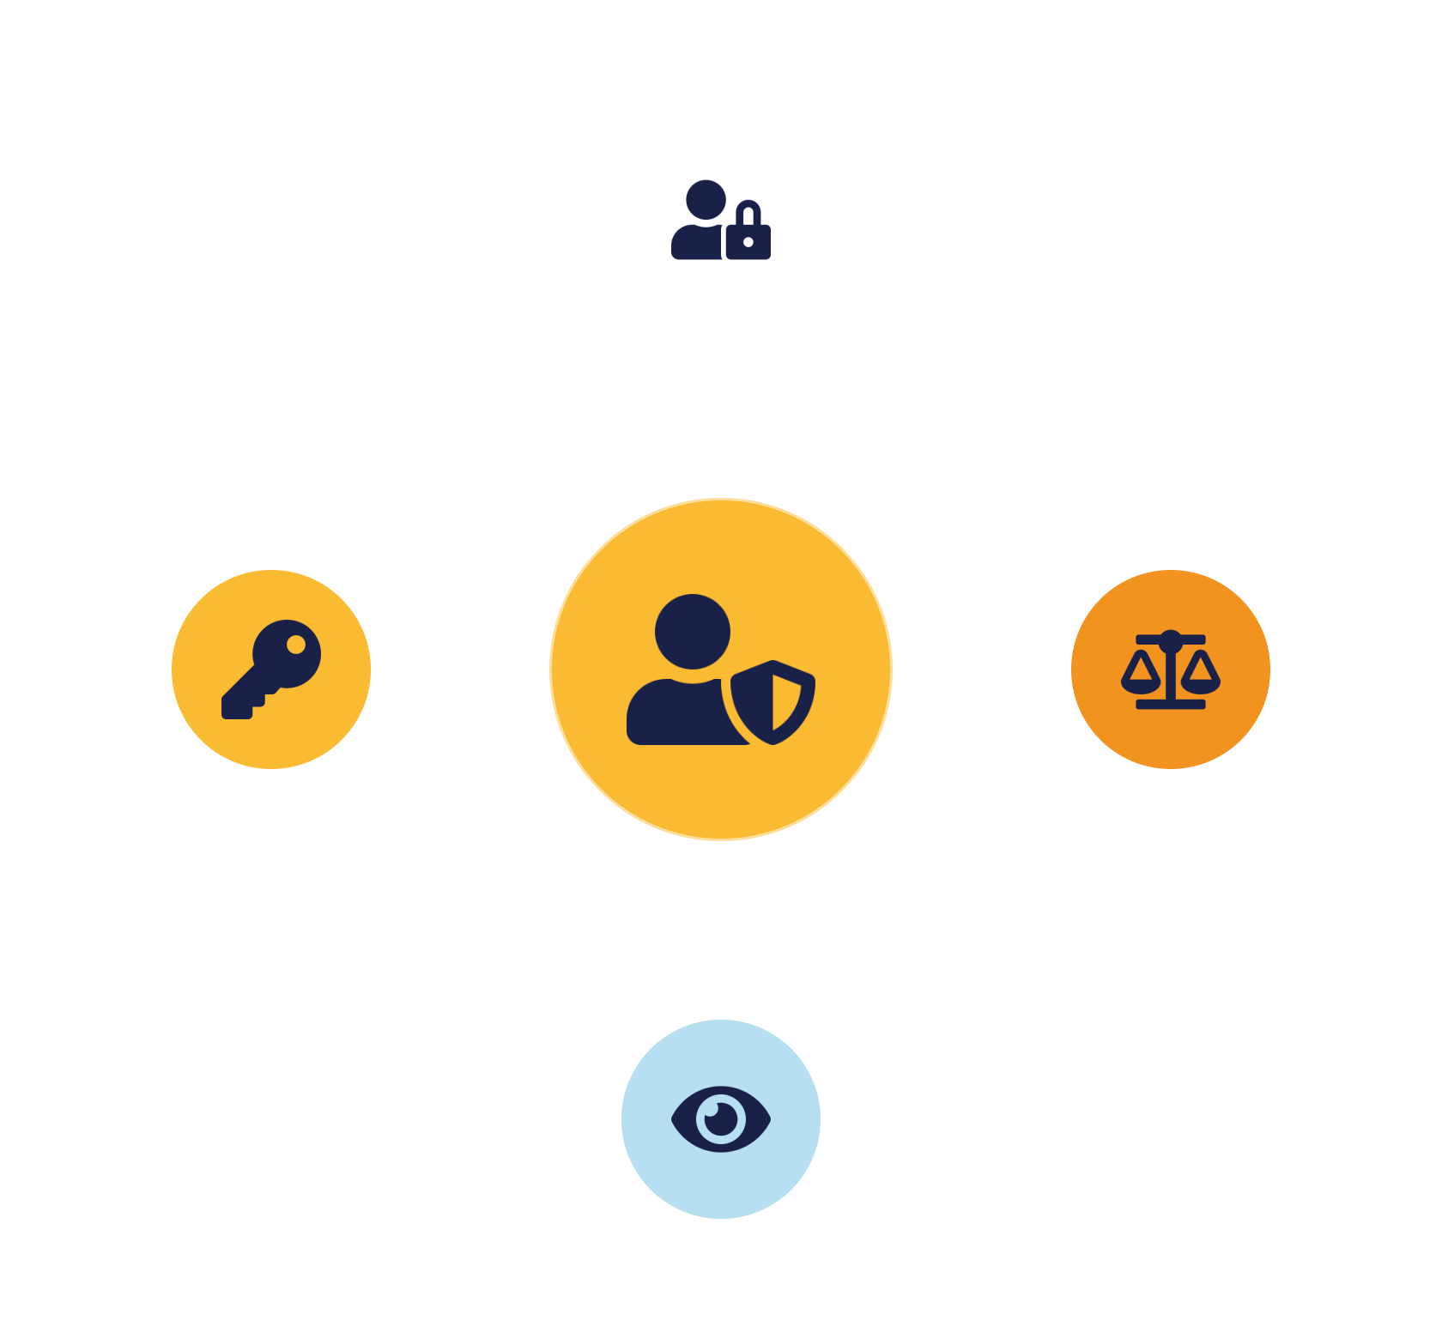
01
PART 1
Access Control Fundamentals
Notes:
Establish what access control is and the principles that govern it. The goal is simple to state and hard to do: only authorised users reach only the resources they need. We ground it in least privilege, need-to-know and separation of duties.

Slide 5

DEFINITION
What is access control?
Restricting access to cloud resources so only authorised users reach systems and data.
Right user, right access, right time
Identity is the new perimeter.
The last line before an attacker reaches data
Resources are reachable from anywhere — so a stolen credential with broad rights is a full breach.
Answers: who are you? what may you do?
IKB42603 Cloud Computing Security Essentials
3
Notes:
Define it: access control restricts access to cloud resources so that only authorised users can reach systems and data. The mantra on the slide captures it — the right user, the right access, the right time. Stress why it is critical in the cloud: resources are internet-reachable, so access control is often the last and most important line between an attacker and your data; a stolen credential with broad rights is a full breach. Note the two questions it must answer, which structure the next section: are you who you claim (authentication), and are you allowed to do this (authorization). Connect to zero trust from Lesson 2 — verify every request — and to least privilege, which access control is the mechanism to enforce.

Slide 6



WHAT THE CLOUD DEMANDS
Access-control requirements
Strong identity mgmt
Secure authentication
Fine-grained authorization
Continuous monitoring
A reliable source of truth for identities (Lesson 7).
Robust proof of identity — MFA as baseline.
Grant exactly what is needed — least privilege.
Watch access in real time to catch misuse.
They work as a set — a weakness in any one undermines the others.
IKB42603 Cloud Computing Security Essentials
4
Notes:
Four requirements a cloud access-control system must meet. Strong identity management: a reliable source of truth for who exists and what they are — the subject of Lesson 7. Secure authentication: robust proof of identity, MFA as baseline, resistant to phishing and brute force. Fine-grained authorization: permissions precise enough to grant exactly what is needed and no more — enabling least privilege. Continuous monitoring: watch access in real time to catch misuse, tying to Lesson 6. The message: these four work as a set — strong authentication is undermined by coarse authorization that over-grants; fine authorization is undermined by weak authentication that lets impostors in; and both need monitoring to catch what slips through. This slide frames the requirements the rest of the lesson satisfies.

Slide 7

GUIDING PRINCIPLES
Principles of access control
Least privilege
Need-to-know
Separation of duties
Grant the minimum access required — limits blast radius.
Access only the specific data a task requires.
Split critical actions — no one person acts alone.
Together they minimise misuse — malicious or accidental.
IKB42603 Cloud Computing Security Essentials
5
Notes:
Three principles govern good access control. Least privilege: grant the minimum access required — the recurring theme; it limits the blast radius of any compromise. Need-to-know: a user should access only the specific data their task requires, even within their privilege level — a finance analyst may have finance access but not to every account. Separation of duties: split critical actions across multiple people so no single individual can complete a sensitive process alone — for example, one person requests a payment and another approves it; this prevents both fraud and single-point mistakes. Together they minimise the risk of misuse, whether malicious or accidental. Tie back: least privilege and separation of duties are exactly the controls that would have contained the breaches in earlier lessons, and they are enforced through the authorization models we cover next.

Slide 8


THREAT LANDSCAPE
Access threats & attack vectors
Attack vectors
Cloud access threats
Credential theft — stolen usernames/passwords
Account hijacking — operating as a real user
Phishing — tricking users to surrender them
Insider threats — misuse by staff
Brute force — guessing weak passwords
Misconfigured permissions — over-broad access
Session hijacking — stealing an active token
Weak authentication — no MFA, reused passwords
IKB42603 Cloud Computing Security Essentials
6
Notes:
Name what access control defends against. General attack vectors target credentials: credential theft (stealing usernames and passwords), phishing (tricking users into surrendering them), brute force (guessing weak passwords automatically), and session hijacking (stealing an active login token). Cloud access threats: account hijacking (an attacker operating as a legitimate user), insider threats, misconfigured permissions (over-broad access, the recurring cloud failure), and weak authentication (no MFA, reused passwords). The through-line: almost all of these are defeated by the controls in this lesson — MFA defeats phishing, credential theft and brute force; least privilege and fine-grained authorization limit hijacking and misconfiguration; monitoring catches session hijacking and insider misuse. Ask students to pair each threat with its counter-control; that mapping is the lesson in miniature.

Slide 9
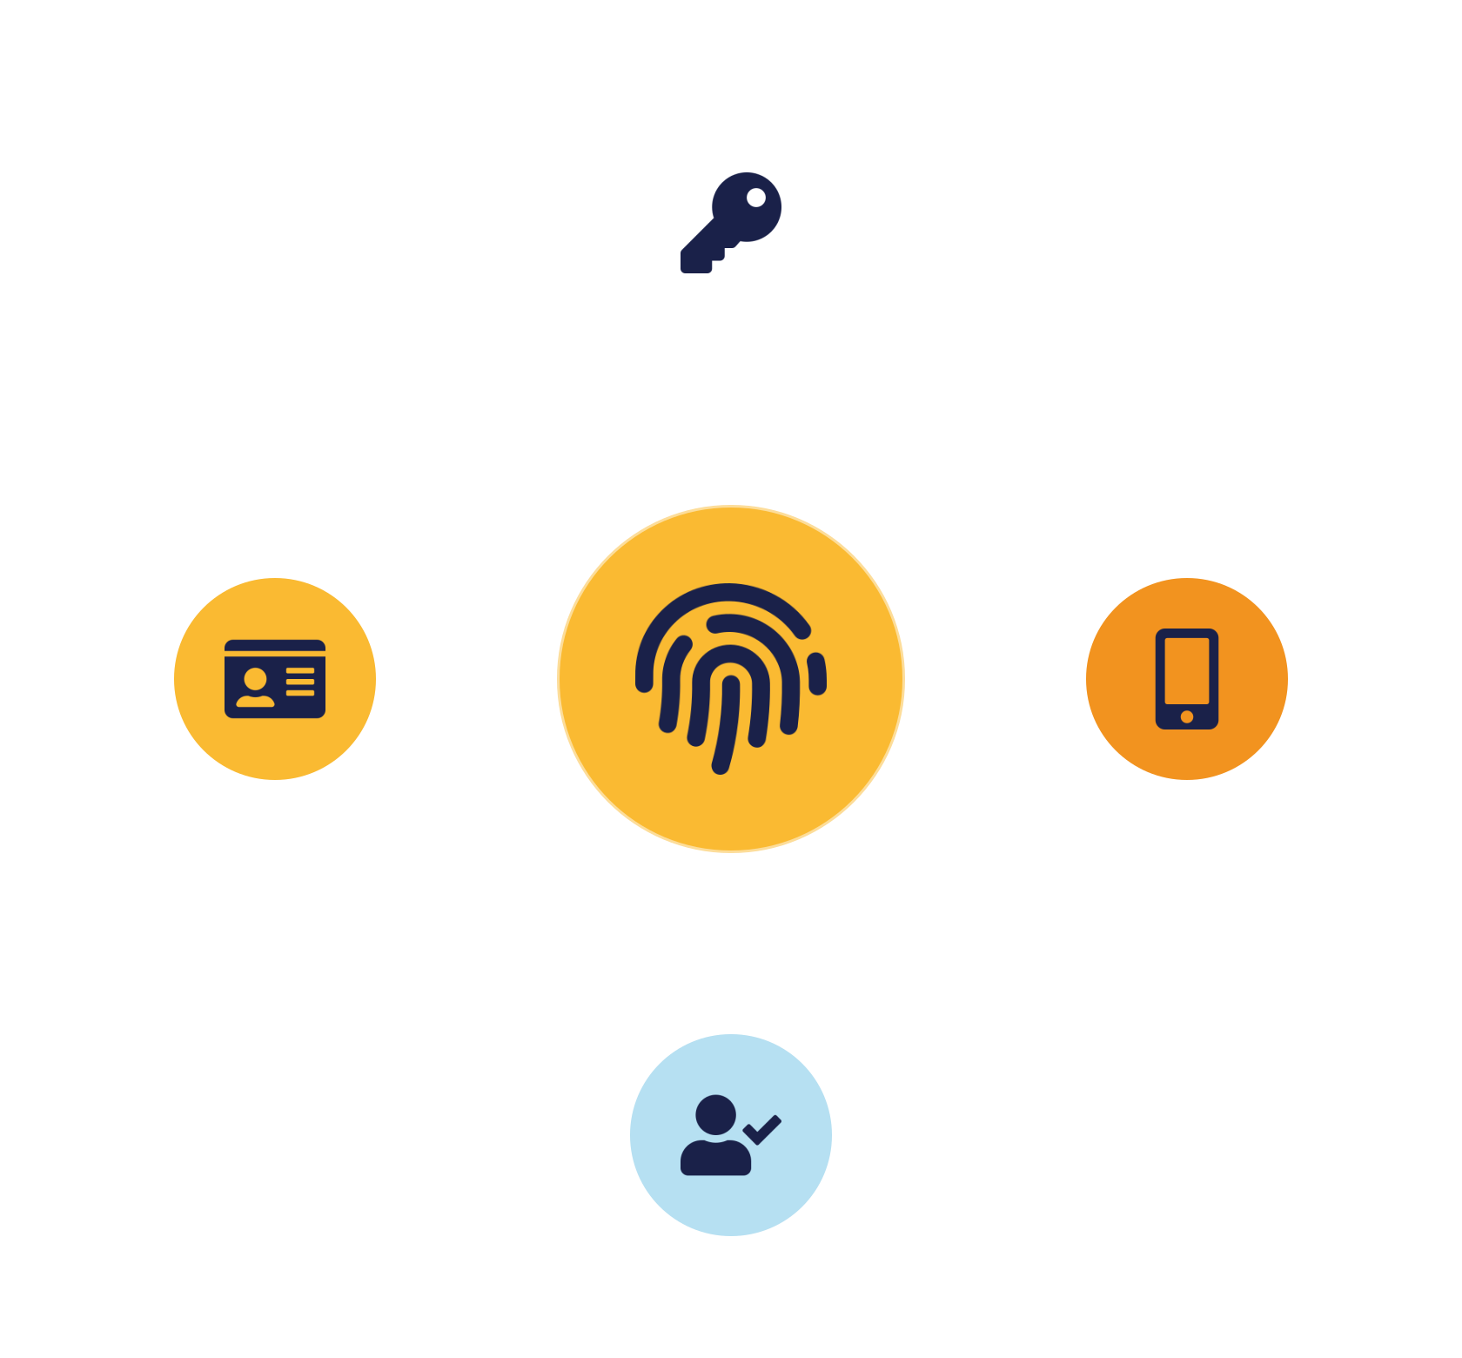
02
PART 2
Authentication & Authorization
Notes:
The two halves of access control, which students must never confuse. Authentication proves who you are; authorization decides what you may do. We cover methods, MFA, and the RBAC/ABAC models.

Slide 10
THE DISTINCTION
Authentication vs authorization
Authentication
Authorization
“Who are you?” — verify identity.
“What may you do?” — grant rights.
Proves identity — password + MFA
Determines permissions — RBAC / ABAC
Happens first —
Happens after auth —
Example — logging in
Example — permission to open a file
Order is fixed: authenticate first, then authorize — and both must be strong.
IKB42603 Cloud Computing Security Essentials
7
Notes:
Make the distinction crisp because it is a perennial confusion and a common exam question. Authentication answers 'who are you?' — it verifies identity, for example logging in with a password and MFA. Authorization answers 'what are you allowed to do?' — it determines access rights once identity is established, for example whether you may open a particular file. The order is fixed: authenticate first, then authorize. Use the slide's example — logging in (authentication) versus having permission to access a file (authorization). Stress that both must be strong: perfect authentication with sloppy authorization means verified users can do too much; tight authorization with weak authentication means impostors slip in. The next slides deepen each half — methods and MFA for authentication, RBAC and ABAC for authorization.

Slide 11

PROVING IDENTITY
Authentication methods & MFA
The three factors
Multi-factor authentication
Something you know — password, PIN
Combine factors from different classes.
Something you have — phone, token, smart card
Defeats most credential attacks — phishing, brute force
Something you are — fingerprint, face
Baseline for anything sensitive —
The cheapest big security win —
IKB42603 Cloud Computing Security Essentials
8
Notes:
Authentication factors fall into three classes: something you know (a password or PIN), something you have (a phone, token or smart card), and something you are (a biometric — fingerprint, face). Passwords alone are the weakest, being phishable, guessable and reusable across sites. Multi-factor authentication combines factors from DIFFERENT classes — for example a password plus a code from your phone — so that stealing one factor is not enough. This is the single highest-impact access control: MFA defeats the large majority of credential attacks, including phishing and brute force, which is why it should be the baseline for anything sensitive. Biometrics add a strong 'something you are' factor and are convenient, though they raise privacy considerations. The takeaway for students: more independent factors means stronger assurance — and MFA is the cheapest large security win available. Preview: identity federation and SSO in Lesson 7 let one strong authentication serve many services.

Slide 12


GRANTING RIGHTS
Authorization models — RBAC & ABAC
RBAC — by role
ABAC — by attributes
Permissions attached to roles, users assigned to roles.
Access from attributes: dept, sensitivity, time, location.
Simple & scalable — the common workhorse
Fine-grained & context-aware —
Manage by role, not per-user —
More complex to manage —
Example — Admin vs User
Example — only from corp network, 9–5
IKB42603 Cloud Computing Security Essentials
9
Notes:
Two dominant models for deciding what an authenticated user may do. RBAC, role-based access control, grants permissions by role — an Admin role, a User role — so you manage access by assigning people to roles rather than setting individual permissions. It is simple, scalable and the workhorse of most organisations; the example is Admin versus User. ABAC, attribute-based access control, decides access from attributes — user department, resource sensitivity, time of day, location, device — giving fine-grained, context-aware control at the cost of complexity. Guidance: use RBAC for broad, stable structures where roles map cleanly to jobs; add ABAC when you need context-sensitive precision, such as 'only from the corporate network during business hours.' Both are mechanisms to enforce least privilege from Part 1. In the cloud, providers' IAM systems implement RBAC natively and increasingly support attribute-based conditions, so students will meet both in practice.

Slide 13
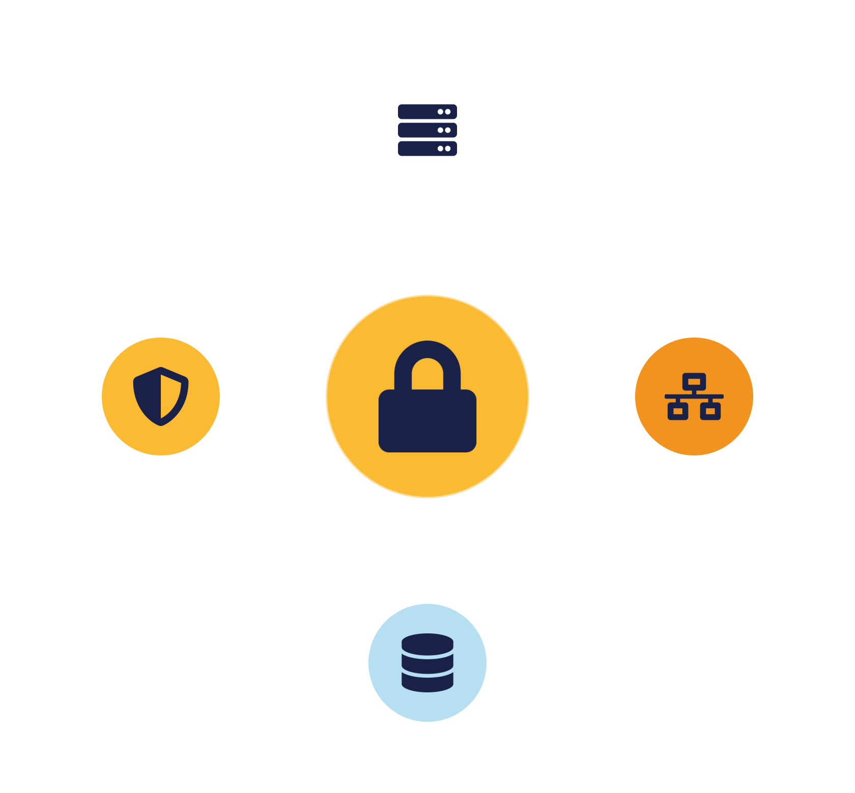
03
PART 3
The Three Access Domains
Notes:
Access control applies to three layers of the infrastructure — compute, network and storage. A gap in any one lets an attacker in, so all three must be controlled together.

Slide 14



OVERVIEW
Compute, network & storage access control
Compute
Network
Storage
Who can log into and administer VMs and workloads.
Which systems may talk to which — firewalls, filtering.
Who may read and write stored data — permissions, encryption.
Securing one domain but not the others is locking the door while leaving the windows open.
IKB42603 Cloud Computing Security Essentials
10
Notes:
Access control is not one thing — it applies across three domains, echoing the isolation dimensions from Lesson 3. Compute access control governs who can log into and administer virtual machines and workloads. Network access control governs which systems may talk to which, using firewalls, segmentation and filtering. Storage access control governs who may read and write stored data, using permissions, encryption and policies. The unifying principle is least privilege applied at every layer, plus default-deny on the network. Tell students the point: securing only one domain is like locking the front door but leaving the windows open — an attacker who cannot log into a VM directly may reach its data through a mis-permissioned storage bucket or an open network path. We take one slide on each.

Slide 15
DOMAINS 1 & 2
Compute & network access control
Compute access control
Network access control
Restrict VM login — key-based, not shared passwords
Firewalls & security groups — control traffic
Limit admin privileges — few hold admin
Segmentation — limit lateral movement
Monitor activity —
IP filtering · VPN · ACLs — known sources only
IKB42603 Cloud Computing Security Essentials
11
Notes:
Detail the first two domains. Compute access control: restrict who can log into virtual machines, use secure login methods (key-based SSH, not shared passwords), and tightly restrict administrative privileges so few identities hold admin — most breaches escalate through over-granted admin rights. Network access control: govern traffic between systems using firewalls and security groups, network segmentation (from Lesson 3), and IP filtering to permit connections only from known sources; add VPNs and access control lists for finer control. The connecting idea is default-deny with least privilege: by default nothing may log in or connect, and you explicitly permit only what is needed. This directly limits lateral movement — an attacker who lands on one machine cannot freely reach others. Both domains rely on the identity system underneath, reinforcing why identity management (Lesson 7) is foundational.

Slide 16



DOMAIN 3
Storage access control
Permissions
Encryption
Access policies
Who may read/write — private by default, least privilege.
A safety net — a permission mistake yields only ciphertext.
Fine-grained rules on who, what, under which conditions.
The exposed-bucket breach is a storage access-control failure — prevented by these controls.
IKB42603 Cloud Computing Security Essentials
12
Notes:
The third domain, and the one behind the most headline breaches. Storage access control restricts who can read and write stored data through three combined mechanisms. File and object permissions define who may access what — the mis-set permission on a storage bucket is the classic cloud breach, so private-by-default and least privilege are essential. Encryption protects the data itself, so even a permission mistake yields only ciphertext — the link back to Lesson 4. Access policies express fine-grained rules, often attribute-based, about who may do what under which conditions. Add monitoring of data access to detect misuse. The lesson to land: the exposed-bucket breach we keep returning to is a storage access-control failure, and it is prevented by exactly these controls — correct permissions, encryption as a safety net, and monitoring to catch mistakes. This connects storage access control to the data-protection pillar and to compliance.

Slide 17
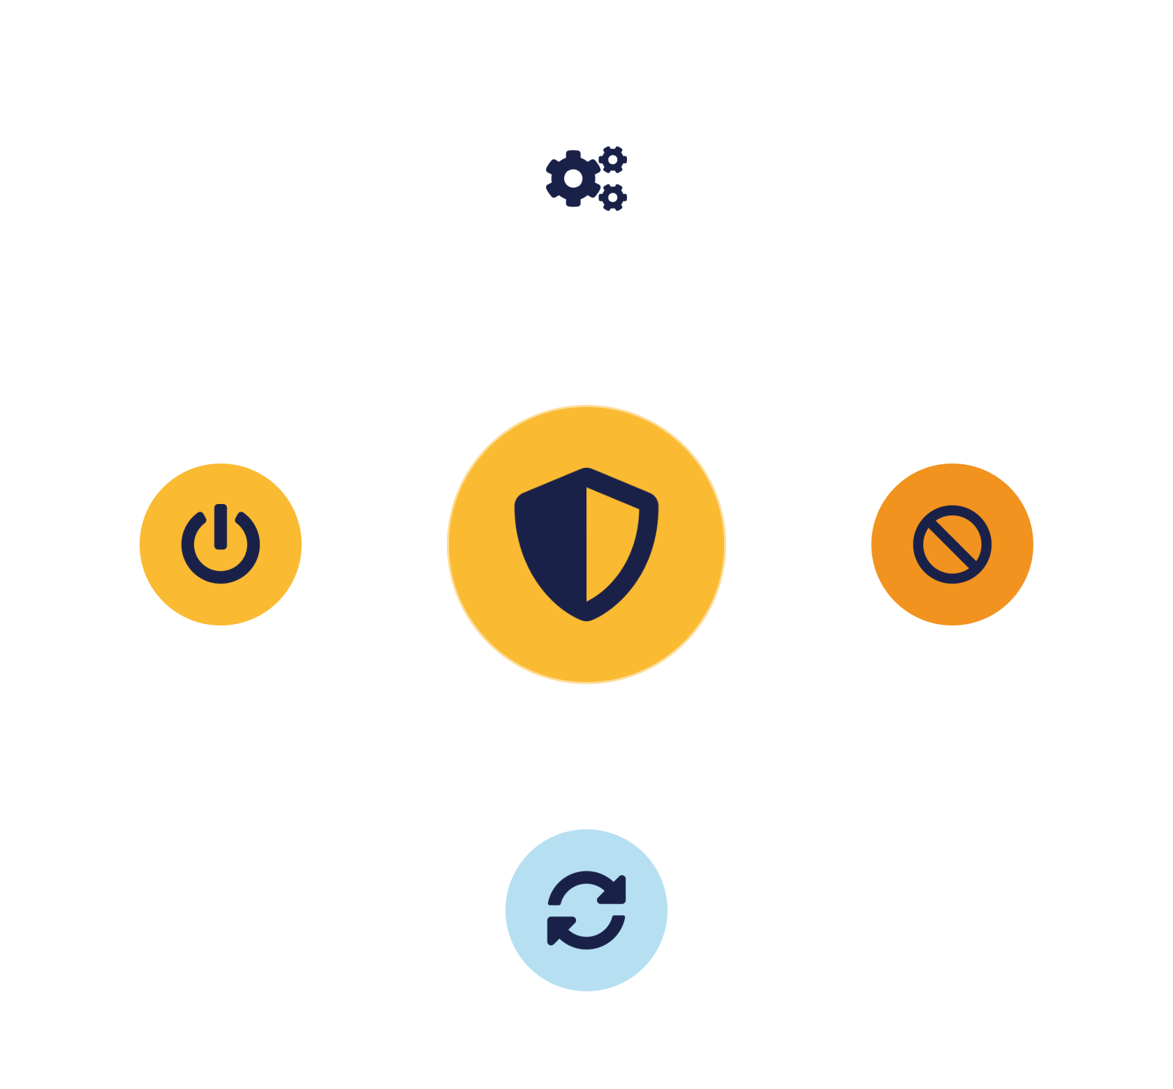
04
PART 4
System Hardening & Remote Access
Notes:
Access control decides who gets in; hardening reduces what they can exploit once the system is running. We cover OS hardening, minimization, secure remote access and trusted boot.

Slide 18


REDUCE THE ATTACK SURFACE
OS hardening & system minimization
OS hardening
System minimization
Remove unnecessary services — fewer entry points
Keep only what you truly need.
Apply security patches — close known flaws
Fewer components = fewer flaws —
Disable unused ports & accounts —
Easier to secure & monitor —
Golden images at scale — secure by default
IKB42603 Cloud Computing Security Essentials
13
Notes:
Hardening means configuring a system to reduce its attack surface — fewer ways in, fewer things to exploit. The core OS-hardening steps on the slide: remove unnecessary services (every running service is a potential entry point), apply security patches promptly (unpatched flaws are the attacker's easiest route), and disable unused ports and accounts. System minimization is the underlying principle: keep only the components you actually need — a minimal system has fewer vulnerabilities and is easier to secure and monitor. Connect to earlier lessons: this is defense in depth and security-by-design applied at the host level, and it complements access control — even if someone gets in, a hardened, minimal system gives them little to exploit and no idle service to abuse. In the cloud, hardened, minimal machine images (golden images) let you deploy secure-by-default hosts at scale. Note verified/measured boot on the next slide extends hardening to startup integrity.

Slide 19


ACCESS & INTEGRITY
Secure remote access & trusted boot
Secure remote access
Verified & measured boot
Use VPNs — tunnel traffic securely
Integrity from the very first instruction.
Enforce MFA — on every remote session
Check each boot component — authentic & unmodified
Limit remote access — a prime attacker target
Detect rootkits / tampering —
Trusted foundation — basis for Lesson 8 patterns
IKB42603 Cloud Computing Security Essentials
14
Notes:
Two more controls. Securing remote access: administrators and users often connect from outside, so require VPNs to tunnel traffic securely, enforce MFA on every remote session, and limit remote access to what is necessary — remote administrative access is a prime attacker target, so it deserves the strongest controls. Verified and measured boot ensures system integrity from the very start: the system checks that each component loaded at startup is authentic and unmodified, detecting rootkits or tampering that would otherwise hide beneath the operating system. This extends integrity — the CIA goal — down to the boot process, and gives you a trustworthy foundation, which becomes important for the trusted-platform design pattern in Lesson 8. The combined message: control how people get in remotely, and verify that the machine itself has not been tampered with before you trust anything running on it.

Slide 20

05
PART 5
Detection, Case Study & Practice
Notes:
Prevention is never perfect, so we add detection — firewalls, intrusion detection and prevention, and honeypots — then apply everything to a breach scenario.

Slide 21




WHEN PREVENTION FAILS
Firewalls, IDS/IPS & honeypots
Firewalls
IDS
IPS
Honeypots
Filter traffic against rules — block unauthorised access.
Detect suspicious activity and alert admins.
Detect AND automatically block threats in real time.
Decoys that attract attackers — detect early, study behaviour.
Prevention plus detection — defense in depth for access; all feed the SIEM (Lesson 6).
IKB42603 Cloud Computing Security Essentials
15
Notes:
The detective and preventive network controls that back up access control. Firewalls filter incoming and outgoing traffic against rules, blocking unauthorised access — the first network gate. Intrusion Detection Systems watch for suspicious activity and alert administrators — they see attacks but do not stop them. Intrusion Prevention Systems go further: they detect AND automatically block threats in real time. Honeypots are decoy systems deliberately exposed to attract attackers, so you can detect intrusions early and study attacker behaviour without risking real assets. The framing: access control and hardening try to prevent intrusion; these tools detect and contain it when prevention fails — the same detect-and-respond philosophy as Lesson 6's monitoring. Together, prevention plus detection is defense in depth for access. Note IDS/IPS and firewalls feed the SIEM, closing the loop with the monitoring pillar.

Slide 22
APPLY IT
Case study — the weak-password breach
A weak password policy let an attacker guess an account's credentials. From that one account they reached sensitive systems — a breach that began with a single weak password.
What failed?
How to improve?
Weak authentication · no MFA · over-broad permissions on the account.
Enforce MFA & strong passwords · least privilege · monitor & lock on brute force · review access.
IKB42603 Cloud Computing Security Essentials
16
Notes:
Run as a think-pair-share. Scenario: a weak password policy allowed an attacker to guess or brute-force an account's credentials, and from that account they reached sensitive systems — a breach that started with a single weak password. Ask the two questions. What failed? Weak authentication (short, reused, no complexity), no MFA to stop the guessed password from working, and likely over-broad permissions on the account so the foothold reached far. How to improve access control? Enforce strong authentication and MFA (which alone would have stopped this), apply least privilege so a single account cannot reach everything, monitor for brute-force patterns and lock accounts, and review access regularly. The teaching point that also answers the discussion question: MFA is the highest-impact fix here, but it is not enough alone — least privilege limits the damage and monitoring catches the attempt. Connect to shared responsibility: password policy and MFA were the customer's to enforce. Let pairs report before consolidating.

Slide 23

BASELINE
Best practices — enforcing access control
Enforce least privilege
Use MFA as baseline
People and machine identities.
For all sensitive access.
Review access regularly
Monitor activity
Fight permission creep.
Detect misuse early.
Harden systems
Secure remote access
Reduce what intruders exploit.
VPN + MFA, tightly limited.
IKB42603 Cloud Computing Security Essentials
17
Notes:
Distil the lesson. Enforce least privilege everywhere — people and machines. Use MFA as the baseline for all sensitive access. Regularly review access to fight permission creep and remove stale accounts. Monitor activity to detect misuse early. Harden systems to reduce what an intruder can exploit. And secure remote access with VPN and MFA. Tell students these six are the operational core of CLO2 and map to Lab Assignment criteria. Preview: Lesson 7 goes deeper into identity — single sign-on, federation and provisioning — the machinery that makes strong, scalable authentication practical across many services.

Slide 24

RECAP
Key takeaways
1 Identity is the perimeter — access control is where most cloud breaches are won or lost.
2 Authentication (who you are) and authorization (what you may do) are distinct — both must be strong.
3 Access control spans compute, network and storage — secure all three, least privilege throughout.
4 Hardening and detection (IDS/IPS, honeypots) back up access control when prevention slips.
IKB42603 Cloud Computing Security Essentials
18
Notes:
Consolidate. One: in the cloud, identity is the perimeter — access control is where most breaches are won or lost. Two: authentication (who you are) and authorization (what you may do) are distinct and both must be strong — MFA and least privilege are the highest-impact controls. Three: access control spans compute, network and storage — secure all three. Four: hardening and detection back up access control when prevention slips. Ask students to state the difference between authentication and authorization and give one control for each. Preview Lesson 7: identity management — SSO, federation and provisioning.

Slide 25

Discussion & Q&A
Is MFA enough on its own to prevent account attacks? Why or why not?
Which access control — authentication, authorization, or monitoring — would you strengthen first, and why?
Next week — Lesson 7: Introduction to Identity Management in Cloud Computing (SSO · federation · provisioning)
Notes:
Close with the prompts. The first is the lesson's thesis: MFA is the single highest-impact control but not sufficient alone — least privilege and monitoring must accompany it. The second has no single answer; the value is the justification. Preview Lesson 7 on identity management. Remind students this lesson maps to CLO2 and the Lab Assignment. (Note: Week 6 covered Monitoring, Auditing & Management, and the Test on CLO1 falls in that week.)

