Slide 1

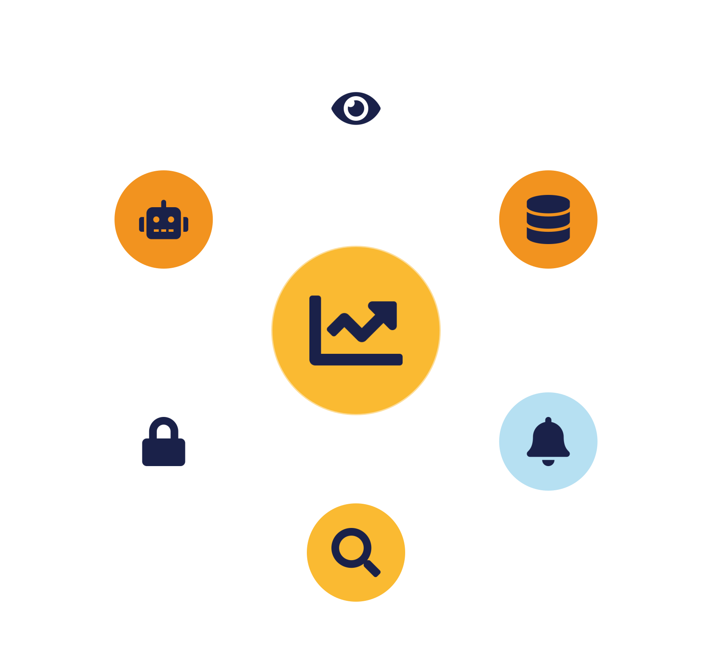
IKB42603 • Cloud Security
WEEK 6 · LESSON 6
Monitoring, Auditing & Management in the Cloud
Logs & telemetry · SIEM · Intrusion detection · Tamper-proof logs · Incident response
Universiti Kuala Lumpur · UniKL MIIT | Prof. Dr. Shahrulniza Musa

Slide 2
LEARNING OUTCOMES
What you will be able to do
1. Explain why cloud monitoring differs
2. Distinguish logs, events & telemetry
Management plane, ephemerality, sprawl, shared responsibility.
And the main cloud telemetry sources.
3. Design a log collection architecture
4. Describe SIEM & intrusion detection
Cascading collection feeding a SIEM.
Correlation, alerting and cloud detection & response.
5. Protect log integrity
6. Run cloud incident response
Tamper-proof, immutable, append-only logging.
Detect, contain, eradicate, recover, learn.
IKB42603 Cloud Computing Security Essentials
1
Notes:
Welcome to Lesson 6. By now students understand isolation (Lesson 3), data protection (Lesson 4) and access control (Lesson 5). Today we add the fourth pillar: the ability to SEE what is happening and RESPOND when something goes wrong. Frame it plainly — prevention will eventually fail, so detection and response are what limit the damage. Walk the six outcomes. Note the assessment link: this lesson maps to CLO2 (constructing secure cloud operations and safeguarding data integrity), which is examined through the Lab Assignment; tamper-proof logging in particular is an integrity control. Also mention the Week 6 Test on CLO1 happens this week, so this is a busy week.

Slide 3



CONSTRUCTIVE ALIGNMENT
Curriculum alignment — CLO · PLO · MQF · clusters
Construct secure cloud computing operations that safeguard data integrity.
CLO 2
Programme outcome
Values & skills
Assessment
PLO2 · Cognitive Skills
MQF Level iii(a)
Bloom P3 (Precision)
VBE3 · Integrity
SC8 · Problem-Solving
Lab Assignment
Test — CLO1 (this week)
Constructive alignment: CLO → PLO → MQF, with VBE (values) and SC (skills) clusters, assessed as shown.
IKB42603 Cloud Computing Security Essentials
2
Notes:
Constructive-alignment slide for the external examiner and MQF accreditation. Lesson 6 maps to CLO2 — constructing secure cloud operations that safeguard data integrity (tamper-proof logging is an integrity control) — aligned to PLO2, MQF Level iii(a), Bloom P3, with the VBE3 integrity value and SC8 problem-solving skill, assessed through the Lab Assignment. Note the Week 6 Test on CLO1 also falls this week, so both CLO1 and CLO2 are active.

Slide 4
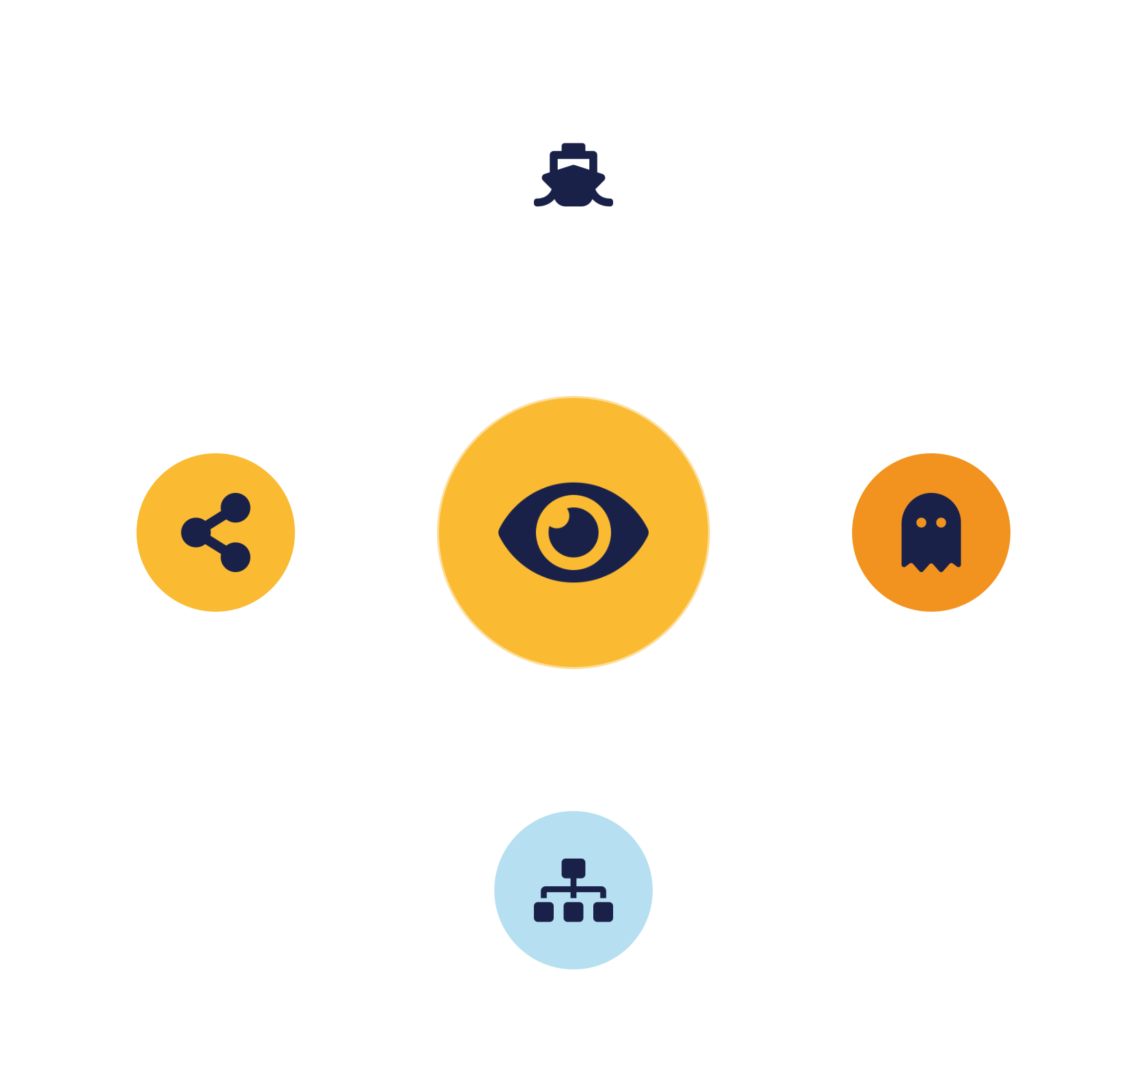
01
PART 1
Why Monitoring Is Different in the Cloud
Notes:
Open with a provocation: 'You can't secure what you can't see.' On-premises, you owned the wires and could tap them. In the cloud, visibility is something the provider grants you through telemetry — so monitoring becomes a design decision, not a given.

Slide 5



PURPOSE
What monitoring buys you
Visibility
Detection
Accountability
Forensics
Continuous insight into activity across every cloud service.
Spot anomalies and attacks early — before they become breaches.
An audit trail of who did what, when — for security & compliance.
The evidence to investigate — only useful if collected beforehand.
“You cannot secure — or prove compliance for — what you cannot see.”
IKB42603 Cloud Computing Security Essentials
3
Notes:
Establish the four things monitoring delivers, straight from the CCSK security-monitoring domain. Visibility: continuous insight into activity across your cloud — the 'see and hear' of the environment. Detection: spotting anomalies and attacks early, before they become breaches. Accountability: an audit trail of who did what and when, essential for both security and compliance. Forensics: the evidence you need to investigate an incident after the fact — and evidence is only useful if it was collected before the incident and cannot be tampered with. Stress the last point because it motivates tamper-proof logging later. The recurring theme: logs and events are foundational to security, compliance and risk management all at once.

Slide 6





THE CHALLENGE
Five things that make cloud monitoring hard
Management plane
Ephemerality
Cloud sprawl
Volume & velocity
Shared responsibility
One console/API controls everything — the prime target.
Resources live for minutes — capture logs or lose them.
Workloads scattered across services & multiple CSPs.
Telemetry floods in faster than humans can review.
Who logs what varies per service — gaps appear.
IKB42603 Cloud Computing Security Essentials
4
Notes:
From CCSK Domain 6, the factors that drive complexity. Management plane: the cloud console and APIs control everything administratively — like a captain steering a ship. A single compromised admin credential can reconfigure the whole estate, so the management plane must be monitored above all else. Ephemerality: cloud resources are short-lived — a container or VM may exist for minutes, so if you did not capture its logs while it lived, the evidence is gone. Cloud sprawl: workloads spread across many services and multiple providers, dispersing the data you need to watch. Volume & velocity: the sheer amount of telemetry overwhelms manual review. Shared responsibility: the model means the provider logs some things and you must log others — and the split varies per service, so gaps appear exactly where nobody thought they were responsible. These five are why we need architecture and automation, not just 'turn on logging.'

Slide 7
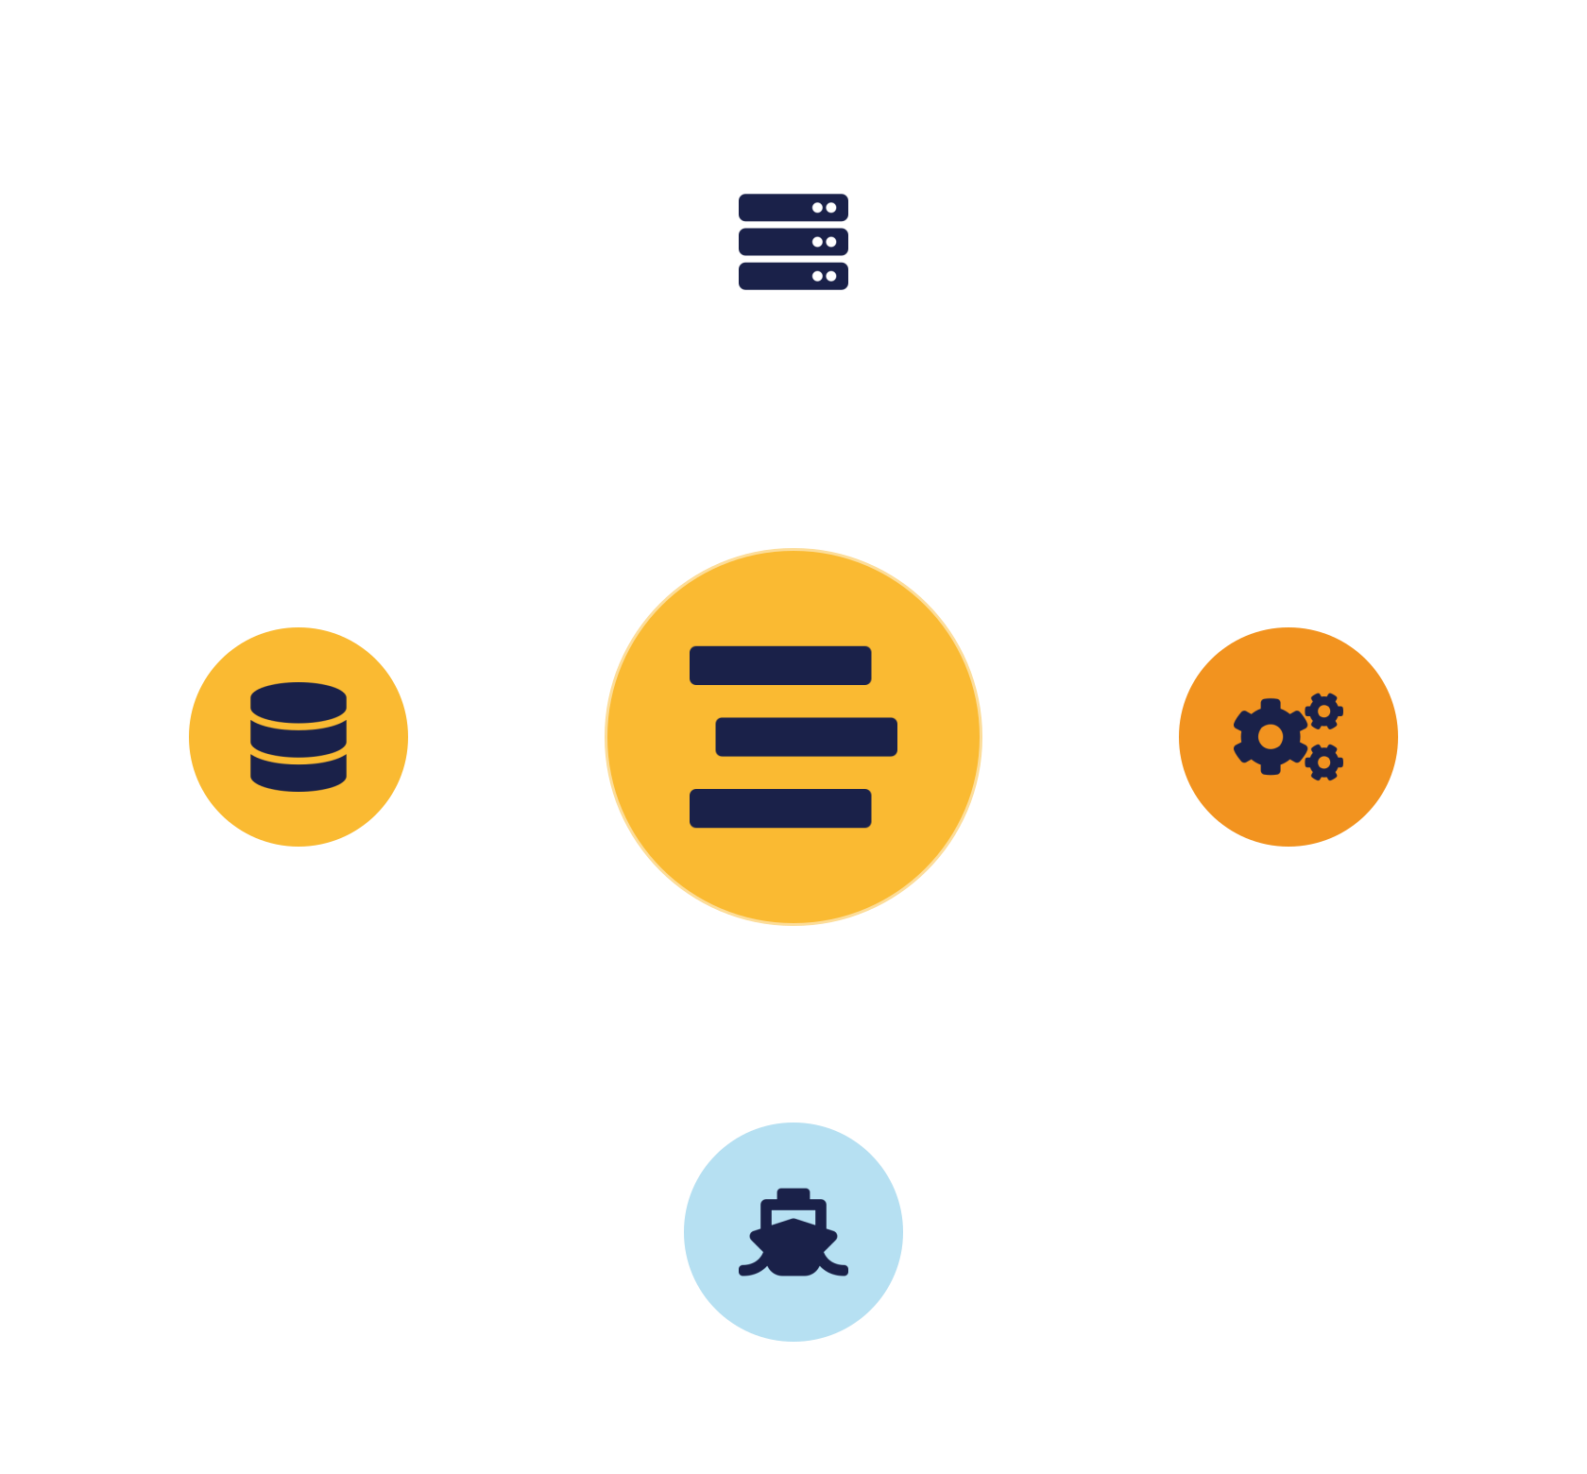
02
PART 2
Logs, Events & Telemetry
Notes:
The raw material of monitoring. Before we can build detection, we need to know what data the cloud actually produces and where it comes from.

Slide 8


FOUNDATIONS
Logs vs events — different jobs
Logs
Events
Detailed, durable records of all activity — full CRUD operations.
Lightweight signals of key state changes — near real time.
Rich context, stored long-term
Immediate — seconds after activity
Best for forensics & audit
Triggers alerts & automated response
Delivery can be delayed; quality varies
Temporary, less context
Answer: WHAT exactly happened
Answer: something happened NOW
IKB42603 Cloud Computing Security Essentials
5
Notes:
A distinction the CCSK material draws clearly and students often blur. Logs are detailed, durable records of all system activity — every Create, Read, Update and Delete operation — stored for long-term analysis. They are rich and good for forensics, but delivery can be delayed and quality varies. Events are lightweight signals of key state changes — typically Create, Update, Delete — triggered in near real time by specific conditions. They are immediate, often available seconds after the activity, but lack the full context of a log; they are what fires an alert. The practical takeaway: use events to know something happened NOW and to trigger response, and use logs to reconstruct exactly WHAT happened afterwards. A good monitoring pipeline uses both — events for speed, logs for depth.

Slide 9


WHERE DATA COMES FROM
Cloud telemetry sources
Management-plane logs
Service & application logs
Resource logs
Every console login & API call that creates or changes resources.
Interactions with managed services — load balancers, storage, databases.
From the workloads — OS, VMs, software-defined networks.
Highest value — captures admin actions & auth failures.
Service-specific activity and access patterns.
Provisioning, config changes, data transfers.
IKB42603 Cloud Computing Security Essentials
6
Notes:
Telemetry is how you 'see and hear' the cloud. Group the sources into the layers CCSK uses. Management-plane logs record administrative actions — every console login, every API call that creates or changes resources; this is your highest-value source because it captures who is doing what to the environment itself, including console authentication failures. Service and application logs capture interactions with specific managed services — load-balancer logs, storage-access logs, database query logs. Resource logs come from the workloads themselves — the operating systems, VMs and software-defined networks recording provisioning, configuration changes and data transfers. Make the point that a complete monitoring strategy pulls from all three layers; relying on only one leaves blind spots. Tie back to shared responsibility: management-plane logs are usually provided by the CSP, but resource-level logging inside your VM is your job to enable.

Slide 10
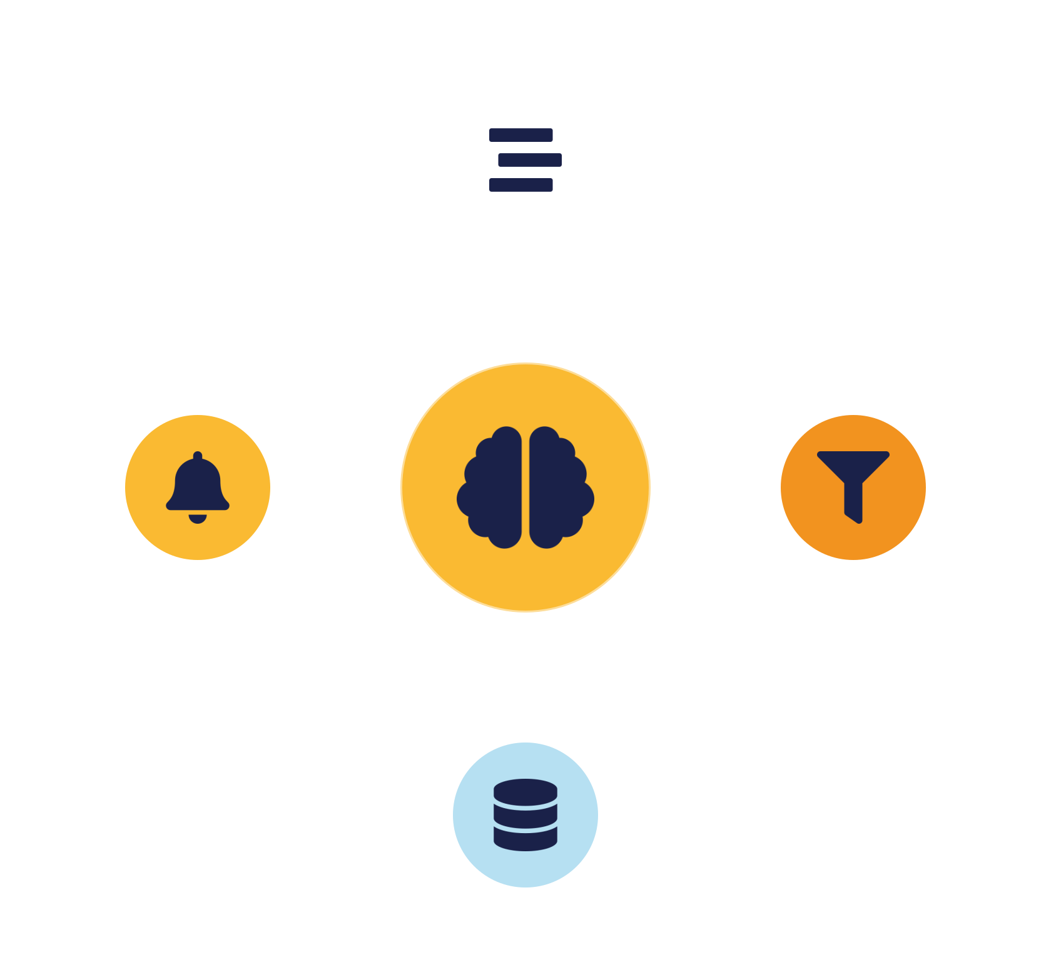
03
PART 3
Collection Architecture & SIEM
Notes:
Raw telemetry is useless if it stays scattered. Now we design the pipeline that collects, centralises and analyses it — ending at the SIEM, the brain of a security operations centre.

Slide 11




DESIGN DECISIONS
Log storage & retention — the trade-offs
Cost
Integration
Cloud storage vs external; egress fees to move logs out.
Cloud logs must combine with on-prem / other-source logs.
Retention
Lock-in
CSP defaults are often shorter than compliance requires.
Logs left only in the CSP tie you to its analysis tools.
IKB42603 Cloud Computing Security Essentials
7
Notes:
Before drawing the architecture, cover the decisions CCSK flags around storing logs. First, cost: storing large volumes in the cloud versus exporting them externally, plus the egress cost of moving logs out of the provider. Second, integration: your cloud logs often need to combine with logs from other sources, such as an on-premises SIEM, so a hybrid organisation must plan how the two meet. Third, retention: the provider's default retention window is frequently shorter than what compliance regimes — PCI DSS, ISO 27001, local regulation — require, so you must actively extend it. Warn students about the trap of leaving logs only in the CSP's native storage: you may then be locked into the CSP's own analysis tools, which may not integrate with your wider security tooling or meet performance needs. But moving everything back on-premises can be even more expensive in transfer and storage. The answer is usually a deliberate middle path — which is the cascading architecture on the next slide.

Slide 12
REFERENCE DESIGN
Cascading log architecture → SIEM
Dev · Test · Prod
Central repository
Security / audit env
SIEM
→
→
→
Each environment emits its own logs
Aggregate + filter the noise
Isolate security-relevant logs
Correlate & detect incidents
Why cascade? filtering & aggregating at each layer controls cost and noise, and gives one pane of glass across all environments.
IKB42603 Cloud Computing Security Essentials
8
Notes:
This is the CCSK reference design for cloud log management and it is worth drawing on the board too. The idea is hierarchical: each environment — Development, Test and Production — generates its own logs and forwards them to a central log repository. That central system aggregates everything, filters out the noise and promotes the security-relevant records into a dedicated security/audit environment. Finally those curated logs feed the SIEM, which correlates across all environments to identify potential incidents. Explain WHY it cascades rather than sending everything straight to the SIEM: filtering and aggregating at each layer controls cost and noise, keeps the SIEM focused on security-relevant data, and gives you a single pane of glass across otherwise siloed environments. Point out the separate security/audit environment — isolating logs there protects their integrity, which sets up the tamper-proof-logging slide. Walk the arrows left to right and have students trace one log record's journey.

Slide 13


THE BRAIN
SIEM — Security Information & Event Management
A SIEM ingests logs and events from across the estate and correlates them to surface incidents no single log would reveal alone.
Aggregate
Correlate
Alert
Report
Collect & normalise data from many sources.
Connect related events into one attack story.
Notify analysts; trigger automated response.
Produce audit evidence for compliance.
IKB42603 Cloud Computing Security Essentials
9
Notes:
Define SIEM properly. A SIEM ingests logs and events from across the whole estate and correlates them to surface security incidents that no single log would reveal on its own. Walk the four capabilities. Aggregation: collect and normalise data from many sources into a common format. Correlation: connect related events across sources — a failed login here, a privilege change there, an unusual data transfer moments later — into a single detected pattern. Alerting: notify analysts, and increasingly trigger automated response, when a rule or anomaly fires. Compliance reporting: produce the audit evidence regulators require. The key insight for students: the power of a SIEM is correlation — individually harmless events become a clear attack story when connected. Mention that modern cloud-native equivalents and CDR tools add analytics and machine learning on top, which we cover shortly. Note also that the SIEM is only as good as the telemetry feeding it — garbage in, garbage out — which is why the earlier architecture matters.

Slide 14


INTEGRITY (VBE3)
Tamper-proof logs — trustworthy evidence
An attacker's first move is to erase the logs. Integrity controls make that impossible — or at least detectable.
Immutable / WORM storage
Object-lock: cannot be changed or deleted for a retention period.
Append-only design
New entries added; existing records never modified.
Hash chaining
Each record cryptographically linked — tampering breaks the chain.
Access separation
Operators can't edit audit logs; forward to a separate audit env.
IKB42603 Cloud Computing Security Essentials
10
Notes:
This slide carries the integrity value that CLO2 assesses, so give it weight. The first thing a capable attacker does after breaking in is delete or edit the logs to hide their tracks — so logs are only useful if they cannot be altered. Cover the techniques. Write-once / immutable storage, often called WORM or object-lock, means records physically cannot be changed or deleted for a set retention period. Append-only design means new entries are added but existing ones are never modified. Cryptographic hashing chains each record to the previous one — like a blockchain — so any tampering breaks the chain and is instantly detectable. Access separation means the people who operate systems cannot also edit the audit logs; segregation of duties, and forwarding logs to that separate security/audit environment we saw, so an attacker who owns the workload does not own its logs. Time-stamping and synchronised clocks keep the sequence of events legally defensible. Land the point: an integrity-protected log is the difference between knowing what happened and merely guessing. This is exactly the kind of control the Lab Assignment expects students to justify.

Slide 15
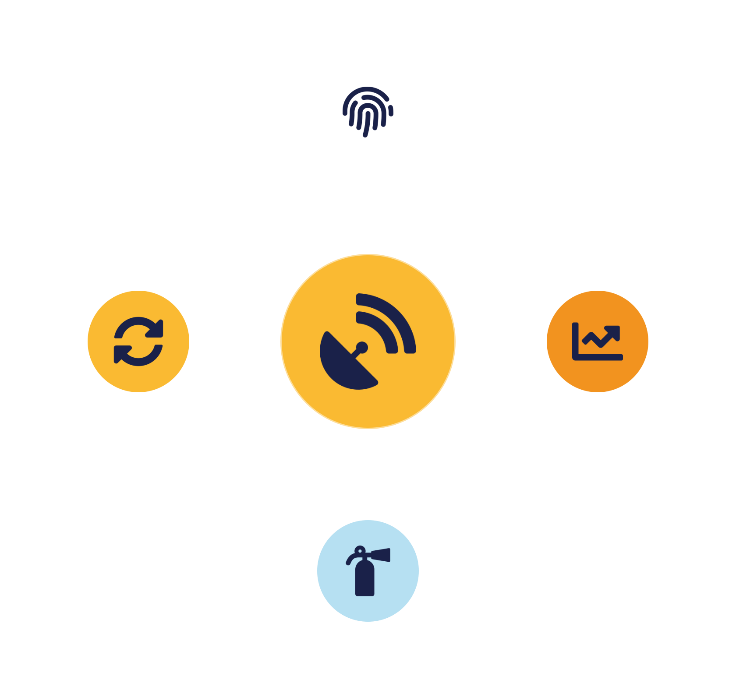
04
PART 4
Detection, Response & Management
Notes:
We can now see and trust our data. The final part turns that visibility into action — detecting intrusions, managing posture, and responding to incidents.

Slide 16

DETECTION
Intrusion detection in the cloud
Signature-based
Anomaly-based
Cloud Detection & Response
Matches known-bad patterns.
Learns normal, flags deviations.
Analytics + threat-intel + ML across cloud.
Reliable for known threats; blind to novel ones.
Catches new attacks; more false positives.
Detects, investigates & responds fast (CDR).
IKB42603 Cloud Computing Security Essentials
11
Notes:
Explain how detection adapts to the cloud. Traditional network IDS/IPS watched traffic at a physical choke point; in the cloud you rarely control the wire, so detection shifts toward the telemetry we've collected and toward provider-native tooling. Signature-based detection matches known bad patterns — reliable for known threats, blind to new ones. Anomaly-based detection learns normal behaviour and flags deviations — catches novel attacks but generates false positives. Then introduce the cloud-native category CCSK highlights: Cloud Detection and Response, or CDR, tools that use advanced analytics, threat intelligence and machine learning to spot suspicious activity and indicators of compromise across cloud environments, then help investigate and respond quickly. The message: in the cloud, your 'sensors' are largely the logs and events from earlier in this lesson, and detection is increasingly analytics-driven rather than perimeter-based.

Slide 17



BEYOND LOGS
Posture management — CNAPP family
CSPM
CIEM
CDR
SSPM
Posture Management
Entitlement Management
Detection & Response
SaaS Posture
Continuously finds misconfigurations & compliance gaps in IaaS/PaaS.
Governs cloud identities; enforces least privilege.
Analytics & ML to detect and respond to threats.
Checks SaaS app configuration & entitlements.
All bundled under CNAPP — Cloud-Native Application Protection Platform.
IKB42603 Cloud Computing Security Essentials
12
Notes:
CCSK stresses that logs alone are not enough at cloud scale — you also need continuous posture management, which asks 'is my cloud configured securely right now?' rather than 'what happened?'. These tools are increasingly bundled under the umbrella term CNAPP, Cloud-Native Application Protection Platform. Walk the members. CSPM, Cloud Security Posture Management, continuously checks IaaS/PaaS configuration for misconfigurations, compliance violations and risks — this is the tool that would have caught the public storage bucket from Lesson 1. CIEM, Cloud Infrastructure Entitlement Management, governs identities and enforces least privilege by revealing who can access what. CDR we just met — detection and response. SSPM does the same posture job for SaaS applications, checking their configuration and entitlements. The unifying idea: posture management is proactive and preventive, detection is reactive; a mature program needs both. Note that CSPM often includes automated remediation, closing misconfigurations without waiting for a human.

Slide 18




WHEN PREVENTION FAILS
Cloud incident response lifecycle
1. Prepare
2. Detect & analyse
3. Contain
Plan, logging & access ready in advance.
SIEM / CDR raises and confirms the alert.
Isolate instance, snapshot, revoke credentials.
4. Eradicate
5. Recover
6. Lessons learned
Terminate malicious resources; rotate keys.
Rebuild from known-good images & backups.
Update detections; close the gap.
IKB42603 Cloud Computing Security Essentials
13
Notes:
Monitoring exists to trigger response, so end with the incident-response lifecycle, based on the NIST model but with cloud twists. Prepare: have the plan, the logging, and the access ready before anything happens — in the cloud, this means ensuring telemetry is on and immutable in advance, because you cannot collect evidence from a VM that has already been destroyed. Detect & analyse: your SIEM and CDR tools raise and confirm the alert. Contain: limit the damage — in the cloud you can isolate a compromised instance instantly by changing its security group, snapshot it for forensics, or revoke the compromised credentials, all through the API. Eradicate: remove the attacker's foothold — terminate malicious resources, rotate all keys, patch the entry point. Recover: restore clean workloads from known-good images and backups — the cloud makes rebuilding from immutable infrastructure fast. Lessons learned: feed findings back into prepare, updating detections and closing the gap. Emphasise the cloud advantage: automation and API control make containment and recovery far faster than on-premises — if you have prepared. The lifecycle is a loop, not a line.

Slide 19


MANAGEMENT
Auditing & AI-assisted monitoring
Auditing & accountability
AI-assisted monitoring
The audit trail proves compliance (ISO 27001/27017, PCI DSS).
ML tackles the overwhelming volume of telemetry.
Who did it?
Faster anomaly detection
When did it happen?
Threat hunting at scale
Can you prove it wasn't altered?
Automated response + analyst assist
IKB42603 Cloud Computing Security Essentials
14
Notes:
Two closing themes. First, auditing and accountability: the durable audit trail we've built is what proves compliance to frameworks like ISO 27001/27017, PCI DSS and local regulation — a topic we develop fully in Lessons 10 and 11. An auditor asks three questions your logs must answer: who did it, when, and can you prove the record wasn't altered — which is exactly why tamper-proof logging matters. Second, AI for security monitoring, which CCSK highlights as the response to overwhelming data volume. Machine learning enhances anomaly detection by spotting unusual patterns faster than rules; threat hunting by correlating huge, diverse data to surface emerging threats; automated response by shrinking the time between detection and mitigation; and analyst assistance by enriching logs, simulating attacks and reducing alert fatigue. The balanced view students should take: AI is a force-multiplier for the human analyst, not a replacement — it handles scale, humans handle judgement.

Slide 20
BASELINE
Monitoring best practices
Log everywhere by default
Centralise into a SIEM
Especially the management plane.
Correlation needs all data in one place.
Make logs tamper-proof
Alert on what matters
And retain for the full compliance window.
Tune out noise; beat alert fatigue.
Automate response
Rehearse incident response
Shrink time from detection to mitigation.
An untested plan fails under pressure.
IKB42603 Cloud Computing Security Essentials
15
Notes:
Distil the lesson into actionable rules. Enable logging everywhere by default, especially the management plane — you cannot analyse what you never captured. Centralise into a SIEM so correlation is possible across silos. Make logs tamper-proof and store them for the full compliance-required retention. Alert on what matters and tune out noise, or analysts will suffer alert fatigue and miss the real signal. Automate response for well-understood incidents to shrink reaction time. And rehearse incident response before you need it — an untested plan fails under pressure. Tell students these six are the operational checklist behind CLO2, and several map directly to criteria they'll be marked on in the Lab Assignment.

Slide 21
APPLY IT
Mini case study — the 3 a.m. alert
3 a.m.: the SIEM correlates a login from an unfamiliar country → new access keys created → a large data export from a storage bucket. No single event was blocked — together they signal a compromise.
How was it detected?
Why trust the evidence?
SIEM correlation across management-plane & service logs — no single event fired.
Logs were immutable and in a separate audit environment the attacker couldn't reach.
IKB42603 Cloud Computing Security Essentials
16
Notes:
Run as a scenario discussion. At 3 a.m. the SIEM correlates three events: a successful console login from an unfamiliar country, immediately followed by the creation of new access keys, then a large data export from a storage bucket. No single event was blocked; together they form a clear compromise. Ask the questions on the slide. How was it detected? Correlation in the SIEM across management-plane and service logs — none of the three alone would have fired. What contains it fastest? Revoke the new keys and the compromised session, isolate the bucket, snapshot for forensics — all via API in seconds. Why can we trust the evidence? Because the logs were immutable and forwarded to a separate audit environment the attacker couldn't reach. What was the prevention gap? No MFA and no anomaly alert on impossible-travel logins. This case deliberately exercises the whole lesson — telemetry, SIEM correlation, tamper-proof logs, containment. Let pairs report before you reveal the analysis.

Slide 22
RECAP
Key takeaways
1 Cloud monitoring is harder — management plane, ephemerality, sprawl, shared responsibility. Design it.
2 Logs give depth, events give immediacy; telemetry spans management-plane, service & resource layers.
3 A cascading architecture feeding a SIEM turns scattered data into detected incidents via correlation.
4 Logs are only evidence if tamper-proof — immutable, append-only, hash-chained, access-separated.
5 Monitoring drives response: detect → contain → eradicate → recover → learn.
IKB42603 Cloud Computing Security Essentials
17
Notes:
Consolidate the five ideas. One: cloud monitoring is harder because of the management plane, ephemerality, sprawl and shared responsibility — so it must be designed, not assumed. Two: logs give depth, events give immediacy, and telemetry comes from the management plane, services and resources. Three: a cascading collection architecture feeding a SIEM turns scattered data into detected incidents through correlation. Four: logs are only trustworthy evidence if they are tamper-proof — immutable, append-only, hash-chained, access-separated. Five: monitoring exists to drive response — detect, contain, eradicate, recover, learn — and prepared automation makes cloud response fast. Ask students to state each in their own words. Preview: Lesson 7 turns to identity management — single sign-on, federation and provisioning — which is the other half of controlling who gets in.

Slide 23

Discussion & Q&A
If a provider only retains logs for 30 days but your regulator requires one year, what do you do?
Where would you spend a limited budget first: better detection, or tamper-proof logging? Why?
Next week — Lesson 7: Introduction to Identity Management in Cloud Computing (SSO · federation · provisioning)
Notes:
Close the lesson with the two discussion prompts — both are real trade-offs practitioners face. The first tests understanding of retention and export; the answer is to forward logs to your own long-term, immutable storage or SIEM. The second has no single right answer but should surface the argument that trustworthy evidence underpins everything else. Preview Lesson 7 on identity management, and remind students the Lab Assignment assessing CLO2 draws on the monitoring and integrity controls covered today.

