Slide 1
ScavengerEXA
An open source program
To fight spam at the source
Thomas Mangin
Exa Networks
UKNOF 12
2009/02/13
http://wiki.exa.org.uk/doku.phpdo=export_s5&id=scavenger:uknof12

Slide 2
The spam battle - Yesterday
Mouse:
  Using existing mail servers, open relay
  Few high volume source
Cat:
  scanning for open relay
  Using RBL
-> Trying to block the spam at the source

Slide 3
The spam battle - Today
Mouse:
  BOTNETs, Spammers creating their own spam infrastructure
  Lots of “low” volume source
Cat:
  Bots are simple, not RFC compliant (Greylisting)
  Spam traps -> RBLs
  when all fails ask SpamAssasin for some CPU time
-> The defense is now at the receiving end

Slide 4
The spam battle - Tomorrow
Mouse:
  Larger, more clever bots, able to bypass greylisting
  Better spam distribution to become more stealthy
Cat:
  Trying to block bots faster, so they send less
-> It looks bleak, doesn't it ?

Slide 5
Using my crystal ball
What will not change:
  The use of bots
  The use of out of date email address databases
  Compromised machine sending spam but no mail before or after.
What should change:
  Postmaster should get help some help from the 'network', spammers do.
  The fight should be brought back to the edge

Slide 6
Why am I here ?
1- present ScavengerEXA
2 - reduce the spam in //my// mailbox
3 - ?
4 - profit .. not !
Get help from the community to produce a turn key solution
Convince some to help us with an high profile deployment

Slide 7
What is scavengerEXA
On the net:
http://www.thefreedictionary.com/scavenger
Alteration of Middle English scauager, schavager, official charged with street maintenance
In my book:
An carnivore eating Junk created by Exa
http://en.wikipedia.org/wiki/Carnivore_(FBI)
http://en.wikipedia.org/wiki/Junk_mail
http://en.wikipedia.org/wiki/Exa-

Slide 8
ScavengerEXA Design
A collection of several application working together through the network
  mail conversation capture program
  dispatch server
  policy server (postfix policy server alike)
  action servers (email, block spam, etc. the part no ISP wants the same)
  a dummy MTA (return 450 on all messages)

Slide 9
Capture
libpcap based application
keep a track of the smtp conversation:
  client command, parameter
EHLO [127.0.0.1]
RCPT TO: <user@domain.com>
  mail server answers
250 Please to meet you
550 user does not exists here
Ignore the body of the mail
Transmit a UDP packet for each command to the dispatching server

Slide 10
UDP Message Content
key=value structure, with the following keys (in no particular order) for each unique si:sp -> di:dp
or=pacp (how the packet was created)
in=unique random id (identifying the SMTP conversation)
si=source IP, the potential bot
di=destination IP, mail server contacted
he=EHLO/HELO string
st=state (HELO,MAIL,RCPT,DATA,END-OF-DATA)
re=last recpient email address
rc=number of recpient in the mail
se=sender email address
co=smtp response code

Slide 11
Example
Mail conversation
220 mail server listing
HELO [127.0.0.1]
250 mx.domain.com
MAIL FROM: test@domain.com
250 2.1.0 Ok
RCPT TO: user@spammed.com
550 5.7.1 <user@spammed.com>: Recipient address rejected: no such user
<Disconnection>
We do not track smtp auth information atm

Slide 12
UDP Message sent 1/3
HELO [127.0.0.1]
250 mx.domain.com
or=pcap
co=250
di=4.3.2.1
rc=0
st=EHLO
re=
si=1.2.3.4
in=01.3c6b.4e.c0c3
se=
he=[127.0.0.1]

Slide 13
UDP Message sent 2/3
MAIL FROM: test@domain.com
250 2.1.0 Ok
or=pcap
co=250
di=4.3.2.1
rc=0
st=MAIL
re=
si=1.2.3.4
in=01.3c6b.4e.c0c3
se=test@domain.com
he=[127.0.0.1]

Slide 14
UDP Message sent 3/3
RCPT TO: user@spammed.com
550 5.7.1 <user@spammed.com>: Recipient address rejected: no such user
or=pcap
co=550
di=4.3.2.1
rc=1
st=RCPT
re=user@spammed.com
si=1.2.3.4
in=01.3c6b.4e.c0c3
se=test@domain.com
he=[127.0.0.1]

Slide 15
Dispatch Logic
1 - Receive the UDP message from a capture source
    Figure out a policy server (hash on sender IP)
2 - Generate a TCP message for that policy server with the same information as the UDP contained
3 - Wait for the answer from the policy server
4 - If the policy server reports it is spam
5 - Generate a/several TCP message(s) to action server(s)
    Prevent new message to the Policy Server from the spammer

Slide 16
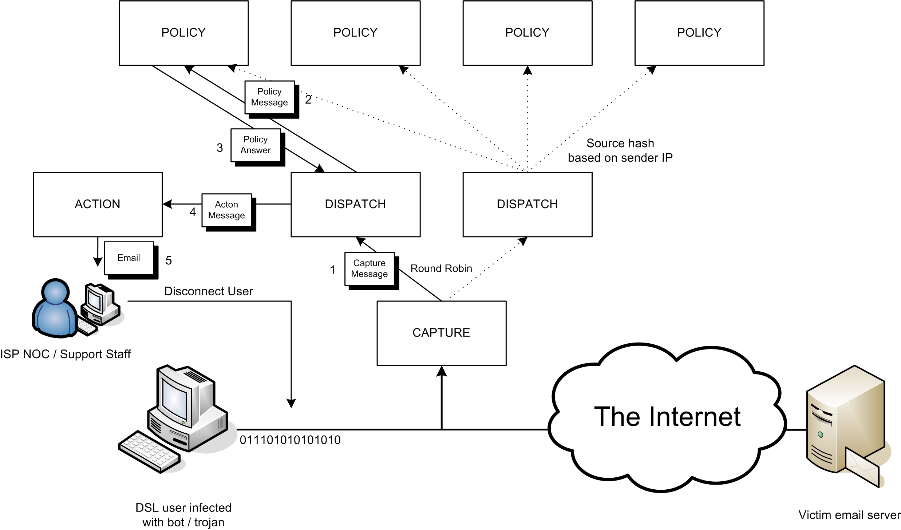
Message Flow

Slide 17
Policy Daemon
Based on the code of Exa's internal Postfix Policy Delegation Daemon (the daemon can still be used with Postfix)
Use the UDP message format instead of Postfix's
Returns:
HAM
HOLD <IP> (<duration>) <reason>
FILTER <IP> [<MTA IP:PORT>] (<duration>) <reason>
an MTA of [0.0.0.0:00000] mean that the MTA used to filter the message is left to the software performing the blocking to decide.

Slide 18
Policy Daemon
A clear API for its spam classfication plugins
  with constraint, run if
      the message match what you are monitoring
      the backend DB is MySQL ...
Explaining its design would take another 20 slides
  writing plugins is **//simple//**
Each plugin has its own database connection.
  support MySQL, PostgreSQL or Sqlite3

Slide 19
Action Mail
You may want to use this action whatever else you do.
  Takes a HOLD or FILTER message
  Emails you the suspected spammer information

Slide 20
Action Netfilter
  Read a Linux machine netfilter rules.
  Force Transproxying of mail to a specified MTA on receipt of a FILTER rule
  Remove the FILTERING when the filtering period is over
  Keep state across reboots

Slide 21
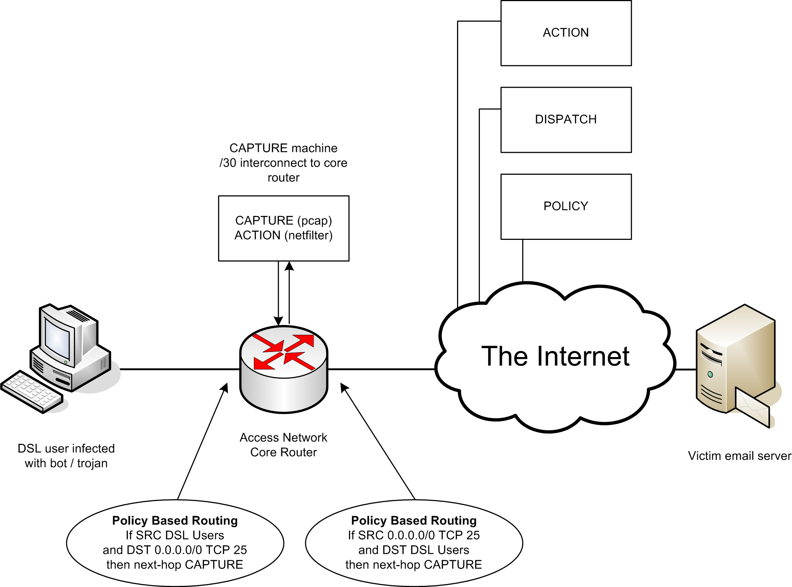
Deployment Example

Slide 22
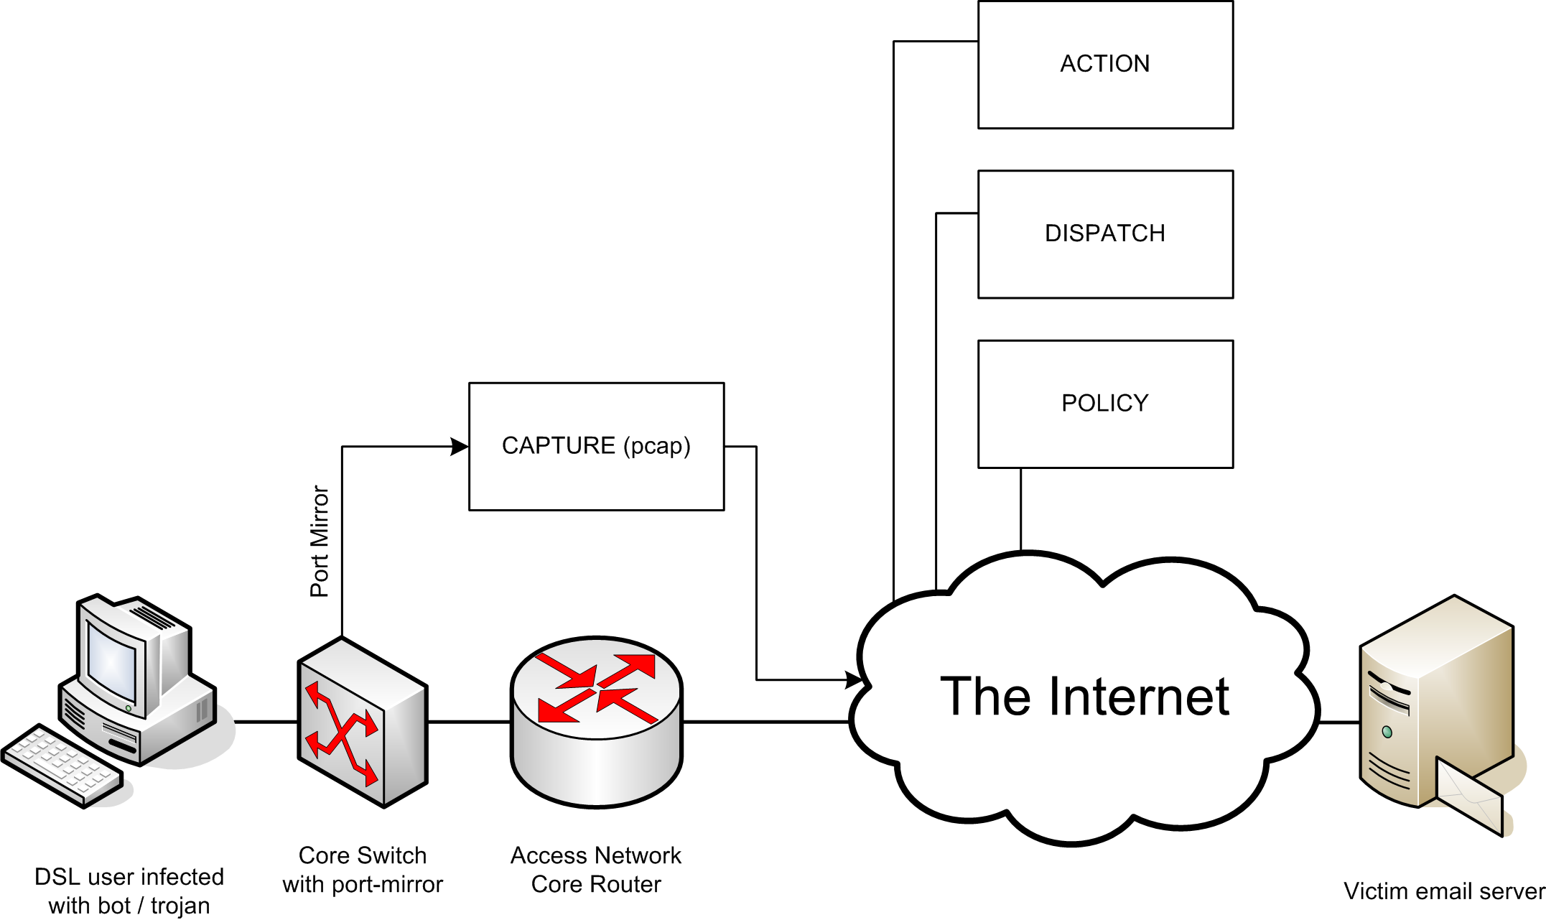
Deployment Example

Slide 23
It is F.R.E.E
Licensed under the Affero GPL 3.0
Each ScavengerEXA program being a separate entity, there is no problem implementing a new server under a proprietary licence.
AFAIK, IMNAL

Slide 24
It is available now
Public SVN Tree
  http://svn.exa.org.uk/scavenger/trunk
Fisheye
  http://fisheye.exa.org.uk/browse/scavenger/
  provides nice delta of changes
  RSS feed of commits
Mailing list
  http://mailman.exa.org.uk/mailman/listinfo

Slide 25
Build on solid foundations
Python, tested with version 2.5.2
  Twisted Matrix, event-driven networking engine
  Python packet capture library (pcap)
  Python dump packet module (dpkt)
  Optional MySQL or PostgreSQL
For more information see:
  http://wiki.exa.org.uk/scavenger/faq

Slide 26
Thank you to
Richard Clayton SpamHINTS
http://www.spamhints.org/

Slide 27
Questions ?
Want to know more:
  website: http://scavenger.exa.org.uk/
Contact us:
  email: scavenger (at) exa (dot) org (dot) uk
Thank you for listening.

