Slide 1
Flux’s Resource Model and Jobspec
Representing and Requesting Resources in Flux
September 17, 2020

Slide 2
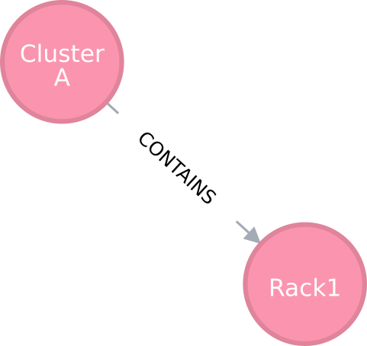
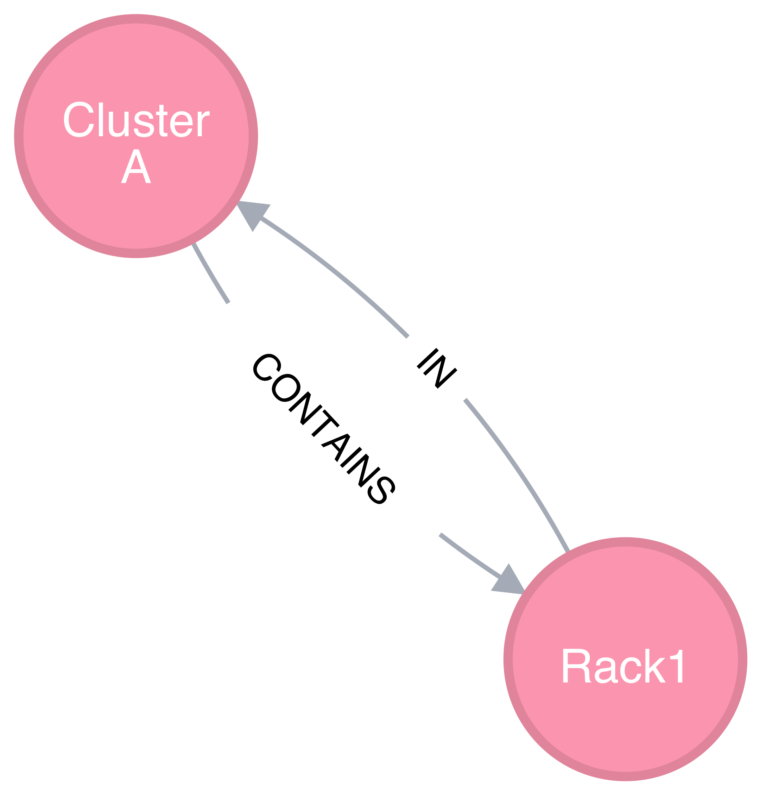
Flux’s Graph Resource Model
Resources are vertices, resource relationships are edges (both uni- and bi-directional)

Slide 3
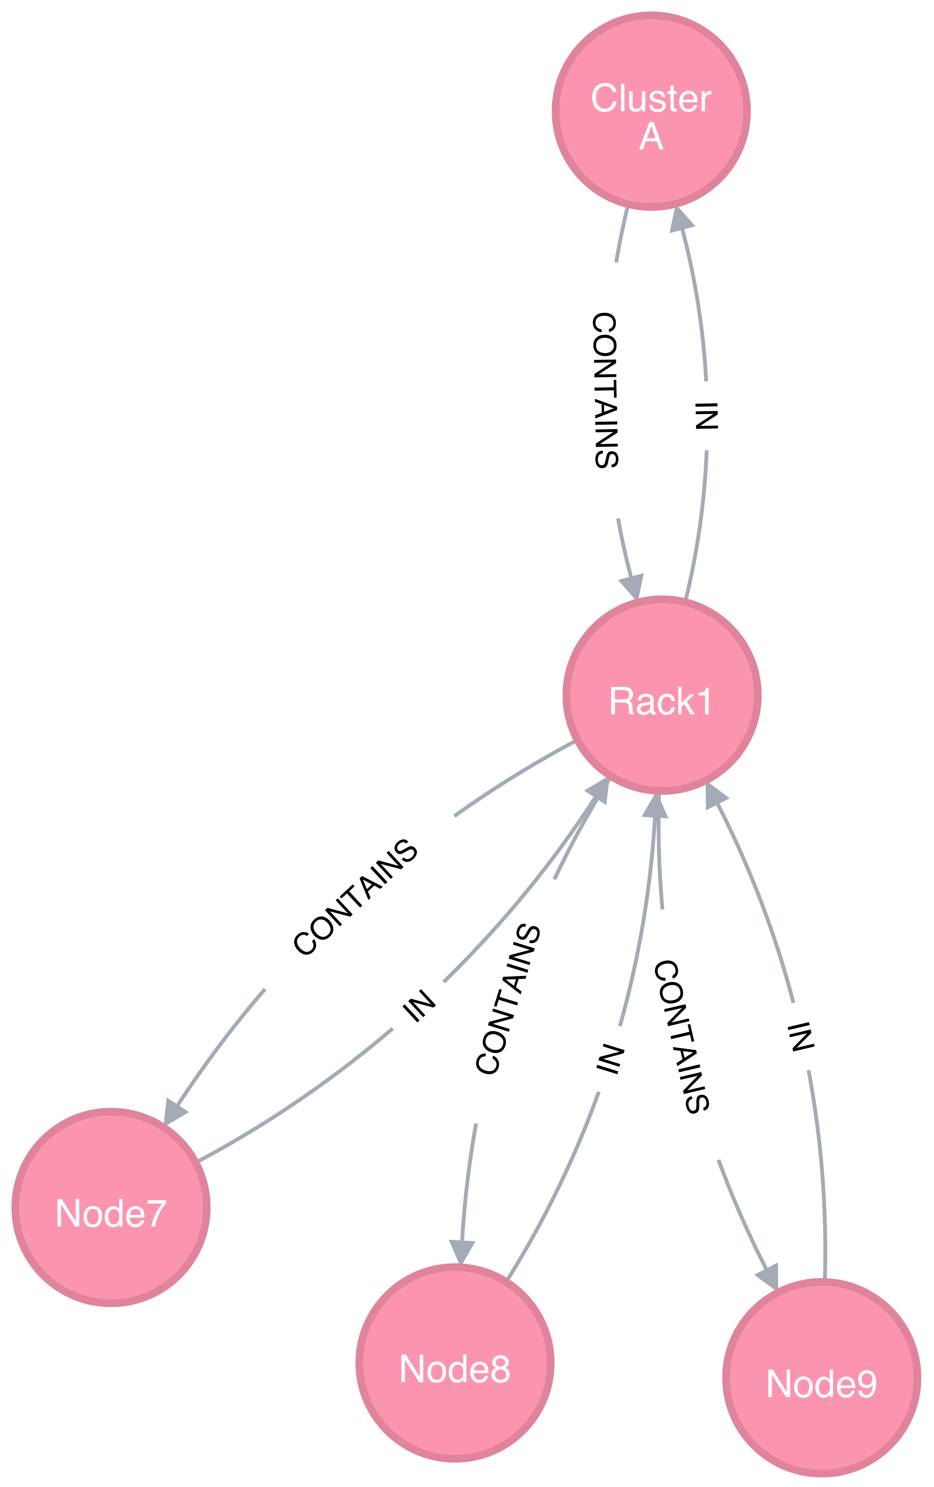
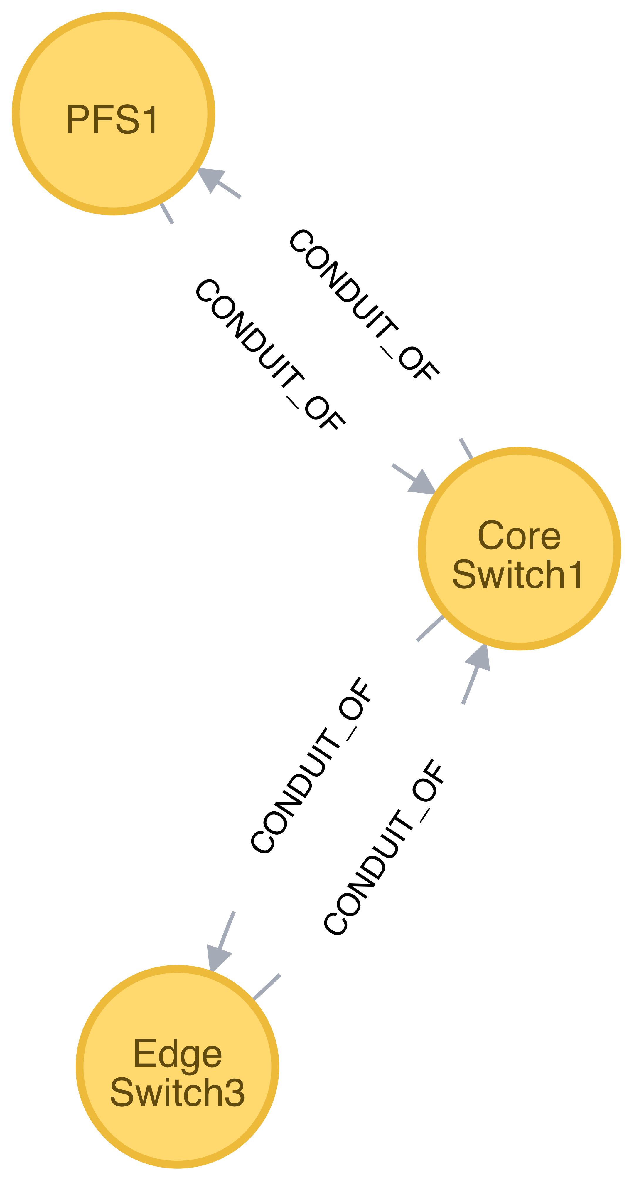
Flux’s Graph Resource Model
An example of how a cluster and a network would be represented independently

Slide 4
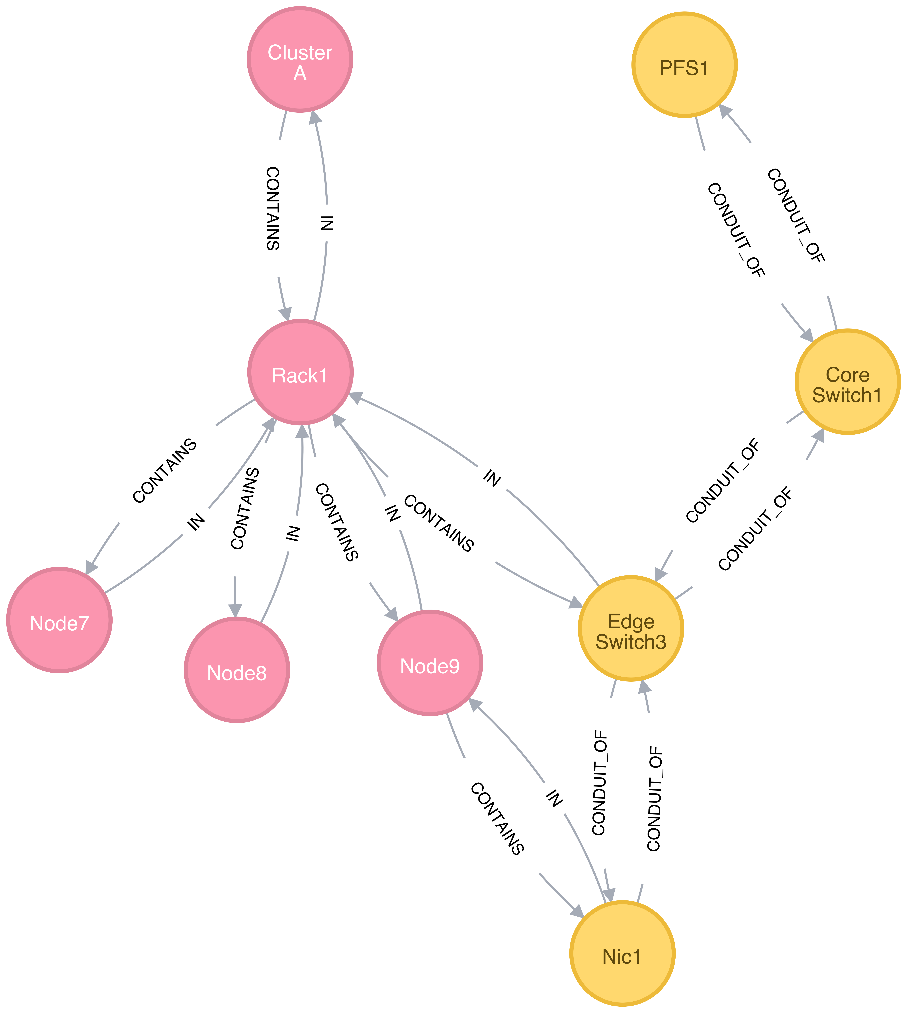
Flux’s Graph Resource Model
An example of how a cluster and a network would be represented combined

Slide 5
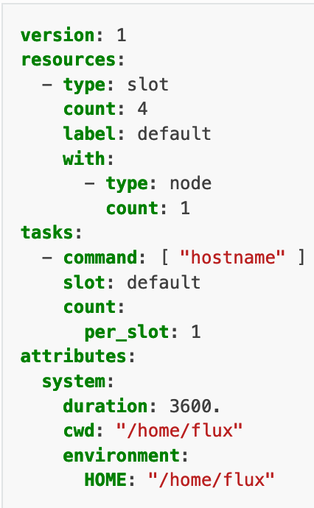
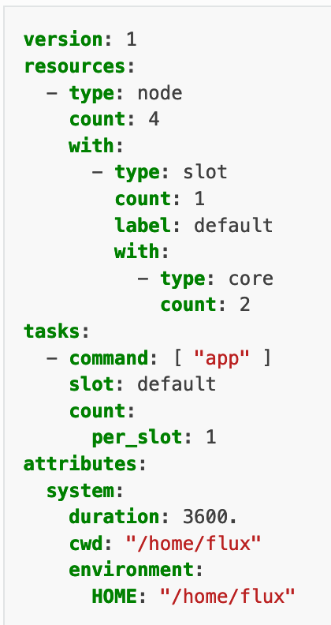
Flux’s Jobspec
Yaml format for requesting abstract set of resources and specifying coarse task mapping

Slide 6
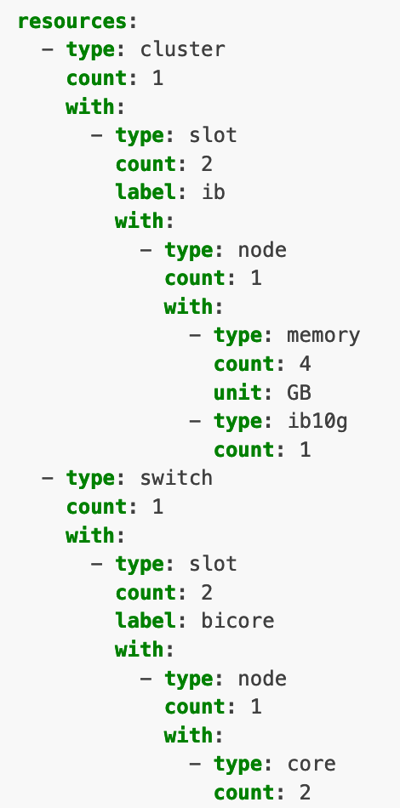
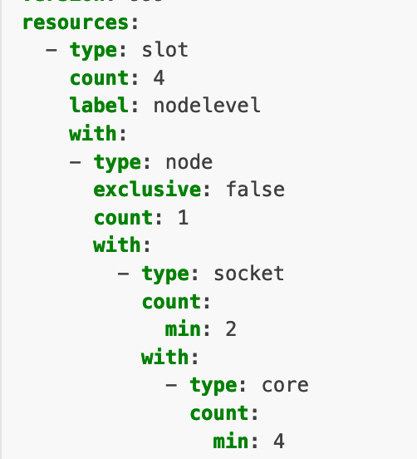
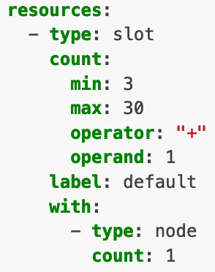
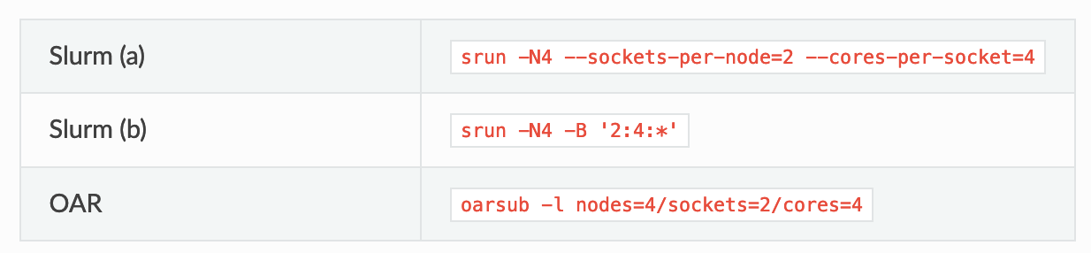
Support for more complex requests

Slide 7
Lessons Learned So Far
What’s worked well
Tying resource specification to a file format/labels is way more flexible than a CLI
It is not scalable to have a `--X-per-Y` flag for every combination of resources X and Y
Much better job provenance
Breaking node-centricity (i.e., support for resources outside of the node) has been hugely beneficial
Let’s us easily explore and specify complex scenarios like multi-tier storage systems: https://github.com/flux-framework/flux-sched/pull/620
Also relevant to heterogeneous clusters, like Flux’s Cloud bursting and LLNL’s Lassen + Cerebras AI
Having the virtual slot resource makes specifying exactly how you want containment applied much easier (e.g., everything in a slot is a cgroup)
What’s hard and needs more work
Jobspec cross-system portability
Is it possible to portably support running the same jobspec across systems where the gpu/memory is a child of node versus a child of the socket?
Achieving complete canonical Jobspec support (see next slide)
Specifying the distribution of resources across unbounded resources (node[*]->core[100])

Slide 8
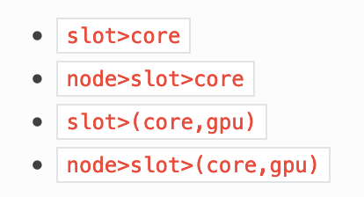
Achieving 100% Canonical Jobspec Compliance is Hard
Created a Jobspec V1 that significantly pares down the support resources and ordering
WIP Jobspec V2: opens up supported resource set and orderings:
Resource set: node, socket, core, hardware-thread, gpu, memory, storage, and slot
Compute hardware “spine” (intermediate resources optional): node->socket->core->hardware-thread
“Auxillary” resources (i.e., memory, storage, gpu) can ”hang off” of anywhere: (node->(socket->(core,gpu), memory), storage)

Slide 9
Disclaimer
This document was prepared as an account of work sponsored by an agency of the United States government. Neither the United States government nor Lawrence Livermore National Security, LLC, nor any of their employees makes any warranty, expressed or implied, or assumes any legal liability or responsibility for the accuracy, completeness, or usefulness of any information, apparatus, product, or process disclosed, or represents that its use would not infringe privately owned rights. Reference herein to any specific commercial product, process, or service by trade name, trademark, manufacturer, or otherwise does not necessarily constitute or imply its endorsement, recommendation, or favoring by the United States government or Lawrence Livermore National Security, LLC. The views and opinions of authors expressed herein do not necessarily state or reflect those of the United States government or Lawrence Livermore National Security, LLC, and shall not be used for advertising or product endorsement purposes.

