Slide 1


Chocoholics anonymous
Comp 370 final project
Thomas Mclennan -
Farzin Dhanji - 300034277
Karanvir Gill - 300093063

Slide 2
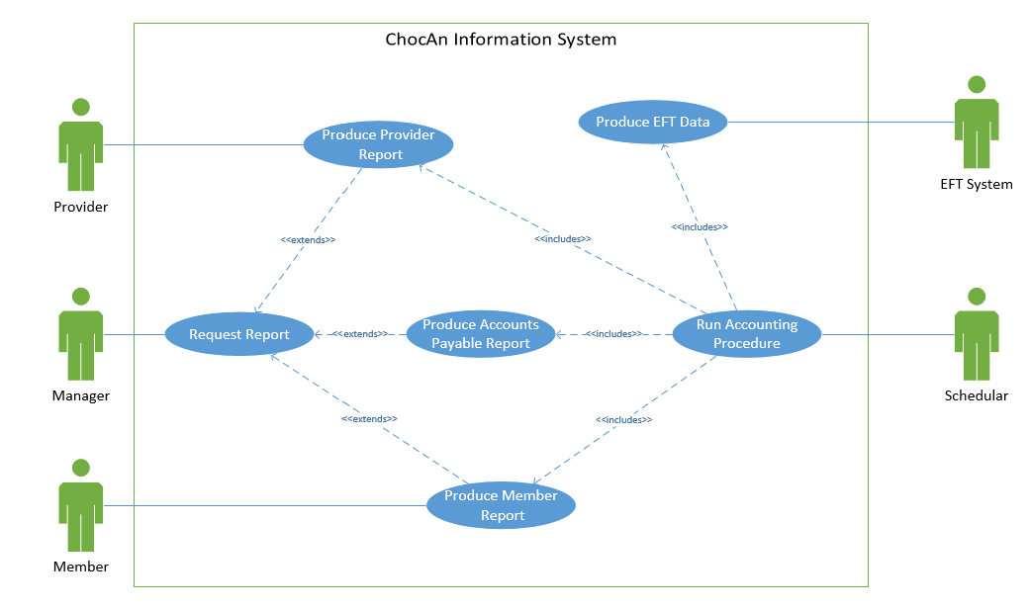
requirements

Slide 3
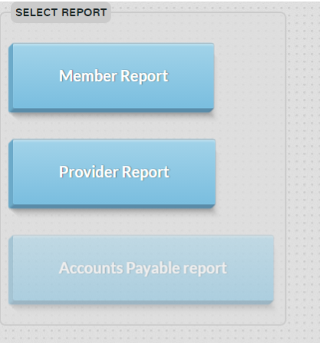
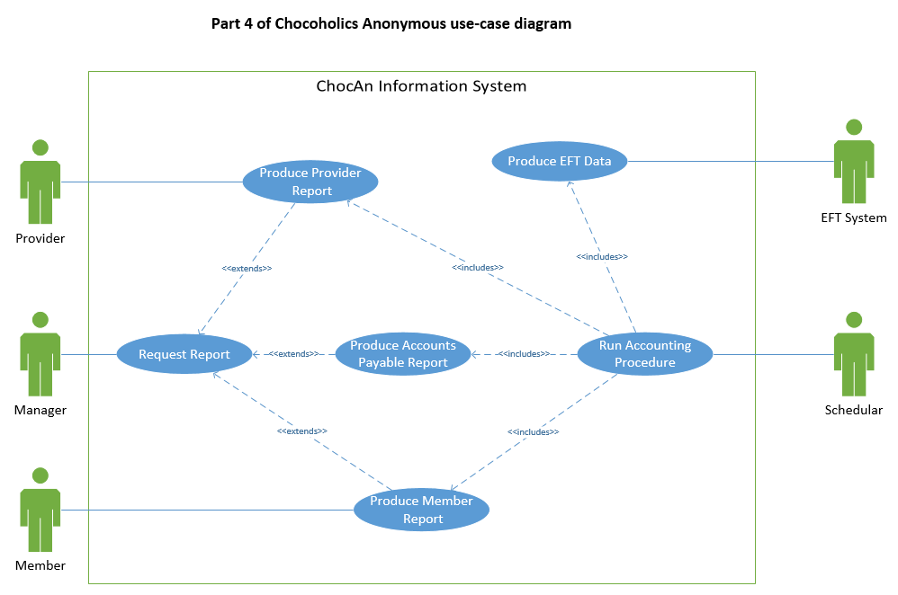
Requirements - manager

Slide 4
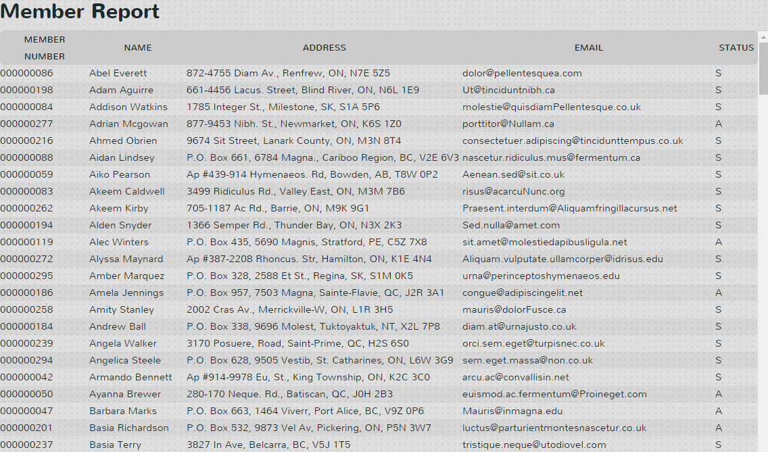
Requirements - manager

Slide 5
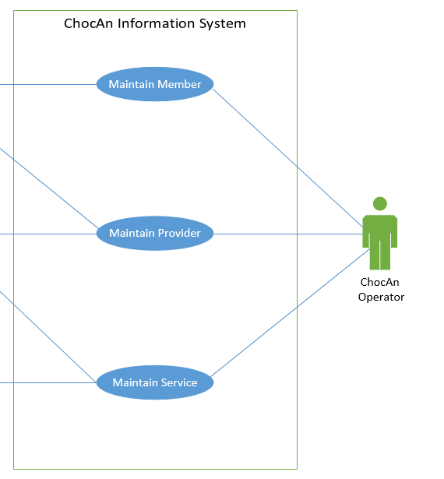
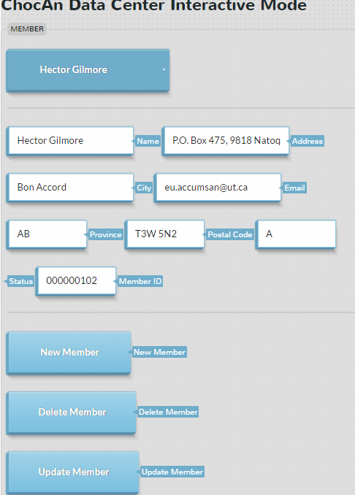
Requirements - operator

Slide 6
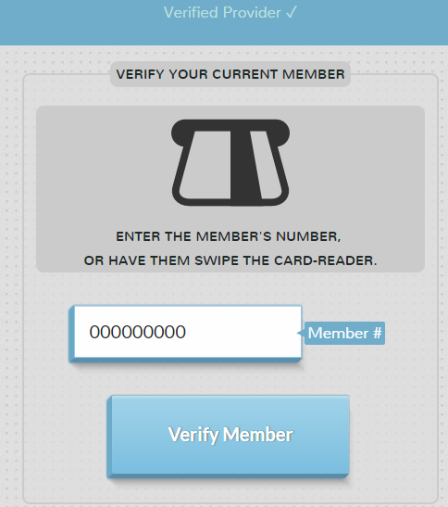
Requirements - provider

Slide 7
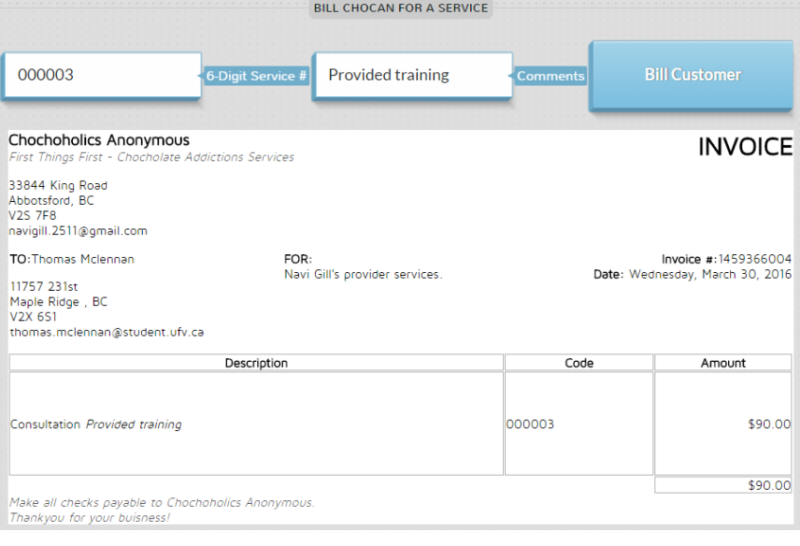
Requirements - provider

Slide 8
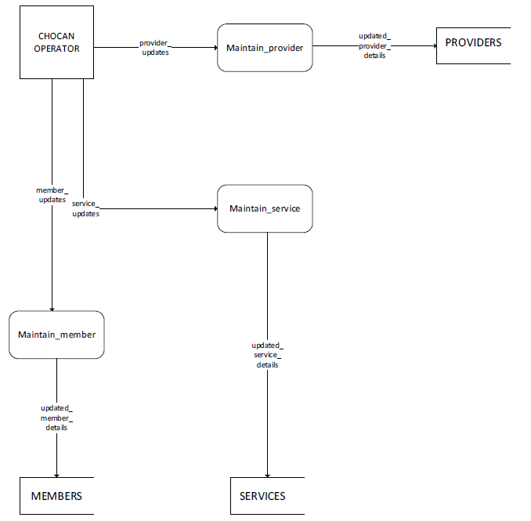
analysis
Operator maintains a provider, updates provider database.
Operator Maintains a member, updates member database.
Operator maintains services, updates services database.

Slide 9
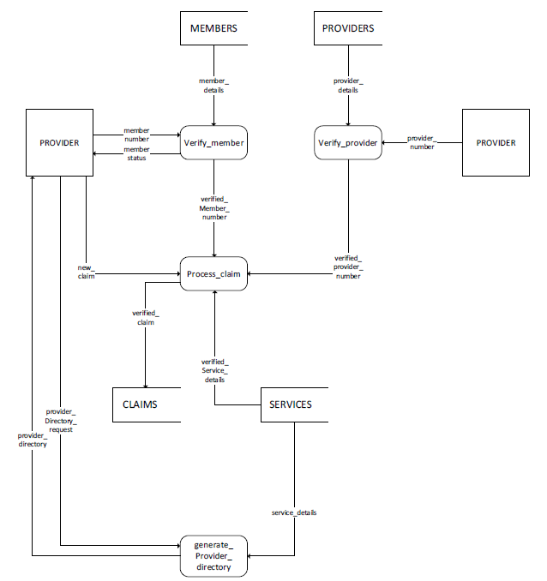
Analysis
Provider verifies member using member database.
Provider processes a claim using claims database.
Provider directory is generated after provider login (when the provider is verified)

Slide 10
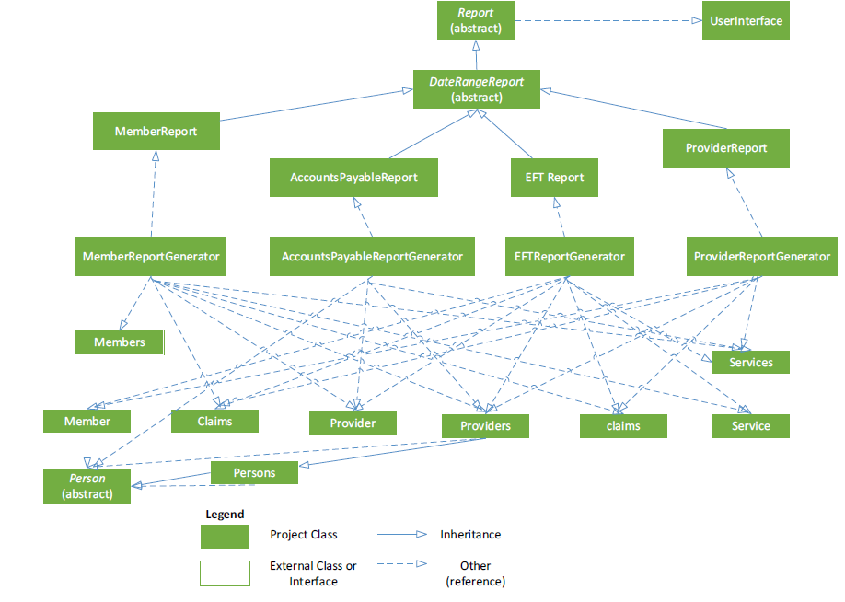
design

Slide 11
implementation
Languages
Php
Html5
Css3
javaScript
SQL
Website - http://caxe.thomasmclennan.ca/
Source Code - https://github.com/Exac/COMP370

Slide 12
Testing
Tested each class during implementation
Black box testing
http://caxe.thomasmclennan.ca/tests/

Slide 13
Testing
PHP (released 1995)
Object Oriented PHP (2004)
PHPUnit (2004)

Slide 14
Testing
414+ Assertions

Slide 15
Testing
MySQL Database Password | Result
Password is string | true
Password's first character is alphanumeric | true
Password < 1 character | true
Database.member_name | Result
member_name is created | true
member_name can be "m" | true
member_name can be "1" | true
member_name can be "xxxx xxxx xxxx xxxx xxxx“ (24/25) | true
member_name cannot be "xxxx xxxx xxxx xxxx xxxx xxxx“ (29/25) | true
member_name cannot be "" | acceptable

Slide 16
Testing
Database.member_province | Result
member_province is created | true
member_province can be "B.C." | true
member_province cannot be "British Columbia" | Acceptable (BC)
member_province cannot be "CB" | true
member_province cannot be “ManitoBa” | Acceptable (MB)
member_province cannot be "NWT" | acceptable
member_province cannot be "CB" | acceptable

Slide 17
Testing
`member_status` CHAR(1) NOT NULL DEFAULT 'A' | Result
member_status is created | true
member_status can be "A" | true
member_status can be "S" | true
member_status cannot be "Suspended" | acceptable
member_status cannot be "Active" | acceptable
member_status cannot be "a" | acceptable
member_status cannot be "s" | acceptable
member_status cannot be "0" | true
member_status cannot be "null" | true

Slide 18
contributions
Analysis and Design – Farzin
Implementation and testing – Thomas & Karanvir

