Slide 1


Chocoholics anonymous
Comp 370 final project
Thomas Mclennan -
Farzin Dhanji - 300034277
Karanvir Gill - 300093063

Slide 2
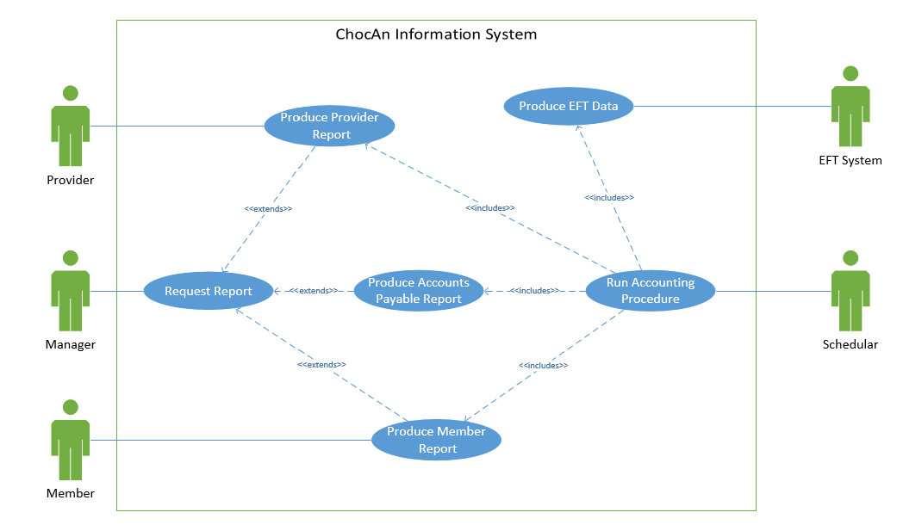
requirements

Slide 3
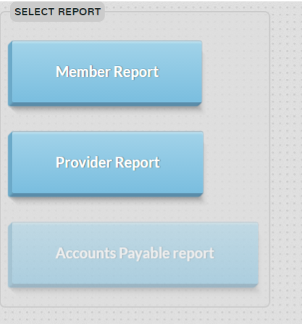
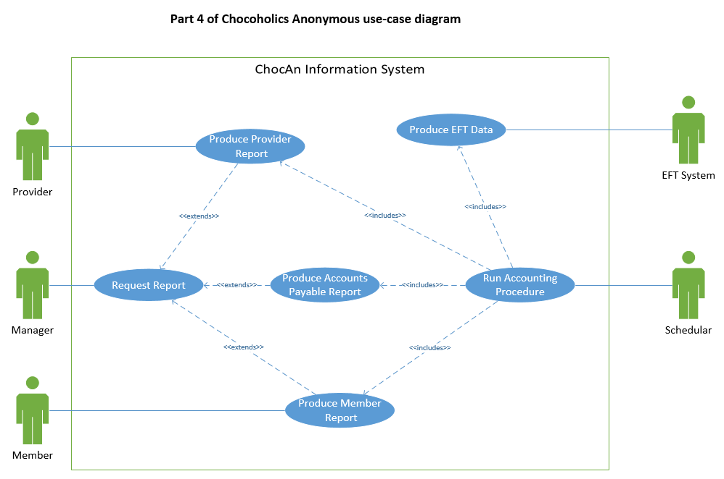
Requirements - manager

Slide 4
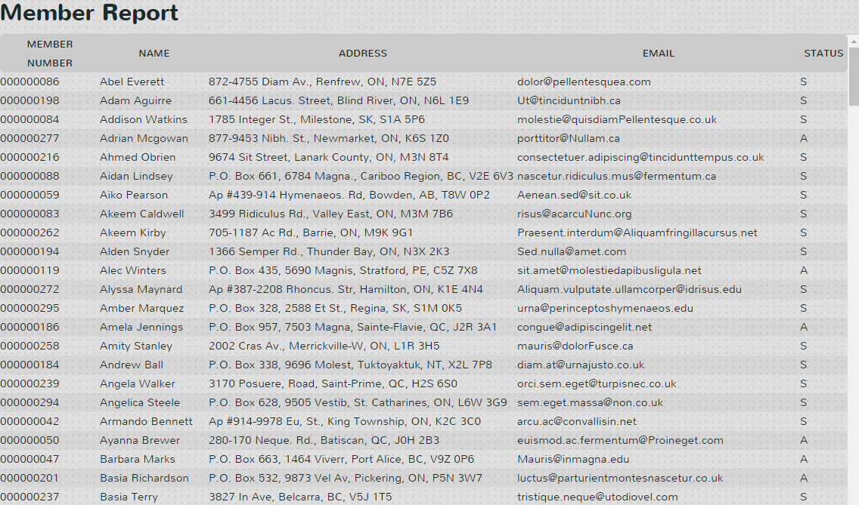
Requirements - manager

Slide 5
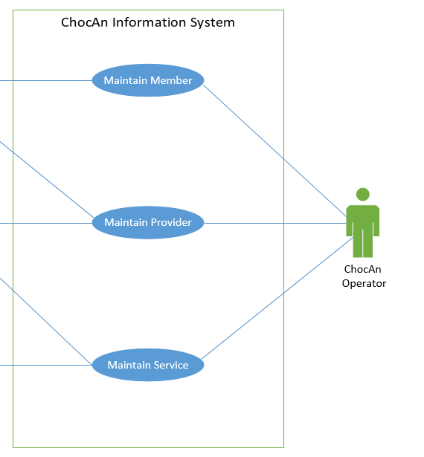
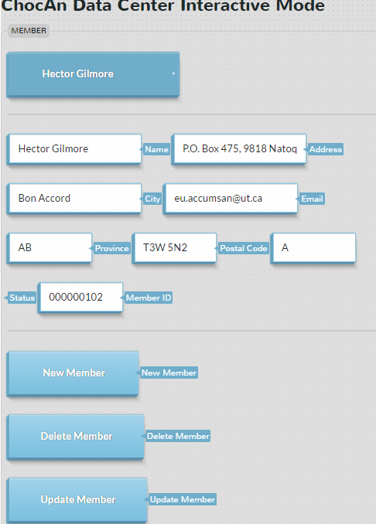
Requirements - operator

Slide 6
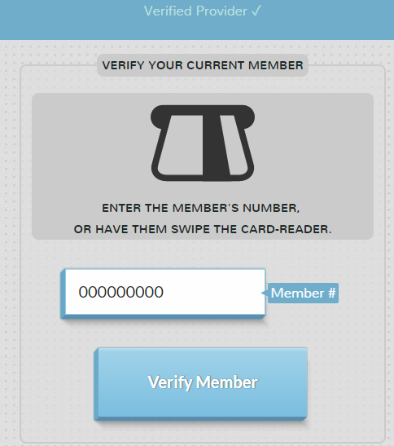
Requirements - provider

Slide 7
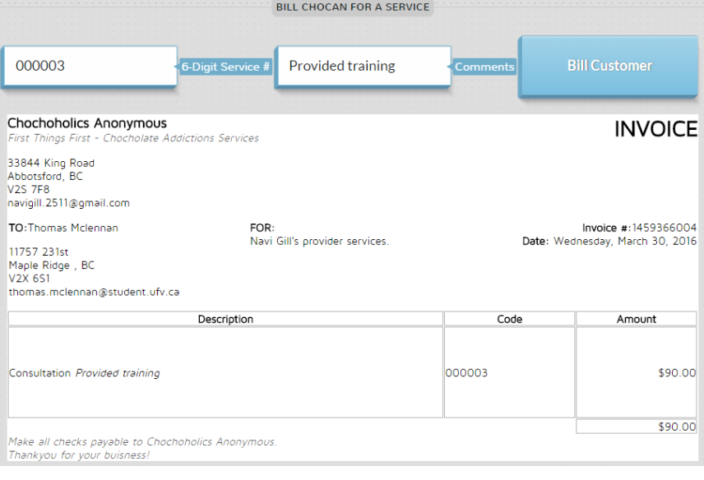
Requirements - provider

Slide 8
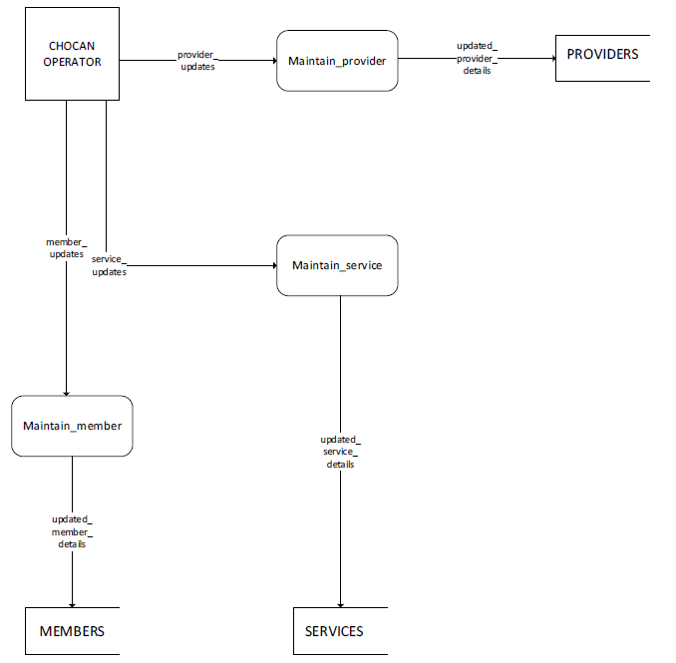
analysis
Operator maintains a provider, updates provider database.
Operator Maintains a member, updates member database.
Operator maintains services, updates services database.

Slide 9
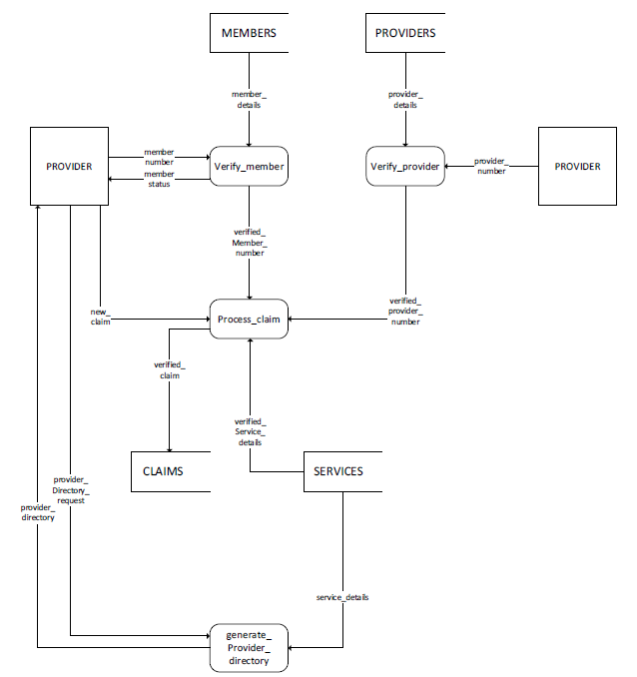
Analysis
Provider verifies member using member database.
Provider processes a claim using claims database.
Provider directory is generated after provider login (when the provider is verified)

Slide 10
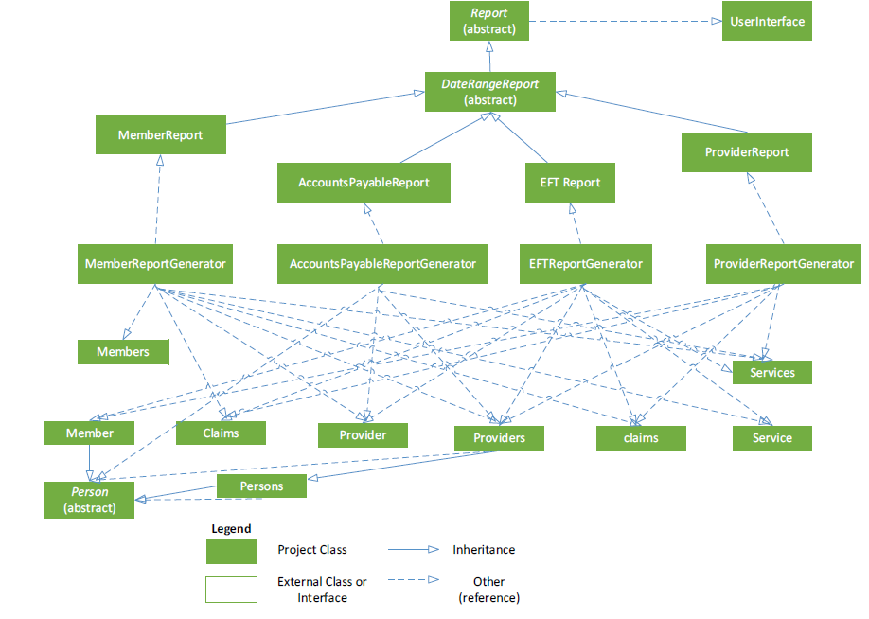
design

Slide 11
implementation
Languages
Php
Html5
Css3
javaScript
SQL
Website - http://caxe.thomasmclennan.ca/
Source Code - https://github.com/Exac/COMP370

Slide 12
Testing
Tested each class during implementation
Black box testing
http://caxe.thomasmclennan.ca/tests/

Slide 13
contributions
Analysis and Design – Farzin
Implementation and testing – Thomas & Karanvir

