Slide 1


Chocoholics anonymous
Comp 370 final project
Thomas Mclennan -
Farzin Dhanji - 300034277
Karanvir Gill - 300093063

Slide 2
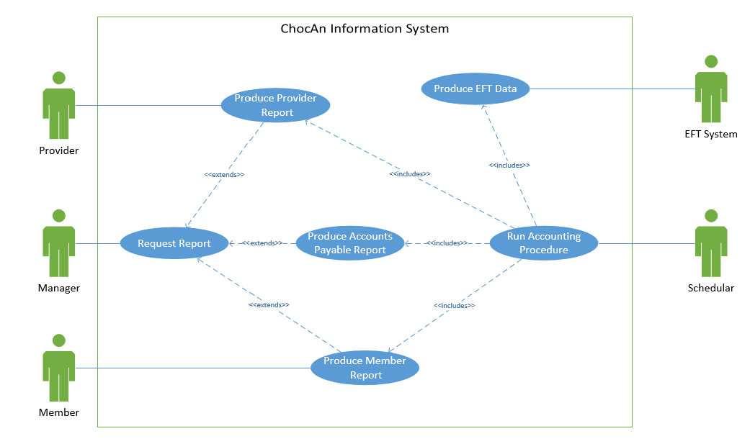
requirements

Slide 3
analysis

Slide 4
design

Slide 5
implementation
Languages
Php
Html5
Css3
javaScript
SQL
Website - http://caxe.thomasmclennan.ca/
Source Code - https://github.com/Exac/COMP370

Slide 6
Testing
Tested each class during implementation
Black box testing
http://caxe.thomasmclennan.ca/tests/

Slide 7
contributions
Analysis and Design – Farzin
Implementation and testing – Thomas & Karanvir

