Slide 1

Title: GYM MANAGEMENT SYSTEM
Prepared By Ubaidullah 21-Arid-678 Ammad Arshad 21-Arid-549 Anas Rafiqe 21-Arid-553

Slide 2
Technology Stack:
• Frontend: HTML5, CSS3, JavaScript (React.js) • Backend: Node.js • Database: Mysql

Slide 3
Features and Functionality:
· Member Management · Class and Schedule Management · Billing and Invoicing · Employee Management · Inventory Management · Communication and Engagement · Integration and Scalability

Slide 4
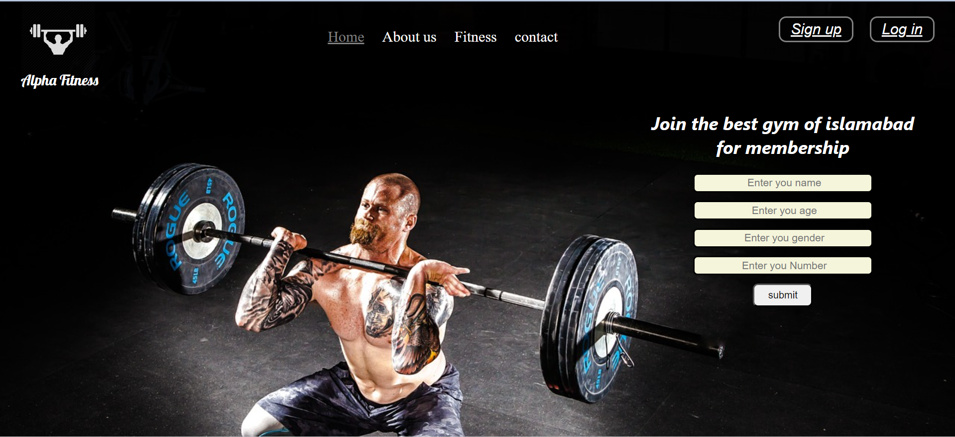
FRONT-END:-

Slide 5
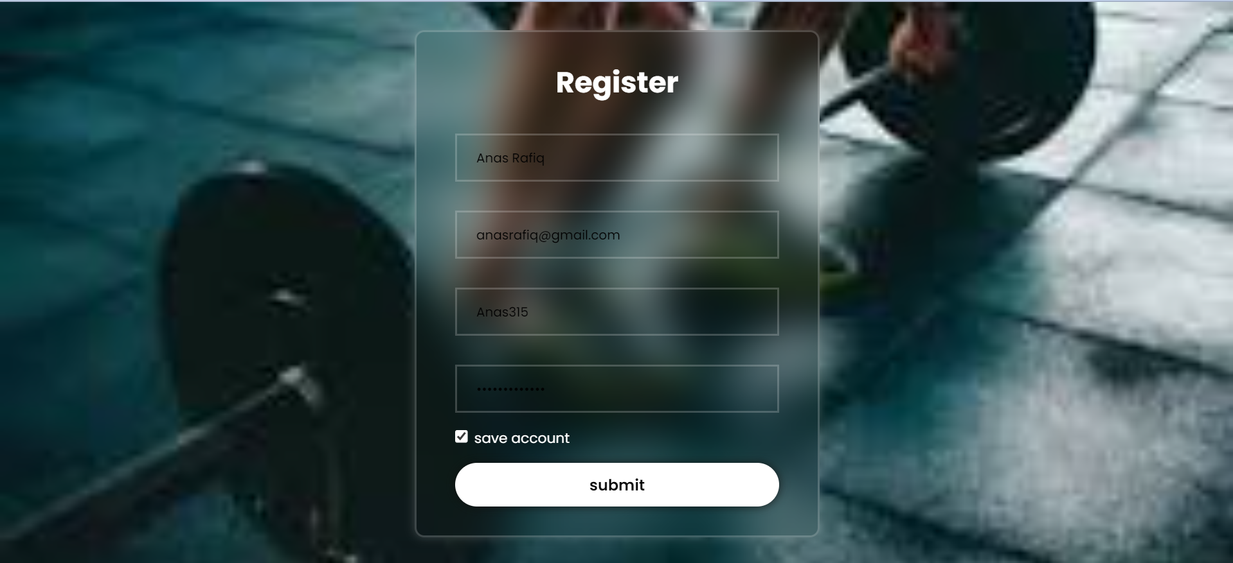
Register Form:

Slide 6
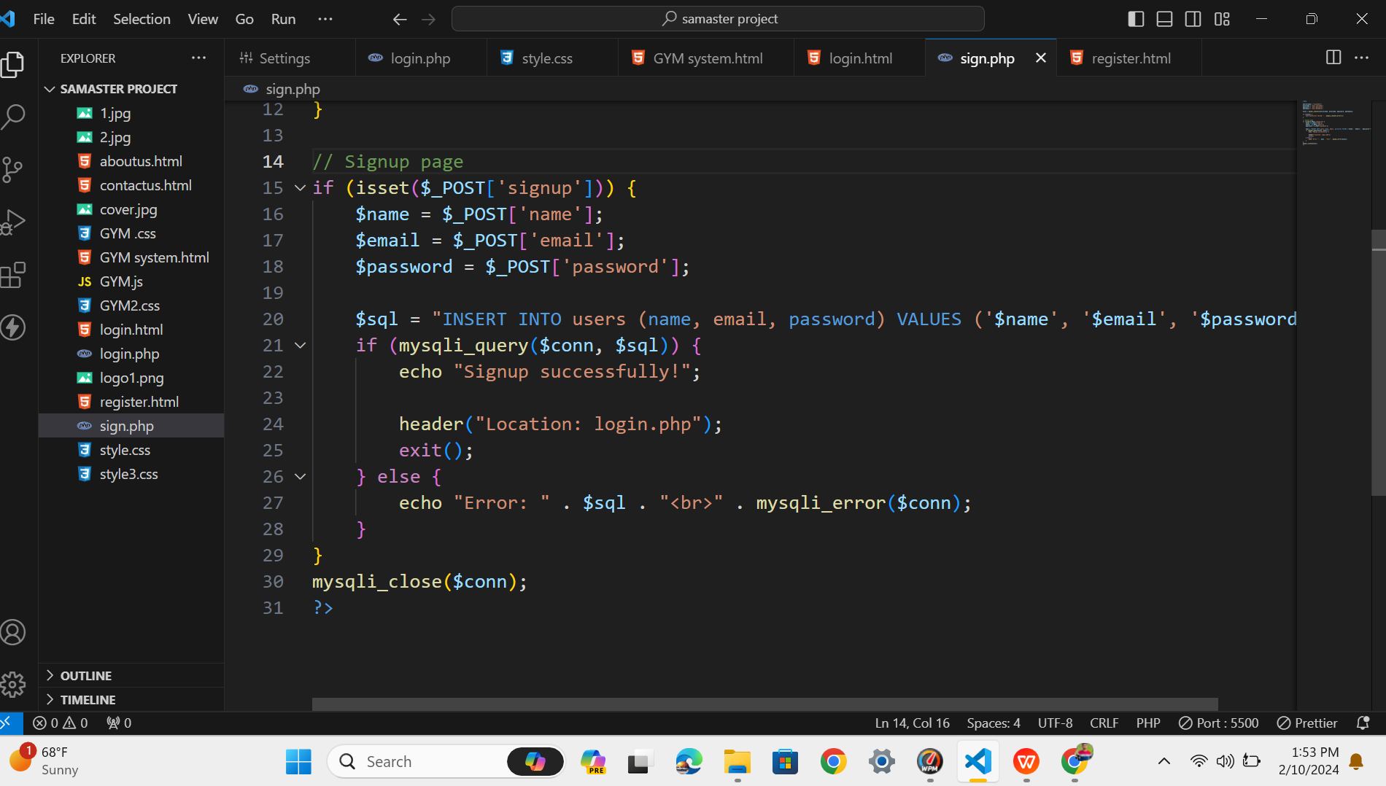
Backend-code for signup:

Slide 7
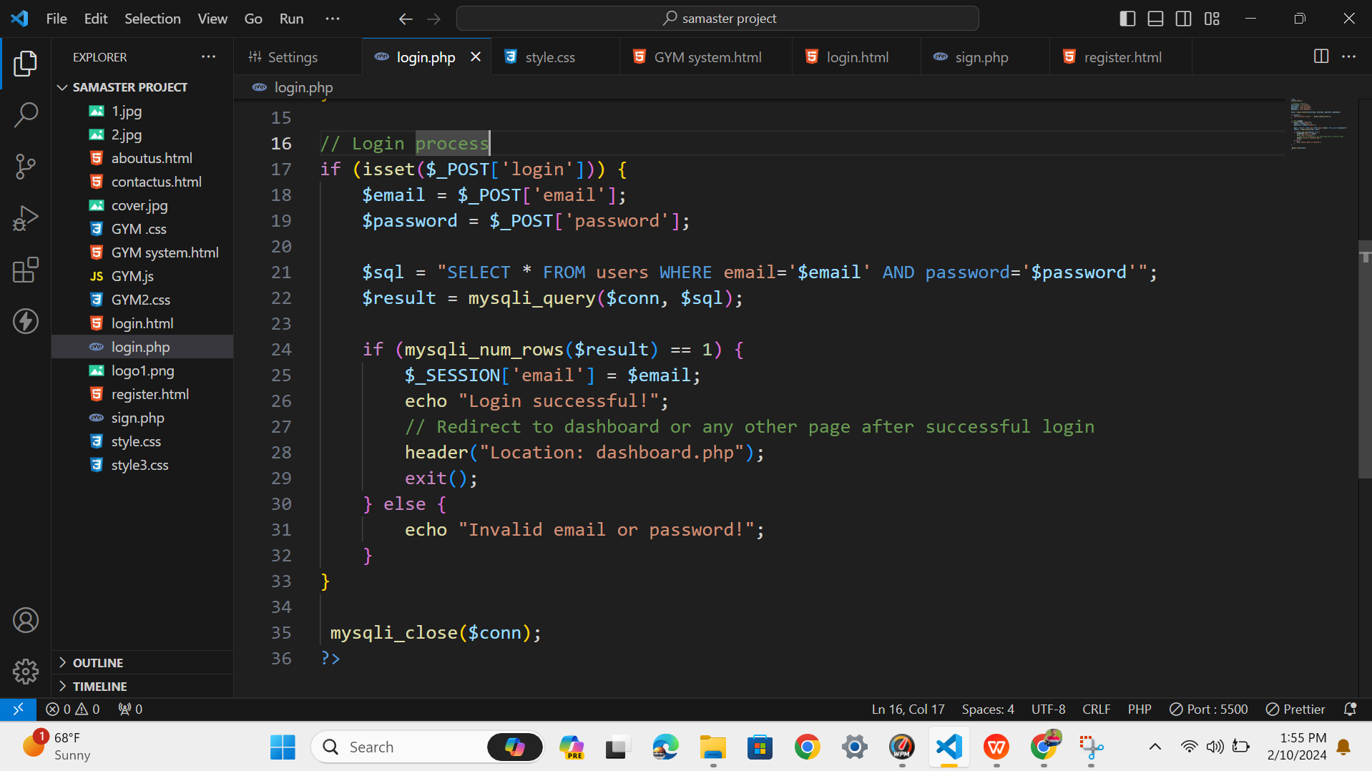
Backend-code for Login:

