Slide 1
Harmony Land
Reyane En-Nabty / Théo Tinti / Timothée Vattier

Slide 2
Introduction

Slide 3
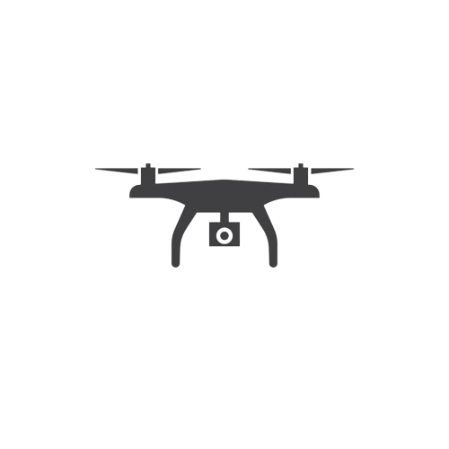

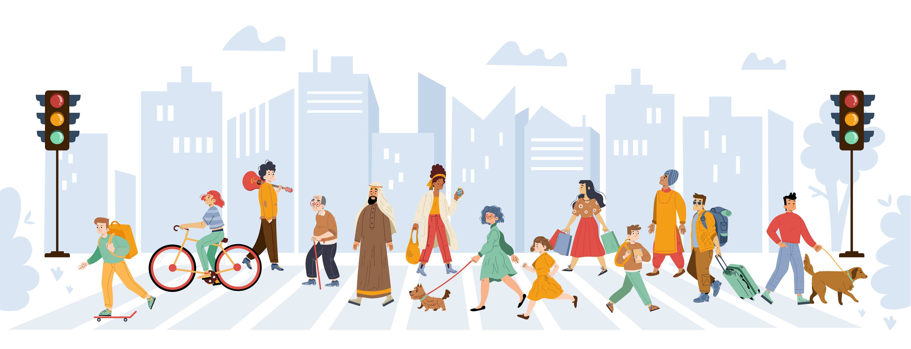

Harmony watchers

Slide 4
Client’s Needs
Program that will receive the harmonywatcher’s data with these expectations :
Store every harmonywatcher’s data
Trigger alerts
Enable harmonymaker officers to perform analysis on the data

Slide 5





Architecture
Stream
Alerts
Kafka
Stream
Kafka
Drones
Web API
S3 Database
Analysis

Slide 6
Demo

Slide 7
Conclusion

