Slide 1
AtliQ Hospitality Analysis

Slide 2
Project overview
Atliq Grands owns multiple five-star hotels across India. They have been in the hospitality industry for the past 20 years. Due to strategic moves from other competitors and ineffective decision-making in management, Atliq Grands are losing its market share and revenue in the luxury/business hotels category. As a strategic move, the managing director of Atliq Grands wanted to incorporate “Business and Data Intelligence” in order to regain their market share and revenue.

Slide 3
Objectives
Leverage business and data intelligence solution to enhance decision- making processes and strategic planning at AtliQ Grands.
Identify and seize market opportunities.
Optimize operational efficiencies for better resource management.
Develop data-driven strategies to regain market share and increase revenue in the luxury and business hotel segments across India.
Integrate advance analytics and intelligence tools to elevate customer satisfaction, drive competitive advantage, and ensure sustainable growth in the highly competitive hospitality industry

Slide 4
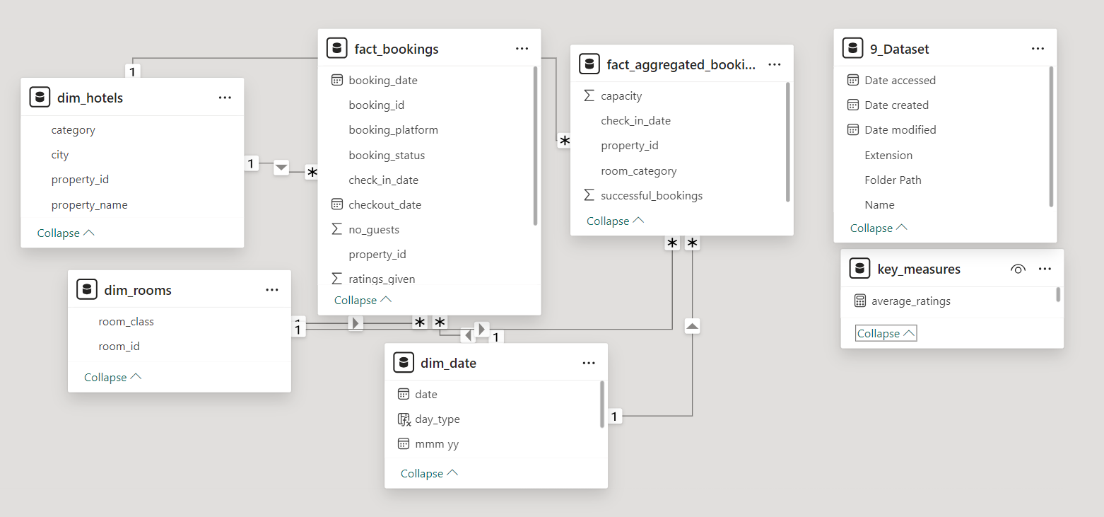
dATASET

Slide 5
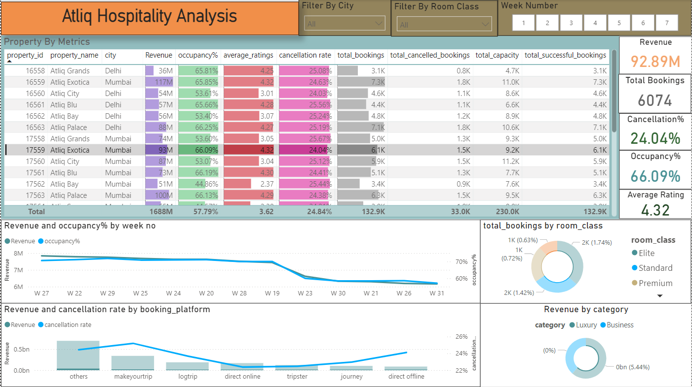
My Dashboard

Slide 6
KEY INSIGHTS
Revenue Generation:
Mumbai generated the highest revenue at 669M. Delhi generated the lowest revenue at 290.92M.
Revenue by Category:
The Luxury category generated more revenue, accounting for 61.62% of the total, compared to the Business category’s 38.82%. Total revenue across both categories was 1.69B
Occupancy Rates:
Delhi has the highest occupancy rate at 60.44%, despite having the lowest Daily Standard Room Night(DSRN) rate at 435.
Bangalore has the lowest occupancy rate at 55.68%
Top-Performing Property:
AtliQ Exotica emerged as the best performer among all the properties with revenue of 316M.
It had an average rating of 3.62, occupancy rate of 57.20% and cancellation rate of 24.39%.
Weekend vs. Weekday Performance:
Weekend occupancy (Friday-Saturday) was 7% higher than weekdays.
However, the difference in Revenue Per Available Room(RevPAR) between weekends and weekdays was negligible.

