Slide 1
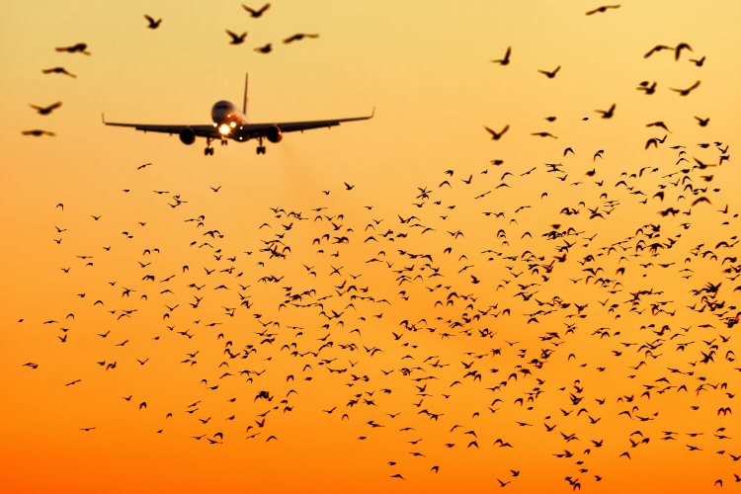
Data Visualization of Bird Strikes between 2000-2011

Slide 2
Objective
The goal of this project is to analyse the bird strike incidents happened between 2000-2011. To achieve the goal, The dataset used is collected by FAA during 2000-2011. The objective of the project is to perform data visualization techniques to understand insights of the data. This project aims apply various Business Intelligence tools such as Tableau or Power BI to get a visual understanding of the data.

Slide 3
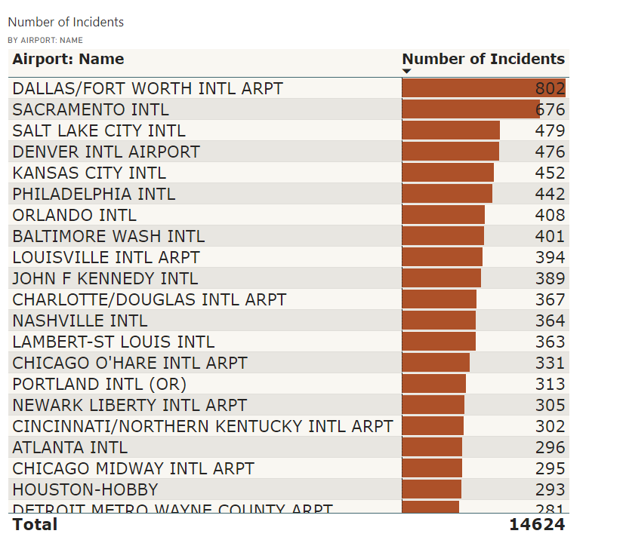
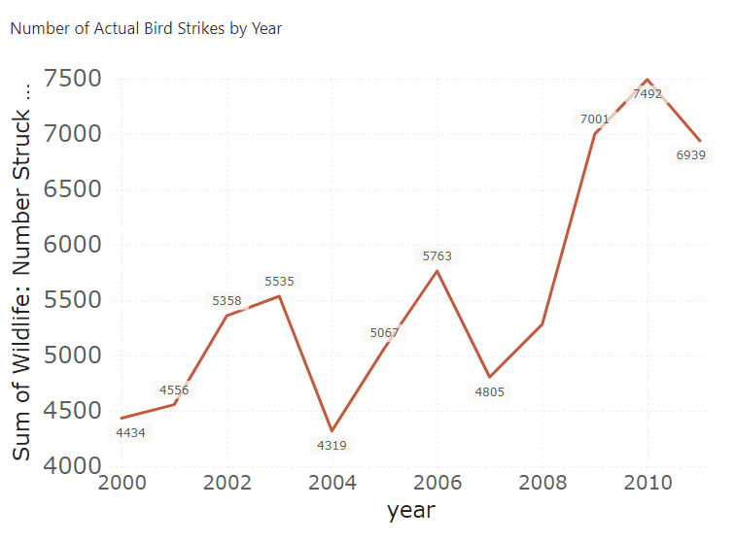
Insights
Airport with Most Air Strikes
Total Number of Bird Strikes Incidents per Year
We can see that Bird Strikes Incidents have an upward trend with year 2009 has the highest number of incidents. The total Bird Strikes from 2000 – 2011 is approximately 67000.

Slide 4
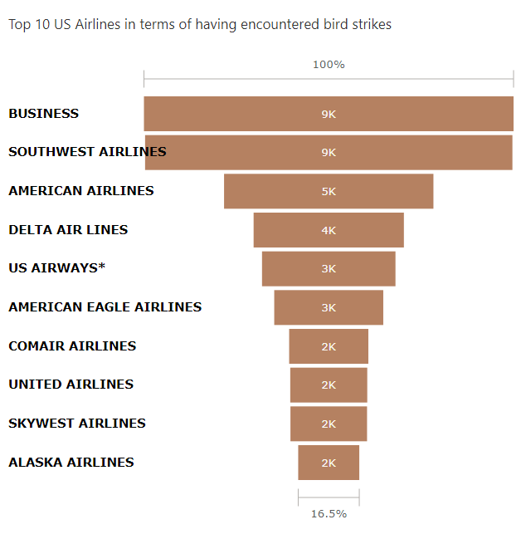
Top 10 Airlines having encountered most number of bird strikes
Business Airlines has encountered most number of bird strike followed by Southwest and American Airlines.

Slide 5
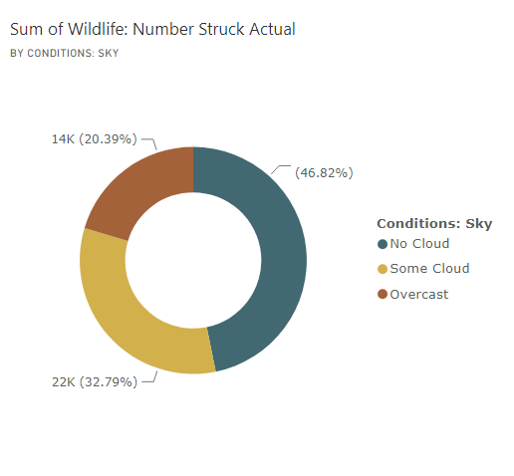
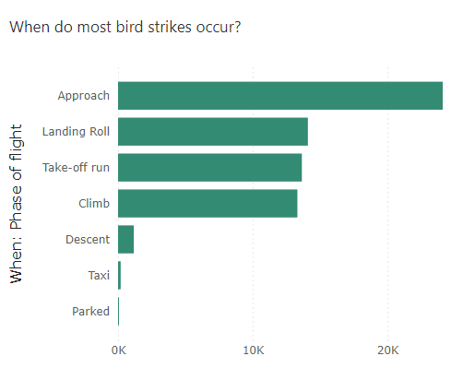
When do most bird strike incidents occur?
Most of the incidents have happened when there was no cloud. Moreover most bird strikes are recorded when the aircraft descends from its cruising altitude towards the runway for landing that is when it is approaching.

Slide 6
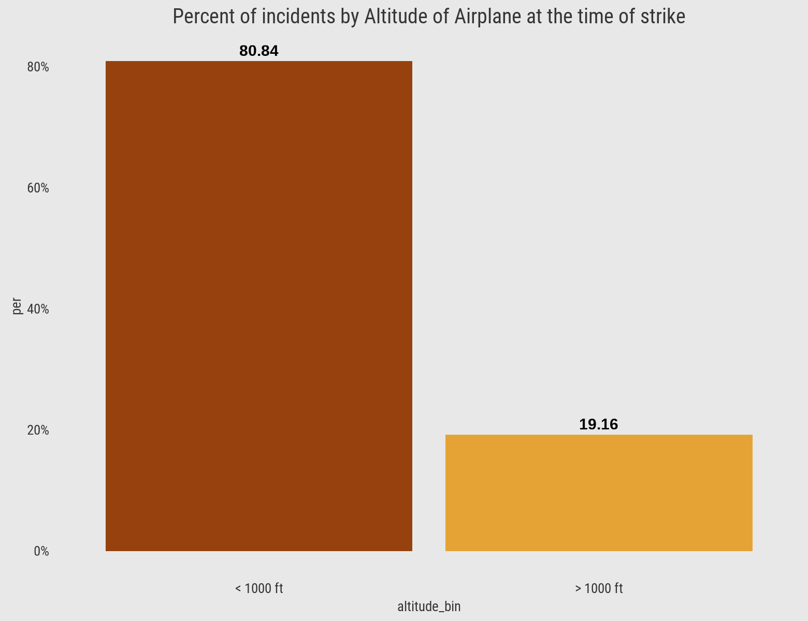
Altitude of Airplane at the time of bird strike
80.84% of bird strike incidents have happened when the altitude of airplane was <1000 ft and 19.16% have happened when altitude was >1000 ft.

Slide 7
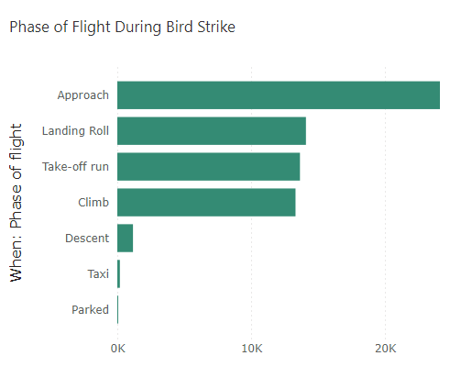
Phase of Flight at the time of strike
Moreover most bird strikes are recorded when the aircraft descends from its cruising altitude towards the runway for landing that is when it is approaching followed by Landing Roll and Take-off run

Slide 8
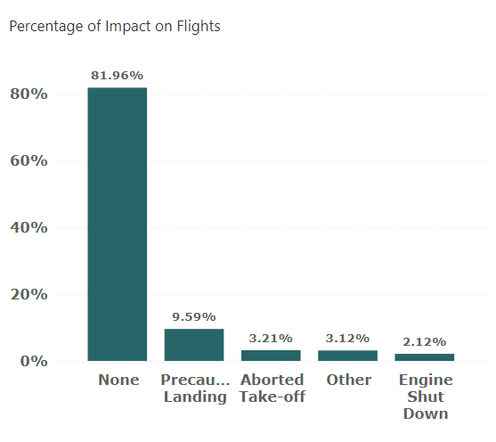
Impact on Flights
About 80% of strikes had no impact leaving with 20% with precautionary landing, aborted take-off, engine shut down and others.

Slide 9
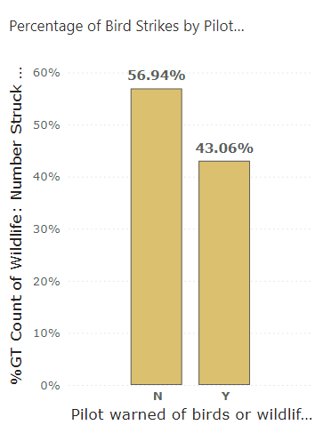
Does prior warning reduces the effect of damage?
The percentage of strikes have lowered by about 14% when the pilots were warned prior to Bird Strike.

Slide 10
Conclusion
14% decrease in incidents when pilots were warned.
Prior warning to the pilot reduces the risk of damage to the aircraft
52.78% of incidents have happened due to some small unknown bird.
72.9% incidents have happened when there is 1 bird/wildlife is struck in the airplane and caused damage.
90.31% incidents caused no damage while 9.69% incidents caused damage
80.84% of bird strike incidents have happened when the altitude of airplane was <1000 ft and 19.16% have happened when altitude was >1000 ft.
Most of the incidents have happened when there is no cloud in each year

