Slide 1

Heart Disease Diagnostic Analysis

Slide 2
Introduction
Health is real wealth in the pandemic time we all realized the brute effects of covid-19 on all irrespective of any status. We are required to analyze health and medical data for better future preparation.

Slide 3
Details of Data
This data set dates from 1988 and consists of four databases: Cleveland, Hungary, Switzerland, and Long Beach V. It contains 76 attributes, including the predicted attribute, but all published experiments refer to using a subset of 14 of them. The "target" field refers to the presence of heart disease in the patient. It is integer valued 0 = no disease and 1 = disease.
Attribute Information:
age
sex
chest pain type (4 values)
resting blood pressure
serum cholesterol in mg/dl
fasting blood sugar > 120 mg/dl
resting electrocardiographic results (values 0,1,2)
maximum heart rate achieved
exercise induced angina
oldpeak = ST depression induced by exercise relative to rest
The slope of the peak exercise ST segment
number of major vessels (0-3) colored by fluoroscopy
thal: 0 = normal; 1 = fixed defect; 2 = reversable defect

Slide 4
Main KPIs
cp – Chest Pain Type
thalach – Maximum Heart Rate Achieved
Slope – the slope of the peak exercise ST segment
exang – Exercise induced angina
oldpeak – ST depression induced by exercise relative to rest
ca – The number of major vessels
thal – A blood disorder called thalassemia

Slide 5
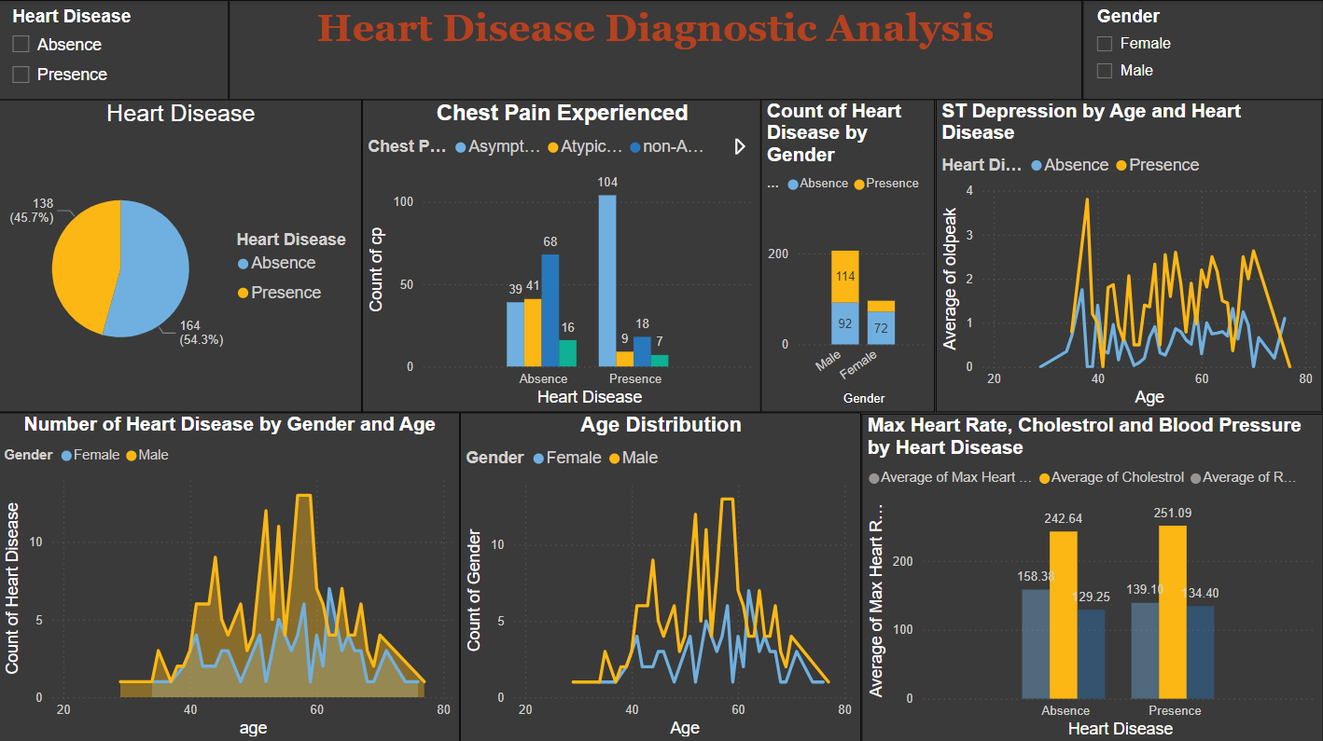
My Dashboard

Slide 6
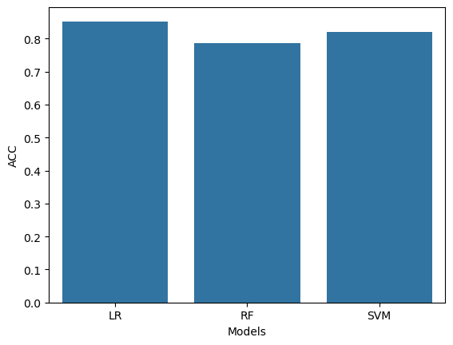
Model Training and Prediction
The best prediction was achieved by Logistic Regression Model with Accuracy Score of about 85%

Slide 7
Conclusions
Heart disease is predominantly more prevailing in male.
Male suffering from Asymptotic Chest Pain is most likely to have heart disease.
Generally lower Max Heart Rate level is observed in person suffering from heart disease.
Higher cholesterol level is observed in person suffering from heart disease.
The average oldpeak value is generally higher in people with heart disease

Slide 8
Thank you

