Slide 1
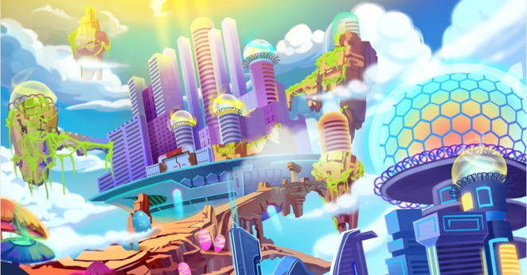
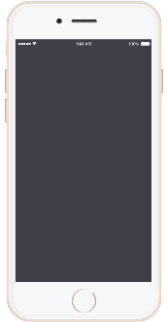
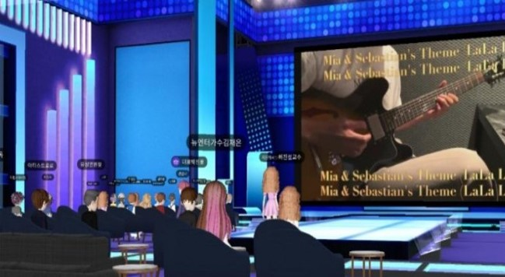
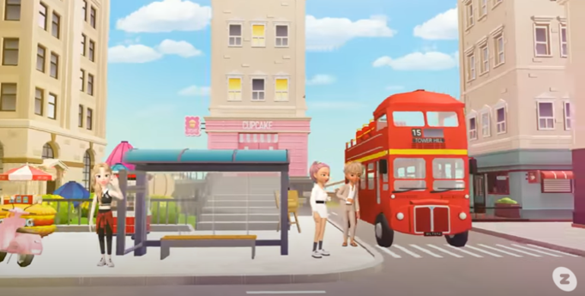
Metaverse
Festival
It is a compound word of "meta" meaning abstract and "Universe" meaning real world, meaning 3D virtual world.
Purpose
To experience a free and endless festival in a world without the virus of COVID19.
Date & time
Ex ) 2021 . 12 . 01 all day!
Entrance Fee
$ 5
Program
Everything you want, including performances, movie festivals, fireworks, food and beer festivals!

Slide 2
