Slide 1


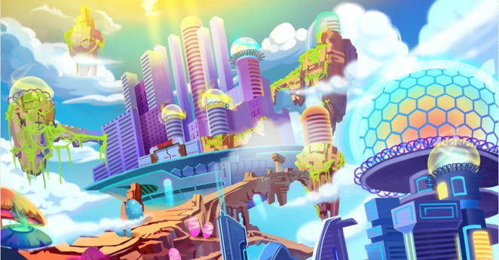
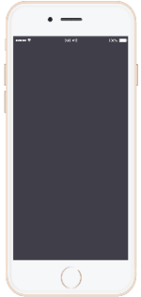
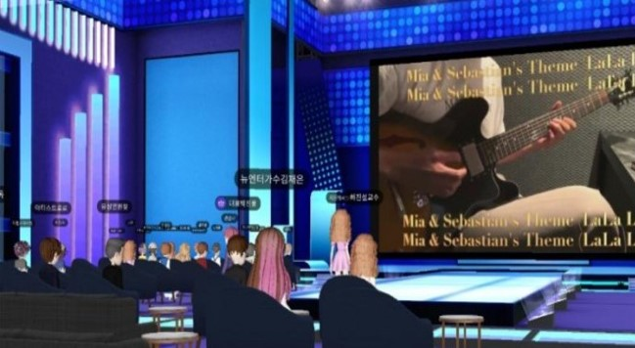

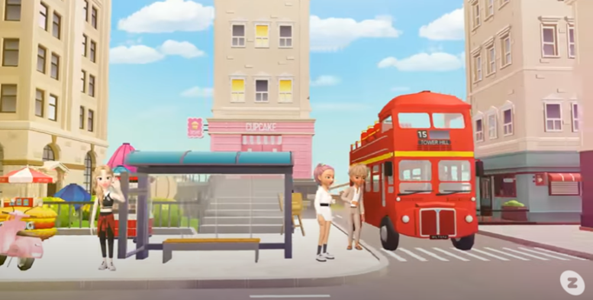

I
ANHA UNIVERSITY
FESTIVAL
2021
with METAVERSE
Program
What Is
School Club Booth Parade
Karaoke in metaverse
Explore virtual ghost house
Take a picture with sculpture
Fireworks
Abstract Real World
“META”+”UNIVERSE”
= 3D Virtual World
Date & Time
5TH NOV
AM 8 – PM 10
Entrance Fee
: $5
* It applies only to non-students. * This fee will be donated for the purpose of activating Metaverse.
Place
Inha University Map on Naver Zepeto
※ Our festival implements the COVID-19 quarantine rules.

