Slide 1
Project 3: Diffusion models
TA: Qian Wang
Sunday, October 8th, 2023

Slide 2
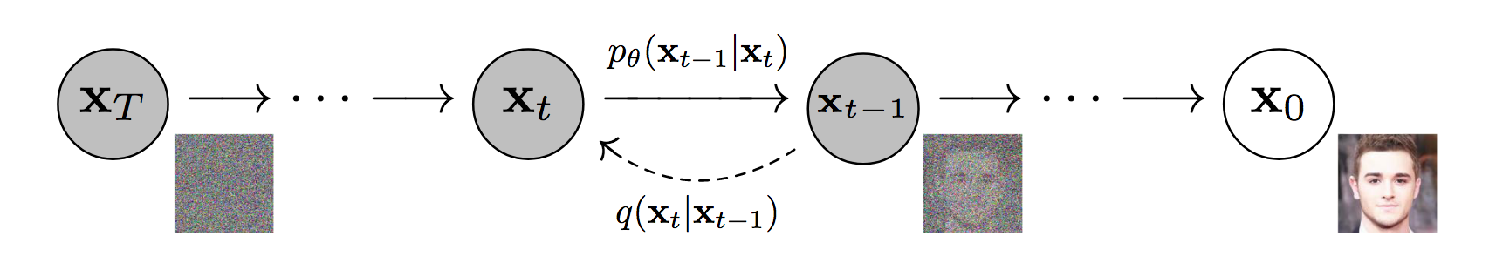
Diffusion models
One of the most popular generative models nowadays
Can be used for generating image, video, audio, 3D …
What you need to understand:
Ho, Jonathan, Ajay Jain, and Pieter Abbeel. "Denoising diffusion probabilistic models." Advances in neural information processing systems 33 (2020): 6840-6851.

Slide 3
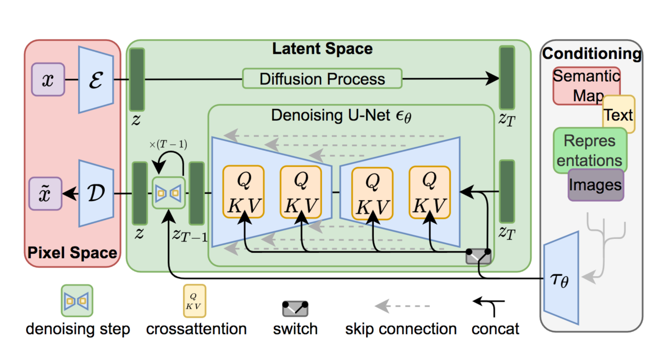
Stable Diffusion
A large text-to-image diffusion models.
Quickly try it out by yourself: https://huggingface.co/spaces/stabilityai/stable-diffusion
Build on top on the Latent Diffusion Models:
Rombach, Robin, et al. "High-resolution image synthesis with latent diffusion models." CVPR 2022.

Slide 4
Diffusers library
Why using diffusers library?
High-level implementation of diffusion pipelines
Easy access of pre-trained diffusion models
Only basic usage in this project.
More interesting pipelines? Training speedup? Less memory consumption? Go to the official documentation: https://huggingface.co/docs/diffusers/index

Slide 5
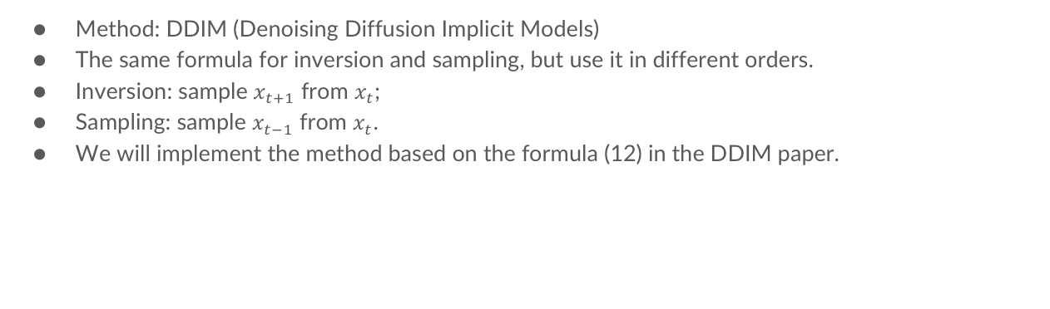
Project 3-1: Inversion and sampling
Method: DDIM (Denoising Diffusion Implicit Models)
The same formula for inversion and sampling, but use it in different orders.
Inversion: sample $x_{t+1}$ from $x_{t}$;
Sampling: sample $x_{t−1}$ from $x_{t}$.
We will implement the method based on the formula (12) in the DDIM paper.
Song, Jiaming, Chenlin Meng, and Stefano Ermon. "Denoising diffusion implicit models." arXiv preprint arXiv:2010.02502 (2020).

Slide 6
Project 3-2: Dreambooth
Personalization of a new concept given a few reference images as input.
We will build it on top of the Stable Diffusion models.
It includes learning an embedding for the newly added concept and finetuning the unet model.
You need to find a good setting of hyperparameters: not underfitting or overfitting.
Ruiz, Nataniel, et al. "Dreambooth: Fine tuning text-to-image diffusion models for subject-driven generation." Proceedings of the IEEE/CVF Conference on Computer Vision and Pattern Recognition. 2023.

Slide 7
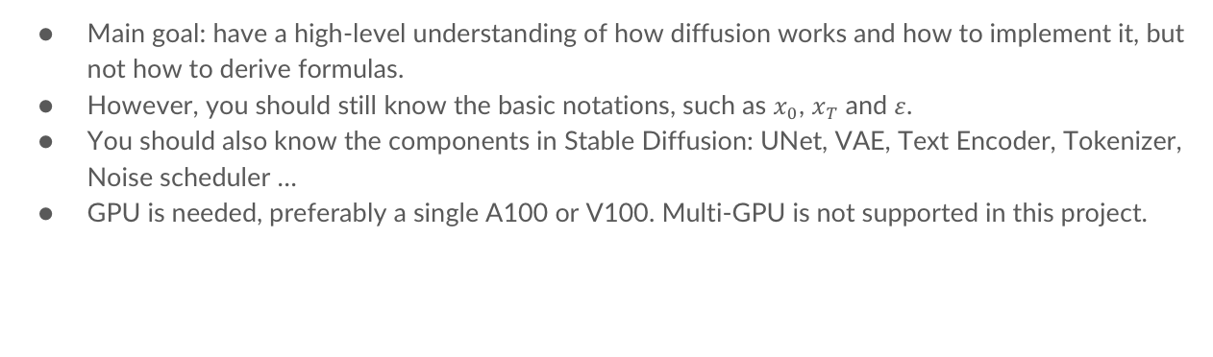
Project goals
Main goal: have a high-level understanding of how diffusion works and how to implement it, but not how to derive formulas.
However, you should still know the basic notations, such as $x_{0}$, $x_{T}$and $ε$.
You should also know the components in Stable Diffusion: UNet, VAE, Text Encoder, Tokenizer, Noise scheduler …
GPU is needed, preferably a single A100 or V100. Multi-GPU is not supported in this project.

Slide 8
Others
Due date: Wednesday, October 25th
Please contact TA (Qian Wang) if you have any questions about the project, or you find any mistakes in the notebook ☺
Training time wouldn’t be long, but good to start earlier. Good luck!

