Slide 1
Project 2: Dense Prediction

Slide 2
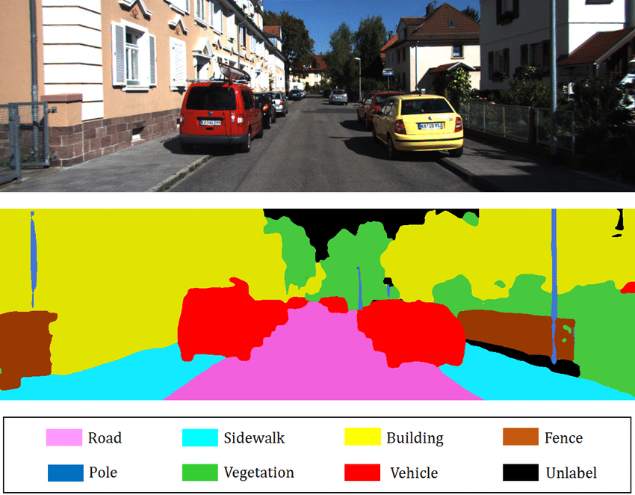
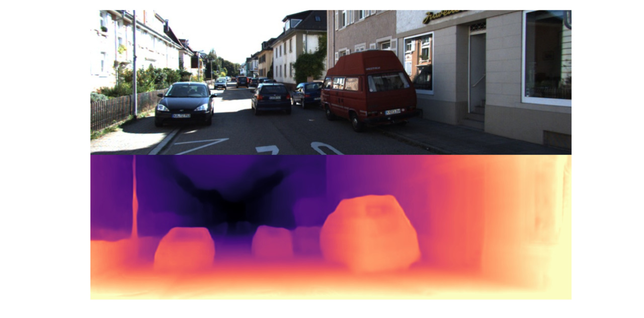
Two important vision tasks
Depth Estimation
Semantic Segmentation

Slide 3
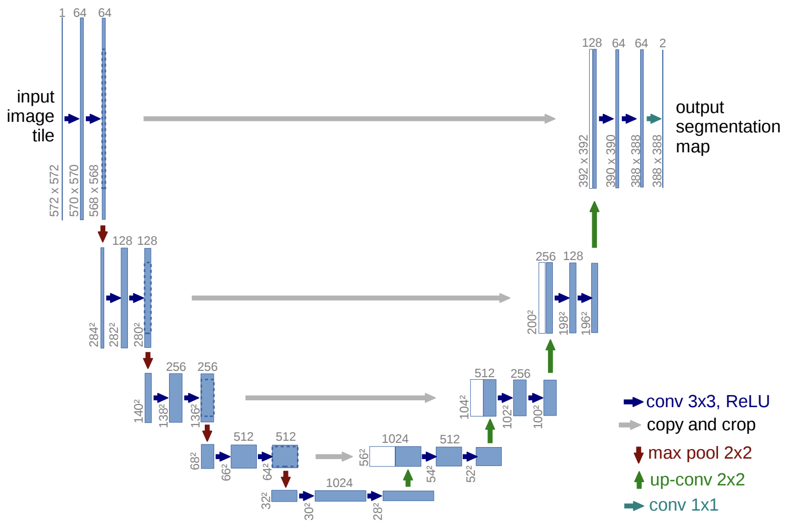
What you will implement?
Unet
The most popular architecture for Dense Prediction
and
Image-to-Image tasks
Example Unet
Notes:
Notebook is self-contained and contains ALL notes and instructions.

Slide 4
Take-aways
By the end of completing this project, you will
Be able to use “timm” library to load pretrained encoders
Be able to define a Unet supporting any arbitrary encoder
Be able to modify pretrained architectures for task-specific fine-tuning and transfer models from one task to another
Be able to implement loss functions for dense prediction tasks
Gain experience in tuning deep learning models for best performance
Gain familiarity with data pre- and post-processing

Slide 5
Competition
You will compete with your classmates for best performance of your models
20 out of total 120 points are reserved for competition and will be given according to your rank within class
Top 3 winners will be given food coupons by Prof. Peter Wonka :)

Slide 6
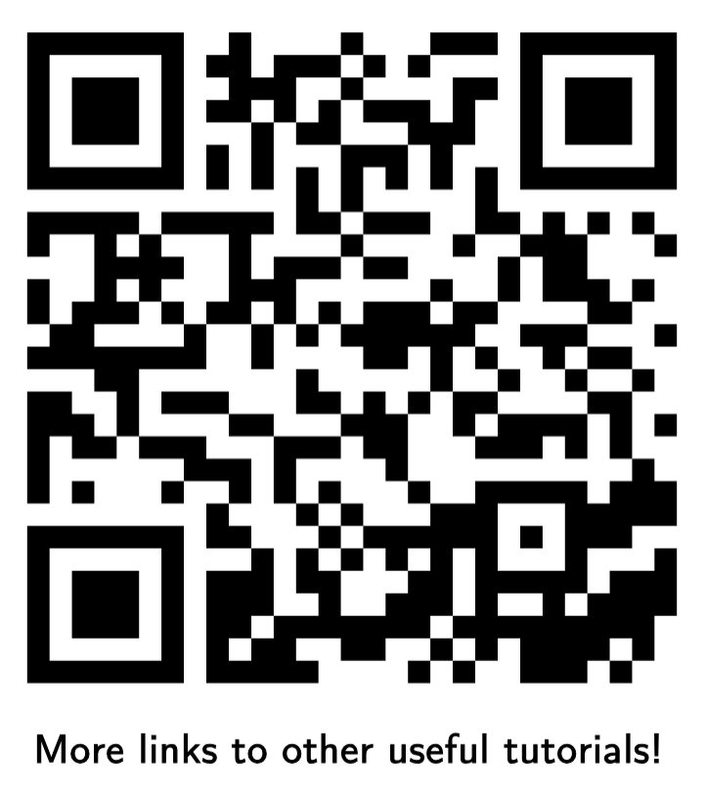
Course webpage

