Slide 1
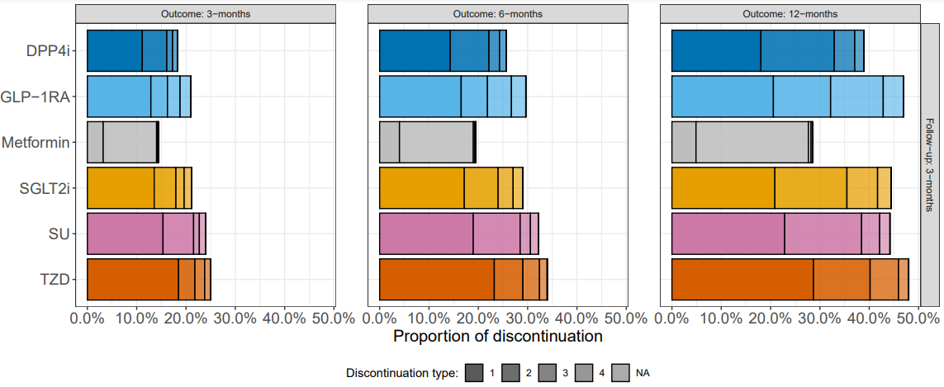
Rules:
0. timeondrug bigger than 91 / 183 / 365 (not represented here)
1. timeondrug less than 91 / 183 / 365
2. nextremdrug = NA (represents a break in the current drug before restarting)
3. nextremdrug = different drug removed from row drug class
4. timetolastpx – timeondrug < 91 / 183
NA. anything else (what thought??)
Old Rules:
These would be NA

